Slide 1
Directed Diffusion: A Scalable and Robust Communication Paradigm for Sensor Networks
Chalermek Intanagonwiwat, Ramesh Govindan and Deborah Estrin
(MobiCOM '00)

Slide 2
Distributed Microsensing
Characteristics of future sensor nodes may include:
  Matchbox size
  Battery power
  Power-conserving processors clocked at several hundred Mhz
  Program and data memory of several tens of Mbytes
  Radio modem
  Energy efficient MAC layer
Such hardware will enable distributed microsensing, in which a collection of nodes coordinate to achieve a larger sensing task

Slide 3
Possible Scenarios
Sensor networks may be deployed in
  Inhospitable physical environments
    Remote geographic regions
    Toxic urban locations
  Difficult to access environments
    Large industrial plants
    Aircraft interiors

Slide 4
Critical Design Constraints
Power conservation
Scalability—must scale to several thousands of sensor nodes
Robustness—high frequency of node failure expected

Slide 5
Directed Diffusion
Directed diffusion is a new data dissemination paradigm for sensor networks
  Data-centric
  Determined by localized interactions: hop-to-hop rather than end-to-end
    Long-range communication requires more energy
    Hop-to-hop communication provides link diversity, helps overcome obstacles
  Incorporates application-specific semantics

Slide 6
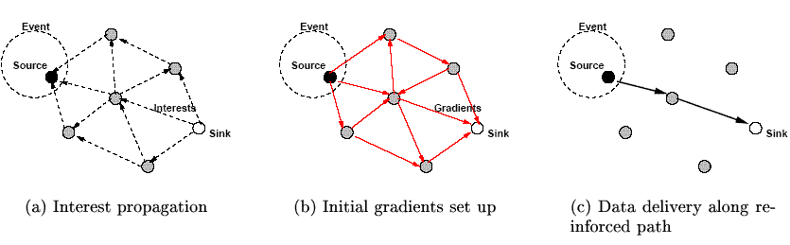
Directed Diffusion Elements
Gradients
  Network paths
Reinforcement
  Manages gradients
Named data
  Described with attribute-value pairs
Interests
  Describe sensing tasks

Slide 7

Naming
Task descriptions are named by a list of attribute-value pairs:
Intuitively, the task description specifies an interest for data matching the attributes. For this reason, such a task description is called an interest

Slide 8

Interest Dissemination
C’s Interest cache
C
Interests Gradients
source
B
Sink disseminates interest for a four-legged animal (~36 bytes).
Initial interval is large.
sink

Slide 9
Interest Dissemination
C’s Interest cache
C
Interests Gradients
source
B
sink
Every node contains an interest cache, with separate entries for distinct interests.
Entries do not contain info about sinks and therefore scale well.
Overlapping entries may be aggregated for efficiency.
Interests must be periodically refreshed by sink.

Slide 10
Interest Dissemination
C’s Interest cache
C
Interests Gradients
Sink: 1s
| B: 1s
source: 1s
source
B
Each interest cache entry contains a list of gradients; events that match interest entries are propagated back to the sink via these gradients. Gradient entries contain locally unique neighbor IDs, data rates, and interval (not shown) attributes.
sink
In the absence of information about which sensor nodes are likely to be able to satisfy an interest, interests are broadcasted to all neighbors.
However, a node may suppress a received interest if it recently re-sent a matching request.

Slide 11
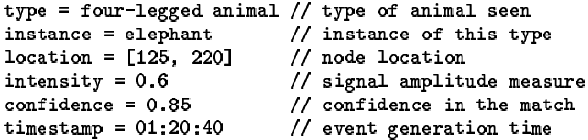
C’s Data cache
Data Propagation
C’s Interest cache
1 eps
C
Interests Gradients
EVENT
Sink: 1s
| B: 1s
source: 1s
source
1 eps
1 eps
B
1 eps
1 eps
Initial interests request data at slow rates (e.g. 1 event per second).
sink
A sensor node that detects a target searches its interest cache for a matching entry; if it finds one, it begins sending data messages (~64 bytes) towards the sink via its gradient list at the highest specified rate.

Slide 12
C’s Data cache
Data Propagation
C’s Interest cache
1 eps
C
Interests Gradients
EVENT
match
Sink: 1s
| B: 1s
source: 1s
source
1 eps
1 eps
B
1 eps
1 eps
Upon receiving a data message, nodes check their interest caches. If no match is found, the data message is silently dropped.
sink
If a match is found, the node checks its data cache, which keeps track of recently seen data items. If no data cache entry matches the message, a new entry is made in the data cache and the message is re-sent to the node’s neighbors.
If a data cache entry matches the data message, the message is silently dropped.

Slide 13
C’s Data cache
Reinforcement
C’s Interest cache
100 eps
C
1 eps
Interests Gradients
EVENT
Sink: 1s
| B: 1s
S: .01s
source: 1s
source
1 eps
1 eps
B
100 eps
1 eps
1 eps
After the sink starts receiving these low data rate events, it reinforces one particular neighbor in order to “draw down” higher quality (higher data rate) events.
sink
It does this explicitly by re-sending the original interest message, but with a smaller interval value, to the empirically low delay path node.
Nodes update their caches and can then propagate reinforcement messages according to local policies. For example, the node might choose that neighbor from whom it first received the latest event matching the interest

Slide 14
Considerations
Embedding application semantics in communication logic allows for optimizations such as loop prevention and downconversion (for instance, interpolating high rate messages for a low rate receiver)
Negative reinforcement is used to prune superfluous gradients

Slide 15
Negative Reinforcement
Could use time outs or explicit degrade messages as negative reinforcement mechanisms
Orthogonal to the mechanism, NR controls can be propagated according to a number of different rules
  E.g.: negatively reinforce that neighbor from which no new events have been received within a window of N events or T time units

Slide 16
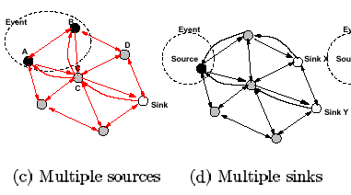
Network Topology
This paradigm works with multiple sources (but sinks may draw redundant data) and multiple sinks hosting identical interests (in which case the second sink can immediately draw down high quality via its cache)

Slide 17
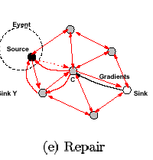
Local Repair
Reinforcement rules can be applied by intermediate nodes to repair faulty links:
  Node C can discover better path by requesting higher rates from non-faulty neighbors
  Reinforcement must be applied carefully to prevent all downstream nodes from doing the same, which will result in discovery of a good path, but will waste resources

Slide 18
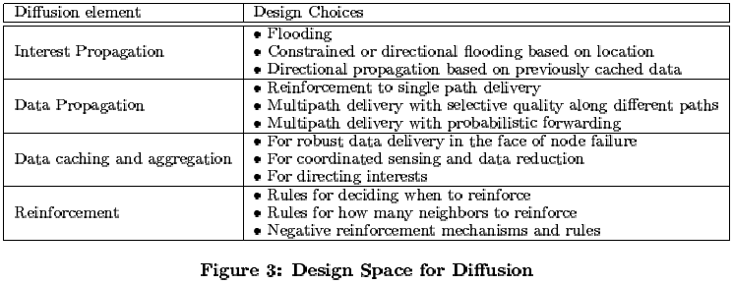
Design Parameters

Slide 19
Evaluation: Metrics
Average Dissipated Energy
  Measures the ratio of total dissipated energy per node in the network to the number of distinct events seen by sinks
  Computes average work done by a node as well as the overall lifetime of sensor nodes
Average Delay
  Measures the average one-way latency between transmitting an event and receiving it at a sink
Event Delivery Ratio
  Ratio of the number of distinct events received to the number originally sent

Slide 20
Evaluation: Setup
ns-2 simulated 1.6 Mbps 802.11 MAC layer (with RTS/CTS—not optimal for this application because nodes expend as much power idle as when receiving)
5 different sensor fields, ranging from 50 nodes (at 160m x 160m) to 250 nodes (at same average density)
DD compared against Flooding and Omniscient Multicast (which approximately represents achievable IP-based performance)

Slide 21
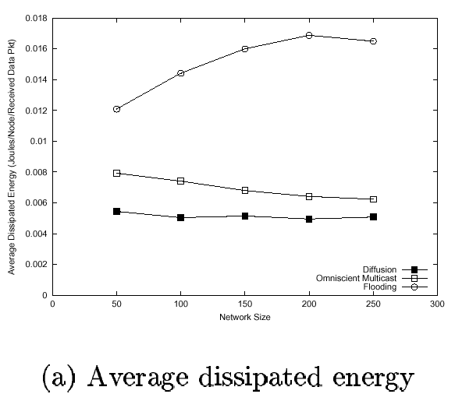
Evaluation: Comparative Results
DD dissipates less energy than OM because of in-network aggregation, in which intermediate nodes suppress duplicate location estimates. However, the savings is not equal to the number of identical sources because 1)both schemes spend significant energy listening, and 2)design parameters are conservative and frequently draw down high quality data along multiple paths.

Slide 22
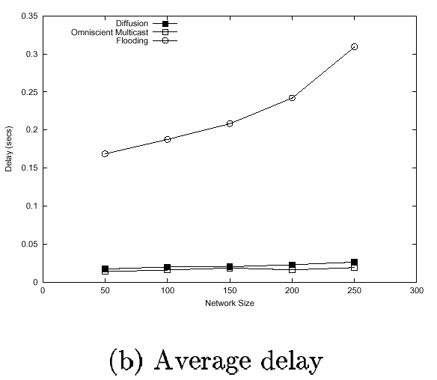
Evaluation: Comparative Results
Flood’s poor performance (which is exclusively dependent upon broadcast) an artifact of the MAC layer: random delay imposed to avoid broadcast collisions. MAC with TDMA might equalize Flood’s performance.

Slide 23
Evaluation: Dynamics
Create node failures in the paths diffusion is most likely to use, as well as creating random failures elsewhere in the network
At any instant, 10 or 20% of nodes unusable
No “settling time” between failures

Slide 24
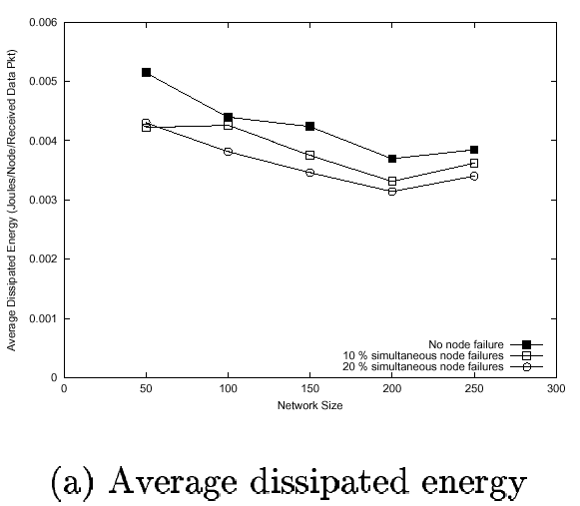
Evaluation: Dynamics
Performance actually improves in some cases because overly-conservative reinforcement rules maintain several high-quality paths during normal operation, some of which fail due to node failures in this experiment, thus decreasing energy consumption.

Slide 25
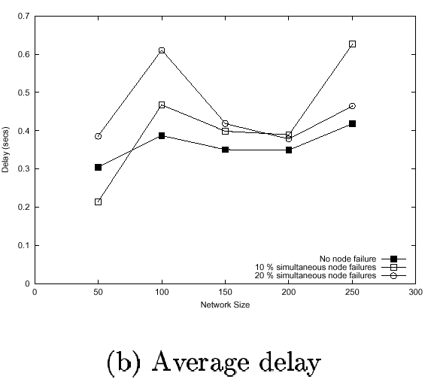
Evaluation: Dynamics

Slide 26
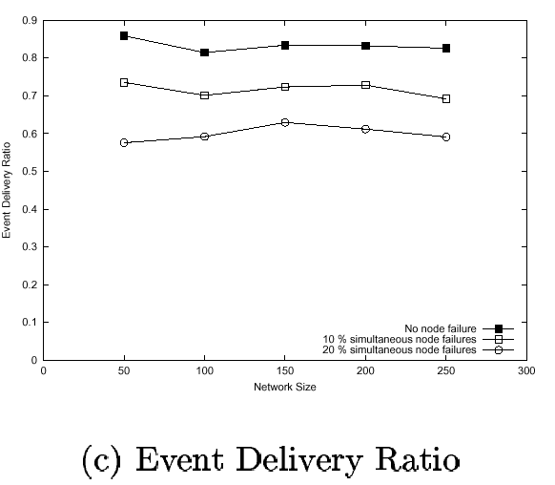
Evaluation: Dynamics

Slide 27
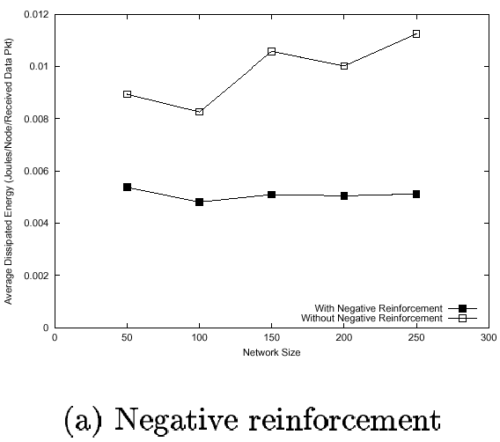
Evaluation: Other Factors
Even conservative negative reinforcement prunes enough redundant paths to achieve substantial energy savings

Slide 28
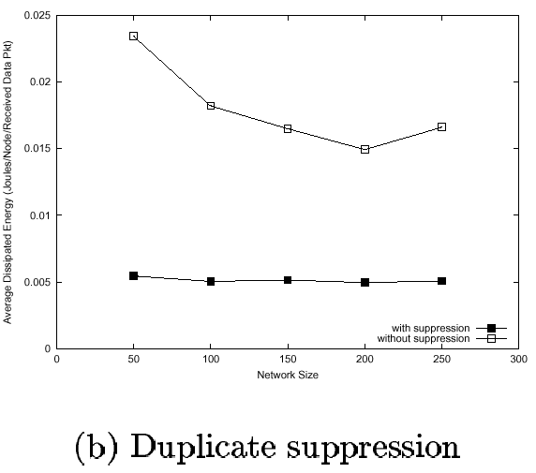
Evaluation: Other Factors
DD expends substantially less energy when it can aggregate (or suppress) duplicate messages.
Conservative negative reinforcement rules account for decrease in energy consumption without diffusion in larger networks: in such networks, the lengths of paths pruned by negative reinforcement are sizeable and result in proportionally sizeable decreases in energy consumption.

Slide 29
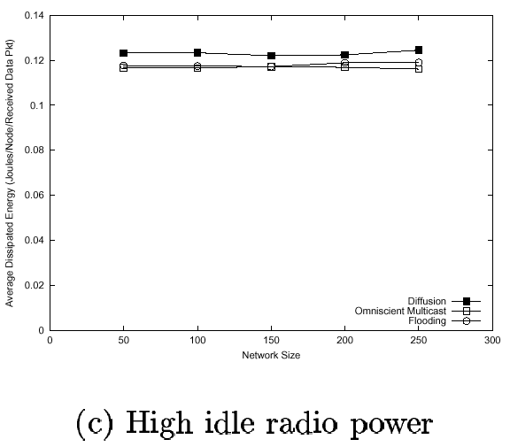
Evaluation: Other Factors
If there are no gains to be had from wise transmission management (i.e. if idle mode consumes as much power as receive mode), then there is no point in implementing complicated communication schemes because idle time will dominate the performance of all schemes.

Slide 30
Related Work
Distributed Sensor Networks
  WINS and Piconet
Reaction-diffusion models for morphogenesis and models of ant colony behavior
Ad hoc unicast routing (particularly reactive protocols)
Multicast routing protocols
  reinforcements similar to join/prune
  interest dissemination and gradient setup similar to data-driven shortest-path tree setup
Router assist for localized error recovery in reliable multicast
Web caching

Slide 31
Conclusions
Diffusion is data-centric
All communication is neighbor-to-neighbor, not end-to-end
No routers—each node can interpret all messages
No globally unique IDs (but locally unique IDs needed)
Application-specific semantics embedded in communication
http://www.isi.edu/scadds/projects/diffusion.html

