Slide 1

Weighted networks: analysis, modeling
A. Barrat, LPT, Université Paris-Sud, France
M. Barthélemy (CEA, France)
R. Pastor-Satorras (Barcelona, Spain)
A. Vespignani (LPT, France)
http://www.th.u-psud.fr/page_perso/Barrat
cond-mat/0311416 PNAS 101 (2004) 3747
cond-mat/0401057 PRL 92 (2004) 228701
cs.NI/0405070

Slide 2
Plan of the talk
Complex networks:
  examples, models, topological correlations
Weighted networks:
  examples, empirical analysis
  new metrics: weighted correlations
  a model for weighted networks
Perspectives

Slide 3
Examples of complex networks
Internet
WWW
Transport networks
Power grids
Protein interaction networks
Food webs
Metabolic networks
Social networks
...

Slide 4
Usual random graphs:
Erdös-Renyi model (1960)
N points, links with proba p:
static random graphs
Connectivity distribution P(k) =
probability that a node has k links
BUT...

Slide 5

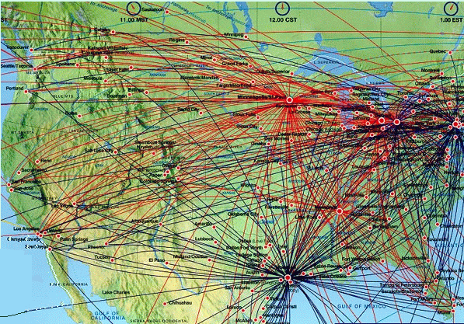
Airplane route network

Slide 6
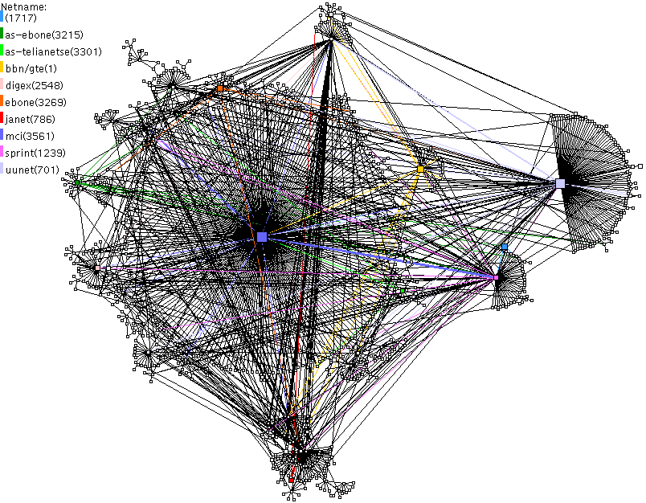
CAIDA AS cross section map

Slide 7
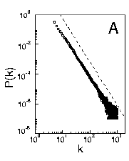
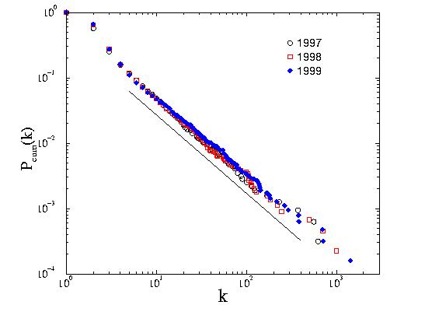
Topological characterization
The Internet and the World-Wide-Web
Protein networks
Metabolic networks
Social networks
Food-webs and ecological networks
Are
Heterogeneous networks
P(k) = probability that a node has k links
P(k) ~ k ^{-γ}
(2 < γ ≤ 3)
<k>= const
<k²> → ∞
Scale-free properties
Diverging fluctuations

Slide 8

Models for growing scale-free graphs
Barabási and Albert, 1999: growth + preferential attachment
P(k) ~ k ⁻³
Generalizations and variations:
  Non-linear preferential attachment : Π(k) ~ k^{α}
  Initial attractiveness : Π(k) ~ A+k^{α}
  Highly clustered networks
  Fitness model: Π(k) ~ η_{i}k_{i}
  Inclusion of space
P(k) ~ k ^{-γ}
(....) => many available models
Redner et al. 2000, Mendes et al. 2000, Albert et al. 2000, Dorogovtsev et al. 2001,
Bianconi et al. 2001, Barthélemy 2003, etc...

Slide 9



Topological correlations: clustering
k_{i}=5
c_{i}=0.1
k_{i}=5
c_{i}=0.
i
a_{ij}: Adjacency matrix

Slide 10


Topological correlations: assortativity
k=4
k=4
i
k_{i}=4
k_{nn,i}=(3+4+4+7)/4=4.5
k=7
k=3

Slide 11
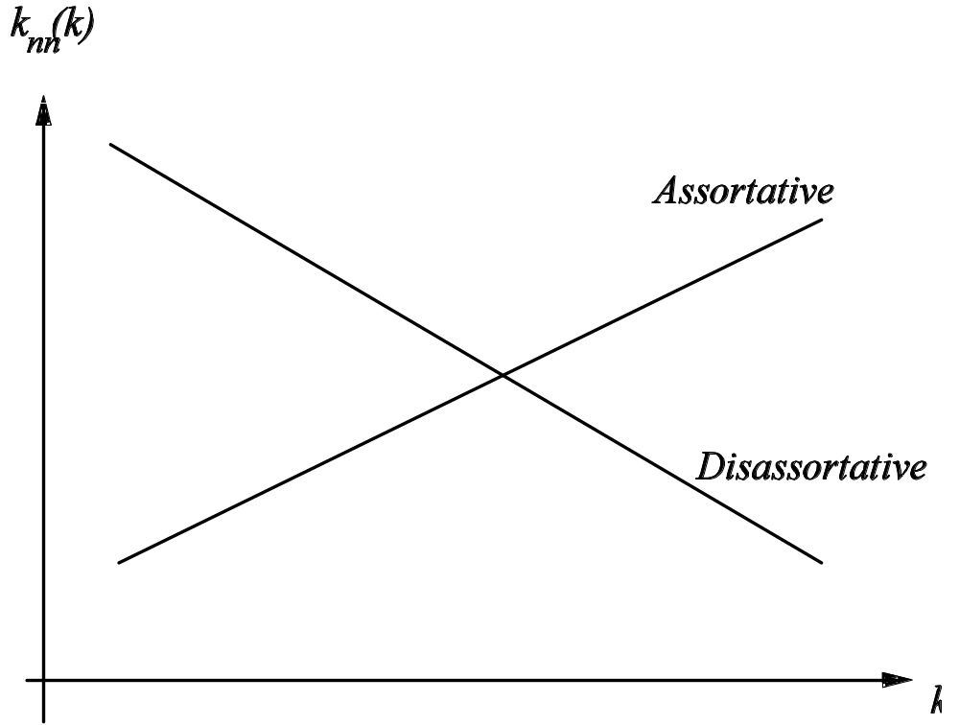
Assortativity
Assortative behaviour: growing k_{nn}(k)
Example: social networks
Large sites are connected with large sites
Disassortative behaviour: decreasing k_{nn}(k)
Example: internet
Large sites connected with small sites, hierarchical structure

Slide 12
Beyond topology: Weighted networks
Internet
Emails
Social networks
Finance, economic networks (Garlaschelli et al. 2003)
Metabolic networks (Almaas et al. 2004)
Scientific collaborations (Newman 2001)
Airports' network*
...
are weighted heterogeneous networks,
with broad distributions of weights
*: data from IATA www.iata.org

Slide 13
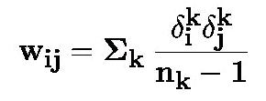



Weights
Scientific collaborations:
(Newman, P.R.E. 2001)
i, j: authors; k: paper; n_{k}: number of authors
: 1 if author i has contributed to paper k
Internet, emails: traffic, number of exchanged emails
Airports: number of passengers for the year 2002
Metabolic networks: fluxes
Financial networks: shares

Slide 14
Weighted networks: data
Scientific collaborations: cond-mat archive; N=12722 authors, 39967 links
Airports' network: data by IATA; N=3863 connected airports, 18807 links

Slide 15
Global data analysis
Number of authors 12722
Maximum coordination number 97
Average coordination number 6.28
Maximum weight 21.33
Average weight 0.57
Clustering coefficient 0.65
Pearson coefficient (assortativity) 0.16
Average shortest path 6.83
Number of airports 3863
Maximum coordination number 318
Average coordination number 9.74
Maximum weight 6167177.
Average weight 74509.
Clustering coefficient 0.53
Pearson coefficient 0.07
Average shortest path 4.37

Slide 16

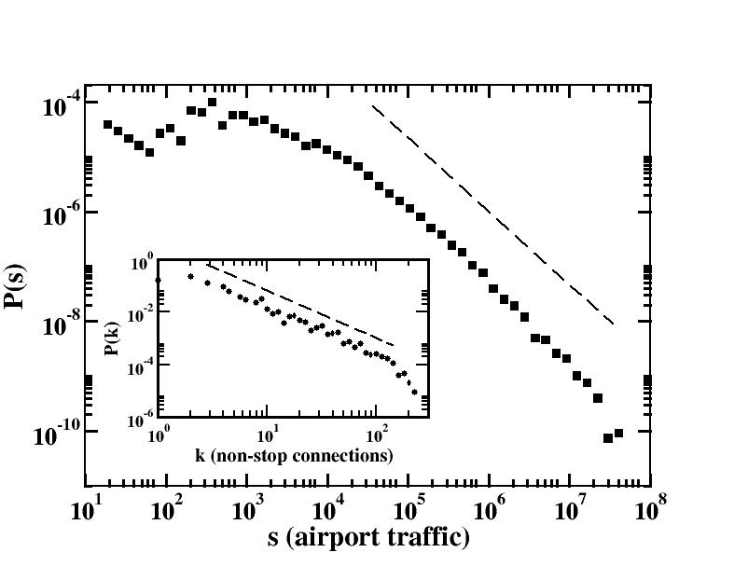
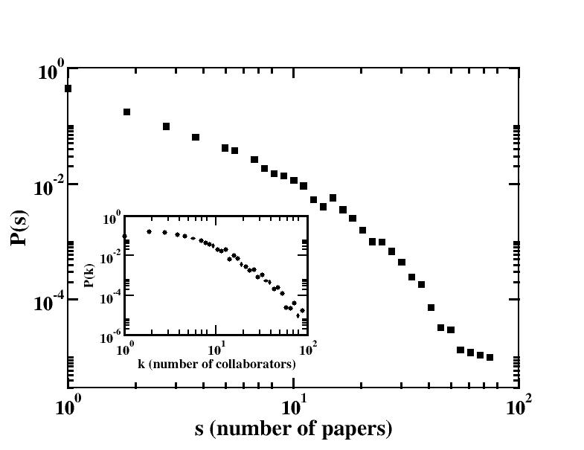
Data analysis: P(k), P(s)
Generalization of k_{i}: strength
_{Broad distributions}

Slide 17
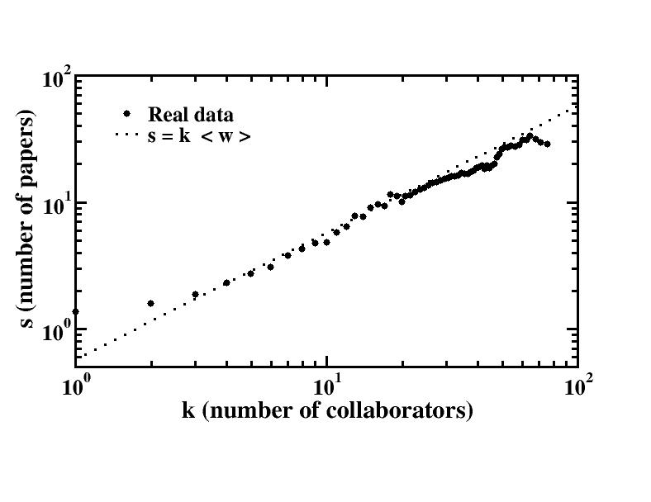
Correlations topology/traffic Strength vs. Coordination
S(k) proportional to k
N=12722
Largest k: 97
Largest s: 91

Slide 18
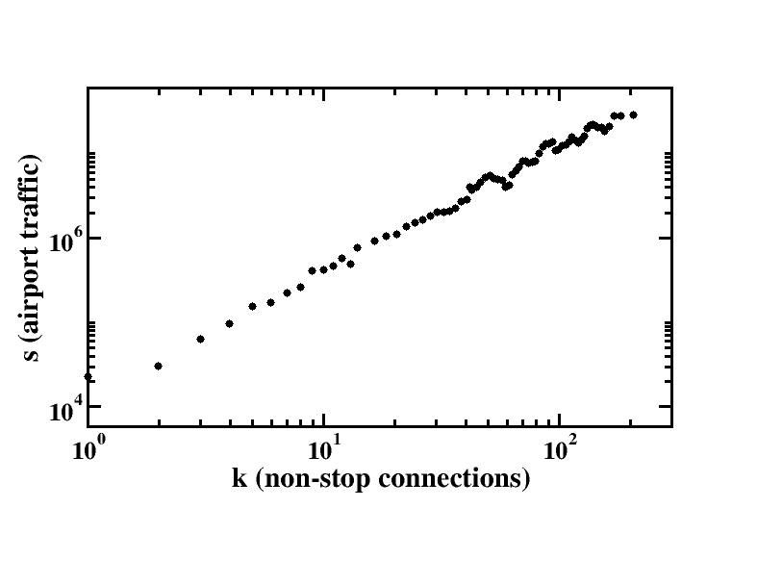
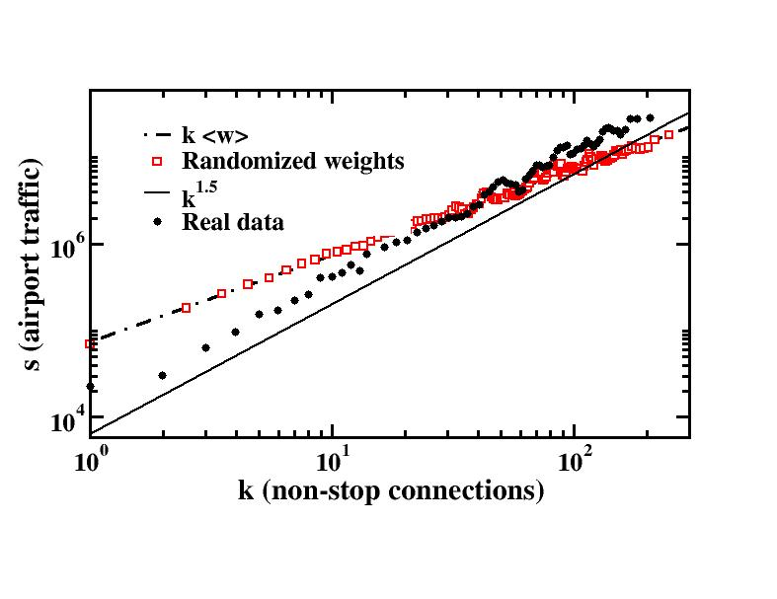
Correlations topology/traffic Strength vs. Coordination
S(k) proportional to k^{β}, β=1.5
Randomized weights: β=1
N=3863
Largest k: 318
Largest strength: 54 123 800
Strong correlations between topology and dynamics

Slide 19
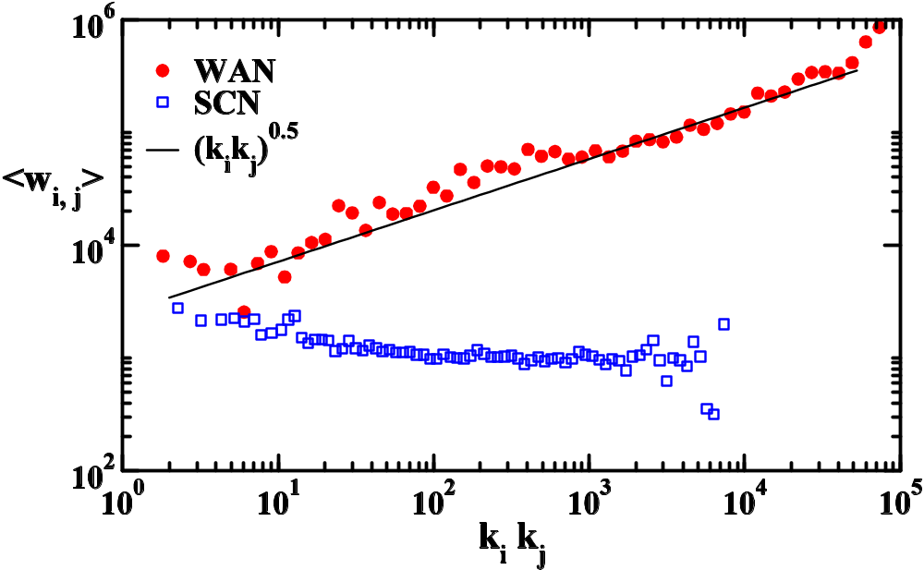
Correlations topology/traffic Weights vs. Coordination
w_{ij} ~ (k_{i}k_{j})^{θ} ; s_{i} = Σ w_{ij} ; s(k) ~ k^{β}
WAN: no degree correlations => β = 1 + θ
SCN: θ∼0 => β=1
See also Macdonald et al., cond-mat/0405688

Slide 20
Some new definitions: weighted metrics
Weighted clustering coefficient
Weighted assortativity

Slide 21

Clustering vs. weighted clustering coefficient
i
w_{ij}=1
i
w_{ij}=5
s_{i}=16
c_{i}^{w}=0.625 > c_{i}
s_{i}=8
c_{i}^{w}=0.25 < c_{i}
k_{i}=4
c_{i}=0.5

Slide 22


Clustering vs. weighted clustering coefficient
k
(w_{jk})
w_{ik}
j
i
w_{ij}
Random(ized) weights: C = C_{w}
C < C_{w} : more weights on cliques
C > C_{w} : less weights on cliques

Slide 23
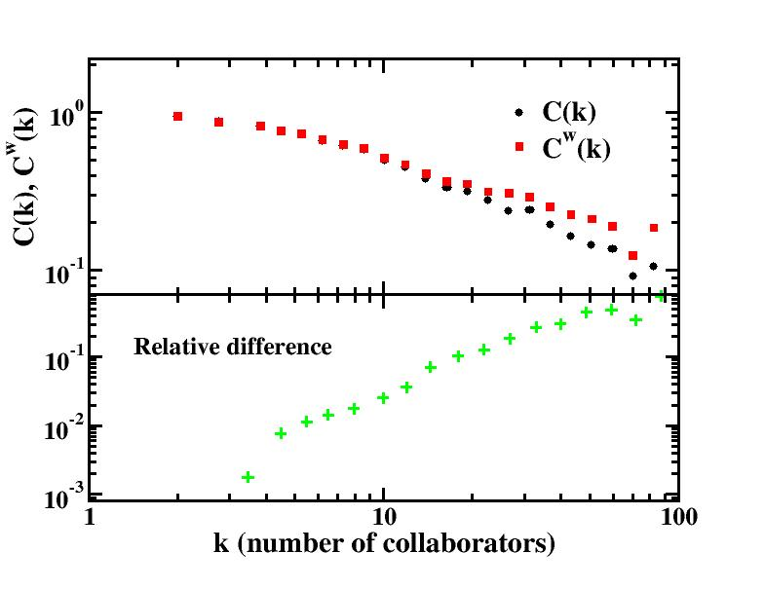
Clustering and weighted clustering
Scientific collaborations: C= 0.65, C_{w} ~ C
C(k) ~ C_{w}(k) at small k, C(k) < C_{w}(k) at large k: larger weights on large cliques

Slide 24
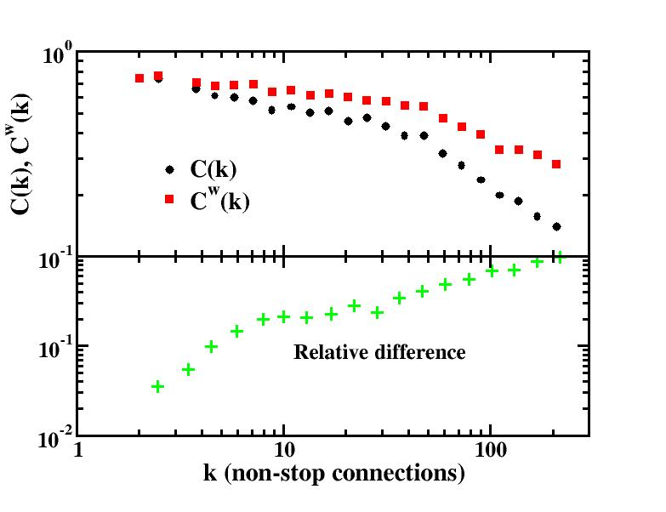
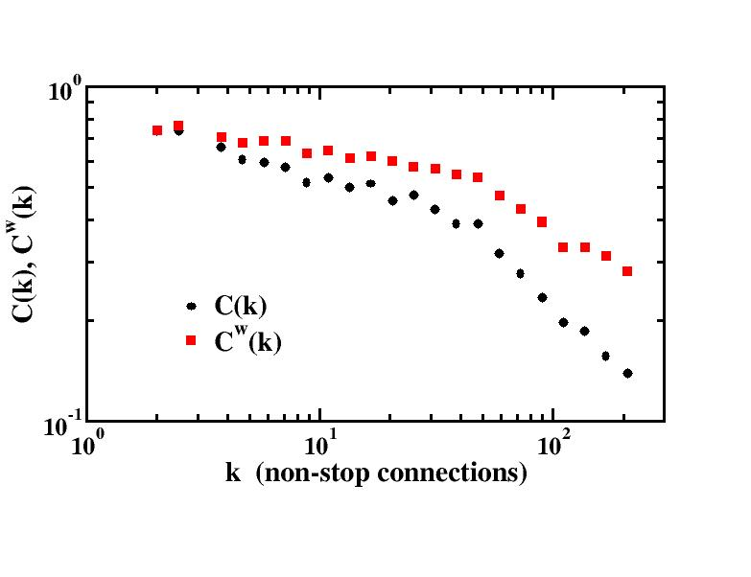
Clustering and weighted clustering
Airports' network: C= 0.53, C_{w}=1.1 C
C(k) < C_{w}(k): larger weights on cliques at all scales

Slide 25
Assortativity vs. weighted assortativity
1
1
5
5
5
1
1
5
i
1
5
k_{i}=5; k_{nn,i}=1.8

Slide 26

Assortativity vs. weighted assortativity
5
5
1
5
i
5
k_{i}=5; s_{i}=21; k_{nn,i}=1.8 ; k_{nn,i}^{w}=1.2: k_{nn,i} > k_{nn,i}^{w}

Slide 27
Assortativity vs. weighted assortativity
1
1
5
1
i
1
k_{i}=5; s_{i}=9; k_{nn,i}=1.8 ; k_{nn,i}^{w}=3.2: k_{nn,i} < k_{nn,i}^{w}

Slide 28
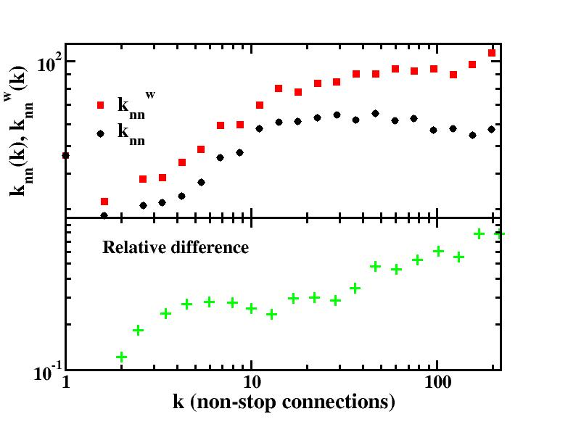
Assortativity and weighted assortativity
Airports' network
k_{nn}(k) < k_{nn}^{w}(k): larger weights between large nodes

Slide 29
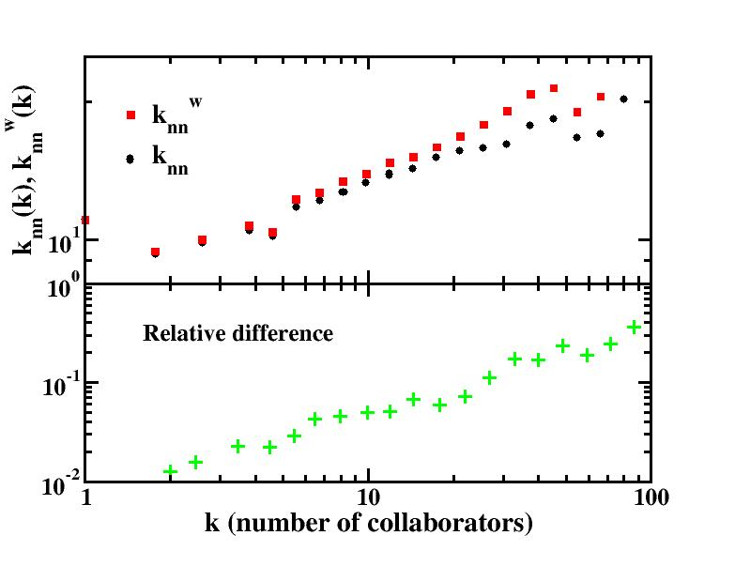
Assortativity and weighted assortativity
Scientific collaborations
k_{nn}(k) < k_{nn}^{w}(k): larger weights between large nodes

Slide 30
Non-weighted vs. Weighted:
Comparison of k_{nn}(k) and k_{nn}^{w}(k), of C(k) and C_{w}(k)
Informations on the correlations between topology and dynamics

Slide 31
A model of growing weighted network
S.H. Yook, H. Jeong, A.-L. Barabási, Y. Tu, P.R.L. 86, 5835 (2001)
Growing networks with preferential attachment
Weights on links, driven by network connectivity
Static weights
Peaked probability distribution for the weights
Same universality class as unweighted network
See also Zheng et al. Phys. Rev. E (2003)

Slide 32

A new model of growing weighted network
Growth: at each time step a new node is added with m links to be connected with previous nodes
Preferential attachment: the probability that a new link is connected to a given node is proportional to the node’s strength
The preferential attachment follows the probability distribution :
Preferential attachment driven by weights
AND...

Slide 33


Redistribution of weights
n
i
New node: n, attached to i
New weight w_{ni}=w₀=1
Weights between i and its other neighbours:
j
s_{i} s_{i} + w₀ + δ
Only
parameter
The new traffic n-i increases the traffic i-j

Slide 34
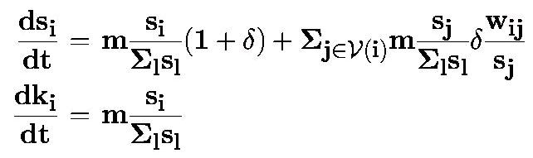


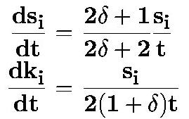
Evolution equations (mean-field)
Also: evolution of weights

Slide 35
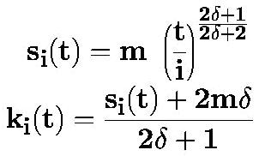



Analytical results
power law growth of s
k proportional to s
Power law distributions for k, s and w:
P(k) ~ k ^{−γ} ; P(s)~s^{−γ}
Correlations topology/weights:
w_{ij} ~ min(k_{i},k_{j})ª , a=2δ/(2δ+1)

Slide 36
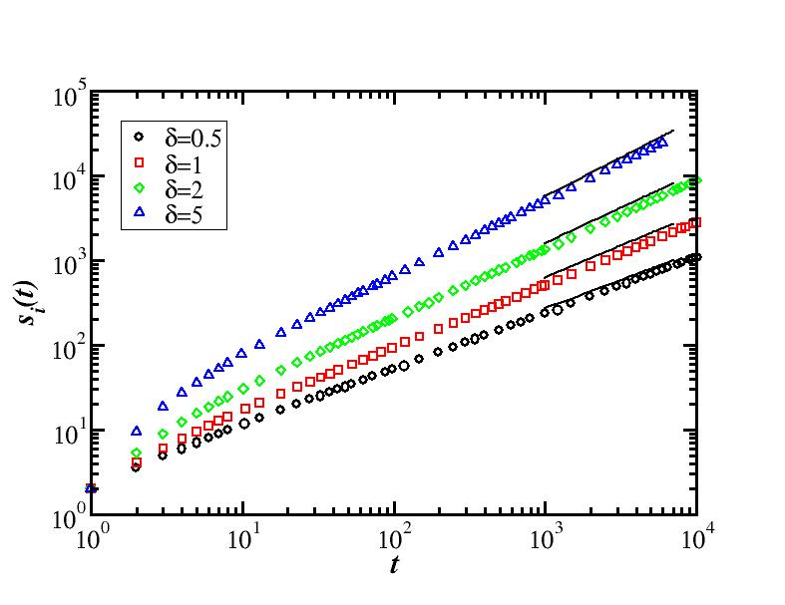
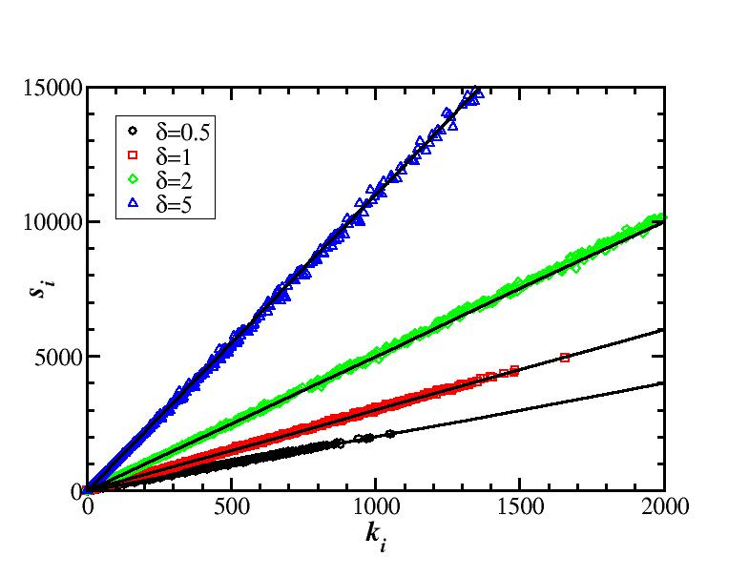
Numerical results

Slide 37
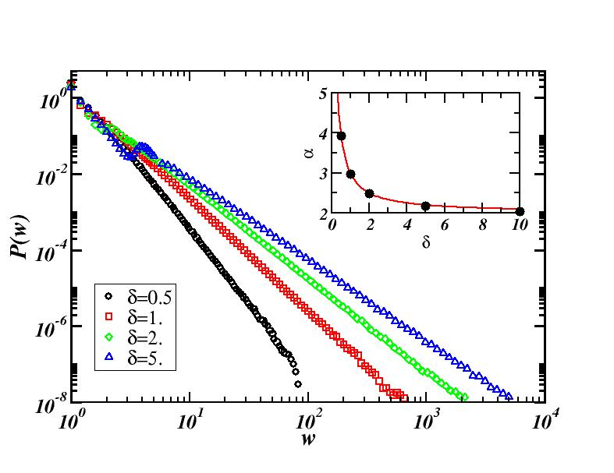
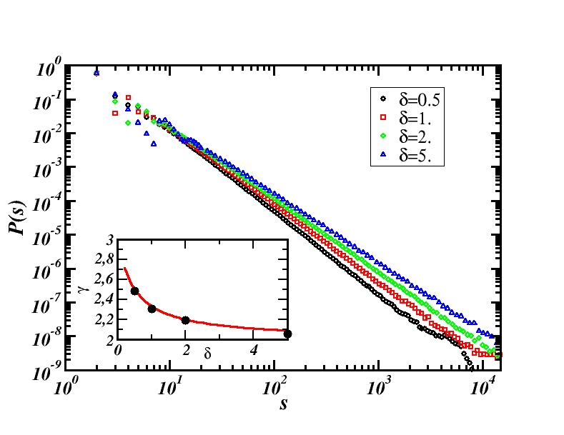
Numerical results: P(w), P(s)
(N=10⁵)

Slide 38
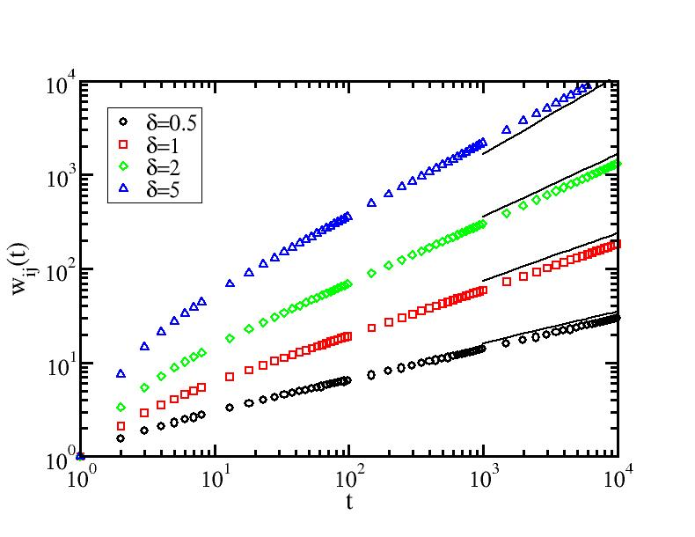
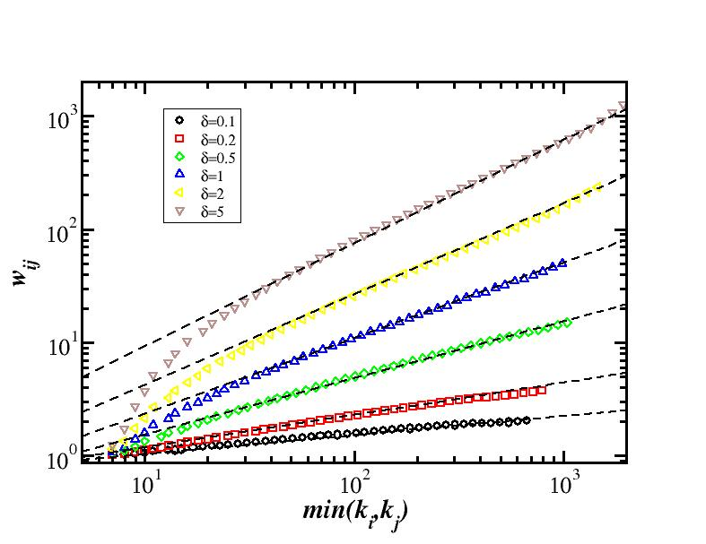
Numerical results: weights
w_{ij} ~ min(k_{i},k_{j})ª

Slide 39
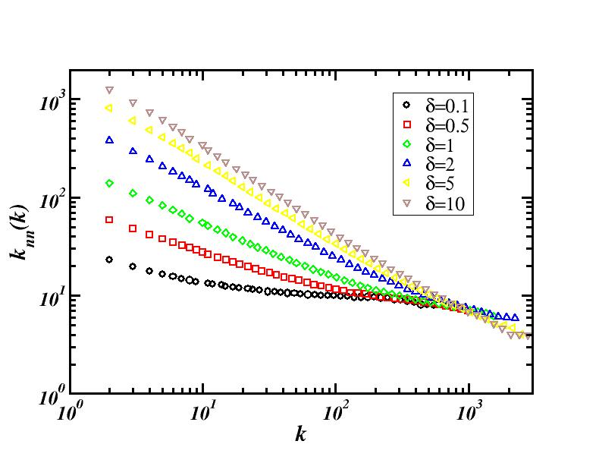
Numerical results: assortativity
analytics: k_{nn} proportional to k^{(γ−3)}

Slide 40
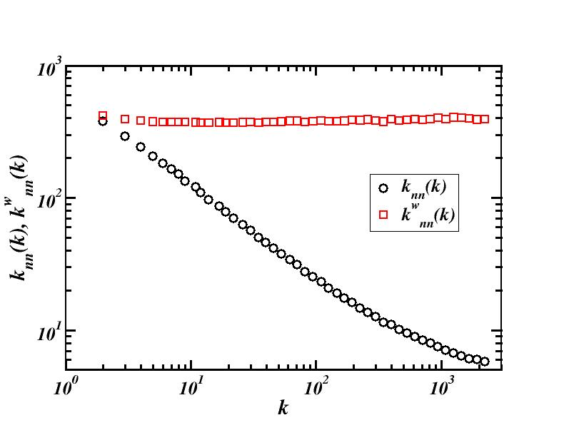
Numerical results: assortativity

Slide 41
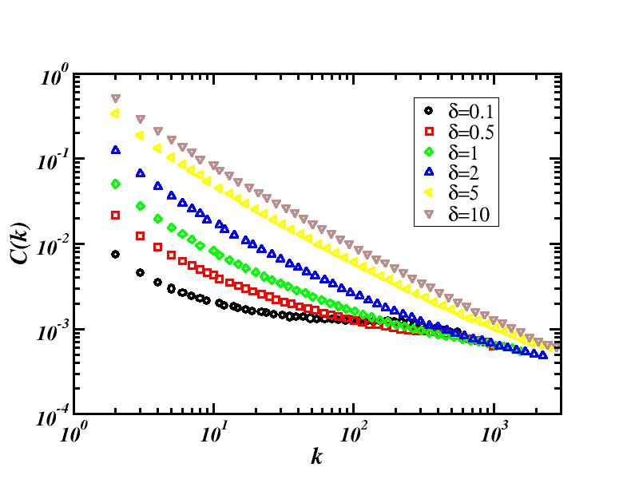
Numerical results: clustering
analytics: C(k) proportional to k^{(γ−3)}

Slide 42
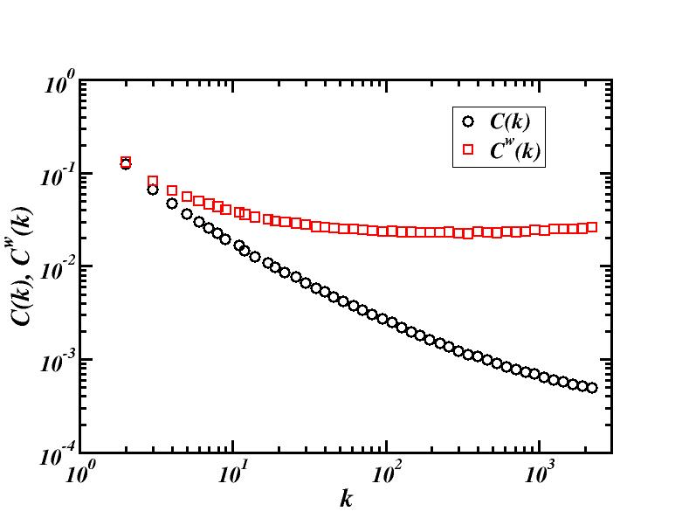
Numerical results: clustering

Slide 43
Extensions of the model:
(i)-heterogeneities
Random redistribution parameter δ_{i} (i.i.d. with ρ(δ) )
  self-consistent analytical solution
(in the spirit of the fitness model, cf. Bianconi and Barabási 2001)
Results
    s_{i}(t) grows as t^{a(δ}_{i}⁾
    s and k proportional
    broad distributions of k and s
    same kind of correlations

Slide 44
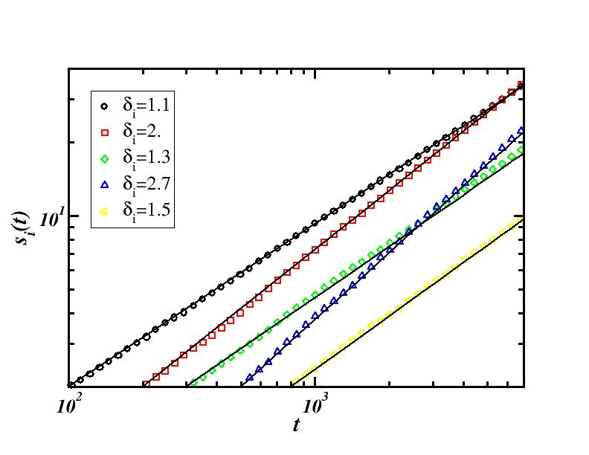
Extensions of the model:
(i)-heterogeneities
late-comers can grow faster

Slide 45
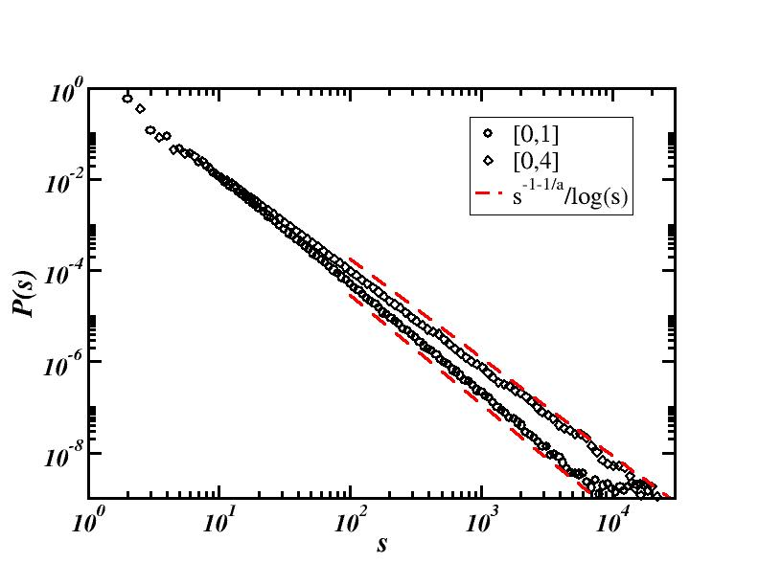
Extensions of the model:
(i)-heterogeneities
Uniform distributions of δ

Slide 46
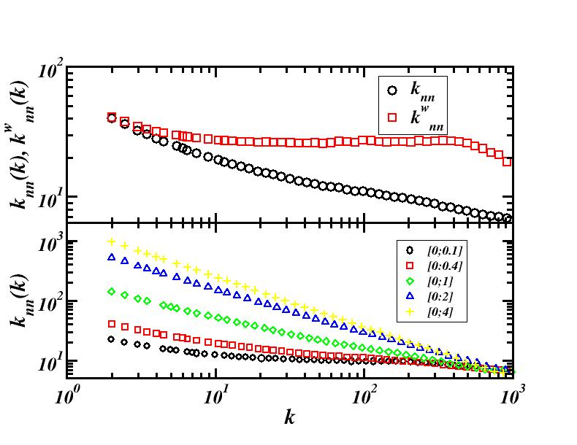
Extensions of the model:
(i)-heterogeneities
Uniform distributions of δ

Slide 47
Extensions of the model:
(ii)-non-linearities
n
i
New node: n, attached to i
New weight w_{ni}=w₀=1
Weights between i and its other neighbours:
j
Δw_{ij} = f(w_{ij},s_{i},k_{i})
Example: Δw_{ij} = δ (w_{ij}/s_{i})(s₀ tanh(s_{i}/s₀))ª
  δ_{i} increases with s_{i}; saturation effect at s₀

Slide 48
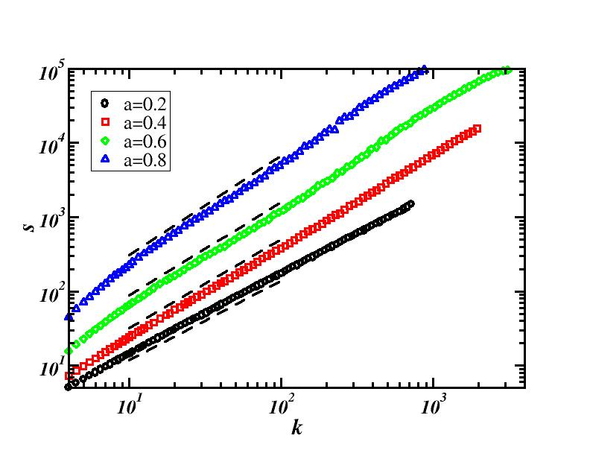
Extensions of the model:
(ii)-non-linearities
Δw_{ij} = δ (w_{ij}/s_{i})(s₀ tanh(s_{i}/s₀))ª
N=5000
s₀=10⁴
δ=0.2
s prop. to k^{β} with β > 1
Broad P(s) and P(k) with different exponents

Slide 49
Summary/ Perspectives/
Work in progress
Empirical analysis of weighted networks
  weights heterogeneities
  correlations weights/topology
  new metrics to quantify these correlations
New model of growing network which couples topology and weights
  analytical+numerical study
  broad distributions of weights, strengths, connectivities
  extensions of the model
    randomness, non linearities
    spatial network: work in progress
    other ?
Influence of weights on the dynamics on the networks: work in progress

