Slide 1
(Social) Networks Analysis III
Prof. Dr. Daning Hu
Department of Informatics
University of Zurich
Oct 16th, 2012

Slide 2
Outline
Network Topological Analysis
Network Models
  Random Networks
  Small-World Networks
  Scale-Free Networks
Ref Book: Social Network Analysis: Methods and Applications (Structural Analysis in the Social Sciences)
  http://www.amazon.com/Social-Network-Analysis-Applications-Structural/dp/0521387078

Slide 3
Network Topological Analysis
Network topology is the arrangement of the various elements (links, nodes, etc). Essentially, it is the topological structure of a network.
How to model the topology of large-scale networks?
What are the organizing principles underlying their topology?
How does the topology of a network affect its robustness against errors and attacks?
Notes:
Distances between nodes, physical interconnections, transmission rates, and/or signal types may differ between two networks, yet their topologies may be identical.

Slide 4
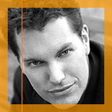



Network Models
Random graph model (Erdős & Rényi, 1959)
Small-world model (Watts & Strogatz, 1998)
Scale-free model (Barabasi & Alert, 1999)

Slide 5
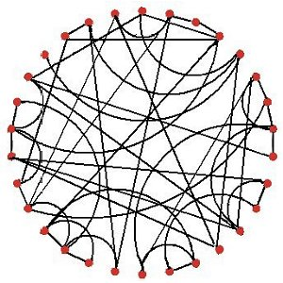
Random Networks
Erdős–Rényi Random Graph model is used for generating random networks in which links are set between nodes with equal probabilities
  Starting with n isolated nodes and connecting each pair of nodes with probability p
  As a result, all nodes have roughly
  the same number of links
  (i.e., average degree, <k>).

Slide 6
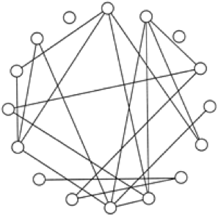
Random Networks
In a random network, each pair of nodes i, j has a connecting link with an independent probability of p
This graph has 16 nodes, 120 possible connections, and 19 actual connections—about a 1/7 probability than any two nodes will be connected to each other.
In a random graph, the presence of a connection between A and B as well as a connection between B and C will not influence the probability of a connection between A and C.

Slide 7
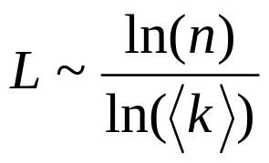
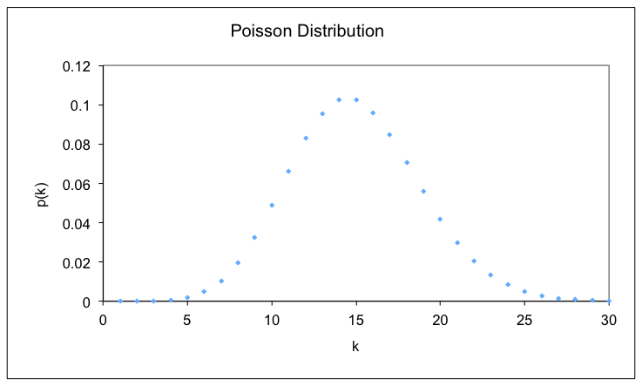
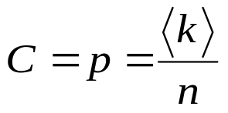
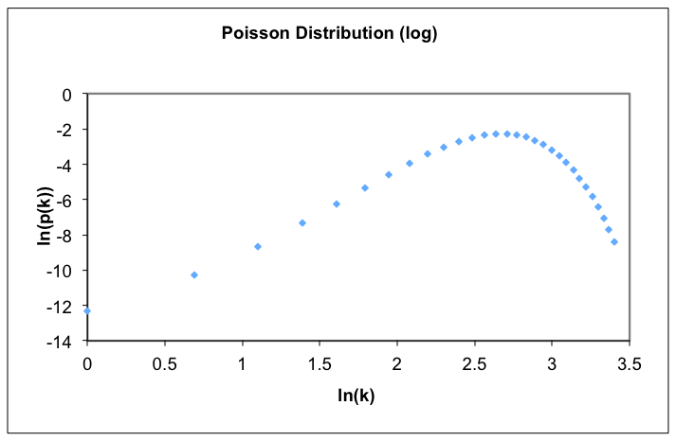
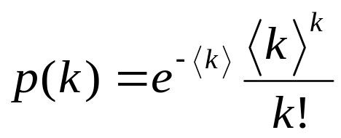
Random Graphs (Cont’d)
Average path length:
Clustering coefficient:
Degree distribution
  Binomial distribution for small n and Poisson distribution for large n
  Probability mass function (PMF)
However, real networks are not random!
Notes:
Poisson distribution predicts the degree of spread around a known average rate of occurrence.
A probability mass function (pmf) is a function that gives the probability that a discrete random variable is exactly equal to some value. The probability mass function is often the primary means of defining a discrete probability distribution, and such functions exist for either scalar or multivariate random variables, given that the distribution is discrete.

Slide 8
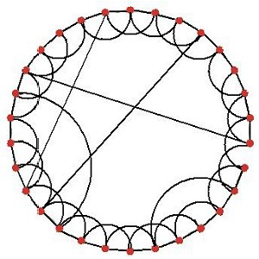
Small-World Network
Social networks usually are small world networks in which a group of people are closely related, while a few people have far-reaching connections with people out side of the group
Starting with a ring lattice of n nodes, each connected to its neighbors out to form a ring <k>. Shortcut links are added between random pairs of nodes, with probability ф (Watts & Strogatz, 1998)
Watts-Strogatz Small World model
  large clustering coefficient
  high average path length

Slide 9
Small-World Networks
A small-world network is defined to be a network where the typical distance L between two randomly chosen nodes (the number of steps required) grows proportionally to the logarithm of the number of nodes N in the network, that is:
and L_{sw} ≤ L_{rand}
Clustering coefficient:
  C_{sw} >> C_{random}
Degree distribution
  Similar to that of random networks
Thus, small-world networks are characterized by large clustering coefficient, small path length relative to n.

Slide 10
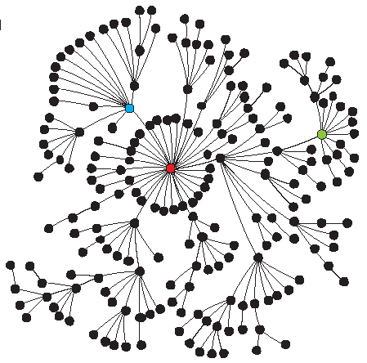
Scale-Free (SF) Networks: Barabási–Albert (BA) Model
“Scale free” means there is no single characterizing degree in the network
Growth:
  starting with a small number (n₀) of nodes, at every time step, we add a new node with m(<=n₀) links that connect the new node to m different nodes already present in the system
Preferential attachment:
  When choosing the nodes to which the new node will be connected to node i depends on its degree k_{i}

Slide 11
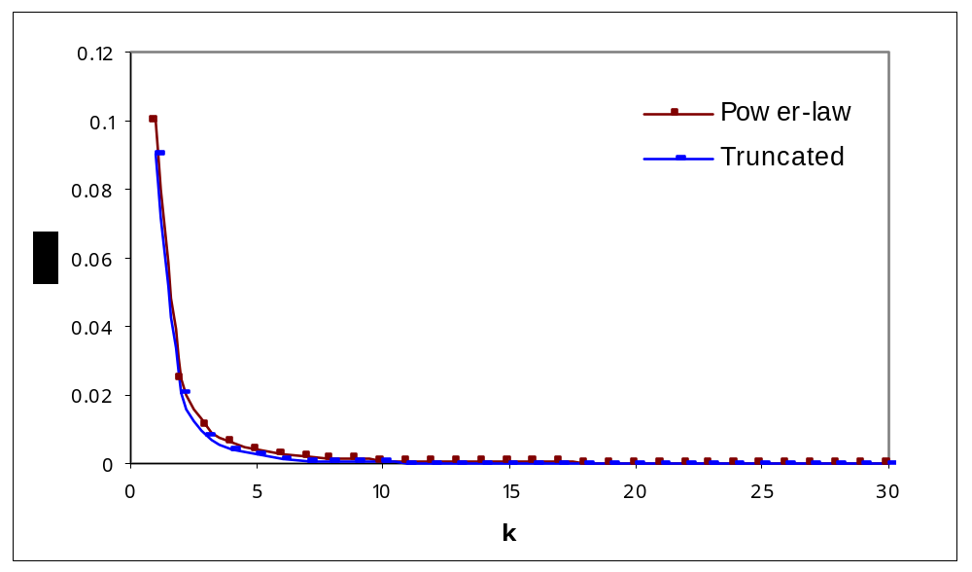
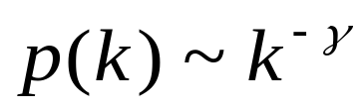
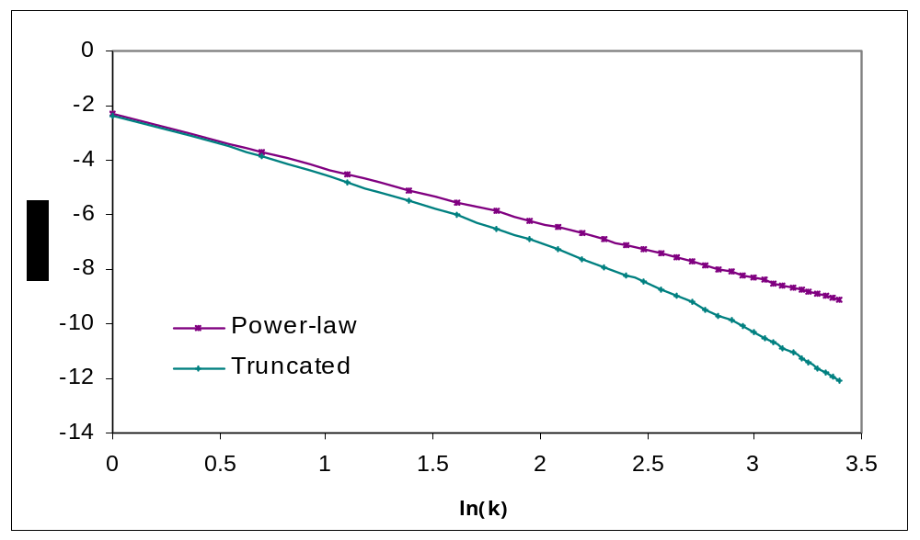
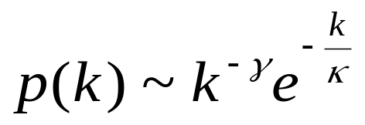
Scale-Free Networks (Cont’d)
The degree of scale-free networks follows power-law distribution with a flat tail for large k
Truncated power-law distribution deviates at the tail

Slide 12
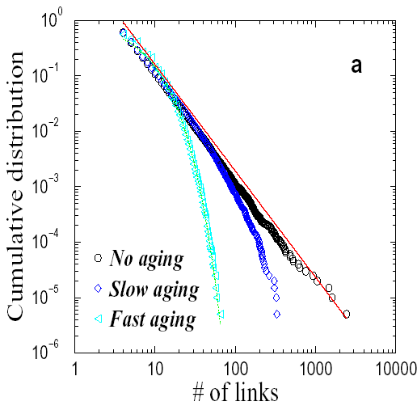
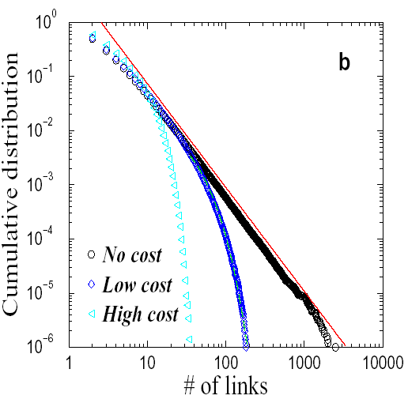
Evolution of SF Networks
The emergence of scale-free network is due to
  Growth effect: new nodes are added to the network
  Preferential attachment effect (Rich-get-richer effect): new nodes prefer to attach to “popular” nodes
The emergence of truncated SF network is caused by some constraints on the maximum number of links a node can have such as (Amaral, Scala et al. 2000)
  Aging effect: some old nodes may stop receiving links over time
  Cost effect: as maintaining links induces costs, nodes cannot receive an unlimited number of links

Slide 13
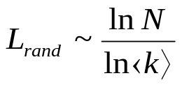
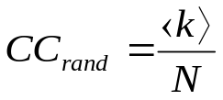
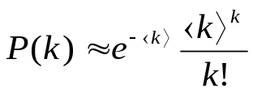

Network Analysis: Topology Analysis
Topology | Average Path Length (L) | Clustering Coefficient (CC) | Degree Distribution (P(k))
Random Graph |  |  | Poisson Dist.:
Small World (Watts & Strogatz, 1998) | L_{sw} ≤ L_{rand} | CC_{sw} >> CC_{rand} | Similar to random graph
Scale-Free network | L_{SF} ≤ L_{rand} |  | Power-law Distribution: P(k) ~ k^{-γ}
: Average degree

Slide 14
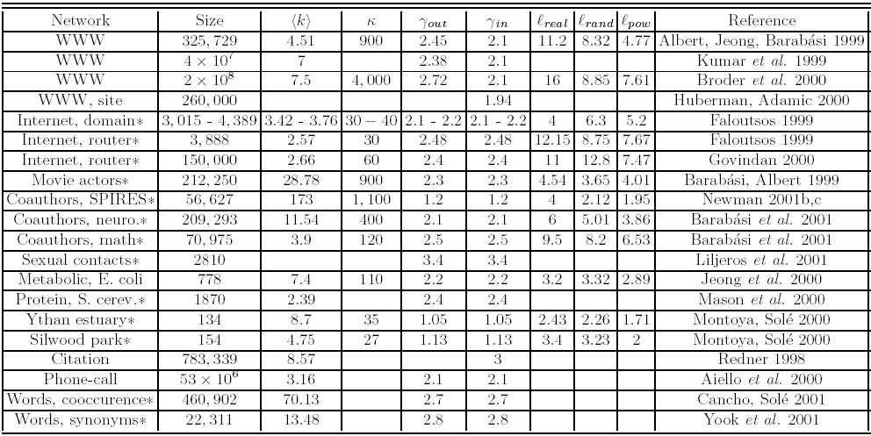
Empirical Results from Real-World Networks

Slide 15
Implications of Network Modeling
The two new models of networks have important implications to many applications, e.g.,
  The 19 degrees of separation on the WWW implies that on average, a user can navigate from an arbitrary web page to another randomly selected page within 19 clicks, even though the WWW consists of millions of pages. Even if the web increase by 10 times in the next few years, the average path length increases only marginally from 19 to 21! (Albert, Jeong, & Barabási, 1999)
  The small-world properties of metabolic networks in cell implies that cell functions are modulized and localized
The ubiquity of SF networks lead to a conjecture that complex systems are governed by the same self-organizing principle(s).

Slide 16
Robustness and Vulnerability of SF Networks
Many complex systems display a surprising degree of robustness against errors, e.g.,
  Organisms grow, persist, and reproduce despite drastic changes in environment
  Although local area networks often fail, they seldom bring the whole Internet down
In addition to redundant rewiring, what else can play a role in the robustness of networks? Is it because of the structure (topology)?

Slide 17
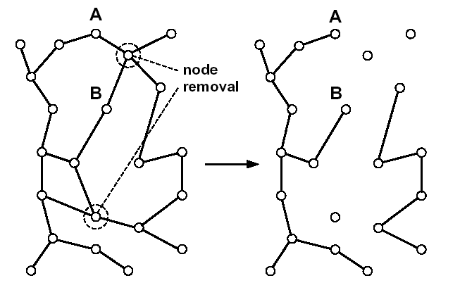
Robustness Testing
How will the topology of a network be affected if some nodes are removed from the network?
How will random node removal (failure) and targeted node removal (attack targeting hubs) affect
  S: the fraction of nodes in the largest component
  L: the average path length of the largest component

Slide 18
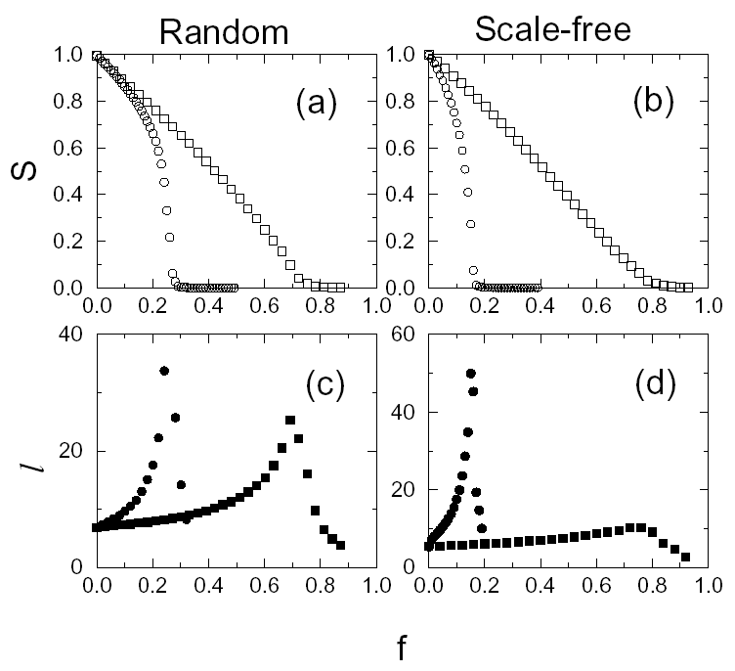
Robustness Testing (Cont’d)
SF networks are more robust against failures than random networks due to its skewed degree distribution
SF networks are more vulnerable to attacks than random networks, again, due to its skewed degree distribution
The power-law degree distribution becomes the Achilles’ Heel of SF networks
Failure
Attack

