Slide 1
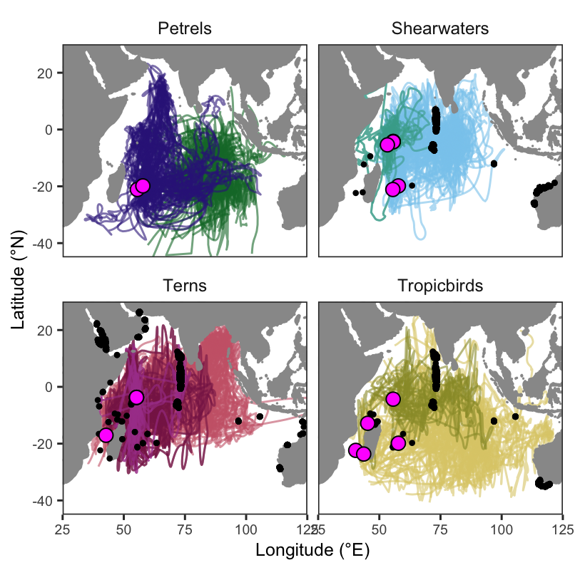
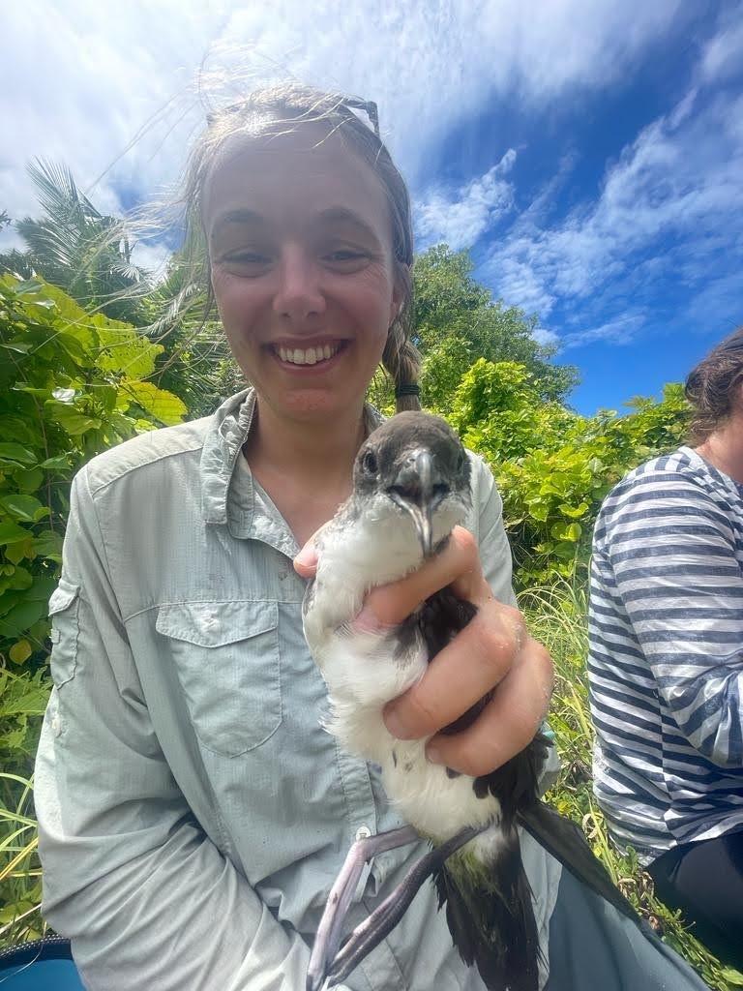

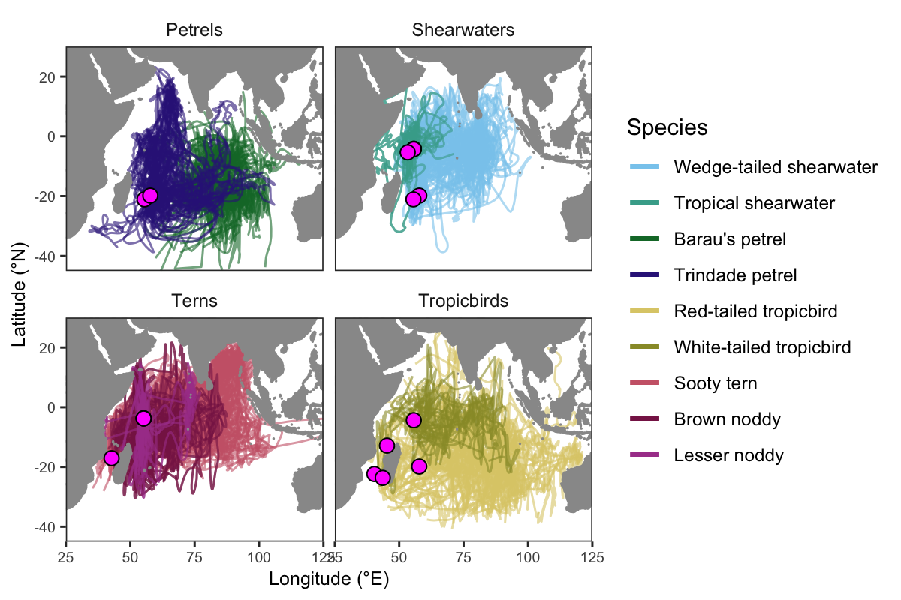

Reproducible data manipulation (in R)
Microteach, Alice Trevail

Slide 2
About today: Intended learning outcomes
Describe why we should manipulate our data in a reproducible way
Manipulate data = write simple code to change data from wide to long format
No need to take part in activities if you would rather watch

Slide 3



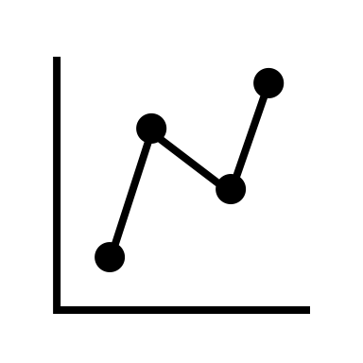

Questions for you Yes/No – please raise your hands if ‘yes’
1: do you work with data?
2: do you manage data in excel?
3: have you used the software R?
4: have you used R for data manipulation?

Slide 4



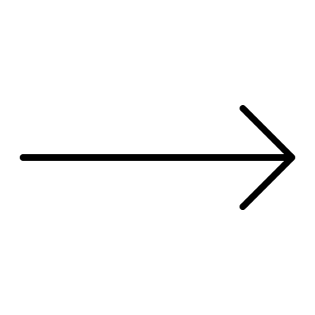

What is data manipulation?
The way we collect data can be different to how we analyse it
E.g., different rows/column structure
To solve this problem, we need to re-organize our data

Slide 5
Why reproducible data manipulation?
Requirement: journals & funding bodies mandate open access data & code
Avoid errors, no more copy-paste
Can be quick, easy, and fun!

Slide 6

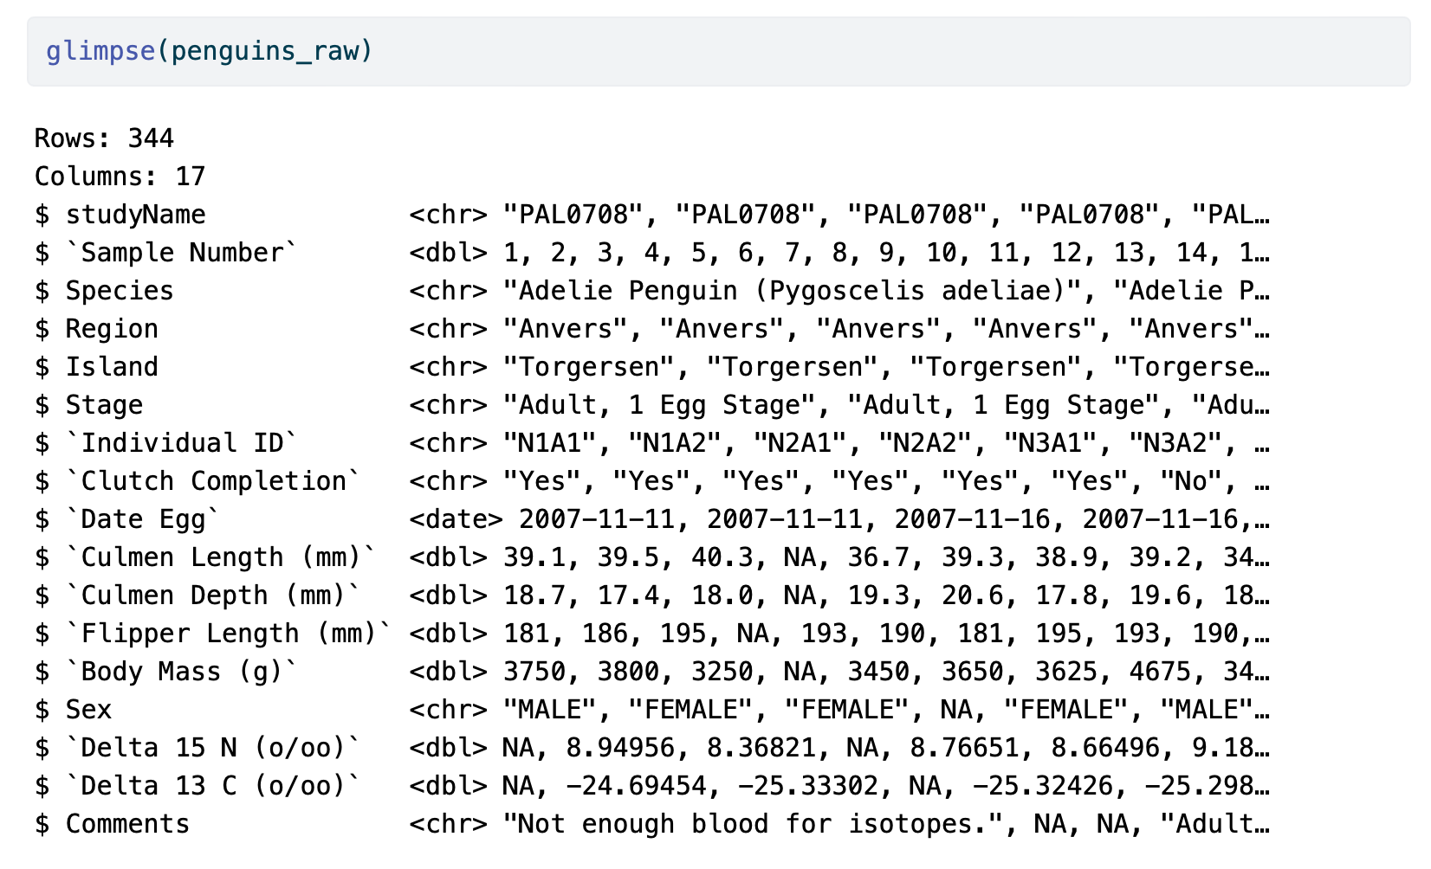
Why reproducible data manipulation? (in R)

Slide 7
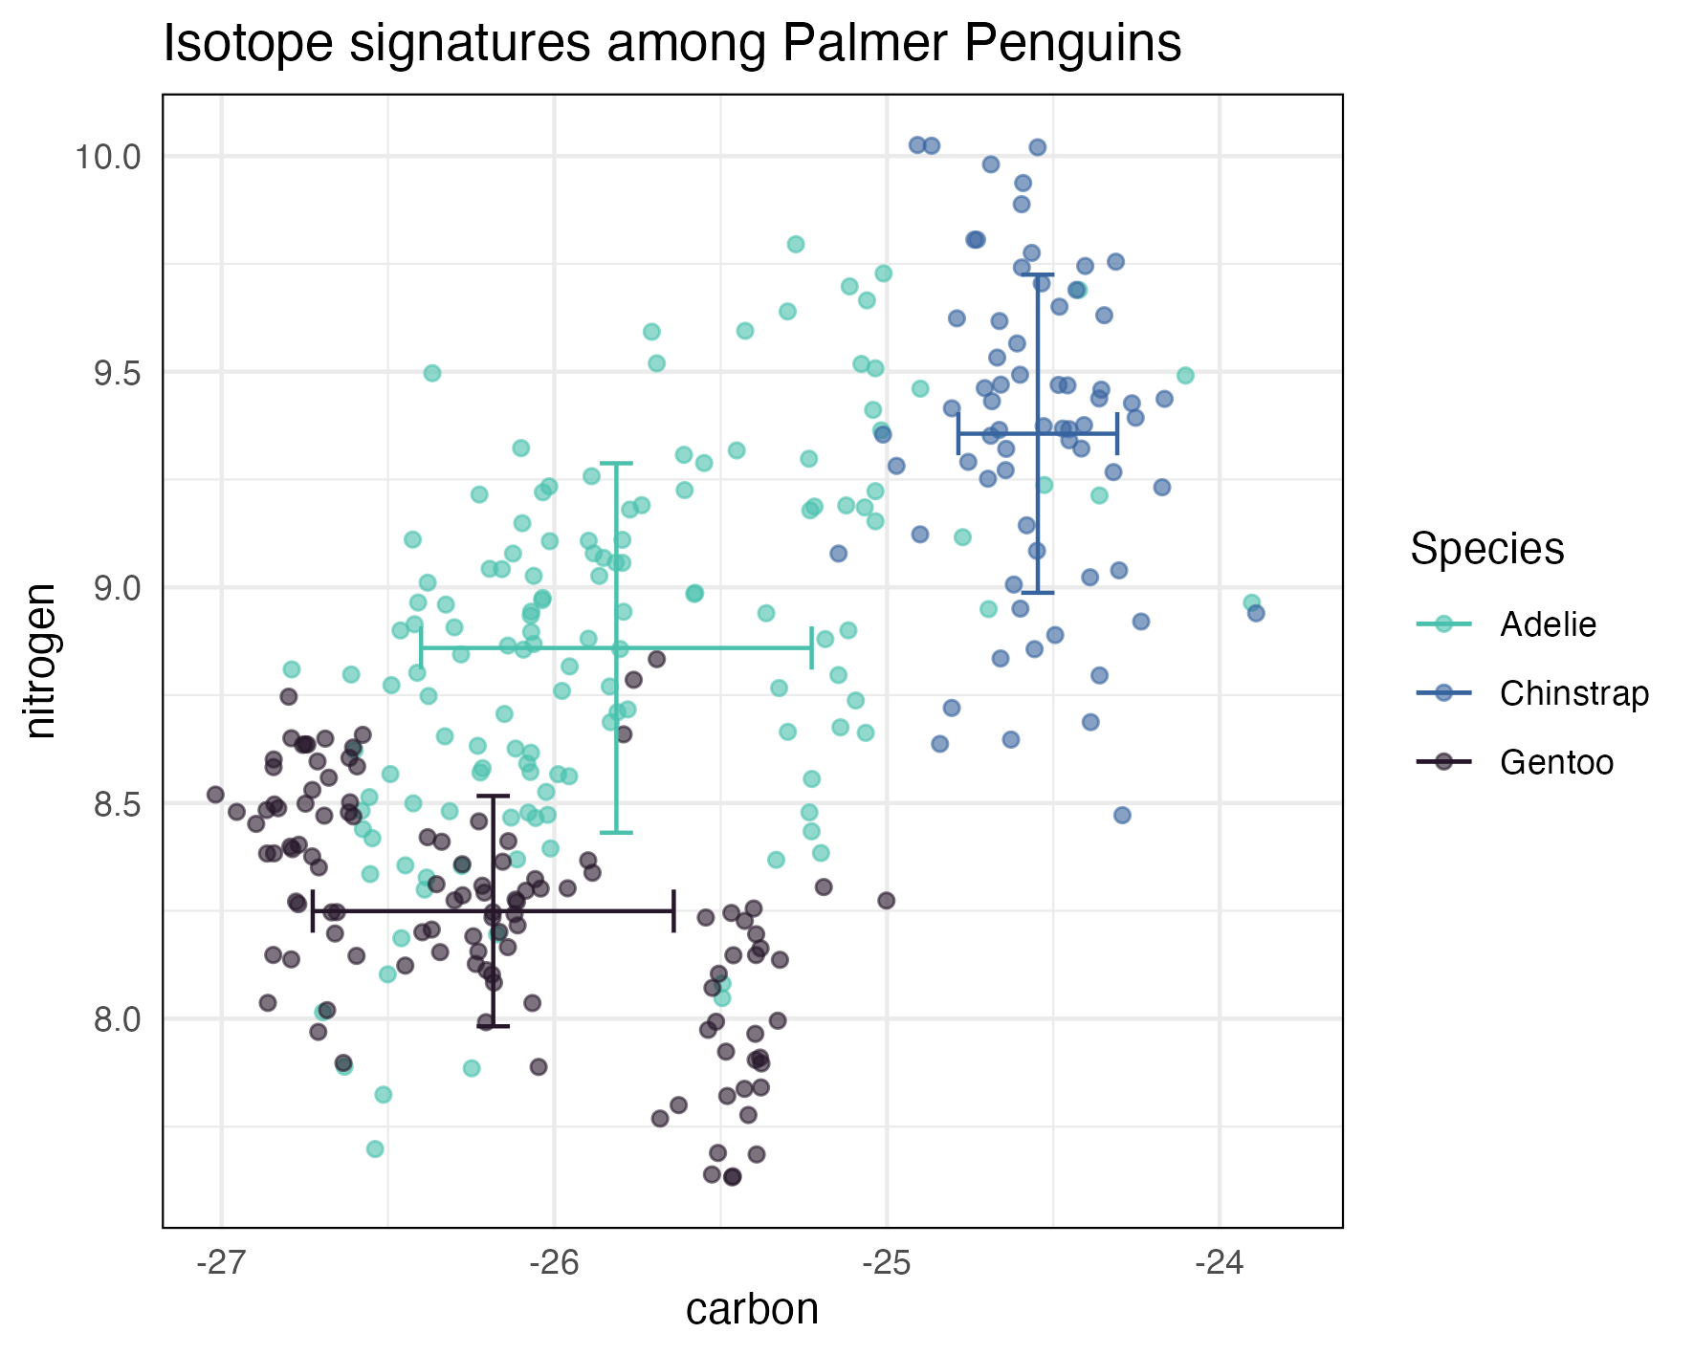
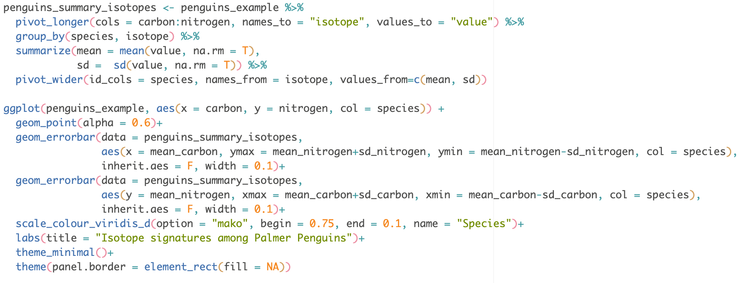
Why reproducible data manipulation? (in R)
27 lines of code:
Horst AM, Hill AP, Gorman KB (2020). palmerpenguins: Palmer Archipelago (Antarctica) penguin data. R package version 0.1.0. doi: 10.5281/zenodo.3960218

Slide 8

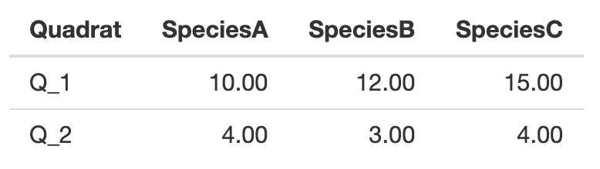

pivot_longer(): An example
Q: do quadrats have different species counts?
Wide data =
Observations across multiple columns and rows

Slide 9
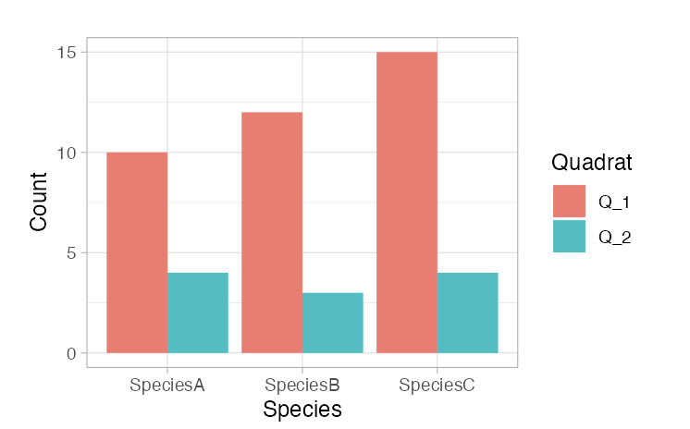
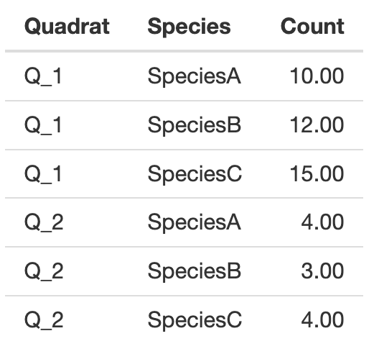
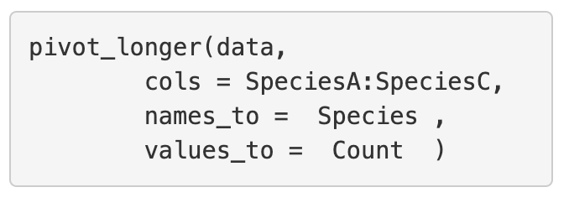
pivot_longer(): An example
Q: do quadrats have different species counts?

Slide 10

pivot_longer(): An example
Q: do quadrats have different species counts?
Columns containing data

Slide 11
pivot_longer(): An example
Q: do quadrats have different species counts?
Columns containing data

Slide 12
pivot_longer(): An example
Q: do quadrats have different species counts?
Values containing observations

Slide 13

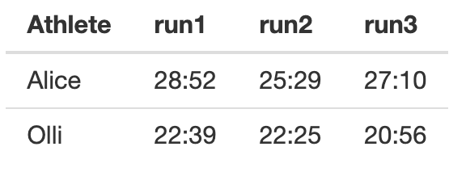
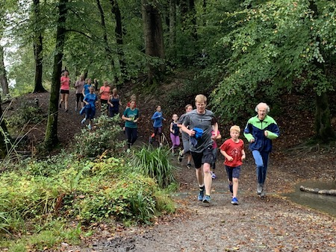
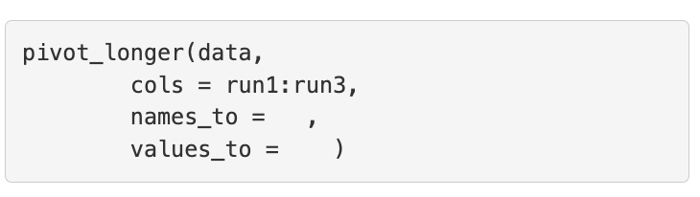

pivot_longer(): Your turn
Q: how do runners times change?
Your task =
Fill in the blanks

Slide 14

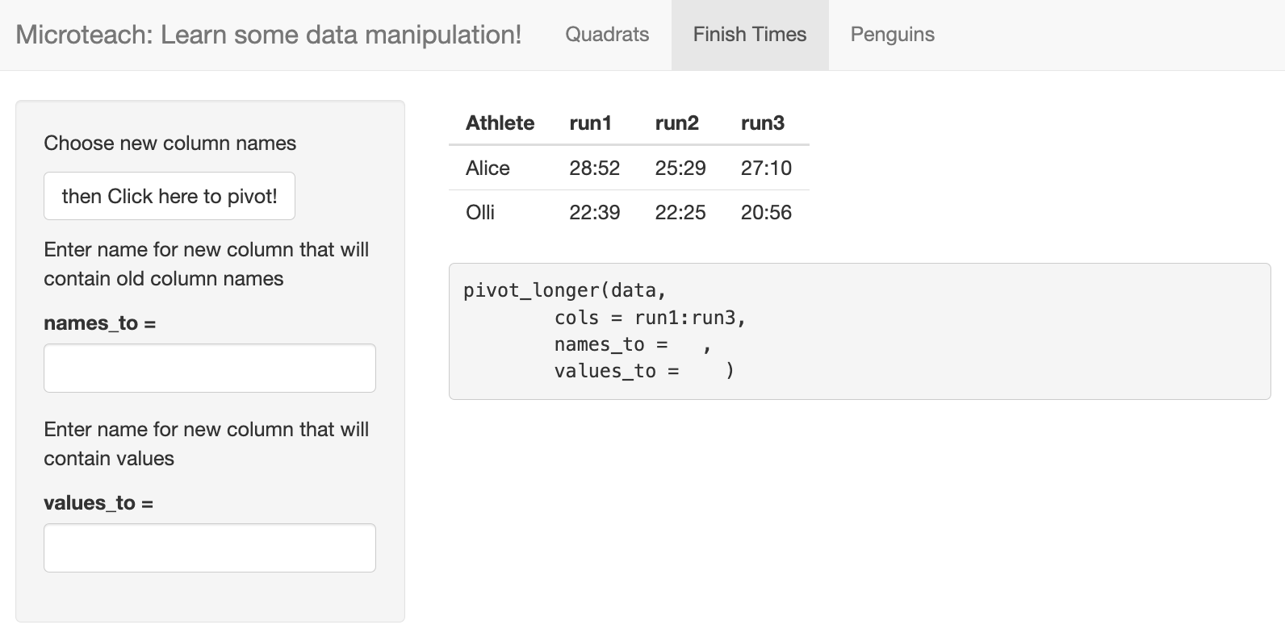
pivot_longer(): Your turn
Q: how do runners times change?
R Shiny app
alicetrevail.shinyapps.io/pivot_learn
Find other examples here
Click here to pivot_longer()
Use these boxes to fill in the code

Slide 15
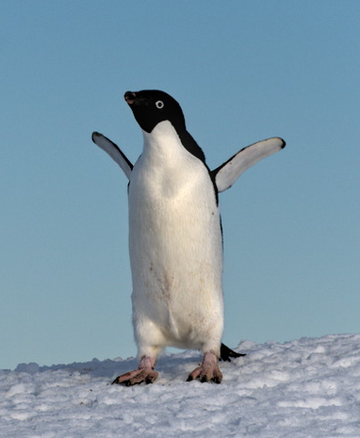
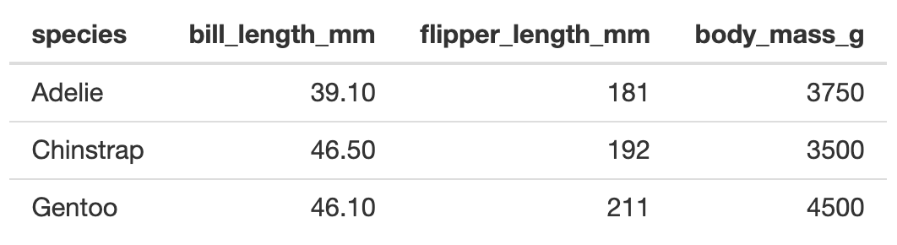
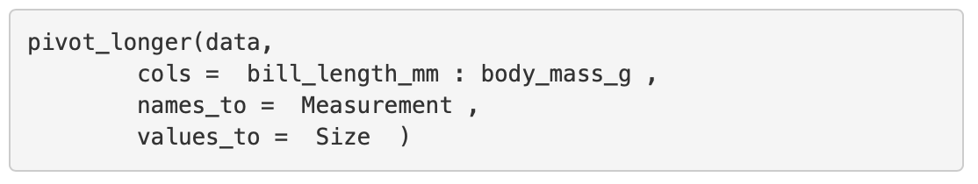
pivot_longer(): Test!
Q: how big are different penguin species?
1
2

Slide 16
pivot_longer(): Test!
Q: how big are different penguin species?
1
2
3

Slide 17

Recap
We have learnt:
Why we should manipulate our data in R = Reproducible & fun
How to manipulate data from wide to long format = pivot_longer()
Find out more: exeter-data-analytics.github.io
Workshop next Tuesday, 21st November
Exchange Lecture Theatre, 3-5pm

