Slide 1
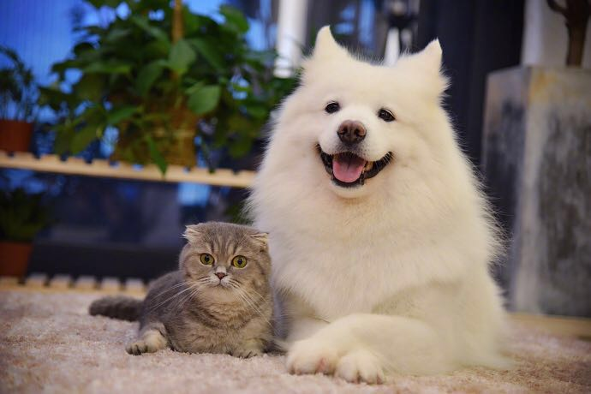
Petfinder
Team 4:
Tianxing Liang
Guiran Niu
Zhongchuan Xiao
Jiajie Tang
Tianjie Xu

Slide 2
Agenda
Goal
Data Description
Candidate & Best Models
Business Analysis
Findings and Conclusion

Slide 3
Our Purpose
Increase adoption rate & Develop proper solutions for shelters
Every year, 6.5 million companion animals enter U.S. animal shelters
1.5 million shelter animals are euthanized (670,000 dogs and 860,000 cats)
On the website of PetFinder(data provider) in Malaysia , there are more than 8000 homeless dogs and 6500 neglected kitties

Slide 4
Data Description
DV: AdoptionSpeed, Adopted
Basic Features: Type, Name, Gender, Breed, Color, Maturity,Size, etc.
Calculated Predictor: mix_breed, most_popular
State Data: Crime Index Ration, living space per capita, Median income by State
Breed Features: Easy To Train, Exercise Needs, Friendly Toward Strangers, Intelligence, Tendency To Bark Or Howl, life_span, etc.
PCA component: PCA component of breed features
Text Analysis: word_count, sentiment

Slide 5
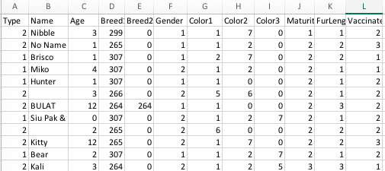

Slide 6
Tune Steps
Step1: basic features, DV=AdoptionSpeed
Step2: basic features, DV=Adopted
Step3: basic features + state data, DV=Adopted
Step4: basic features + state data + calculated predictors , DV=Adopted
Step5: basic features + state data + calculated predictors +sentiment , DV=Adopted
Step6: basic features + state data + calculated predictors +sentiment + breed feature, DV=Adopted
Step7: basic features + state data + calculated predictors +sentiment + PCA, DV=Adopted

Slide 7
Research Questions
How do the features of the pet itself affect the adoption rate?
How does the way that the PetFinder list the pet affect the adoption rate?
How do the demographic factors of shelters affect the adoption rate?

Slide 8
Candidate and Best Models

Slide 9
Method & Model----KNN
The best model to predict adopted rate (83%).
The best K value for different models are changing.
High computationally demand, as number of variables are large. Cost long time to run.
Hard to interpret variables’ significant.
To our surprise, more features included, lower accuracy. Though the difference is not significant.

Slide 10
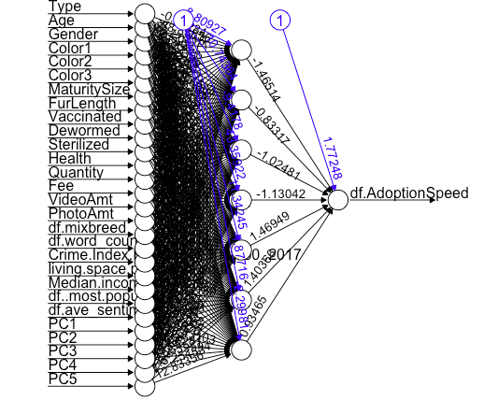
Neural Network
One hidden layers
Requires high computational power
No insights to the relationship
Accuracy: 0.7402713
Notes:
One layer because two layers not giving better results

Slide 11
Naive Bayes
Add variables does not always increase the accuracy;
PCA does not help;
Bin numerical variables to categorical variables increase a little in accuracy.
 | Step1 | Step2 | Step3 | Step4 | Step5 | Step6 | Step7
Accuracy | 0.3309 | 0.7085 | 0.7049 | 0.7069 | 0.7091 | 0.6891 | 0.7082
Accuracy(Binned) | 0.3407 | 0.7178 | 0.7147 | 0.714 | 0.7147 | 0.6731 | 0.7002

Slide 12

Logistic Regression Model vs Tree and Ensemble Method
 | LGM | Tree & EM
Experiment Steps | Start from step 2 | Full steps
Accuracy | Increasing from step 2 to step 6 (highest 74.59%) | Increasing from step 1 to step 7 (highest 76.47%)
Best Step | Step 6 with breed features | Step 6 & 7 tie Breed feature or PCA
Interpretation | What and How | What only

Slide 13
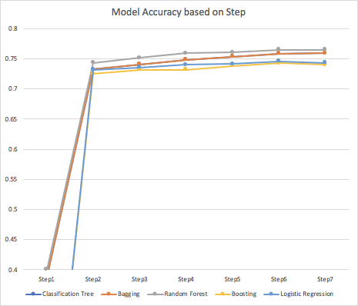
Logistic Regression Model vs Tree and Ensemble Method

Slide 14
Best Models
Accuracy
Interpretation
Random forest with logistic together
Logistic : What and How
Random forest: High accuracy
 | Model with highest accuracy | Highest Accuracy
Step1 | Random forest | 0.4000
Step2 | KNN | 0.8323
Step3 | KNN | 0.8225
Step4 | KNN | 0.8185
Step5 | KNN | 0.8185
Step6 | KNN | 0.8083
Step7 | KNN | 0.8147

Slide 15
Business Analysis

Slide 16
Important
Unimportant
Age
Dewormed
Sterilization
Description sentiment
Amount of photo in the profile
Number of animals in one profile
· Type(Dog or Cat)
· Color
· Health condition
· Amount of Video in the profile

Slide 17
Finding
People prefer to adopt more matured animals.
More photos in the pet’s profile increase the adoption rate.
The sterilized pet has a lower odd of adoption.
The more negative words in a description, the faster a pet will be adopted because negative words can trigger the sympathy inside people.
(e.g. Negative:This is a stray kitten that came to my house. Have been feeding it, but cannot keep it.
Positive: Good guard dog, very alert, active, obedience waiting for her good master.)

Slide 18
Conclusion
The biological features of pets do not have so much influences on the adoption rate as people expected.
For the shelters stand point, they can adjust the way of listing to increase the adoption rate.
The shelters can also adjust their carrying facilities based on our findings.

Slide 19
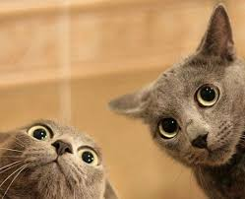
？？？

Slide 20
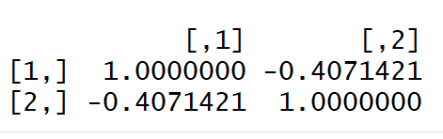
Appendix
Correlation between Age and Sterilized

Slide 21
