Slide 1
A market research study Alice Xiong
Principal component analysis
Factor analysis

Slide 2
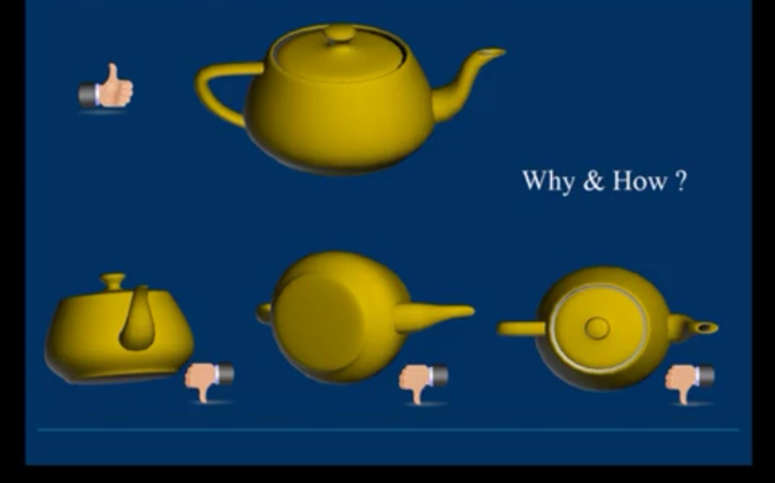
Which one give you the best summarized information?

Slide 3
Introduction to PCA
Technique quite old: Pearson (1901) and Hotelling (1933), but still one of the most used multivariate techniques today
Main idea:
Start with variables X1, . . . , Xp
Find a rotation of these variables, say Y1, . . . , Yp (called principal components), so that:
- Y1, . . . , Yp are uncorrelated
- Var (Y1)≥ Var (Y2)≥ . . . Var (Y1)

Slide 4
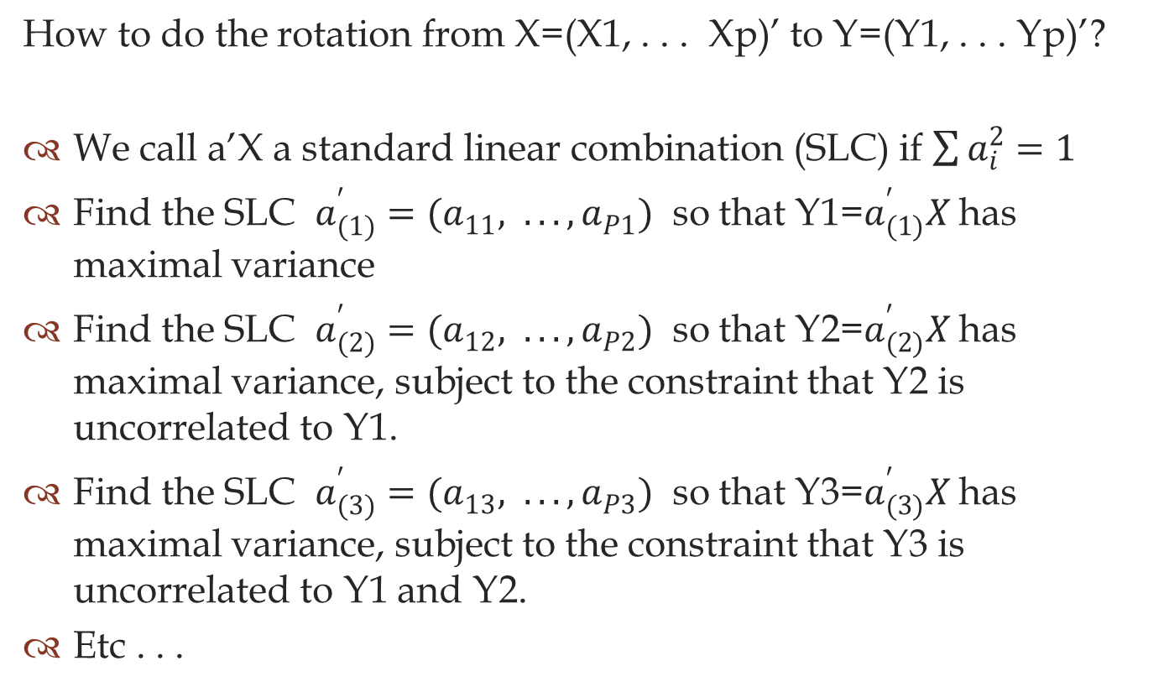
Definition of PCA
How to do the rotation from X=(X1, . . . Xp)’ to Y=(Y1, . . . Yp)’?
We call a’X a standard linear combination (SLC) if $\sum{a_{i}^{2}=1}$
Find the SLC $a_{(1)}^{′}=(a_{11}^{}, . . . , a_{P1}^{})$ so that Y1=$a_{(1)}^{′}X$ has maximal variance
Find the SLC $a_{(2)}^{′}=(a_{12}^{}, . . . , a_{P2}^{})$ so that Y2=$a_{(2)}^{′}X$ has maximal variance, subject to the constraint that Y2 is uncorrelated to Y1.
Find the SLC $a_{(3)}^{′}=(a_{13}^{}, . . . , a_{P3}^{})$ so that Y3=$a_{(3)}^{′}X$ has maximal variance, subject to the constraint that Y3 is uncorrelated to Y1 and Y2.
Etc . . .

Slide 5
Possible use of PCA
Interest in first principal component:
Usually some kind of average of the measurements
Interest in 2nd principal components:
Give important information about the remaining
pattern
Interest in first few principal components:
Dimension reduction (losing as litter information as
possible)
Use PCA as input for regression analysis:
Replace highly correlated explanatory variables by their
principal components

Slide 6
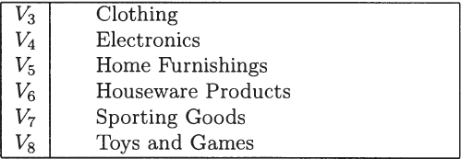
Programming example display

Slide 7
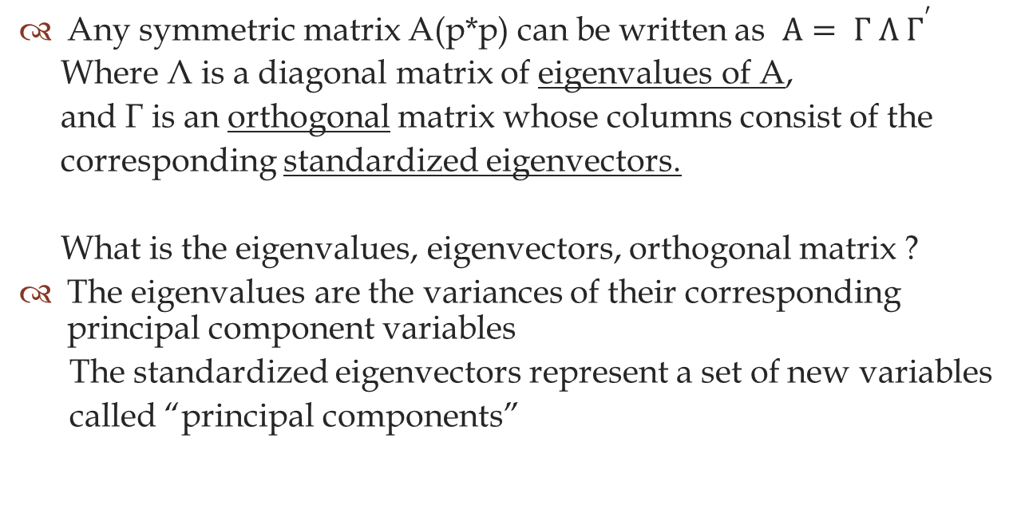
PCA Algorithm (or algebra review)
Any symmetric matrix A(p*p) can be written as $A= Γ Λ Γ^{′}$
Where Λ is a diagonal matrix of eigenvalues of A,
and Γ is an orthogonal matrix whose columns consist of the
corresponding standardized eigenvectors.
What is the eigenvalues, eigenvectors, orthogonal matrix ?
The eigenvalues are the variances of their corresponding principal component variables
The standardized eigenvectors represent a set of new variables
called “principal components”

Slide 8
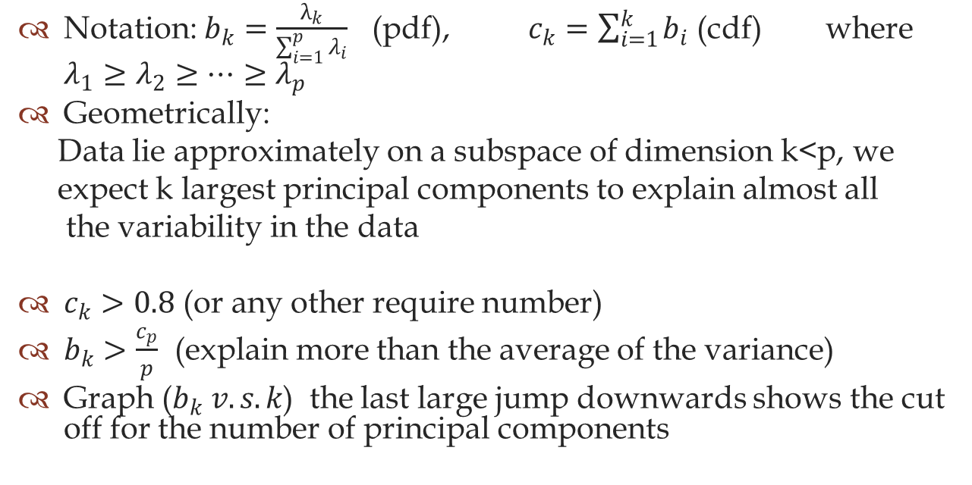
How many variables to choose to put in the model?
Notation: $b_{k}=\frac{λ_{k}}{\sum_{i=1}^{p}{λ_{i}}}$ (pdf), $c_{k}=\sum_{i=1}^{k}{b_{i}}$ (cdf) where $λ_{1}≥λ_{2}≥…≥λ_{p}$
Geometrically:
Data lie approximately on a subspace of dimension k<p, we
expect k largest principal components to explain almost all
the variability in the data
$c_{k}>0.8$ (or any other require number)
$b_{k}>\frac{c_{p}}{p}$ (explain more than the average of the variance)
Graph ($b_{k} v.s. k$) the last large jump downwards shows the cut off for the number of principal components

Slide 9
Some limitations of PCA
We only consider orthogonal transformations of the original variables
Dimension reduction can only be achieved if the original variables were correlated.
PCA is not scale invariant.
PCA is based only on the mean vector and the covariance matrix of the data, which is sensitive to outliers.

Slide 10
Review of factor analysis
Multiple linear regression model:
X= λ f+u
Where f is a random vetor with zero mean and covariance
matrix equal to Ip (identity)
λ ij=covariance of variable X and factor f
x1 = λ11f1 + · · · + λ1kfk + u1
x2 = λ21f1 + · · · + λ2kfk + u2
.
xp = λp1f1 + · · · + λpkfk + up
express the observed variables x1, …, xp as linear combinations of a few unknown quantities called factors f1, …, fk (k < p), with some added noise.

Slide 11
Why factor analysis?
In social sciences (e.g. psychology), it is often not possible to measure the variables of interest directly. (e.g. Intelligence, social class, called common factors )
Examine such variables indirectly, by measuring variables that can be measured (observed variables) and that are believed to be indicators of the common factors
Goal: study the relationship between common factors and observed variables

Slide 12
Assumption for the model: X= λ f+u
E(x)=0 (if this is not the case, simply substract the mean vector)
E(f)=0, cov(f)=I
E(u)=0, error i.i.d. cov(ui, uj)=0 for i≠j
Cov(f, u)=0 factor and error are uncorrelated

Slide 13
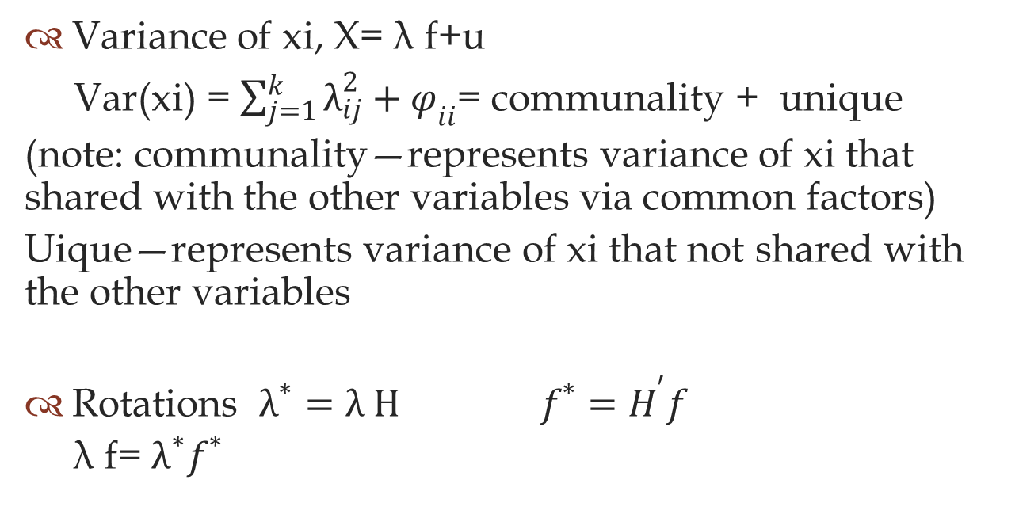
Factor Analysis Algorithm (or algebra review)
Variance of xi, X= λ f+u
Var(xi) = $\sum_{j=1}^{k}{λ_{ij}^{2}}+φ_{ii}$= communality + unique
(note: communality—represents variance of xi that shared with the other variables via common factors)
Uique—represents variance of xi that not shared with the other variables
Rotations $λ^{∗}=λ H f^{∗}=H^{′}f$
λ f= $λ^{∗}f^{∗}$

Slide 14
Is it a good idea to do such roations?
Pros: one can keep rotating the factors until one finds an interpretation that one likes
Cons: factor rotation does not change the overall structure of a solution. It only changes how the solution is described, and finds the simplest description

Slide 15
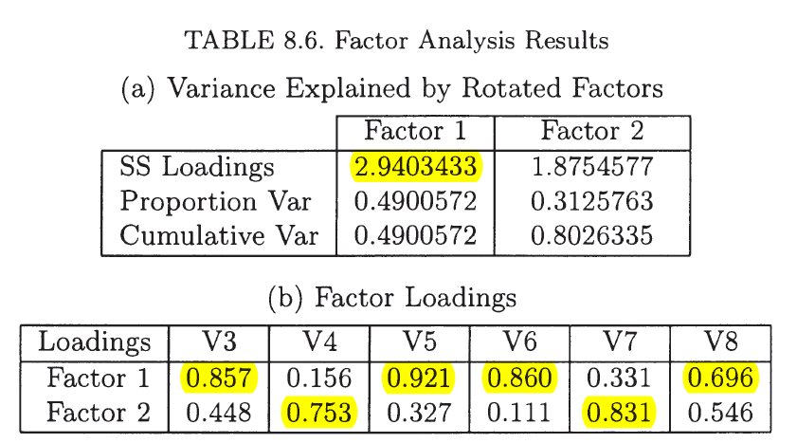
Programming example display

Slide 16
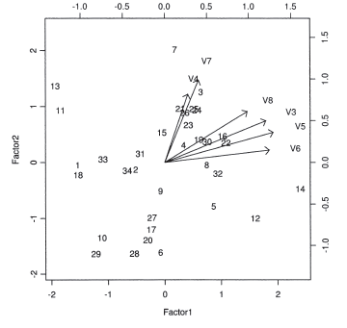

Slide 17
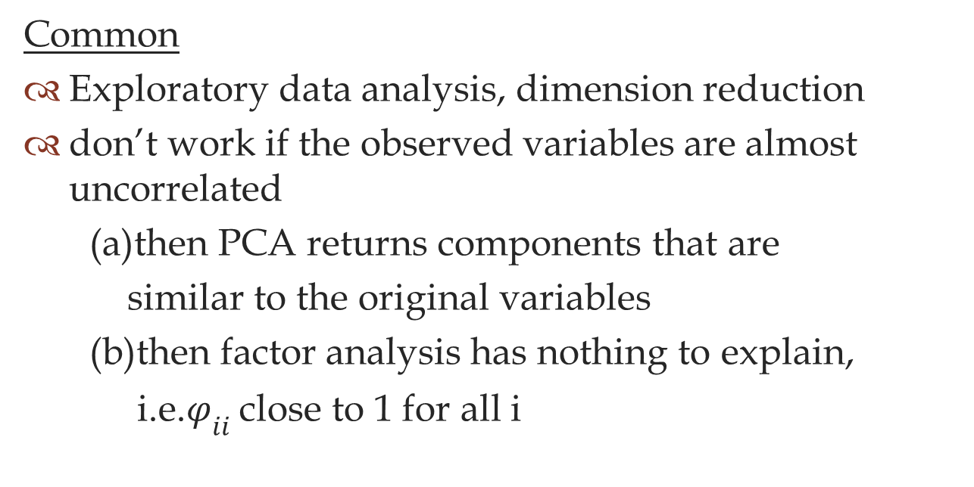
PCA v.s. Factor Analysis
Common
Exploratory data analysis, dimension reduction
don’t work if the observed variables are almost uncorrelated
(a)then PCA returns components that are
similar to the original variables
(b)then factor analysis has nothing to explain,
i.e.$φ_{ii}$ close to 1 for all i

Slide 18
PCA v.s. Factor Analysis (cont.)
Difference
PCA required virtually no assumptions
Factor analysis assumes the data come from a specific model
In PCA emphasis is on transforming observed variables to principle components
In factor analysis, emphasis is on transforming observed variables to common factors
PCA is not scale invariant.
Factor analysis (with MLE) is scale invariant.
In PCA, considering k+1 instead of k components does not change the firs k components
In factor analysis, considering k+1 instead of k factors may change the first k factors (when using MLE method)
Calculation of PCA scores is straightforward.
Calculation of factor scores is more complex.

Slide 19

Thank You

