Slide 1
CST8917 Serverless Applications
Final Project:
Dual Implementation of an
Expense Approval Workflow
Version A: Azure Durable Functions
Version B: Logic Apps
Alice Yang
Winter 2026
Notes:
Hi everyone, I'm Alice. For my final project, I built a serverless expense approval pipeline using two different architectures to compare a code-first approach against a visual, declarative approach.

Slide 2
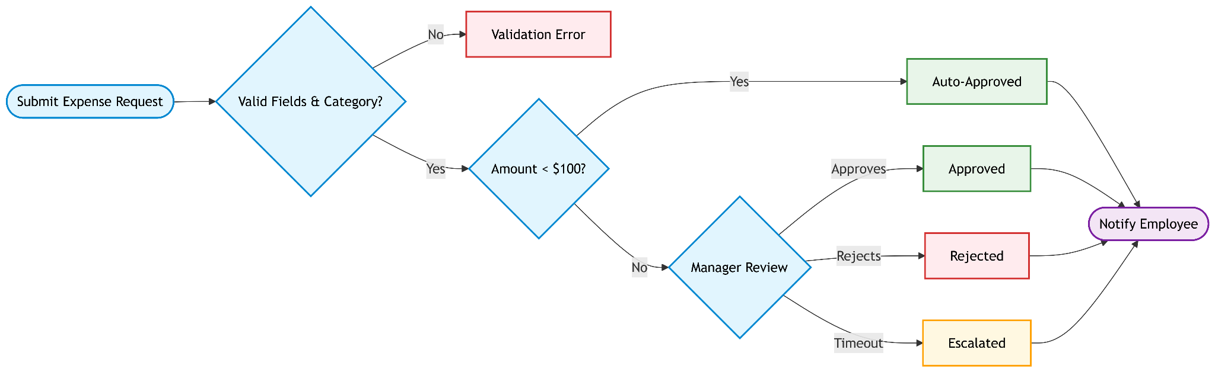
Introduction
Validation Rules
Routing Rules
Notification
Required 6 fields
Valid categories: travel, meals,
supplies, equipment, software, other
Amount < $100 → Auto-Approved
Amount ≥ $100 → Manager Approval
Timeout → Escalated
Employee notified of all outcomes
Outcomes: Approved, Rejected, or Escalated (or Failed)
Notes:
This pipeline handles 6 business rules: field validation, category enforcement, auto-approval for low-value expenses, manager approval with a timeout/escalation path, and employee email notification for all outcomes. Both versions implement the exact same logic.

Slide 3
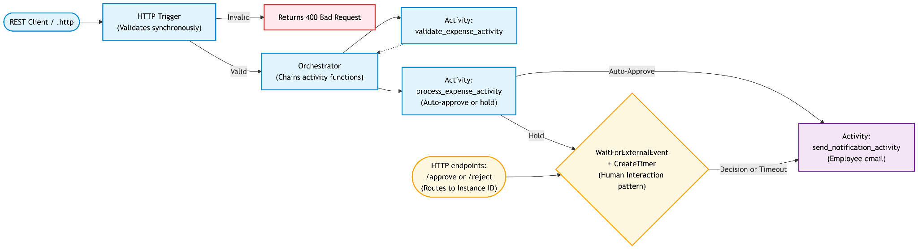
Version A: Azure Durable Functions
Key Design
“Human Interaction” Pattern
Validation happens in HTTP Trigger
Durable Timer for state management & external event handling
Orchestrator sleeps via WaitForExternalEvent
Durable Timer (CreateTimer) runs in parallel
Timeout → escalated outcome
Manager POSTs to endpoint to “Approve” or “Reject”
Notes:
Version A relies on Durable Functions. The biggest design choice was pulling validation into the HTTP Starter rather than the orchestrator, preventing silent background failures. The human interaction pattern uses WaitForExternalEvent alongside a CreateTimer — both run as parallel tasks.

Slide 4
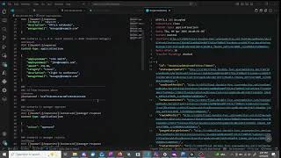
Version A: Azure Durable Functions
Notes:
Talk through the demo video: show a successful auto-approved run (< $100), the manager approval flow (≥ $100), the timeout/escalation scenario, and a validation error rejection.

Slide 5
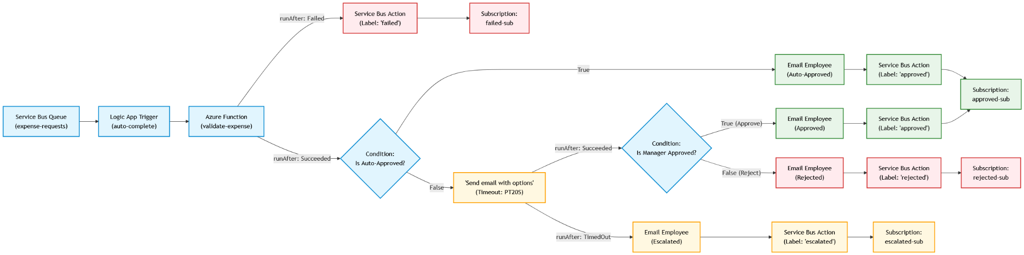
Version B: Logic Apps + Service Bus
Key Design
Service Bus Topic Subscriptions
Service Bus: decouples consumers from workflow
Outlook “Send email with options”: removes need for Durable Timer/state management
approved-sub
failed-sub
rejected-sub
escalated-sub
Notes:
Version B shifts to an event-driven model. The Logic App acts as the brain, pulling from a Service Bus Queue. The Python function handles pure validation math, and the human interaction is handled natively via the Outlook connector.

Slide 6
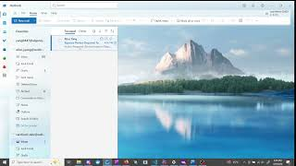
Version B: Logic Apps
Notes:
In this demo, show the Logic App visually routing a request. Highlight how the approved and failed messages are routed into separate Service Bus Subscriptions using SQL filters. Show the run history panel to illustrate the visual observability advantage.

Slide 7
Comparison: Development, Testability & Error Handling
Version A: Durable Functions
Version B: Logic Apps
Development
Experience
Code-first: Python
Full control over logic & state
Easy debugging via CLI & logs
Visual drag-and-drop workflow designer
Requires full live Azure infra deployment before testing
Testability
Full local E2E via VS Code:
Azurite
Azure Functions Core Tools.
SAS tokens needed for Service Bus conn
E2E untestable offline across Service Bus -> Logic Apps -> Function -> Storage Accounts
✓ WIN
Error
Handling
try/except blocks.
Custom RetryOptions with configurations
'Configure run after' state transitions.
Canvas clutters quickly with state handling actions
✓ WIN
Notes:
Version A wins on testability and error handling granularity. The biggest testing surprise for Version B was that 'low-code' doesn't mean 'easy to test' — triggering a Service Bus queue locally required writing a custom HMAC-SHA256 Python script just to generate a SAS token.

Slide 8
Comparison: Human Interaction, Observability & Cost
Version A: Durable Functions
Version B: Logic Apps
Human
Interaction
WaitForExternalEvent & Durable Timer
Req. HTTP endpoints to route Approve/Reject to instance ID.
'Send email with options' Outlook connector
Timeout set in action settings.
Zero custom UI needed.
✓ WIN
Observability
Relies on statusQueryGetUri polling & Application Insights.
Debugging failures req. Log Analytics queries or instance status API calls.
'Runs history': click any step to see inputs/outputs.
Instantly shows which branch was taken & which action succeeded/failed
✓ WIN
Estimated
Cost
100 expenses/day: $0.70
10K expenses/day: $12.64
Free grant under 1 mil calls
Mostly storage costs
100 expenses/day: $9.25
10K expenses/day: $243.76
Standard tier for Service Bus req. for Topics
Mostly fixed costs
✓ WIN
Notes:
Version B wins on human interaction and observability. The visual run history makes debugging state transitions effortless compared to parsing Application Insights logs. Cost-wise, Version A is cheaper at scale due to the Service Bus Standard tier fixed base cost in Version B.

Slide 9
Recommendation
✓ Version B: Logic Apps ✓
Rationale
When Version A?
Native 'Send email with options'
Visual run history enables observability
Service Bus: decoupled & event driven
~$13/mo Service Bus cost is negligible for complex business workflow
Require complex and custom logic
Fan-out/Fan-in
Local development/testing is required
Notes:
If building this for production, I recommend Version B. The decoupled Service Bus architecture allows us to easily add new consumers — like an external accounting system — just by adding a new topic subscription without ever modifying the Logic App itself.

Slide 10
Lessons Learned
Low-code ≠ Easy to test
Leverage connector ecosystem
01
02
Visual drag-and-drop hides auth layers underneath
Triggering Service Bus required SAS token
Full Azure infra had to be deployed first to test E2E
Version A:
Custom HTTP endpoints for human approval
Implement Graph API or SMTP for email handling
Version B:
‘Send email with options' Outlook connectors saved time on dev and is a friendly end-user experience.
Notes:
The biggest surprise was that 'low code' doesn't mean 'easy to test.' Moving forward, I would ensure infrastructure-as-code is fully deployed before attempting to build or debug Logic App triggers. I'd also plan for the determinism constraint in Durable Functions from the start.

