Slide 1
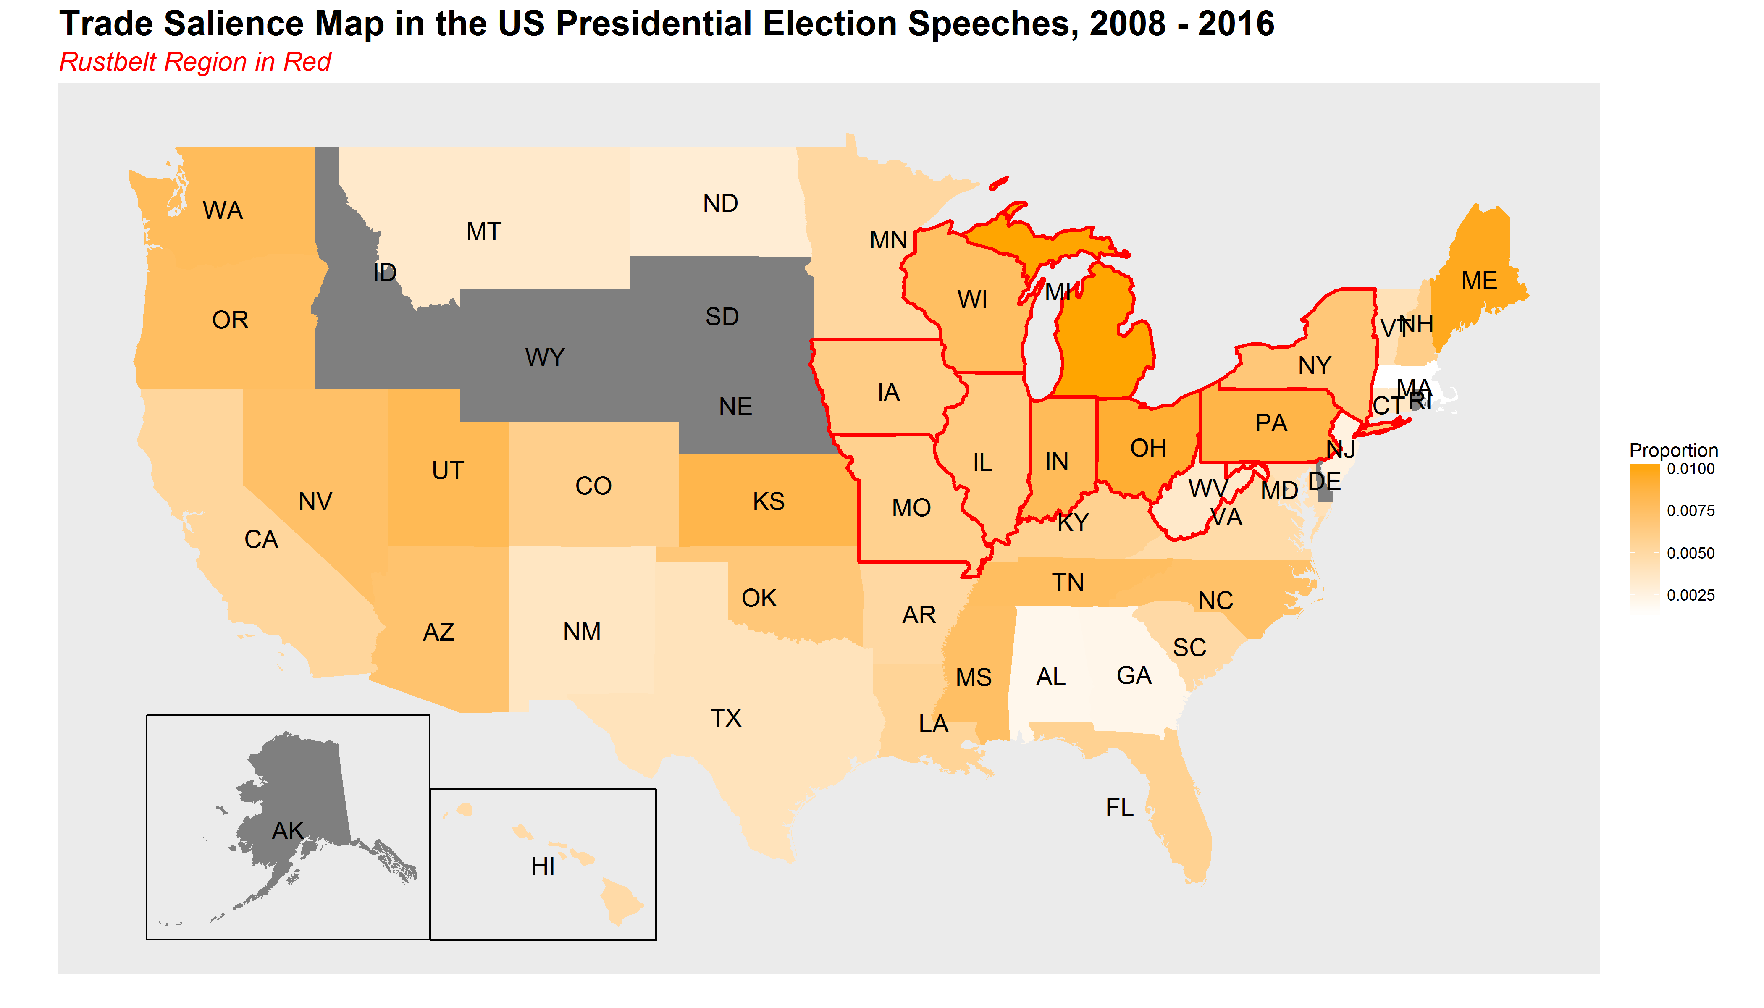
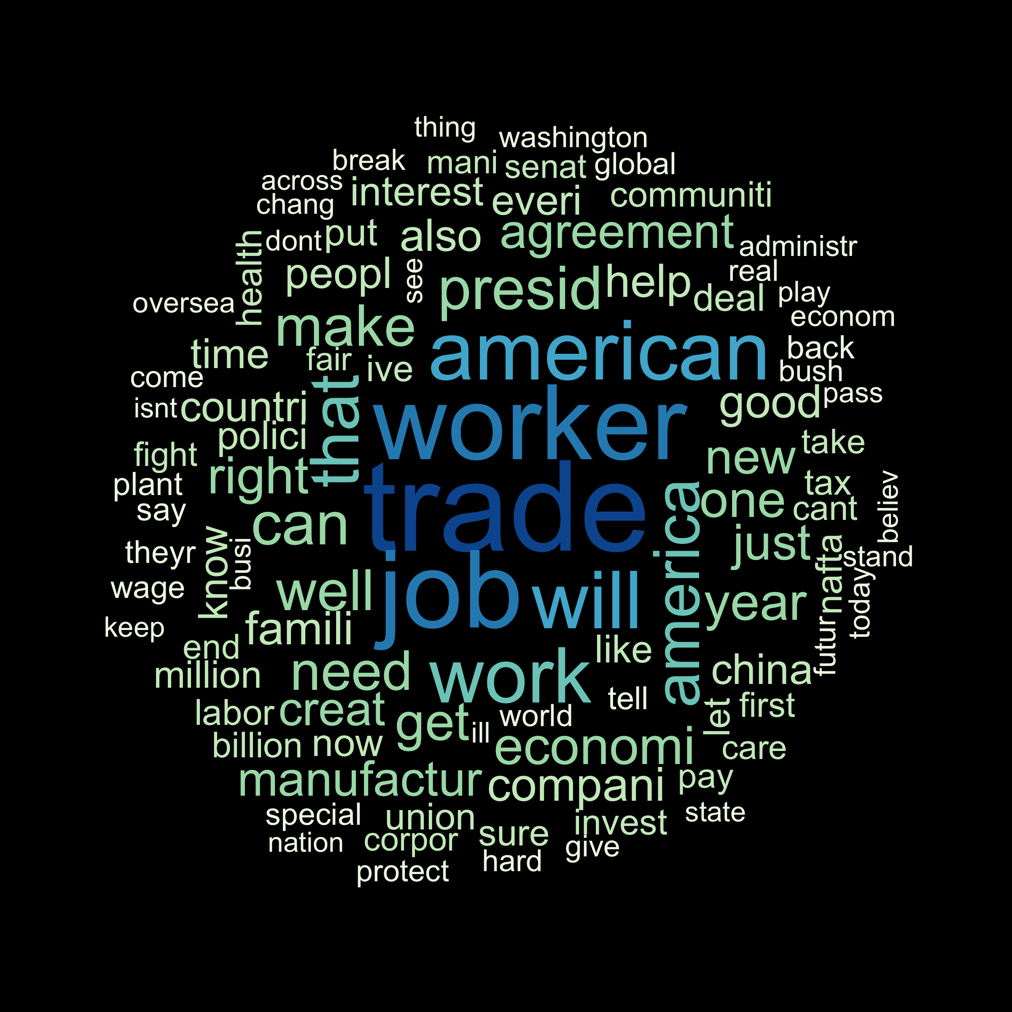
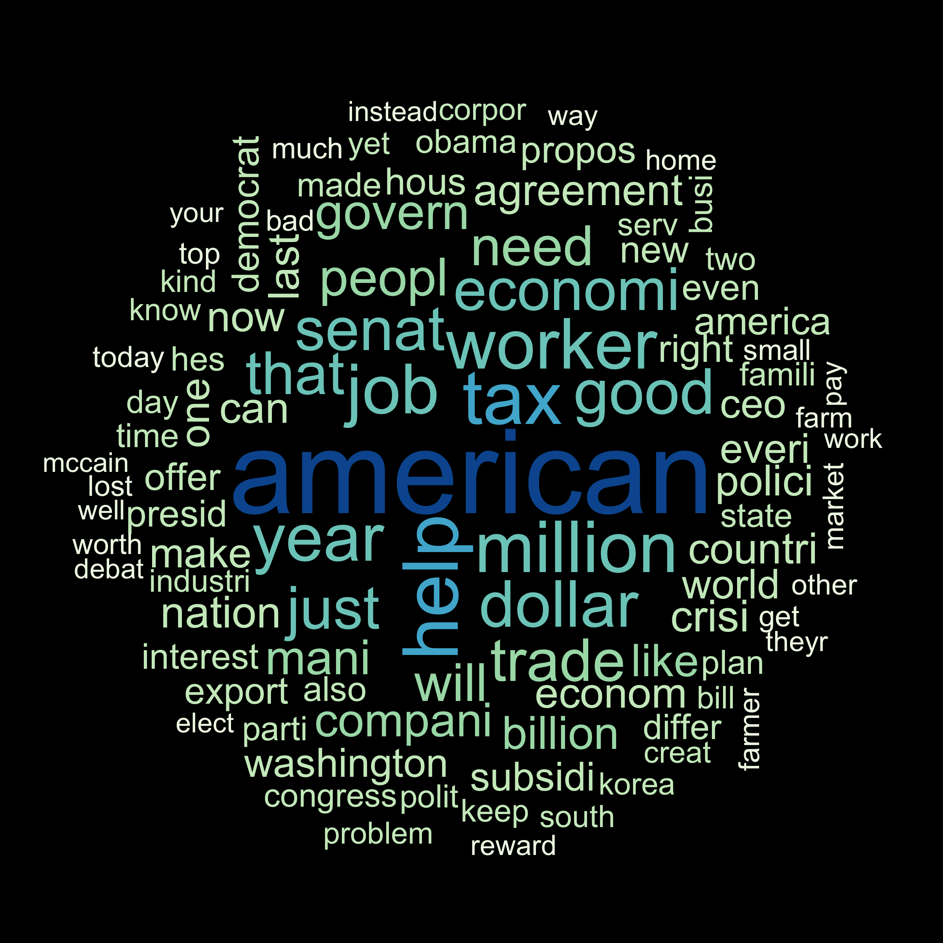
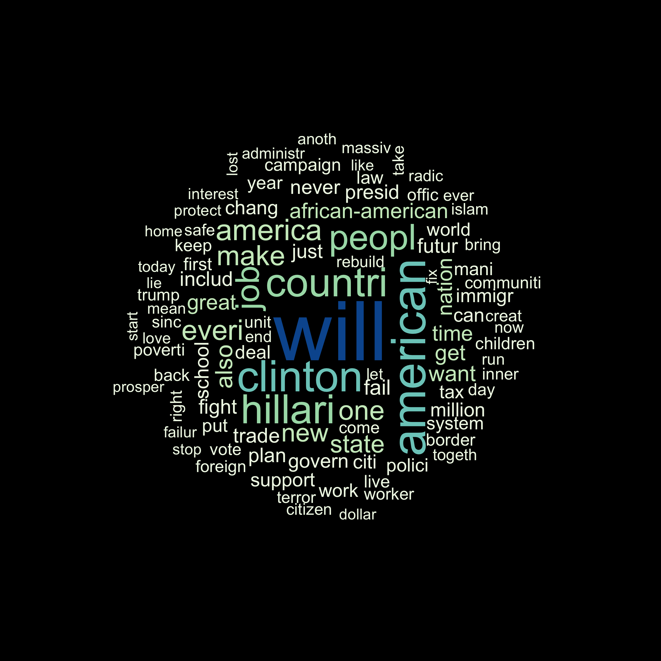
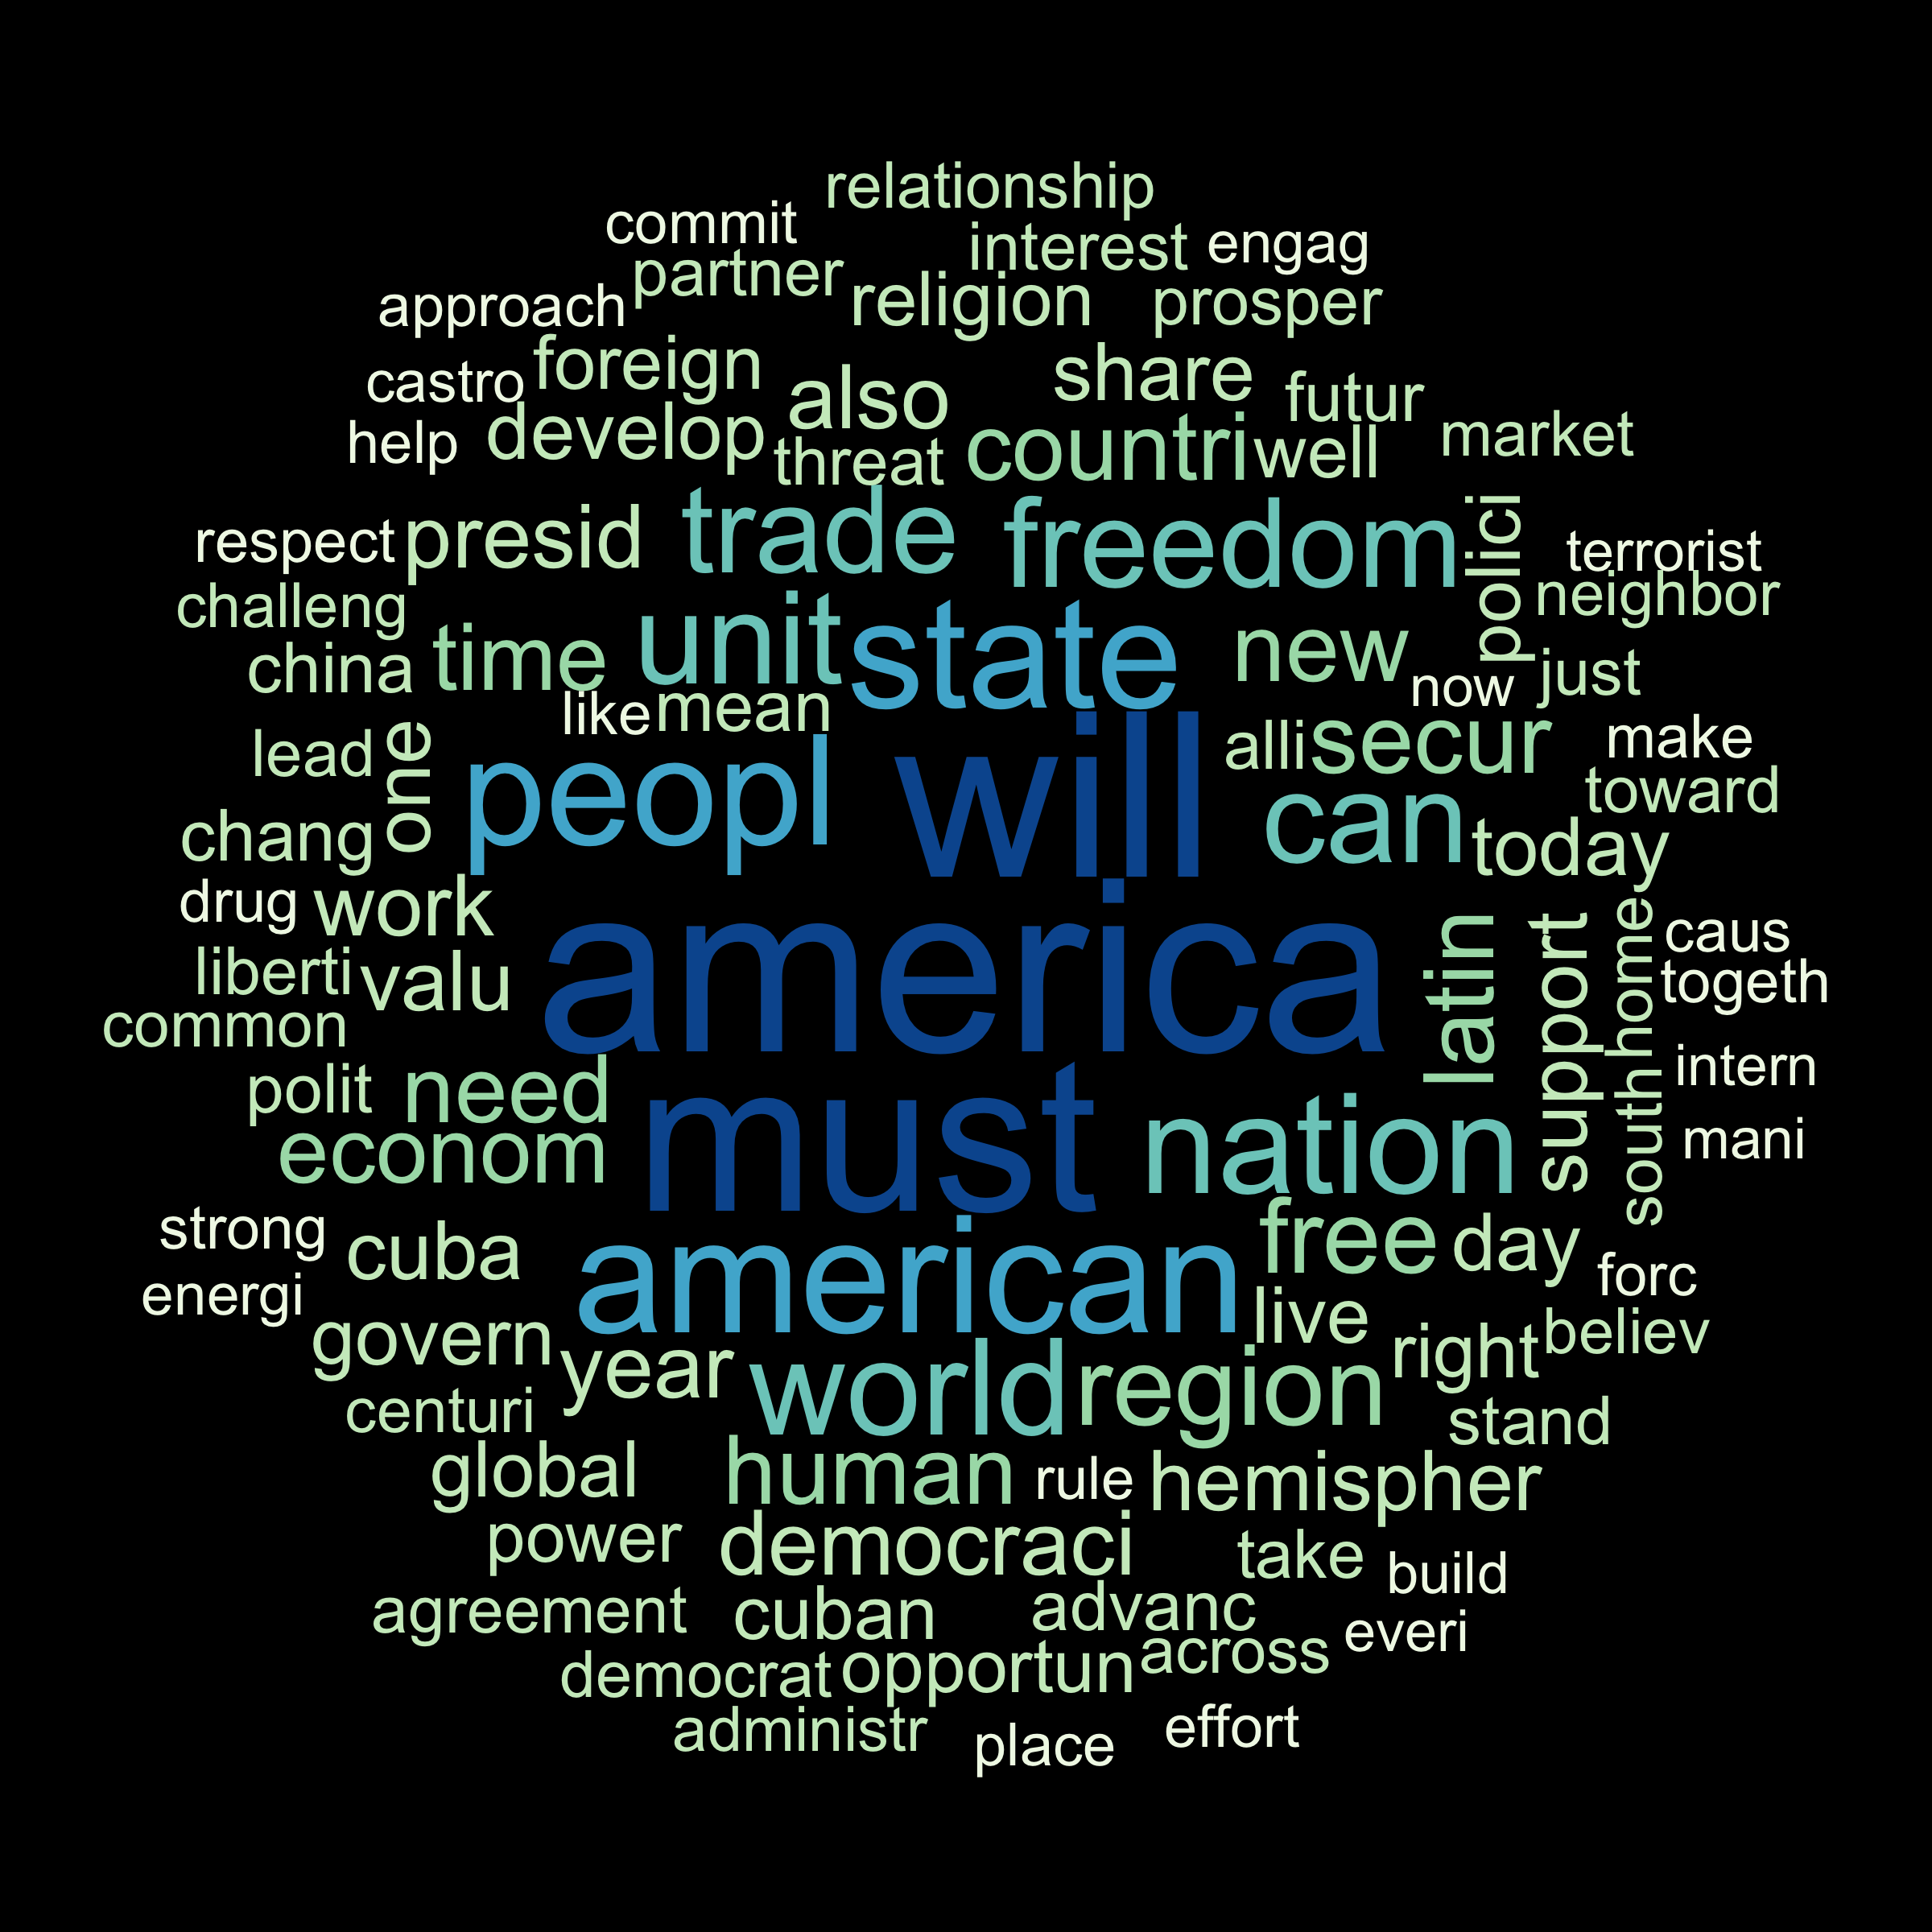
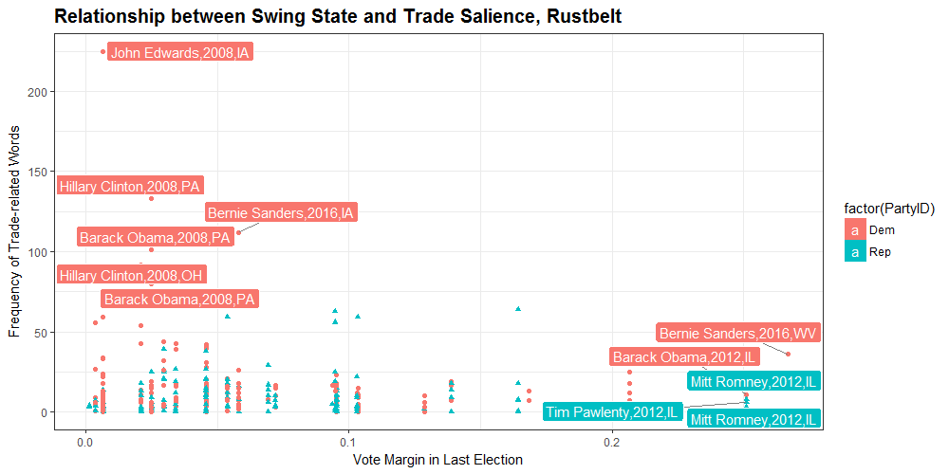
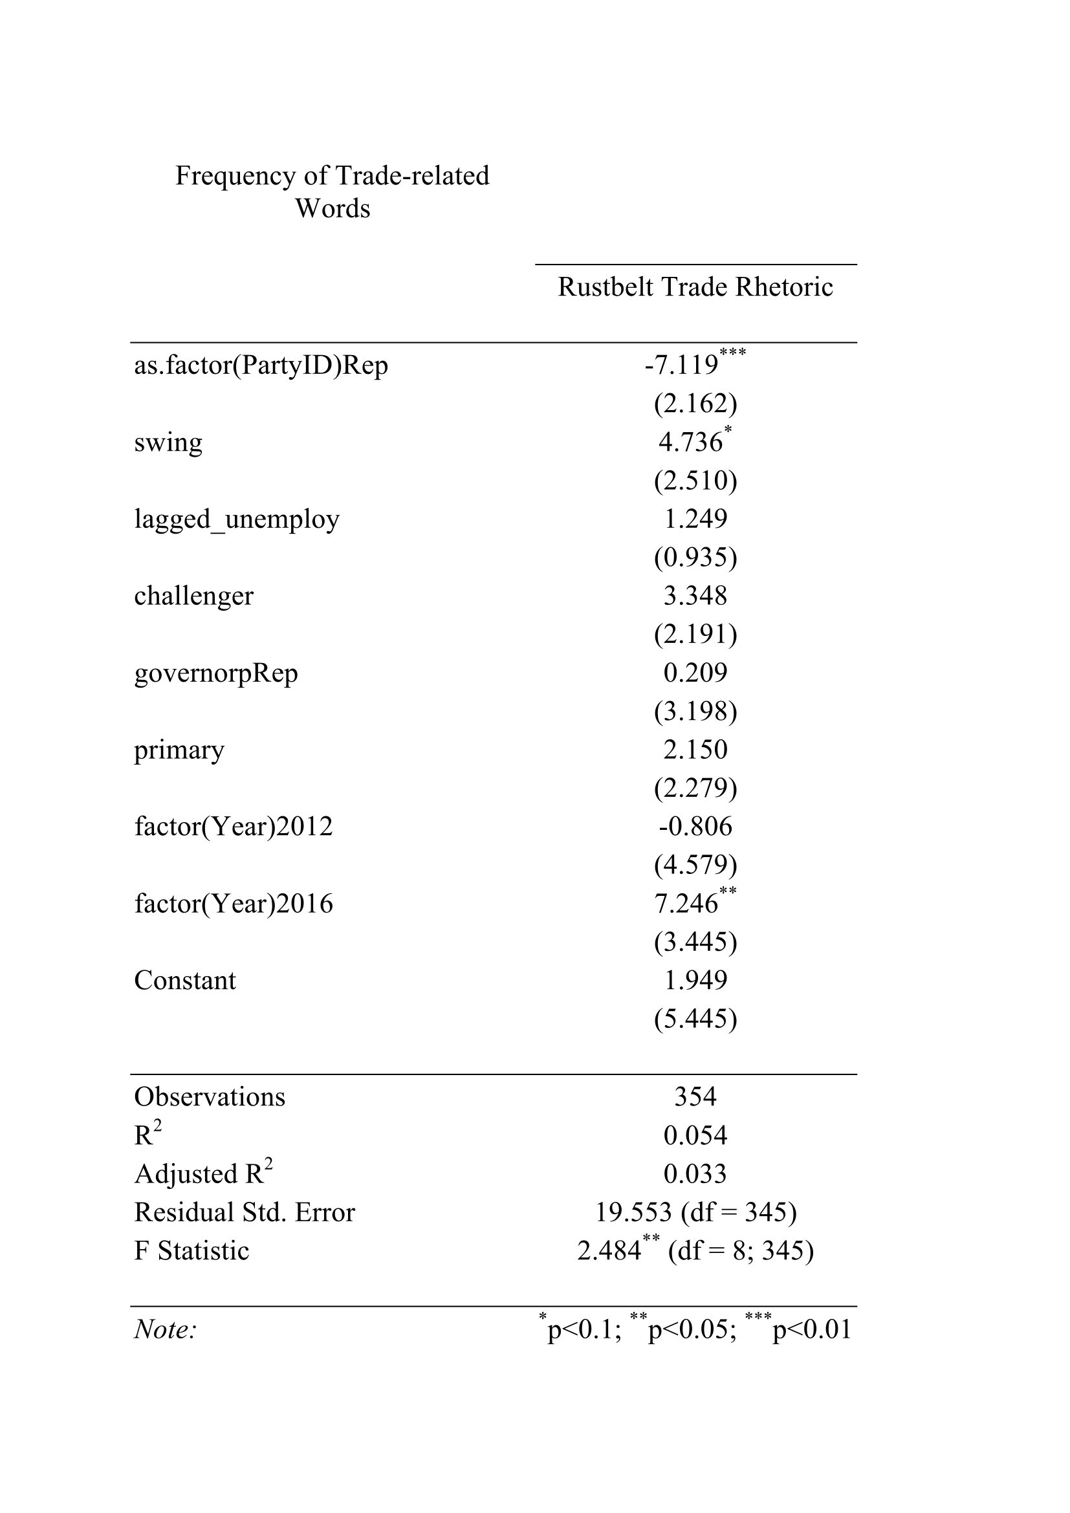
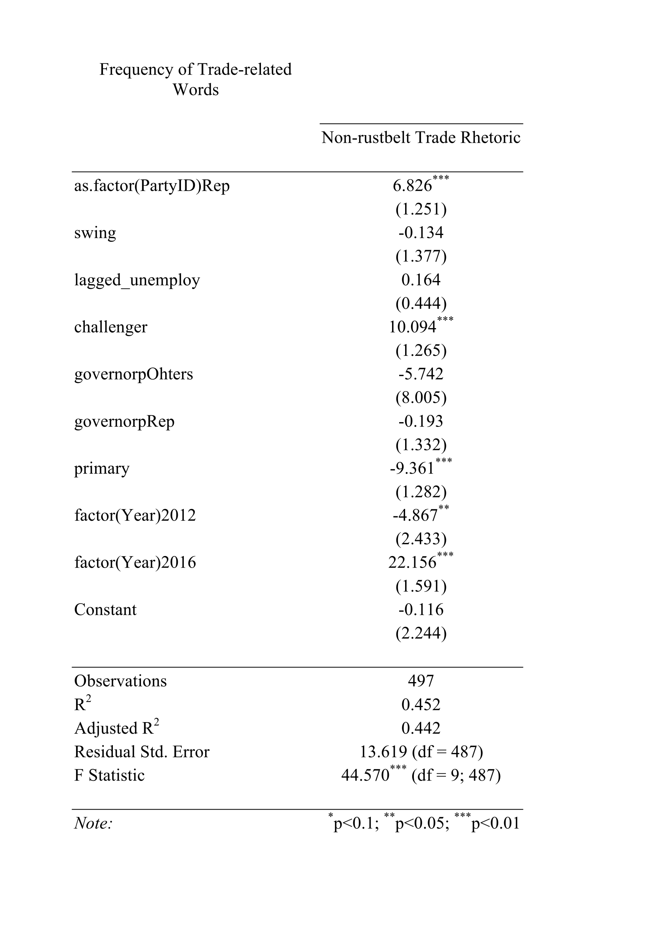
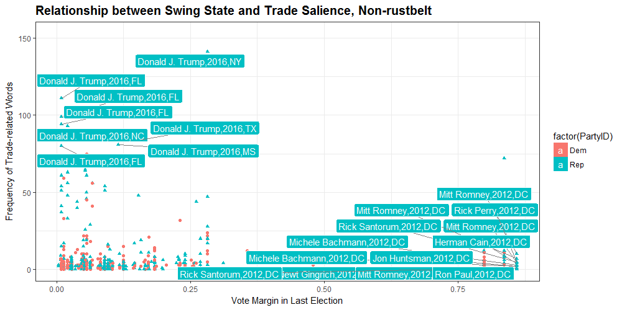
How do presidential candidates speak differently
about trade within rust belt regions?
Minju Kim(minjukim@uchicago.edu), Alice Mee Seon Chung(alicechung@uchicao.edu)
University of Chicago
Abstract / Background
Data / Data Structure
Graphs
Regression Results
Web scraping the presidential election speech of every candidates in 2008, 2012, and 2016 from The American Presidency Project(APP).
Descriptive Statistics
By party, by year
Rust map
Theory
Presidential candidates make campaign speeches considering the regional characteristics of the location where they delivery speech.
Methods
STM (Structural Topic modelling)
K=45 topics and extract 15 FREX words
Select the most trade-related topic from the results
DTM (Document Term Matrix)
Using 15 FREX words for each dimension, count the frequencies and scaled by each document length.
Regression Model
Dependent Variable:
Unigram frequency (of trade-related documents extracted from the stm, subset to rustbelt & swing state)
Independent Variable:
Partisanship of the author
Controls:
Year-fixed, state-level unemployment, candidate-fixed, candidate from incumbent party vs. opposing party, the partisan similarity of the author and the local governor (1= same, 0 = different)
Hypothesis
H1: Presidential candidates talk trade as an act of economic transactions in speeches of rust belt regions.
H2: Presidential candidates link trade with national security in speeches of non-rustbelt regions.
H3-1: Within rust belt regions, if the regions are swing states, presidential candidates talk more about threatened job security due to import competition.
H3-2: Within rust belt regions, if the regions are swing states, Democrats link threatened job security with domestic words (worker, manufactur, labor, plant, union) , while Republicans link threatened job security with foreign or international words (agreement, nafta, china, deal).
H4: Within non-rust belt regions, if the regions are swing states, presidential candidates talk more about threatened national security due to globalization.
Contribution/Conclusions

