Slide 1

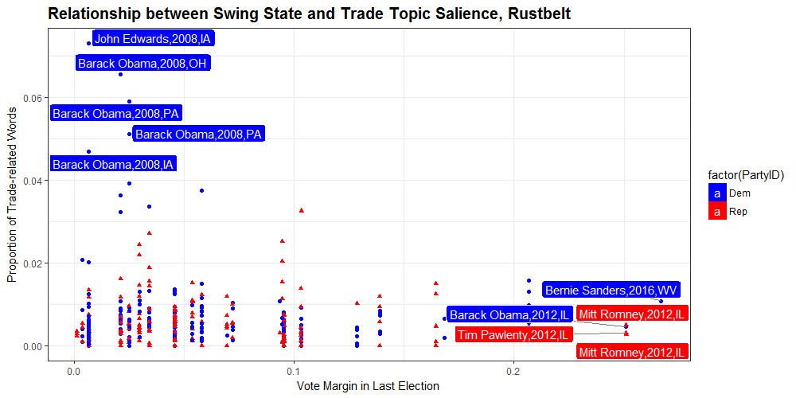
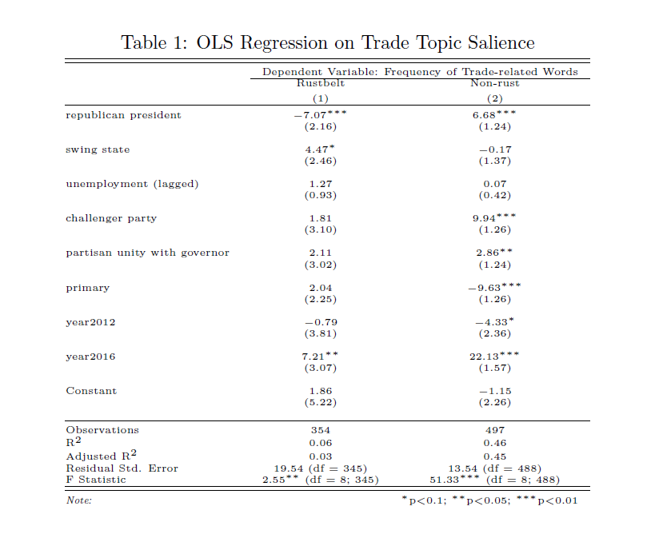
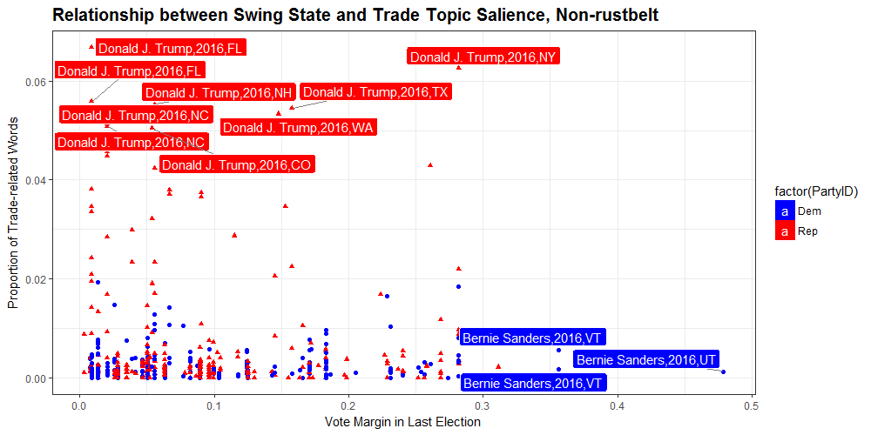
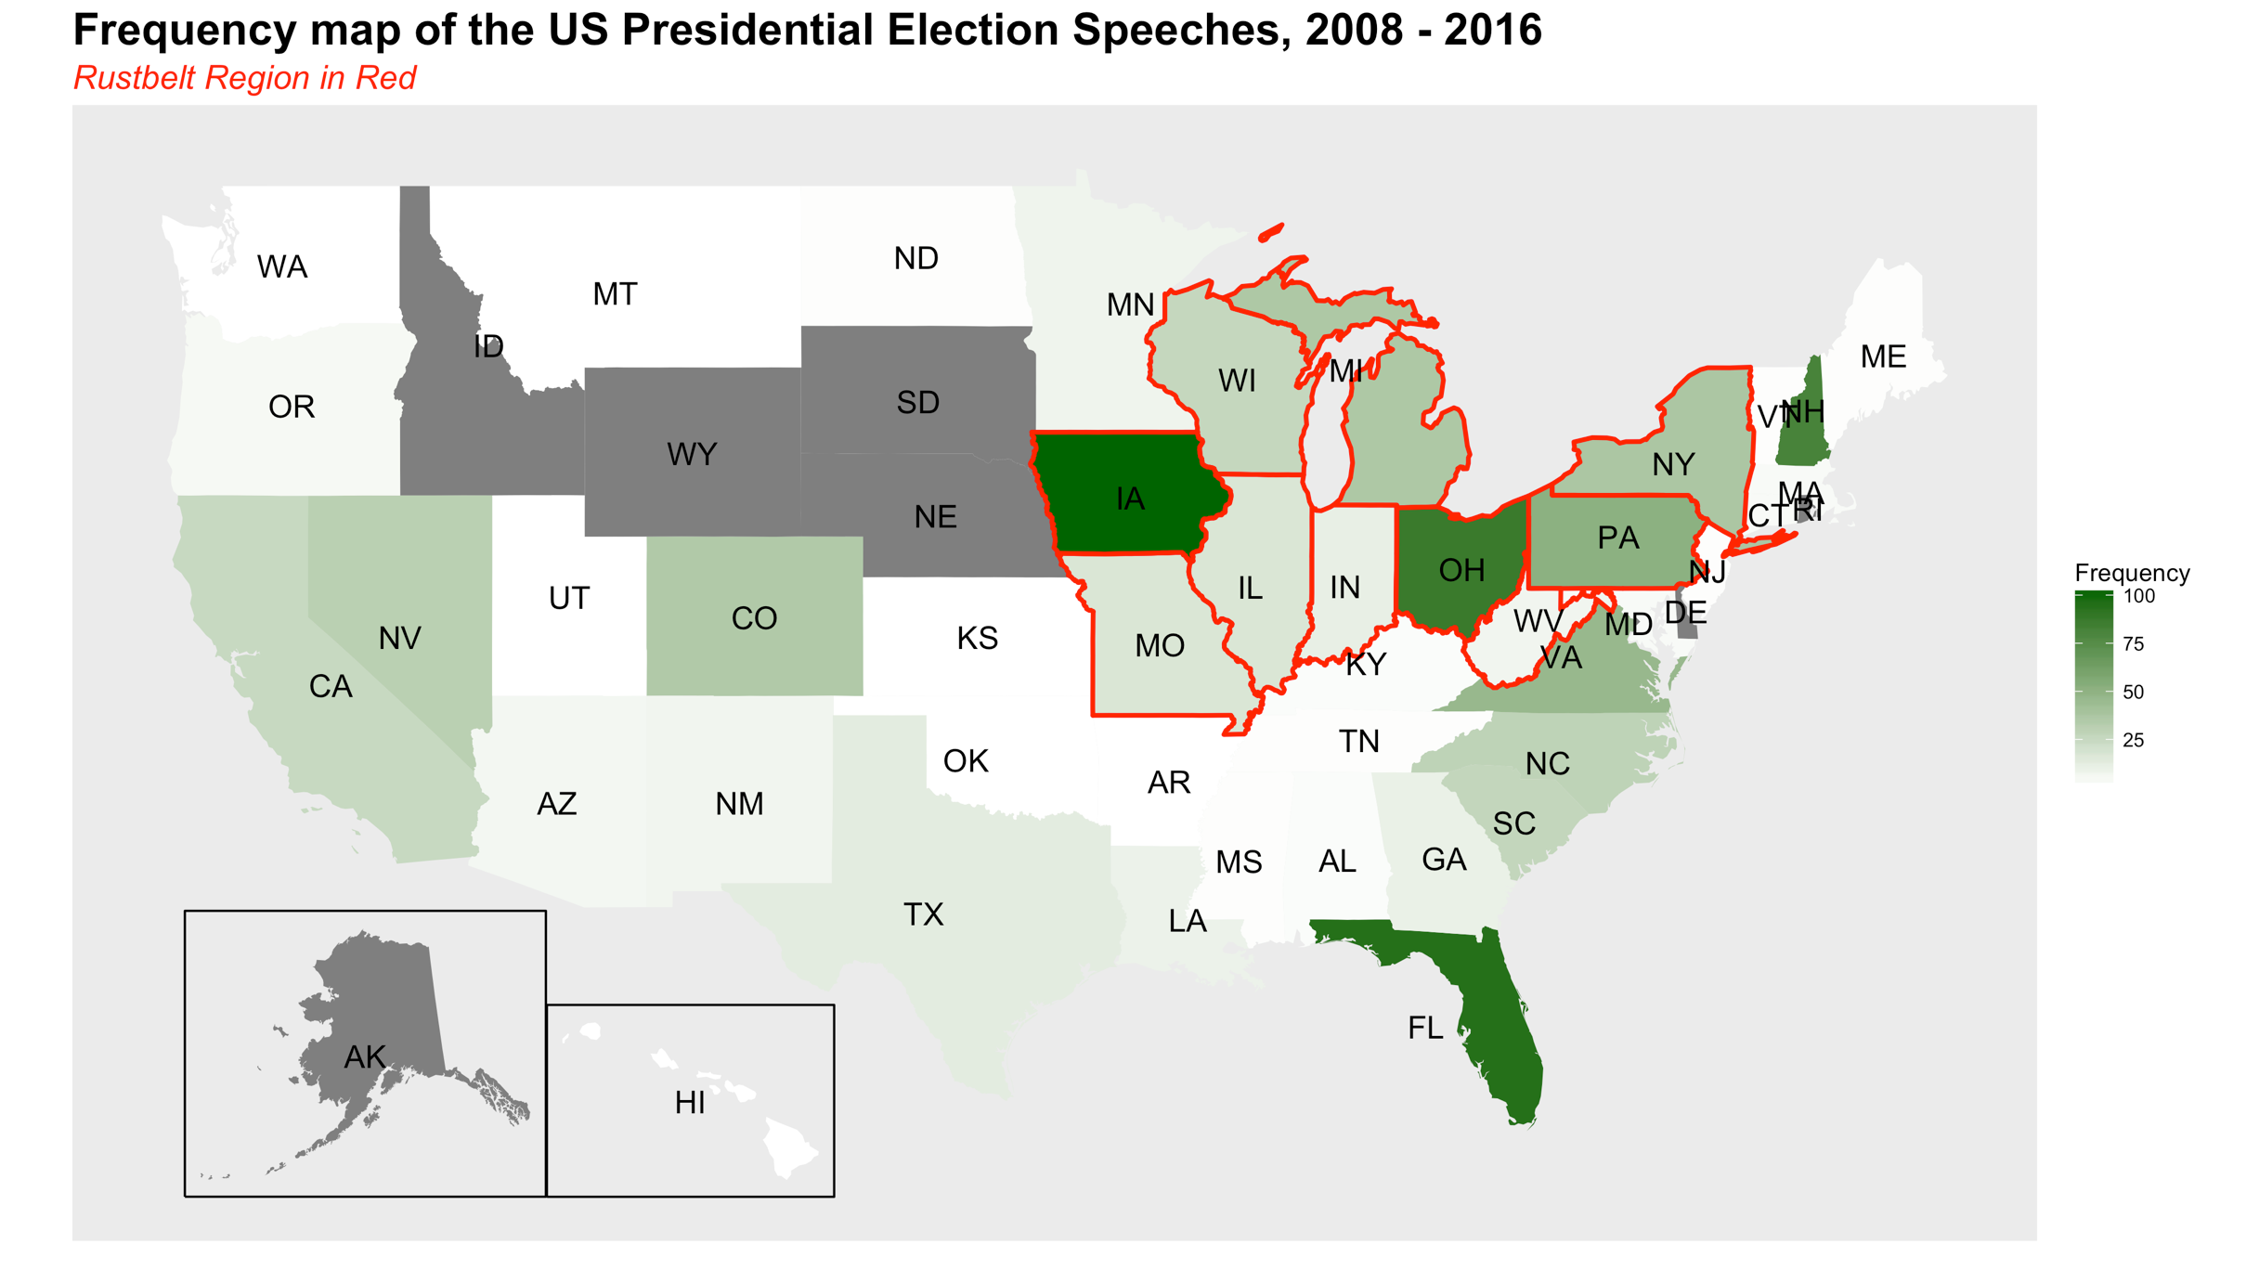
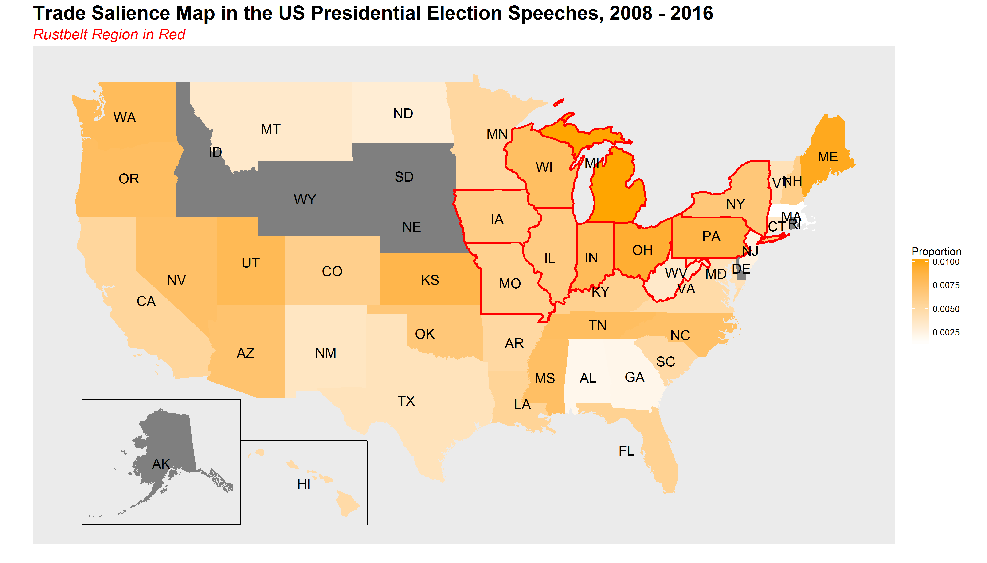
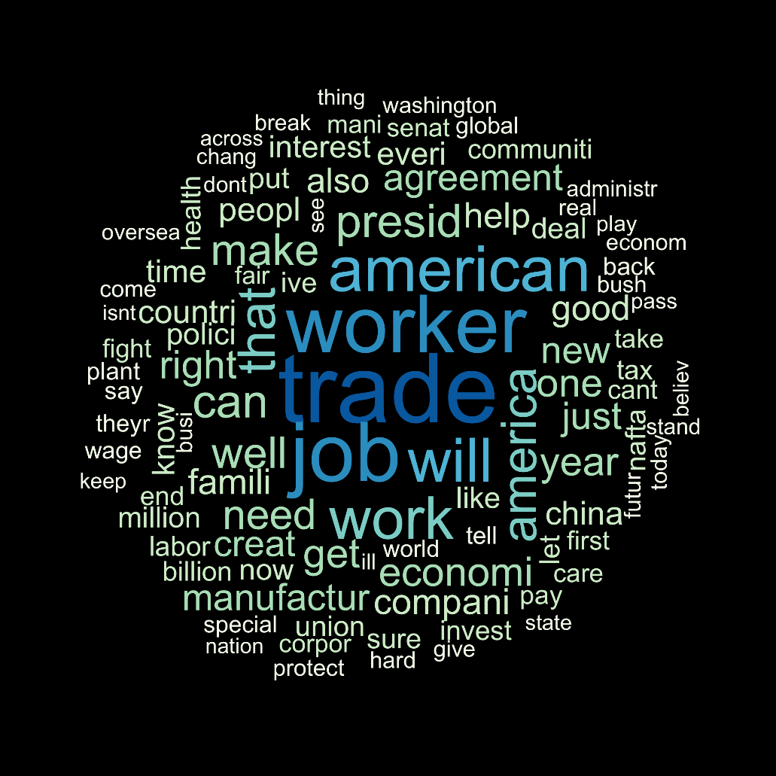
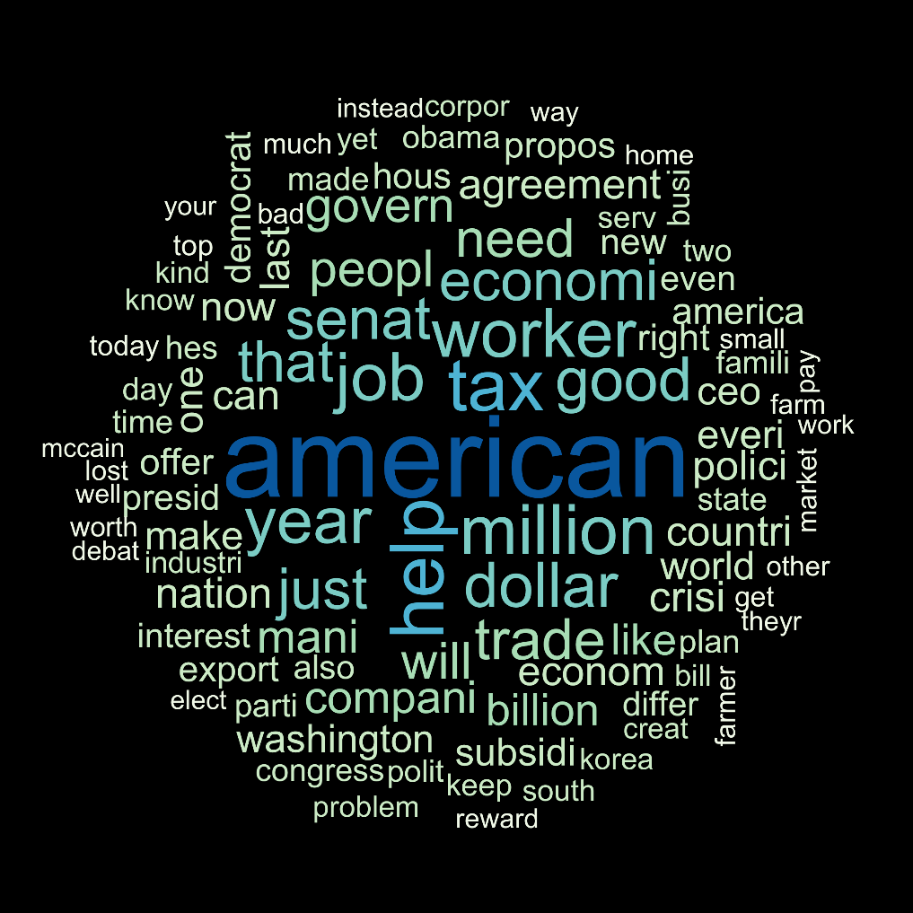
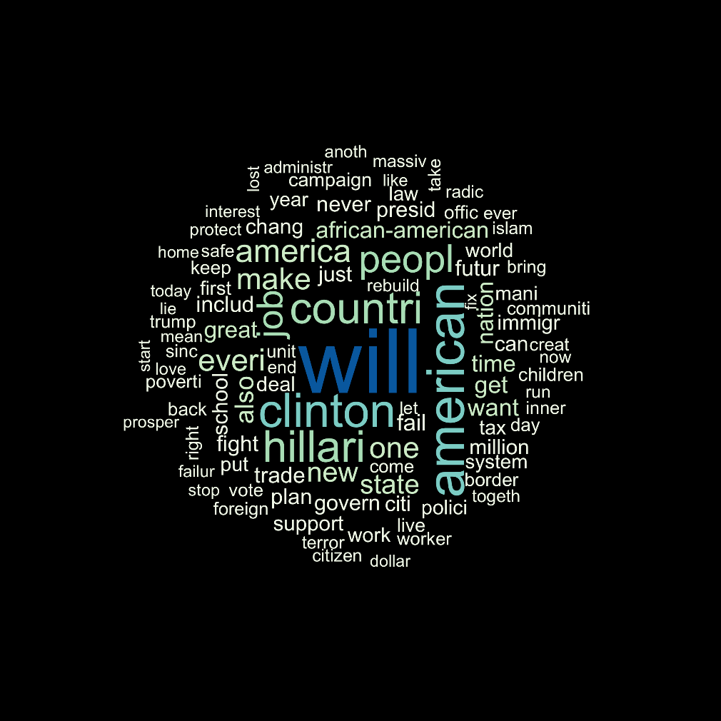
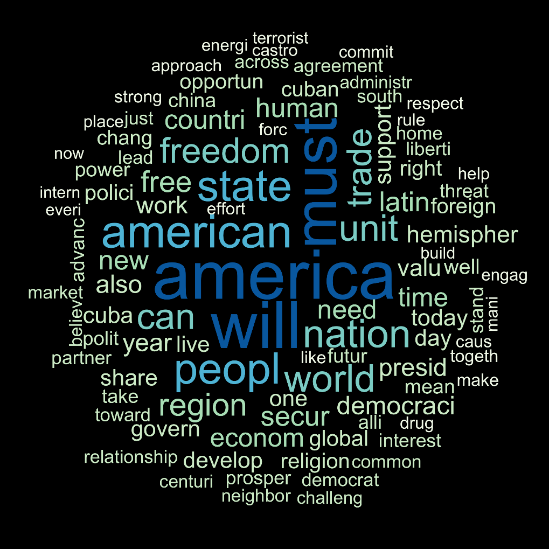
Trade Rhetoric Geography in the US Presidential Election Speeches
Alice Mee Seon Chung (alicechung@uchicago.edu), Computational Social Science
Minju Kim (minjukim@uchicago.edu), Department of Political Science
Research Question
Data / Data Structure
Graphs
Regression
Voters suffering from job insecurity due to international trade are known to punish the incumbent president by choosing the presidential candidate from the other political party (Jensen et al 2017; Margalit 2011).
Then, how would presidential candidates ex-ante respond to expected voter punishment in their presidential campaign speeches?
Web scraping the presidential election speech of every candidates in 2008, 2012, and 2016 from The American Presidency Project(APP).
Descriptive Statistics
Total 1,247 speeches
676 from Democratic Party, 571 from Republican Party
685, 282, 280 speeches in each year
Theory
Trade Topic Salience Map
Presidential candidates make campaign speeches considering the regional characteristics of the location where they delivery speech.
Word Cloud
Hypothesis
Methods
 | Swing | Non-swing
Rust belt
Non- Rust belt
H1: Presidential candidates frame trade as an economic activity in speeches of rust belt regions.
H2: Presidential candidates link trade with national security in speeches of non-rustbelt regions.
H3: Within rust belt regions, if the regions are swing states, presidential candidates frame trade as special interest by linking trade with job security.
STM (Structural Topic modelling)
K= 45 topics and extract 15 FREX words
DTM (Document Term Matrix)
With 15 FREX words for each dimension, counted the frequencies and scaled by each document length
OLS Regression
DV: Trade topic related 15 FREX words frequencies (Subset on rust belt and non-rust belt region)
IV: Political Party of the speaker
Controls: Year-fixed, state-level annual unemployment, speaker’s party status as a challenger, partisan similarity between the speaker and the local governor.
Conclusion
Presidential candidates ex-ante respond to expected voter punishment on trade through customizing different rhetoric by region.
The rhetoric varies by political party, with higher intensity in swing states.
While Democrats target rustbelt voters, Republicans target non-rustbelt voters in their usage of trade rhetoric.

