Slide 1
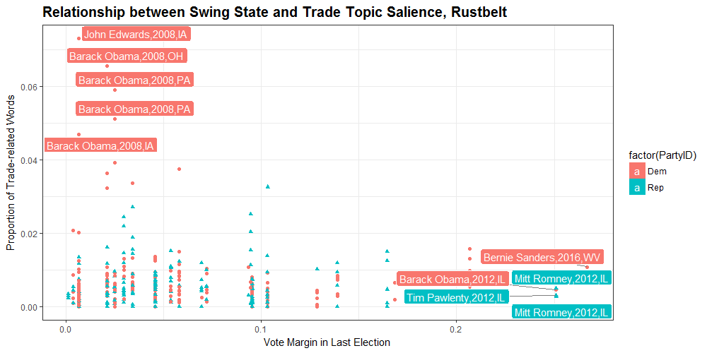
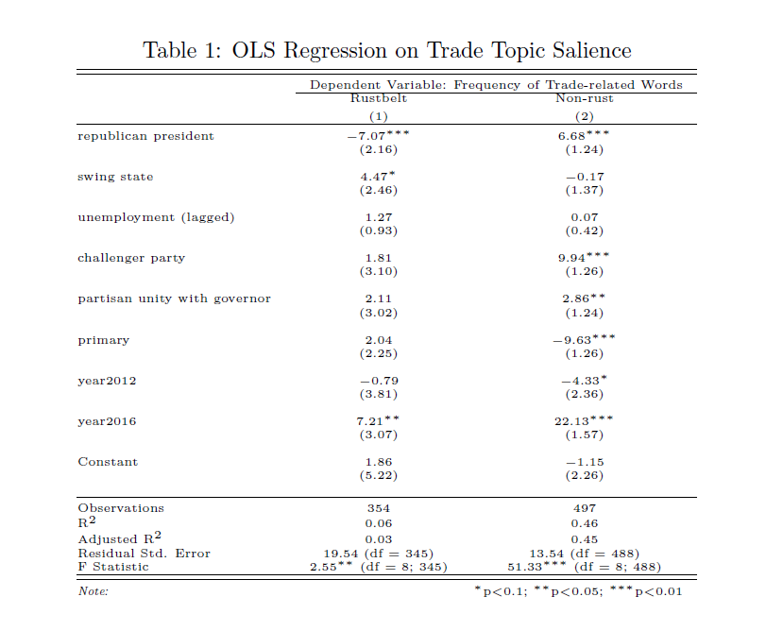
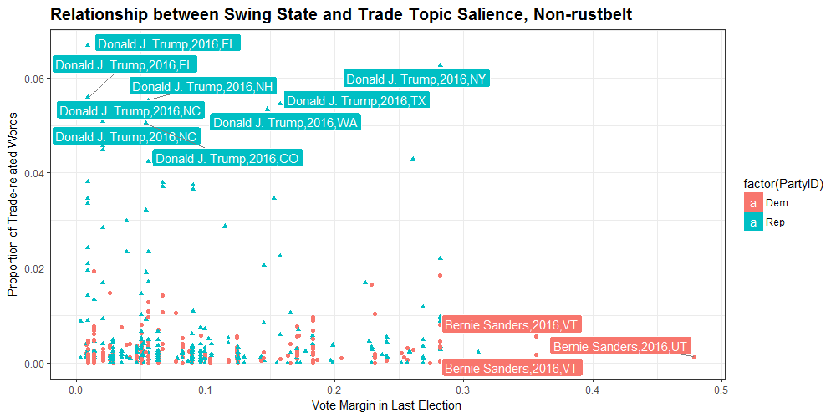
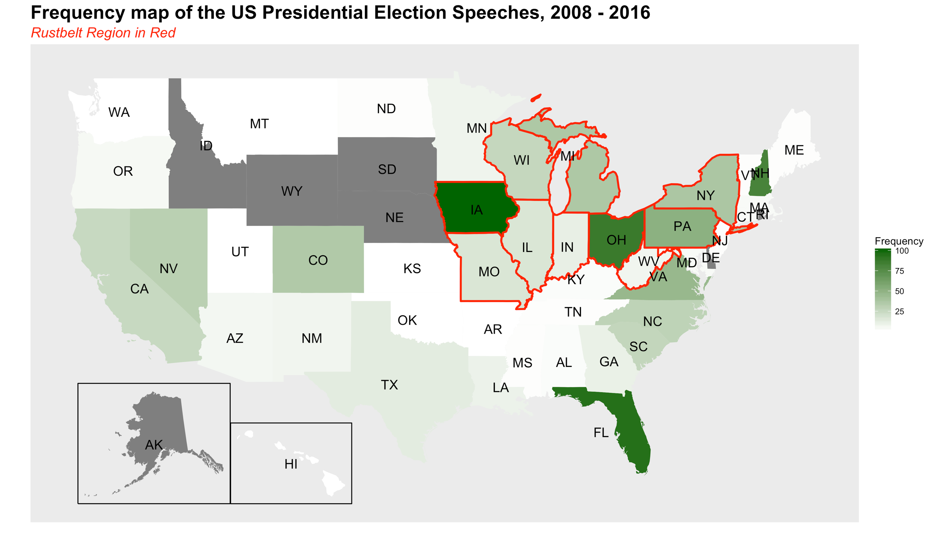
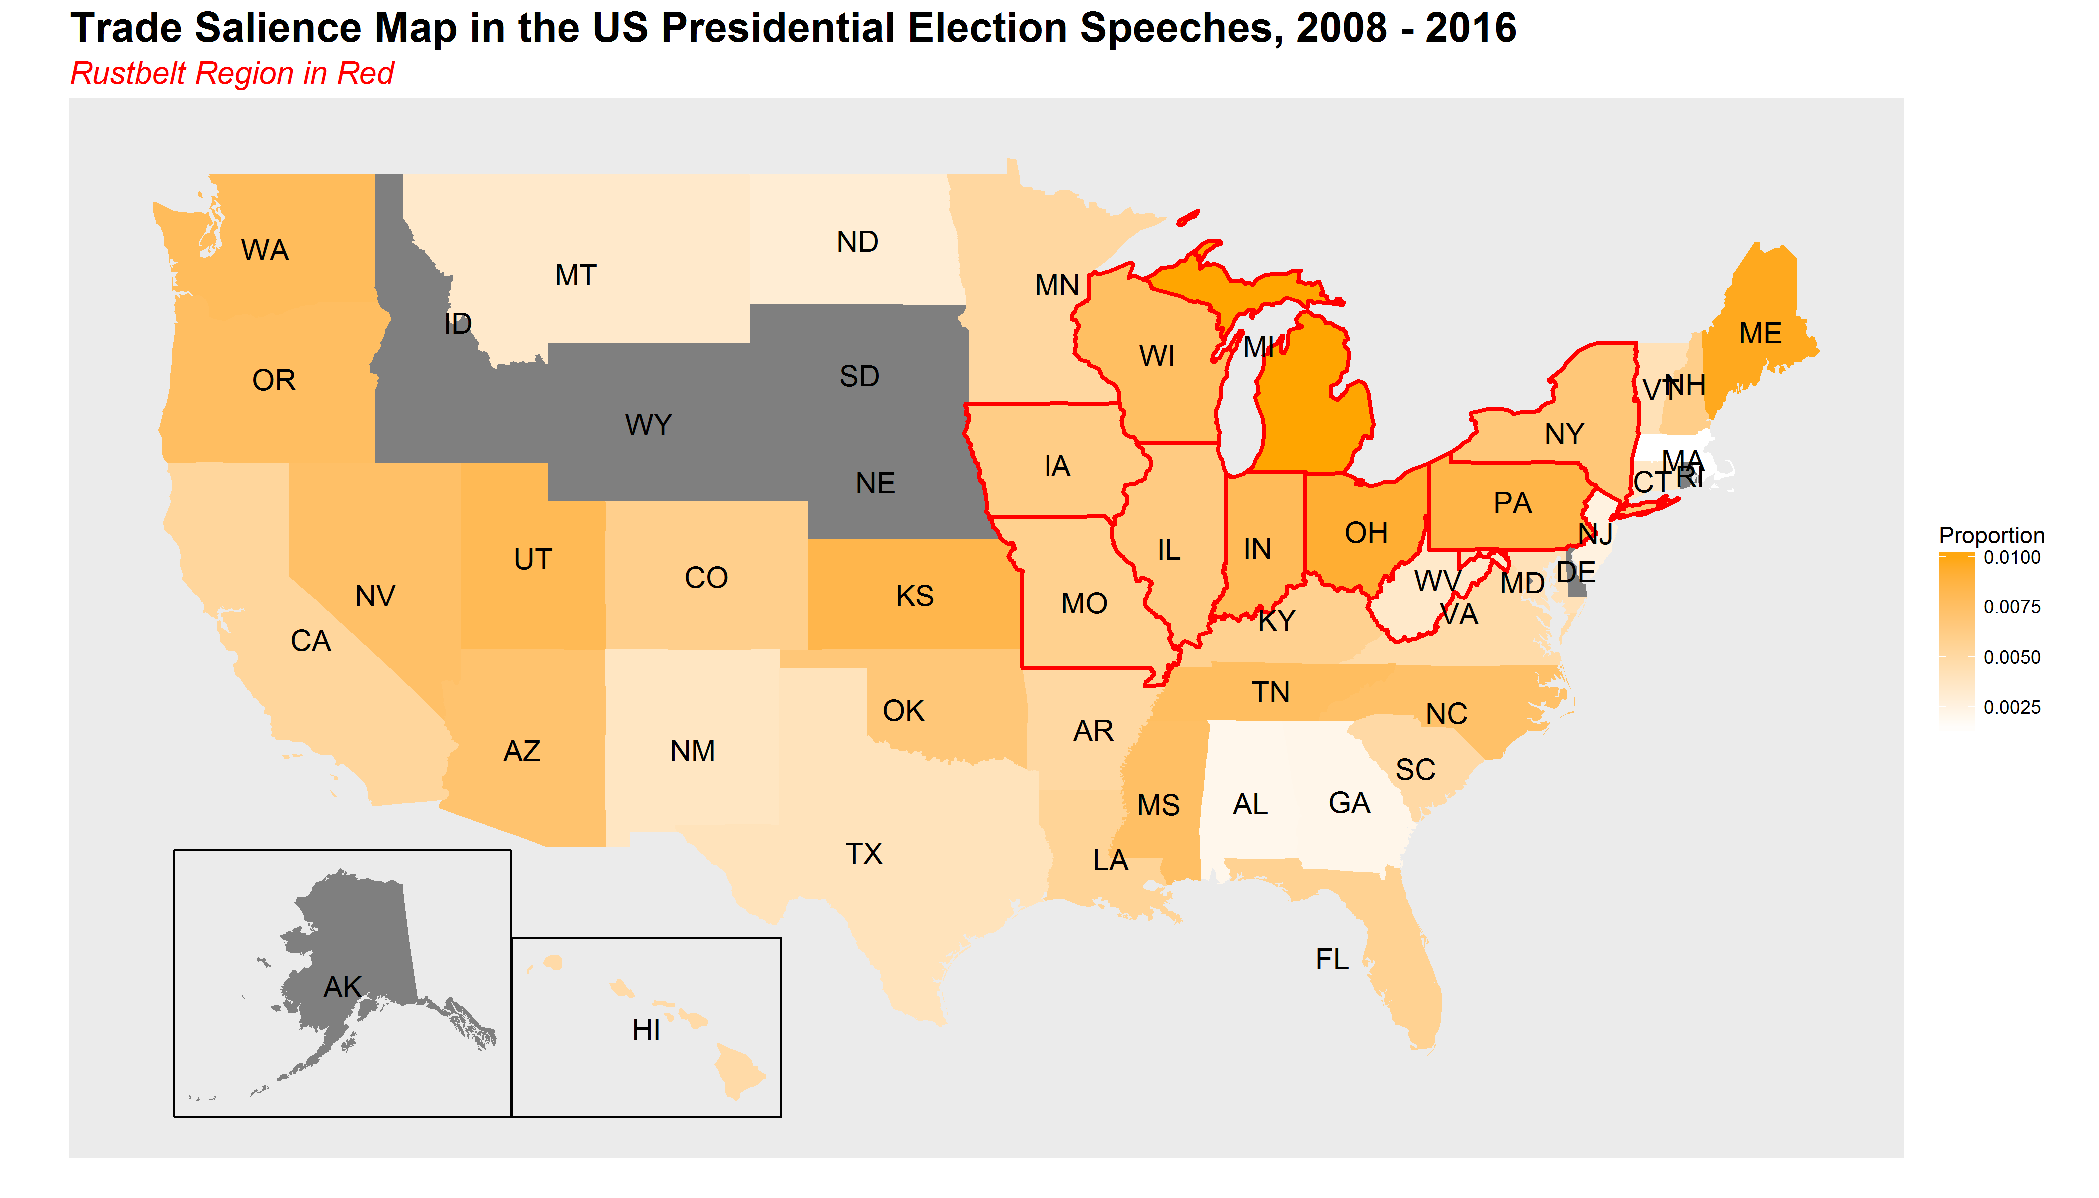
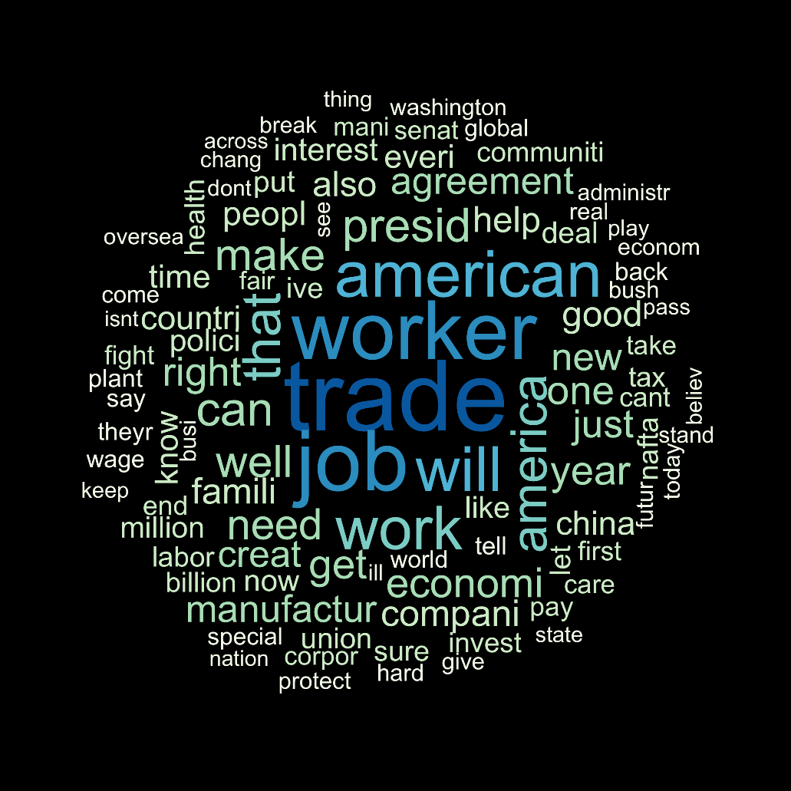
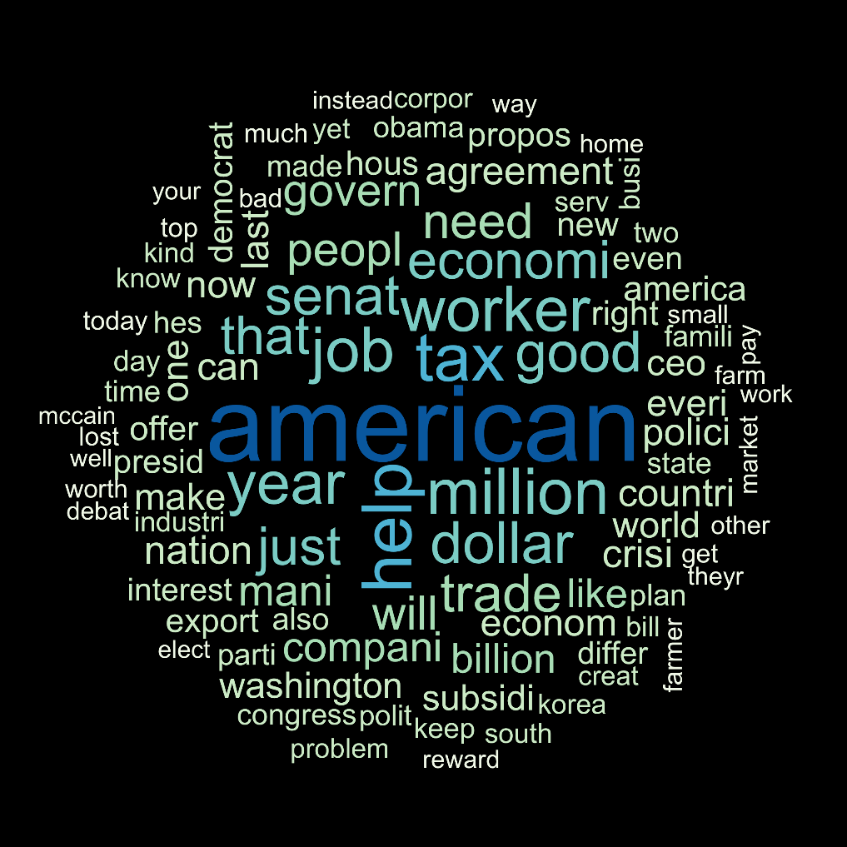
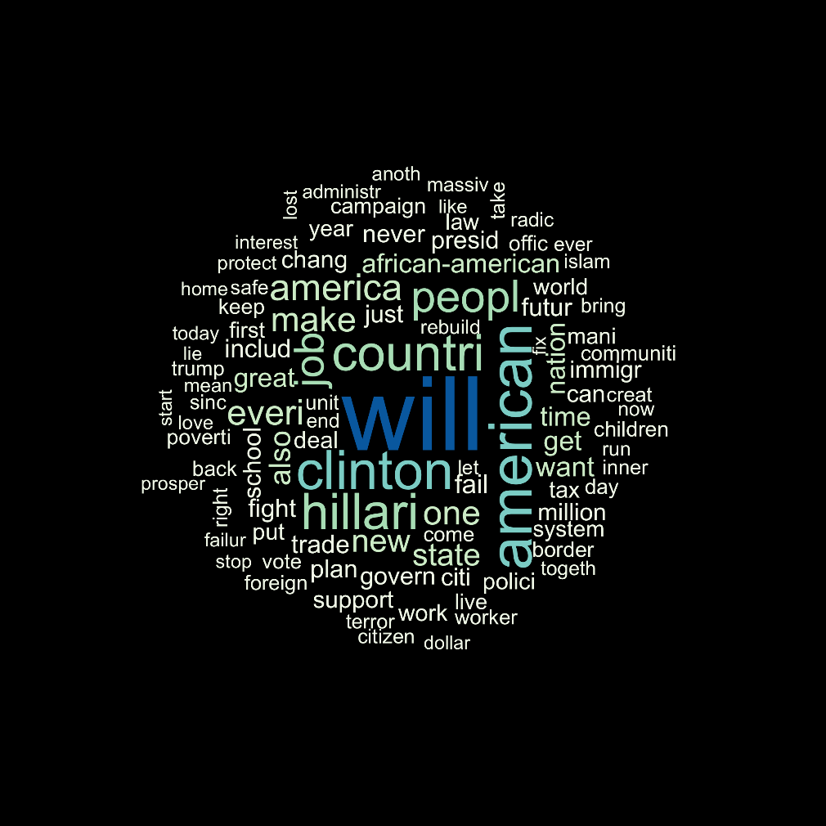
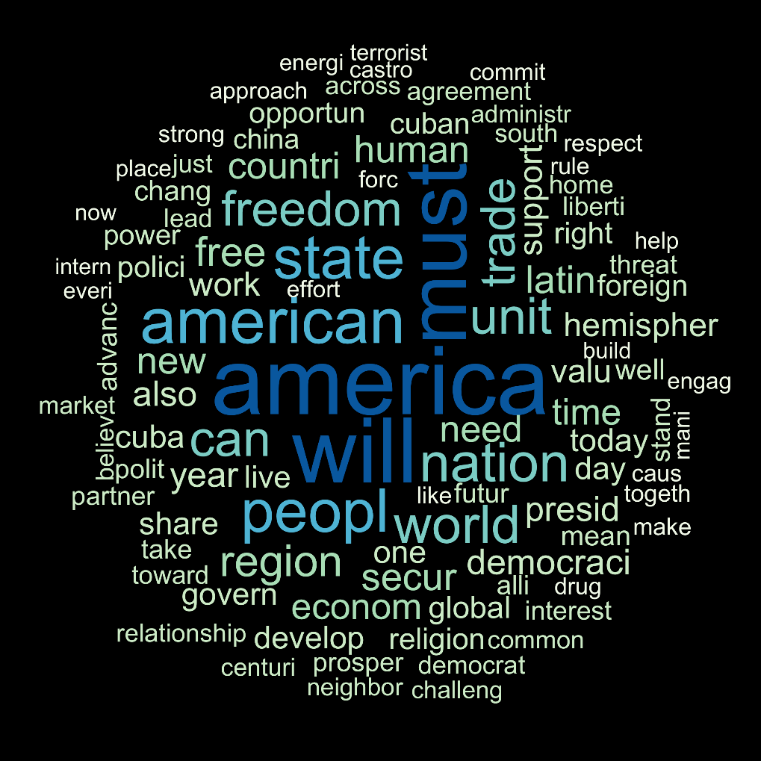
Trade Rhetoric Geography in the US Presidential Election Speeches
Alice Mee Seon Chung(alicechung@uchicao.edu), Computational Social Sciences
Minju Kim(minjukim@uchicago.edu), Department of Political Science
Abstract / Background
Data / Data Structure
Graphs
Regression
Voters suffering from job insecurity due to international trade are known to punish the incumbent president by choosing the presidential candidate from the other political party (Jensen et al 2017; Margalit 2011).
Then, how would presidential candidates ex-ante respond to this voter punishment in their presidential campaign speeches?
Web scraping the presidential election speech of every candidates in 2008, 2012, and 2016 from The American Presidency Project(APP).
Descriptive Statistics (1) Total 1247 speeches (2) 676 from Democratic Party, 571 from Republican Party (3) 685, 282, 280 speeches in each year
Theory
Trade Topic Salience Map
Presidential candidates make campaign speeches considering the regional characteristics of the location where they delivery speech.
Word Cloud
Hypothesis
Methods
 | Swing | Non-swing
Rust belt
Non- Rust belt
H1: Presidential candidates frame trade as an economic activity in speeches of rust belt regions.
H2: Presidential candidates link trade with national security in speeches of non-rustbelt regions.
H3: Within rust belt regions, if the regions are swing states, presidential candidates frame trade as special interest by linking trade with job security.
H4: Within non-rust belt regions, if the regions are swing states, presidential candidates frame trade as a source of personal-level security threat.
STM (Structural Topic modelling)
K=45 topics and extract 15 FREX words
DTM (Document Term Matrix)
Using 15 FREX words for each dimension, count the frequencies and scaled by each document length.
Regression Model
Dependent Variable: Trade topic related 15 FREX words frequencies by Rust belt/ Non-Rust belt regions
Independent Variable: Partisanship of the speaker
Controls: Year-fixed, state-level unemployment, candidate-fixed, candidate from incumbent party vs. opposing party, the partisan similarity of the author and the local governor.
Contribution/Conclusions
Presidential Candidates ex-ante respond to voter punishment on trade through the means of adopting different rhetoric by region.
The different rhetoric varies by political partisanship.

