Slide 1
Project ALDA
Alice Mee Seon Chung
Luxi (Luke) Han
Ningyin (Ariel) Xu
Dongping (Gabriel) Zhang

Slide 2
Project Motivation
myUChicago.edu course registration system

Slide 3
Project Milestones
1. Schedule builder
2. Waitlist Reminder
3. Course Evaluation and Instructor Evaluation
4. Integrate those features with an interface

Slide 4
Project Milestone 1. – Schedule Builder
1. Visualization of selected courses using schedule builder feature
2. Customization of preferred lecture time, lab/TA sections
Send emails to CNET ID notifying that a previously fully-loaded course now has empty seats
Project Milestone 2. – Wish list

Slide 5
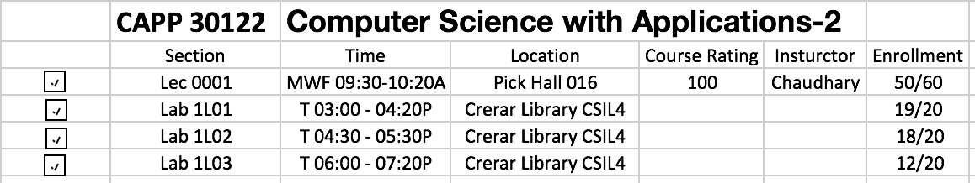
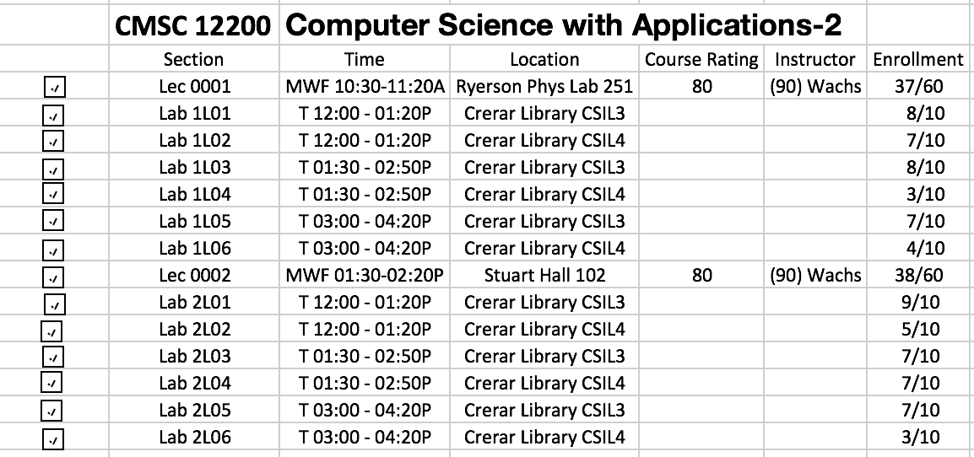

Slide 6
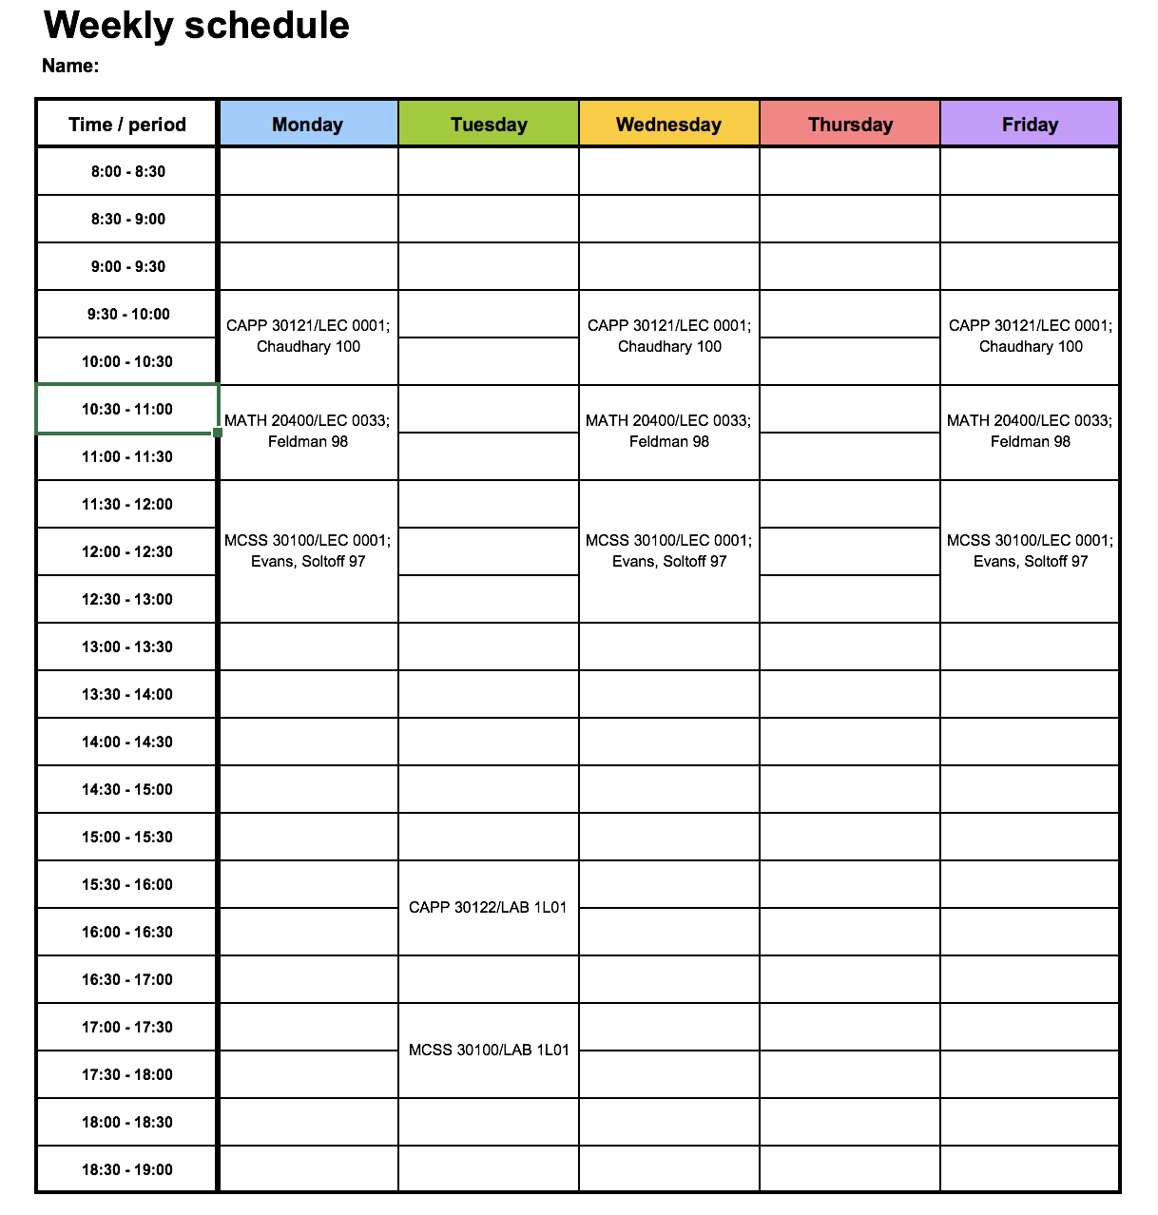
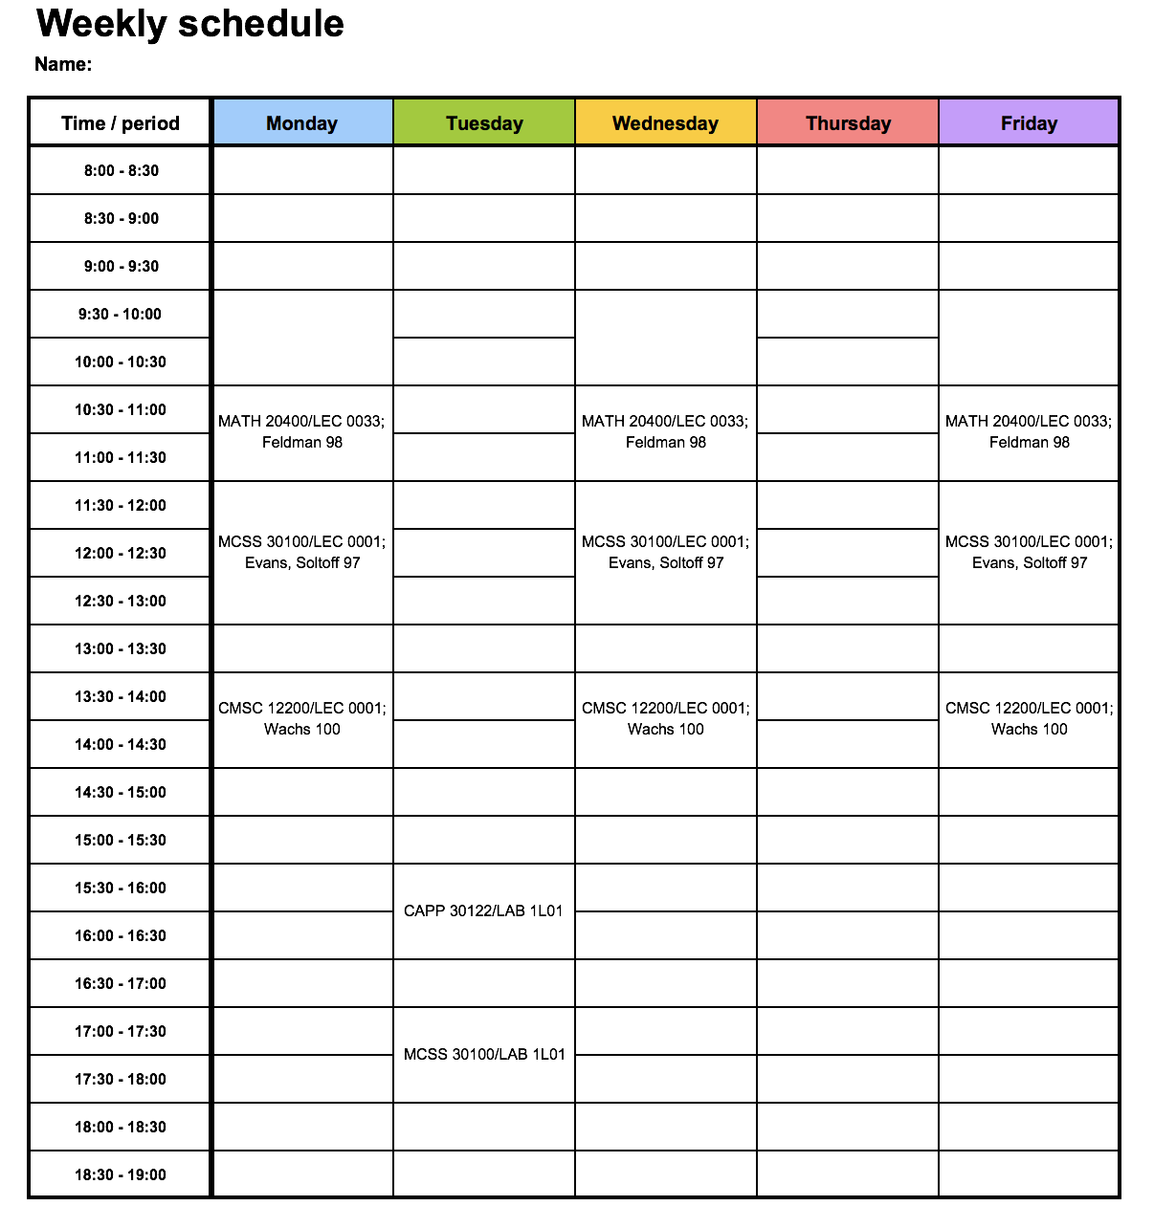

Slide 7
Project Milestone 3. – Evaluation
Goals:
1. Course and professor ratings
2. rank and compare professors
Tasks:
1. Web Scraping
2. Data storage
3. Data cleaning
4. Metric

Slide 8
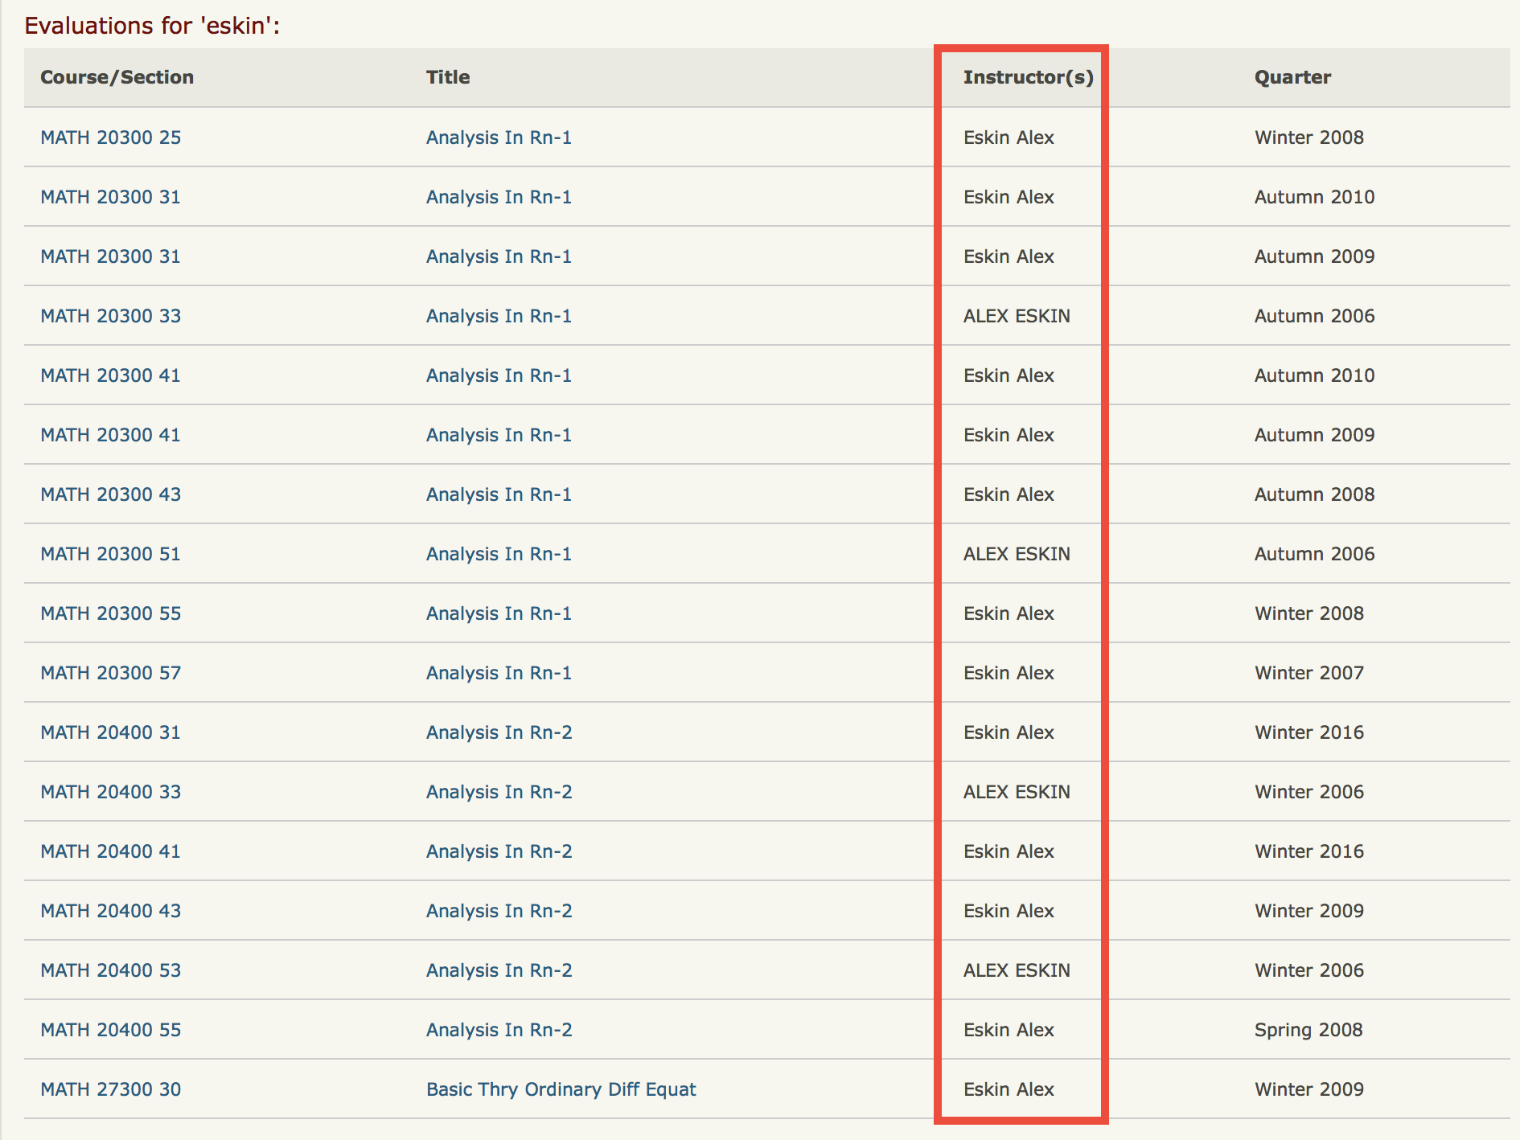

Slide 9
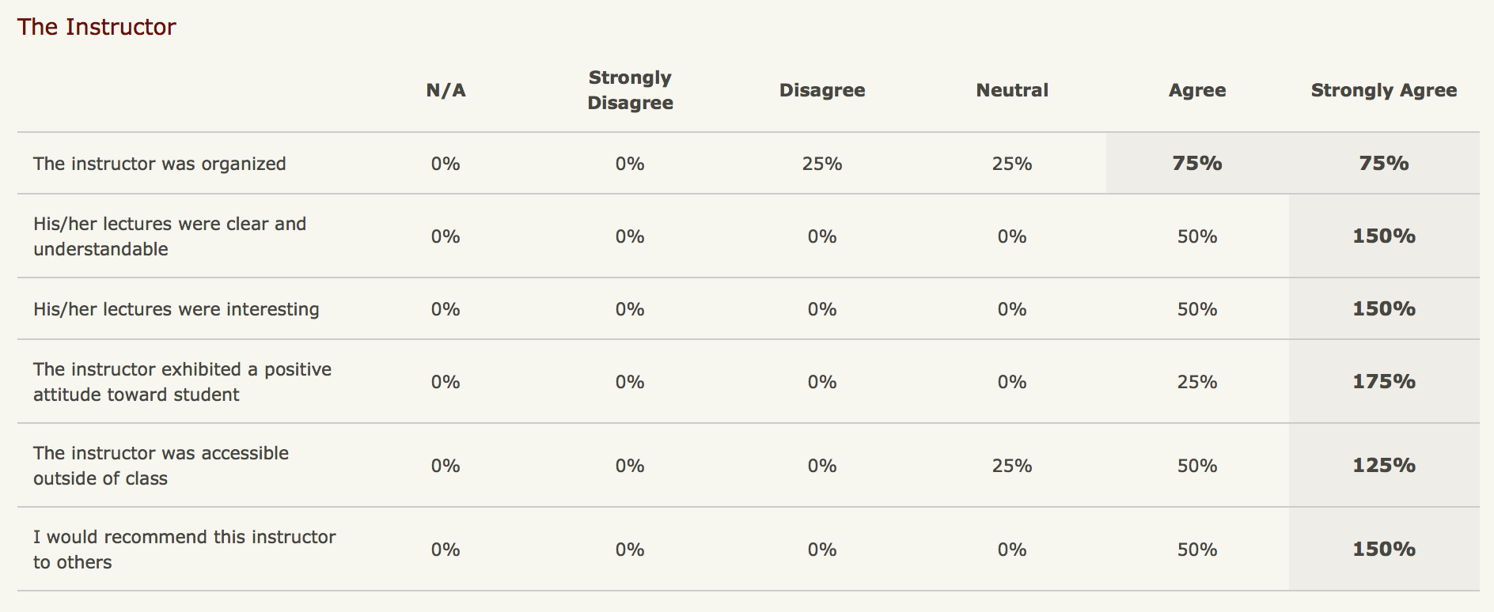

Slide 10
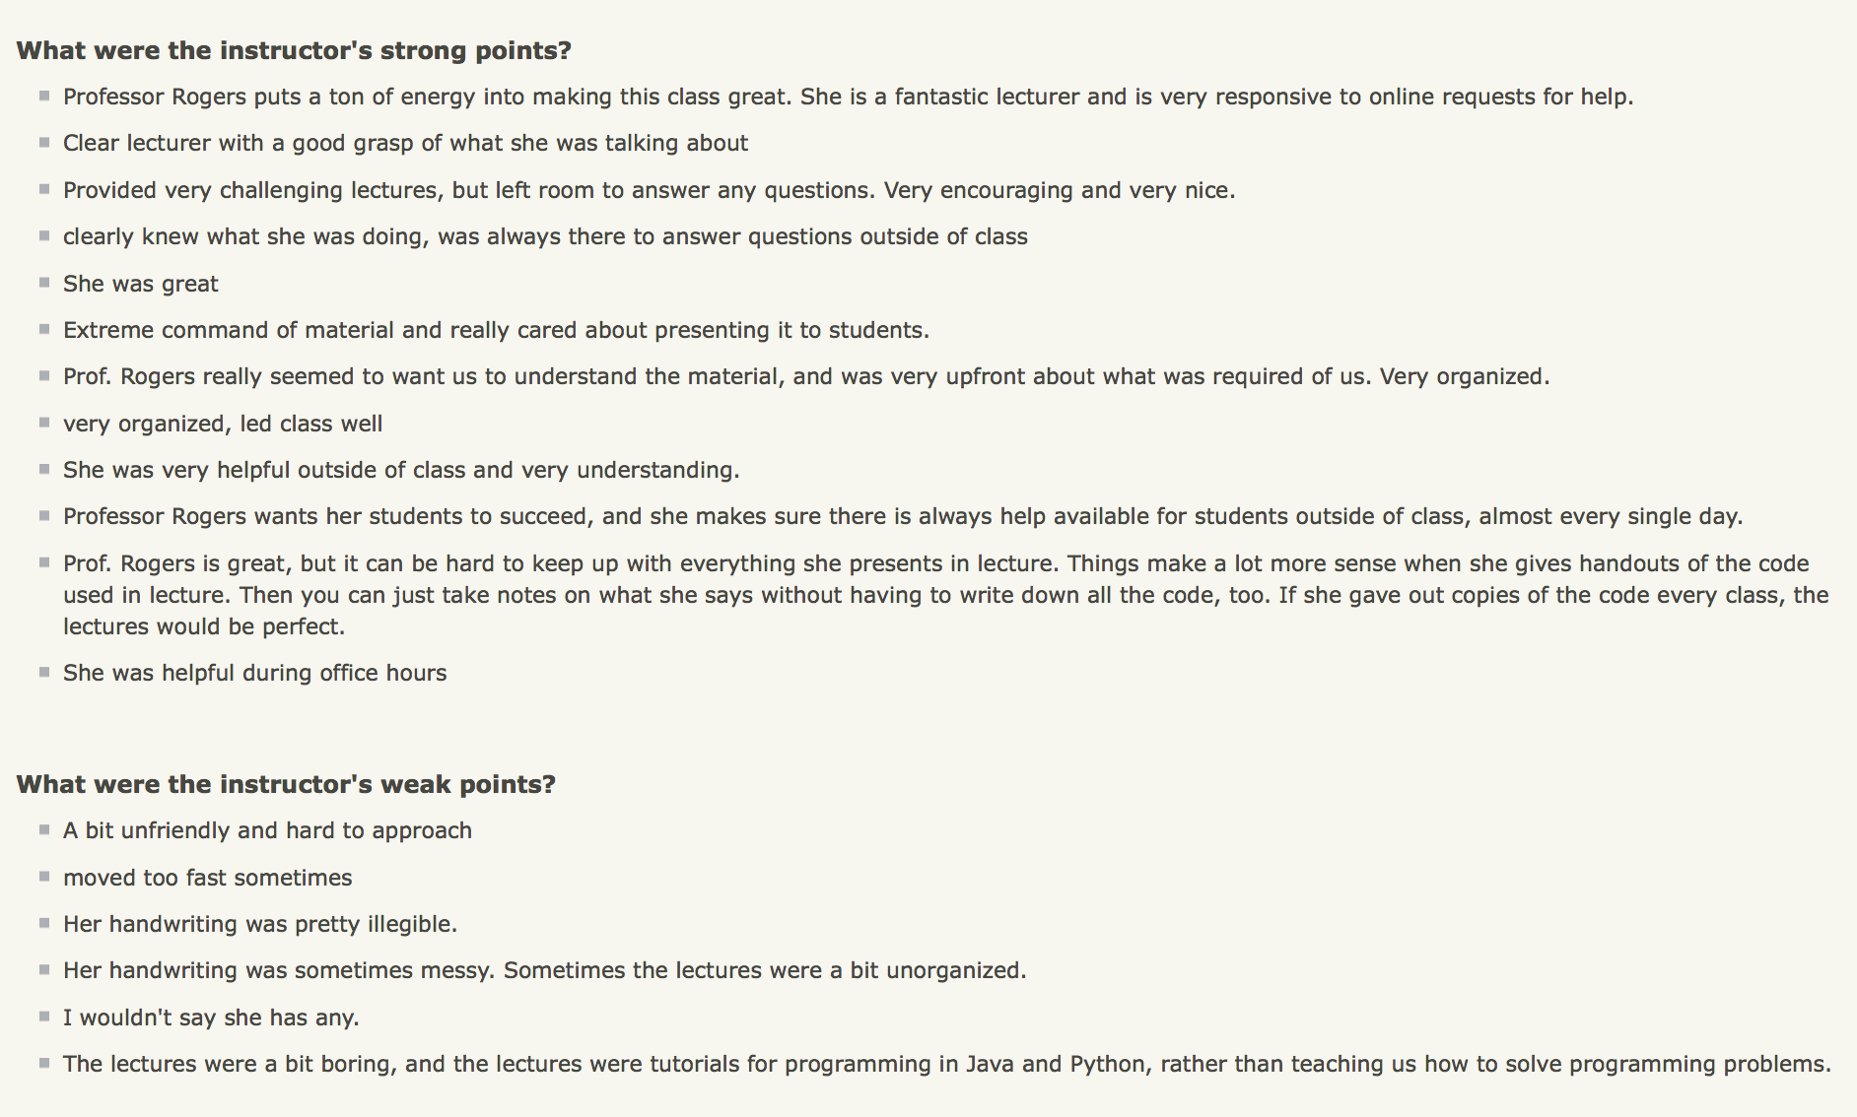
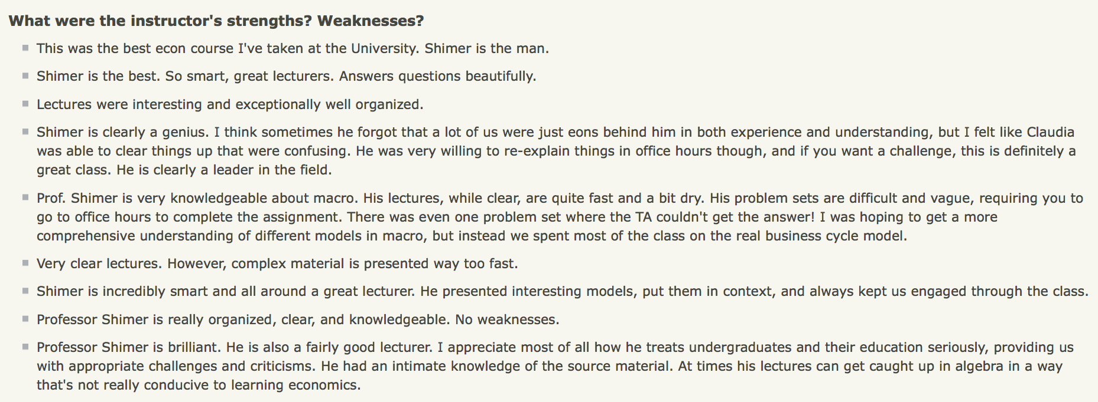
CS Department
Econ Department

Slide 11
Data sources
https://evaluations.uchicago.edu
College course evaluation website
Course Evaluation
https://harris.uchicago.edu/harris-insider
Harris School’s course evaluation website
Course Evaluation
Course Scheduling
my.Uchicago.edu

Slide 12
Time Schedule
Project
Check-in #1
Project
Check-in #2
Final
Presentation
Presentation
Week 4
Week 5
Week 6
Week 7
Week 8
Week 9
56 days
Today
Studying data characteristics and html structure
Task 1
100%
41 days
Design logistics and algorithms
Task 2
50%
50 days
Gather sample dataset and test feasibility
Task 3
38%
210 days
Interface design
Task 4
40%
26 days
Finish Crawler and gather actual dataset
Task 4
35 days
Data cleaning, linkage
and matching
Task 6
Task 7
Testing and Development

Slide 13
Thank you!

