Slide 1
TENDER IT……..
ITECH TEAM "AMIGO"
ALMIN VEHABOVIC
MRUNALINI RANE
ISMAYIL RZAYEV
GADIR RUSTEMLI
PRESENTS

Slide 2
TENDER IT……….. Mission – To help bring creative projects to life
What is Tender IT?
Tender IT is a B2B website – Its intention is to create a hub where people from around the world can access creative talent, and help creatives from across the globe find new customers.
It connects companies with ‘needs’ who can post projects whilst companies with ‘resources’ can apply for it. Companies post their projects along with the scope, requirement and skills needed. The companies applying give quotations or bids for the amount that they would charge to provide the service.
Tender IT makes geography and title irrelevant and, thereby, opens new markets for creativity all the world over.

Slide 3
TENDER IT……….. HOW TO GET STARTED?
Are you looking to hire?
Are you looking for work?
Register your company
Post your project
View bids from other companies
Select the company of your choice
Start work with the company
Leave feedback when work is completed / Ratings for work or company
Register your company
Add your skills and update your portfolio
Bid on Projects
Accept projects that are awarded to you by clients
Start working on the project
Leave feedback when work is completed / Ratings for work or company

Slide 4
TENDER IT………..
What is focus of application?
The best companies win with the best talent. But great people can be hard to find. We’ve created an online website for the world – connecting companies who wants service with other companies who wants to render the service.
Team Amigo is focused on building one great workplace for companies who want to post projects and companies who have skills to complete such projects.
Targeted users are all types of companies that either need some IT work or can perform some IT work.
We are expecting that majority of the companies that will post projects will be non IT companies from developed countries like USA, UK and Western European countries while majority of the companies that will apply and work on project will be IT companies from developing countries like India, African country or Southeast European countries.
Main focus of application is to connect companies from developed countries that needs work with companies from developing countries that are willing to work. We will not provide any project management functionality. After the initial contact is made all other business arrangement(contract agreement, deliverables, payments, etc.) between the companies is handled outside out the application.

Slide 5
TENDER IT………..
What problem is it going to solve?
Many IT projects do not require location presence and can easily be outsourced. Because of the affordable labor IT companies from developing countries can finish IT projects with the same quality but for a fraction of price in comparison with the IT companies from developed countries. Non IT companies from developed countries can save money by hiring companies from developing countries to finish their IT projects.
There is a big problem to establish connection between these companies. If you are a medium size company from Glasgow and you need to implement some IT solution where can you find a company that can do that for you? You realize that it would be cheaper to outsource your project but how to find a good and trusted company that can work on your project?
On the other side, a small IT company from Albania has excellent employees and a perfect reputation in domestic market, but they also want to work on IT projects from other countries. To find work in UK they probably would need to open an office somewhere in UK and employ at least one person and give that person a task of project hunting. This could be a huge investment for the company.
Our application is going to help solve two problems. First, companies that need some IT development done can easily find companies that will finish that work. Second, companies that want to work on IT development can easily find and apply for that kind of work.

Slide 6
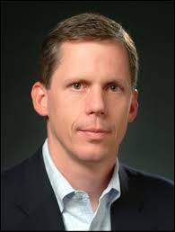
TENDER IT………..
FIRST PERSONA
Chris is a 38 years old business owner from Glasgow. He owns three restaurant, two in Glasgow and one in Edinburgh. He is married and have two kids. His son John is 11 and his daughter Sarah is 6 years old. He started his business from scratch so he is very hard working and demands professionalism from all his partners. In the next five years he plans to open three more restaurants.
He recognized the important role of IT in every business so he wants to modernize his business. For start, he wants to make a website for his company where users could see all the relevant information (menus, opening times, special events, etc.) about his restaurants and also order food from the restaurants. He needs a company that will develop and maintain this system. If this online ordering proves successful he also wants to create a phone app with the same purpose.
Name: Chris
Age: 38
Education: MSc in Business, University of Glasgow
Marital status: Wife Joan, married for 13 years
Occupation: Business owner

Slide 7
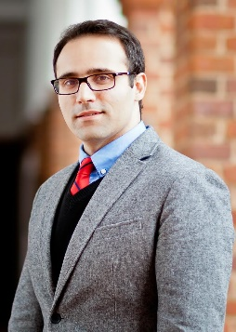
TENDER IT………..
SECOND PERSONA
Amir is a 35 year’s old IT manager from Tirana, Albania. He works for a company called “BestDev” that employs 55 IT developers (programmers, designer, etc.). He also works as a part time professor at Tirana University. He is teaching Java programming. He is not married and spends his free time exercising and reading books.
“BestDev” headquarters are in Tirana, Albania. They have a reputation as one of the best IT companies in Albania. Amir works for “BestDev” for the last seven years. His main role is to find new projects and to run the projects. He has worked on many different projects in Albania and neighboring countries. Company owner wants to spread their business to USA so he is going to create a team that will work solely on these projects. Amir will be the lead of this team. He needs to find a cheap and easy way to access the USA IT market.
Name: Amir
Age: 35
Education: BSc in Computer Science, Technical University Munich
Marital status: Not married
Occupation: IT manager

Slide 8
TENDER IT………..
Chris – After completing the registration process he can post projects. To post a project he needs to fill the necessary project details and publish the project. At any point he can save project details without publishing the project. He can add documents to his project. He can browse registered companies and send invitation to view his project. He receives a notification after any company has applied for his projects. He can see all details of that application and the company that applied. He can post ratings for other companies.
Amir – He can browse projects and view details of every published project. After completing the registration process he can apply for projects. He can search projects by a number of different criteria (location, size, number of people needed, etc.). To apply for a project he need to fill the details of his application and then he can send the application. At any point he can save the application without sending it. He can post ratings for other companies.

Slide 9
SYSTEM ARCHITECTURE

Slide 10
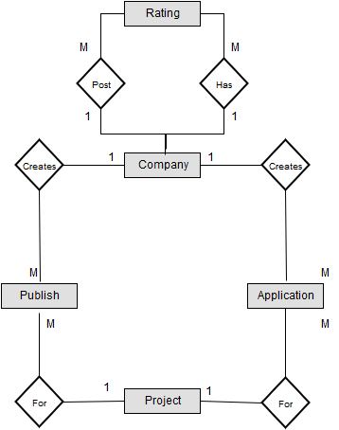
ER DIAGRAM

Slide 11
TENDER IT………..
ATTRIBUTES
Company
Project
Field | Type
CompanyID | Integer, primary key
ID Code | Char (30)
Name | Char (128)
Address (street) | Char (128)
Address (city) | Char (128)
Address (country) | Char (128)
Address (postcode) | Char (16)
Email | Char (64), formatted
PhoneNumber | Char (32), formatted
Password_hash | Char (64)
Field | Type
ProjectID | Integer, primary key
Title | Char (128)
Description | Char (1024)
Budget | Integer
StartDate | Date
EndDate | Date
File | MediumBlob
Rating
Publish
Field | Type
RatingID | Integer, primary key
Value | Integer, range 1-5
Comment | Char (1024)
Field | Type
PublishDate | Date
Application
Field | Type
ApplicationDate | Date
Price | Integer
Description | Char (1024)

