Slide 1
BIO WEB

Slide 2
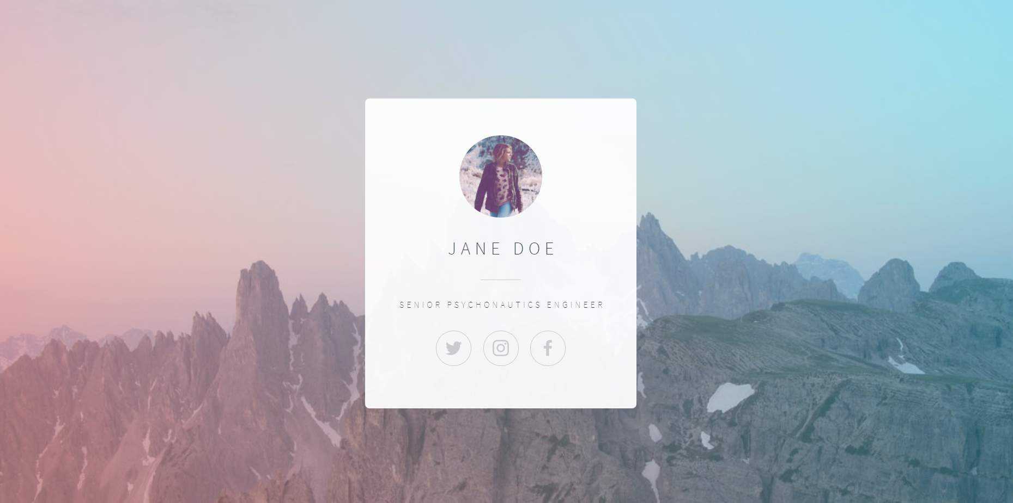
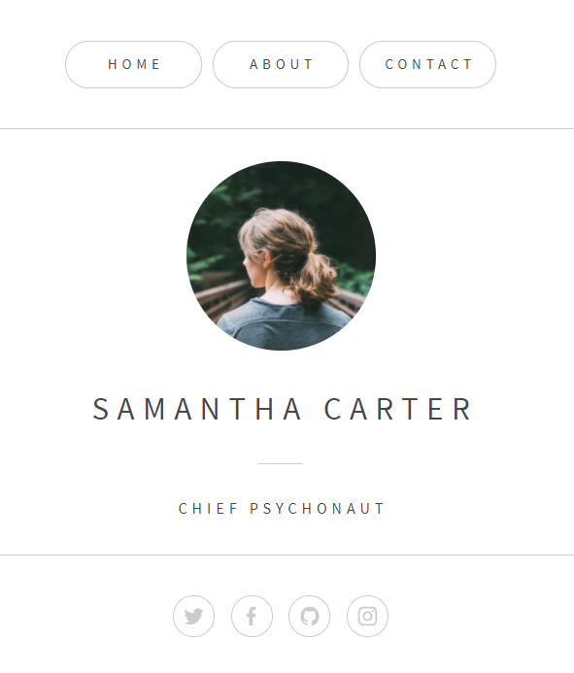

Slide 3
<wrapper>
<main>
<header>
<nav>
<hr>
<section>
<img>
<h1>
<hr>
<h3>
<footer>

Slide 4
CSS FLEX

Slide 5
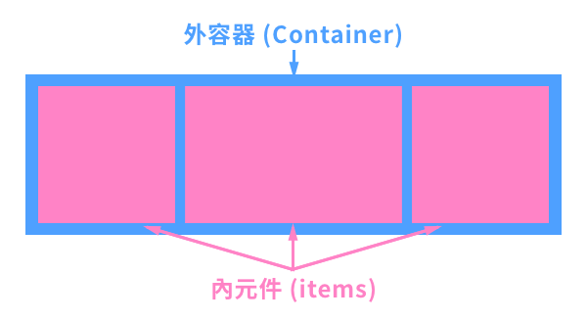
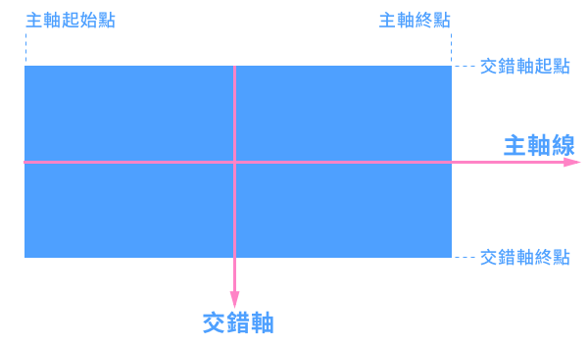
display: flex 彈性盒子
預設會橫向排列

Slide 6
Flex 外容器屬性：
display
flex-flow
flex-direction
flex-wrap
justify-content
align-items
Flex 內元件屬性：
flex
flex-grow
flex-shrink
flex-basis
order
align-self

Slide 7
外容器-display
.flex-container {
display: flex | inline-flex;
}

Slide 8
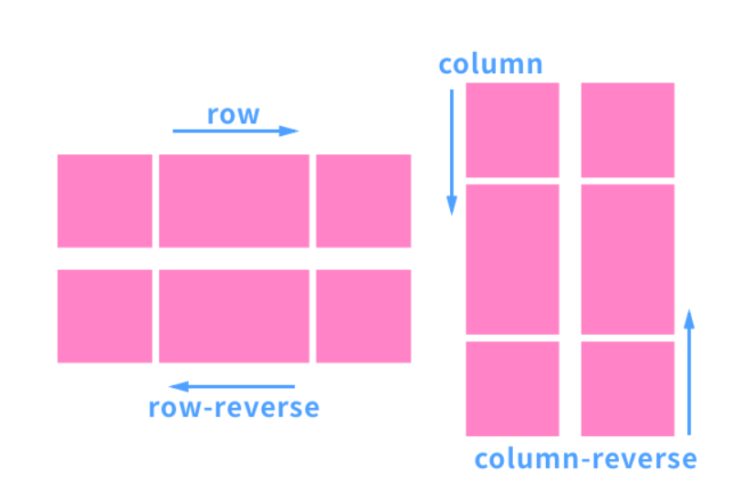
flex-direction

Slide 9
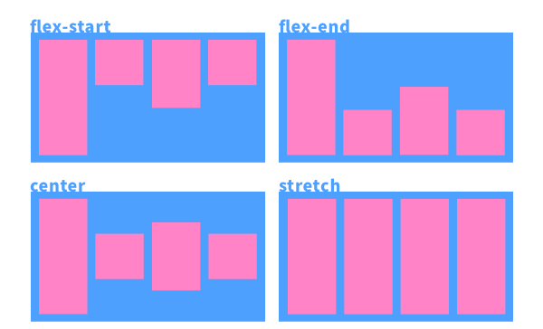
display: flex - align-items
align-items:外容器屬性，交錯軸(cross)的對齊設定

Slide 10
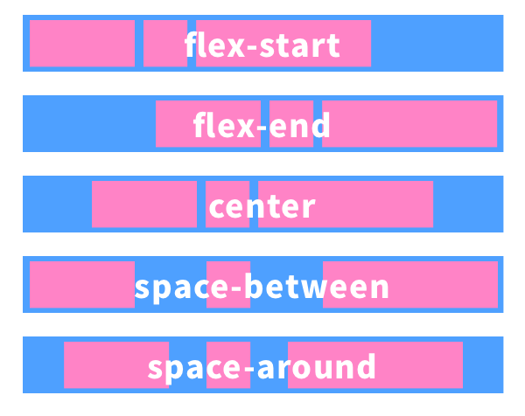
display: flex - justify-content
justify-content:外容器屬性，主軸對齊(main)的對齊設定

