Slide 1

How Does a Bike-Share Navigate Speedy Success?
Cyclistic Bike-Share
Case Study
Google Data Analytics Capstone
Notes:
Introduce the case study and explain that the goal is to understand rider behavior in order to increase annual memberships.

Slide 2

Business Problem
Cyclistic wants to grow annual memberships
  Marketing needs insight into rider behavior
  Key question: How do members and casual riders differ?
Notes:
Explain the business objective and why understanding rider behavior matters for revenue growth.

Slide 3

Stakeholders
Director of Marketing
  Marketing Analytics Team
  Executive Leadership
Notes:
Mention that insights must be actionable and understandable for non-technical stakeholders.

Slide 4

Data & Tools
Divvy Trips data (Q1 2019 & Q1 2020)
  Public, anonymized bike-share data
  R (Posit Cloud) and tidyverse
Notes:
Briefly describe the data source and emphasize the use of R for cleaning and analysis.

Slide 5

Data Cleaning & Preparation
Standardized columns across years
  Converted timestamps
  Created ride length and day-of-week variables
  Removed invalid rides
  Merged into a clean dataset
Notes:
Highlight that cleaning was essential due to schema differences across years.

Slide 6

Analysis Approach
Grouped riders by Member vs Casual
  Compared ride frequency and duration
  Analyzed patterns by day of week
Notes:
Explain that descriptive statistics were used to uncover usage trends.

Slide 7

Key Insight: Ride Length
Casual riders take longer rides
  Longest rides occur on weekends
  Indicates leisure-based usage
Notes:
Point to the chart and explain how ride length differs significantly by rider type.

Slide 8

Key Insight: Ride Frequency
Members take far more rides
  Highest usage on weekdays
  Indicates commuting behavior
Notes:
Explain that members rely on bikes for routine transportation.

Slide 9
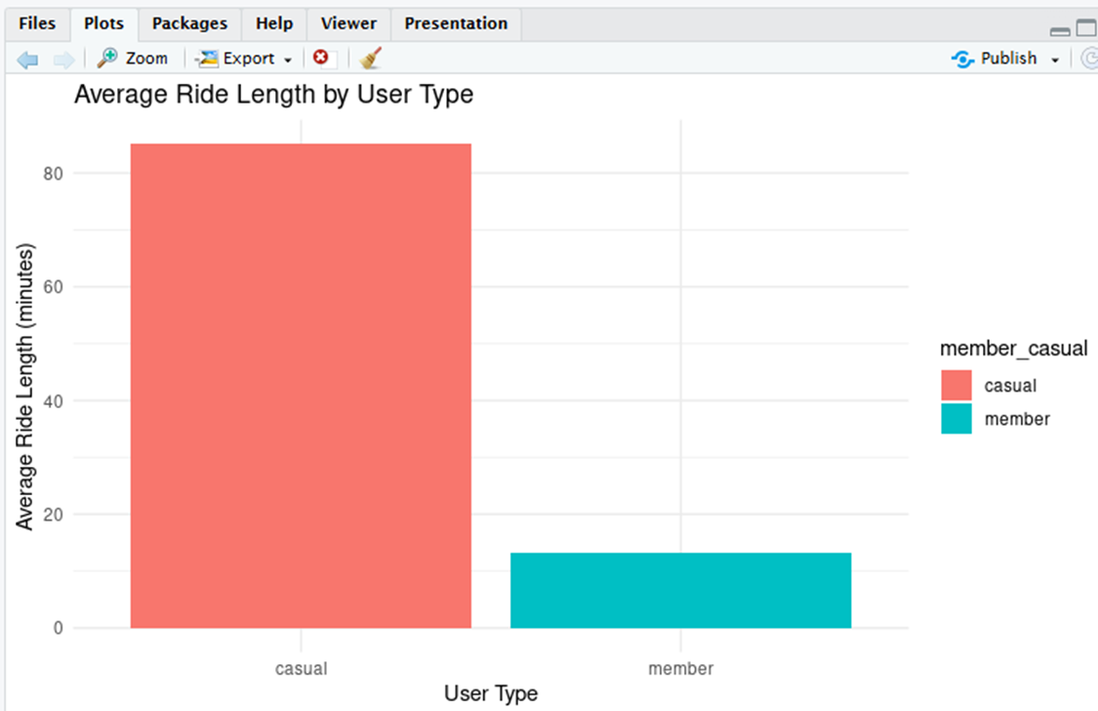
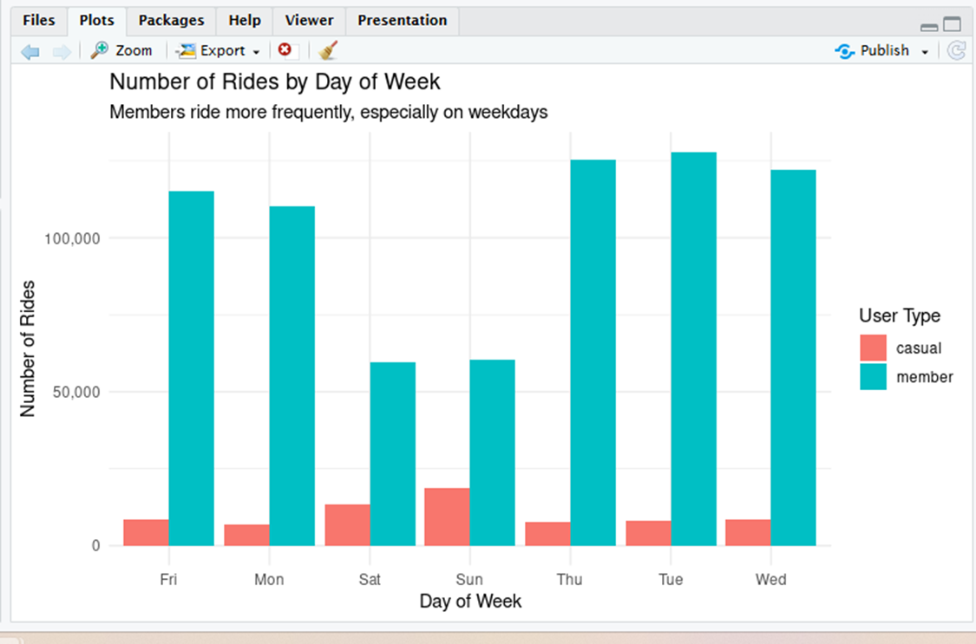
Summary of Findings
Members: short, frequent, weekday rides
Casual Riders: long, infrequent, weekend rides
  Two distinct rider behaviors identified
Notes:
Reinforce that these differences support targeted marketing strategies.

Slide 10

Recommendation 1: Weekend Promotions
Target Casual Riders during peak usage
  Promote benefits of annual membership
Notes:
Explain why marketing during weekends increases conversion potential.

Slide 11

Recommendation 2: Trial Memberships
Lower barrier to entry
  Encourage casual-to-member conversion
Notes:
Discuss how short-term plans can ease commitment concerns.

Slide 12

Recommendation 3 & Next Steps
Use digital campaigns during leisure periods
  Analyze more months of data
  Explore geographic and seasonal trends
Notes:
Close with how these actions support Cyclistic’s long-term growth.

