Slide 1
C12 at 2261 GeV

Slide 2
Subtraction Plots

Slide 3
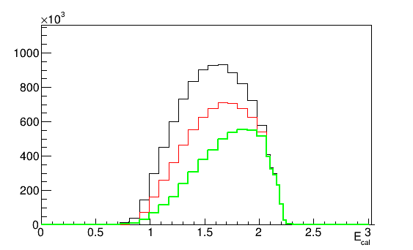
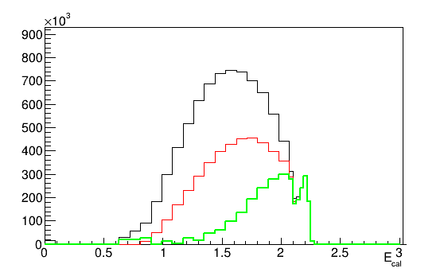
Pipl 1p1pi Events
DATA
GENIE
1+p 1+pi Events
ONLY 1p1pi Events
Subtraction Histogram

Slide 4
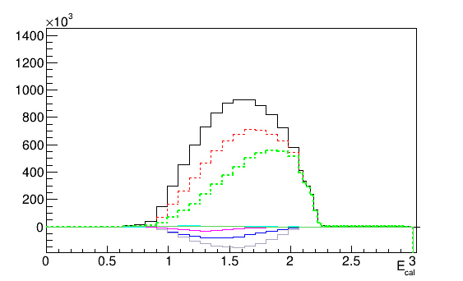
DATA
Pipl Subtraction Histogram
1+p 1+pi Events
1p1pi ONLY Events - -
Subtracted - -
1p2pi Events
2p1pi Events
2p2pi Events
1p3pi Events
3p1pi Events

Slide 5
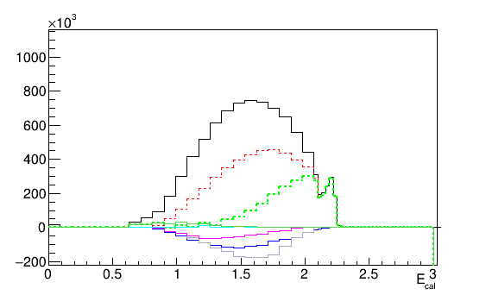
GENIE
Pipl Subtraction Histogram
1+p 1+pi Events
1p1pi ONLY Events - -
Subtracted - -
1p2pi Events
2p1pi Events
2p2pi Events
1p3pi Events
3p1pi Events

Slide 6
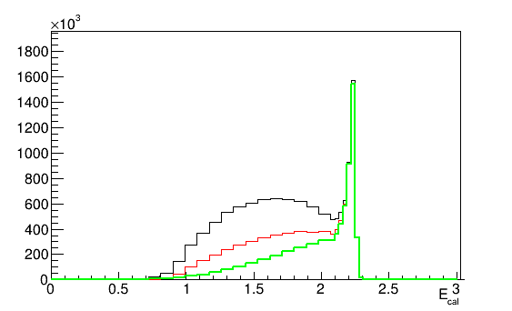
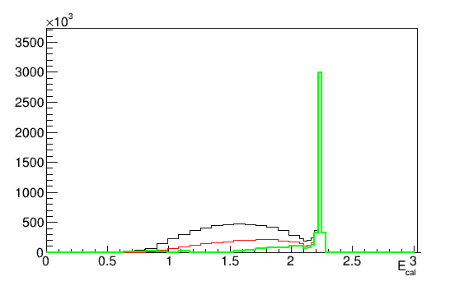
Pimi 1p1pi Events
DATA
GENIE
1+p 1+pi Events
ONLY 1p1pi Events
Subtraction Histogram

Slide 7
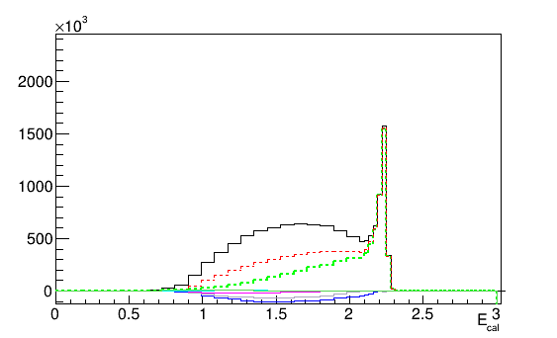
DATA
Pimi Subtraction Histogram
1+p 1+pi Events
1p1pi ONLY Events - -
Subtracted - -
1p2pi Events
2p1pi Events
2p2pi Events
1p3pi Events
3p1pi Events

Slide 8
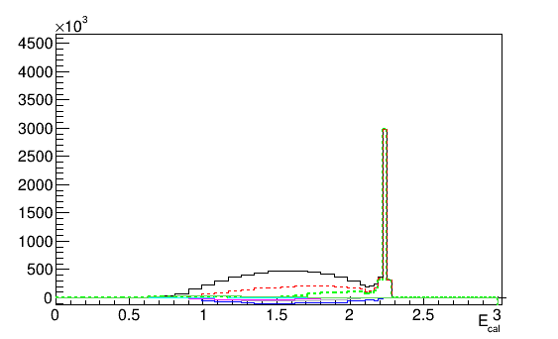
GENIE
Pimi Subtraction Histogram
1+p 1+pi Events
1p1pi ONLY Events - -
Subtracted - -
1p2pi Events
2p1pi Events
2p2pi Events
1p3pi Events
3p1pi Events

Slide 9
Multiplicity Plots

Slide 10
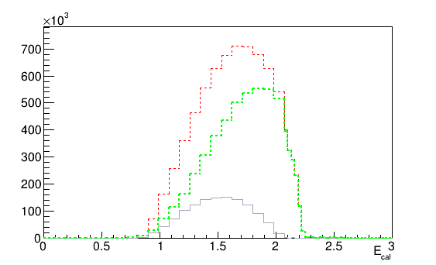
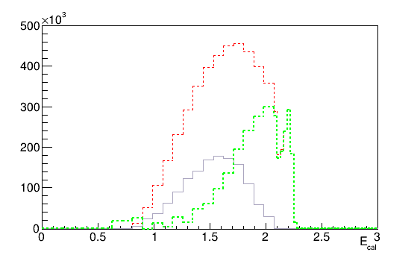
Pipl 1p2pi Multiplicity
Data
Genie
ONLY 1p1pi Events
Subtraction Histogram
1p2pi Multiplicity

Slide 11
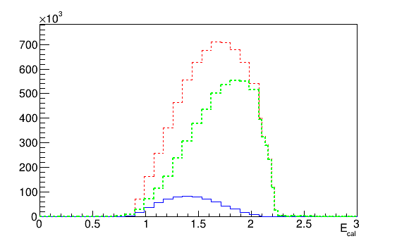
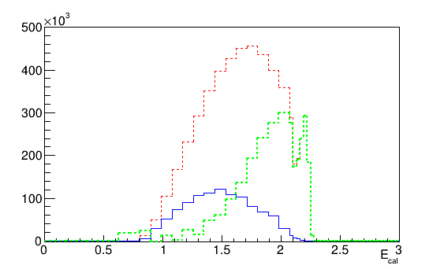
Pipl 2p1pi Multiplicity
Data
Genie
ONLY 1p1pi Events
Subtraction Histogram
2p1pi Multiplicity

Slide 12
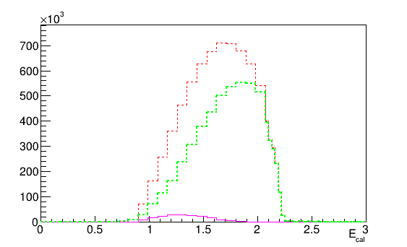
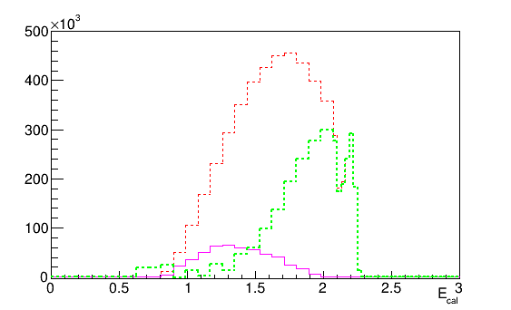
Pipl 2p2pi Multiplicity
Data
Genie
ONLY 1p1pi Events
Subtraction Histogram
2p2pi Multiplicity

Slide 13
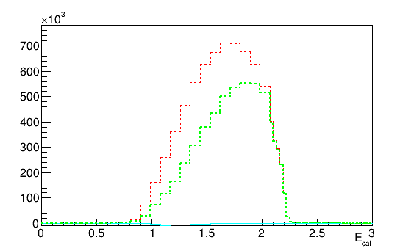
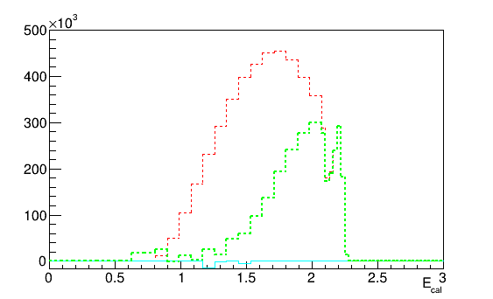
Pipl 1p3pi Multiplicity
Data
Genie
ONLY 1p1pi Events
Subtraction Histogram
1p3pi Multiplicity

Slide 14
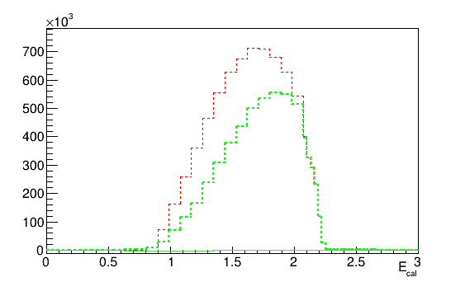
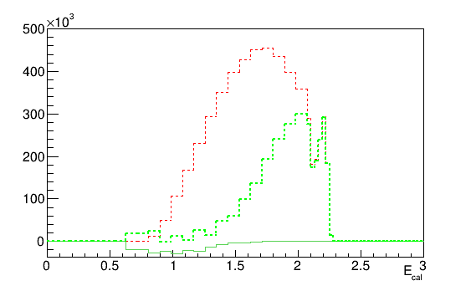
Pipl 3p1pi Multiplicity
Data
Genie
ONLY 1p1pi Events
Subtraction Histogram
3p1pi Multiplicity

Slide 15
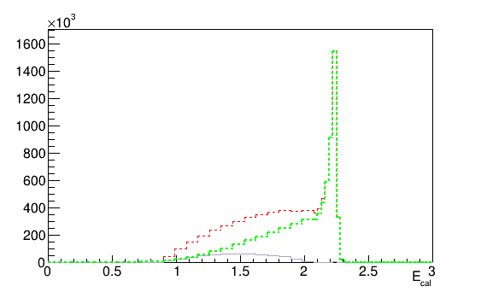
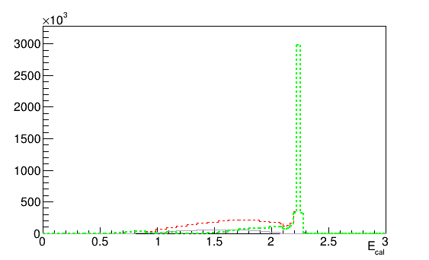
Pimi 1p2pi Multiplicity
Data
Genie
ONLY 1p1pi Events
Subtraction Histogram
1p2pi Multiplicity

Slide 16
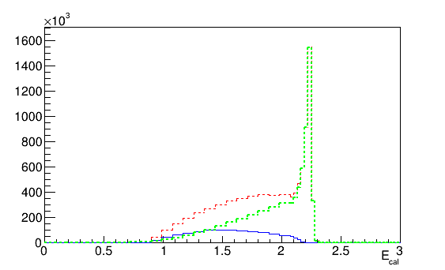
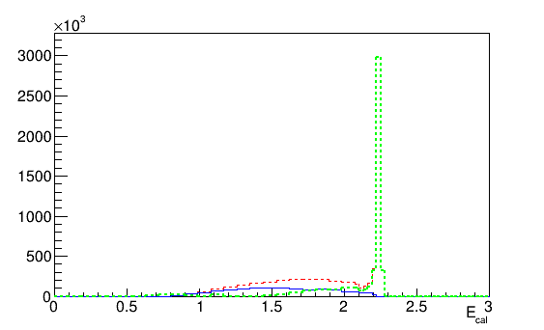
Pimi 2p1pi Multiplicity
Data
Genie
ONLY 1p1pi Events
Subtraction Histogram
2p1pi Multiplicity

Slide 17
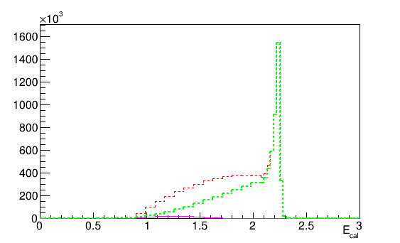
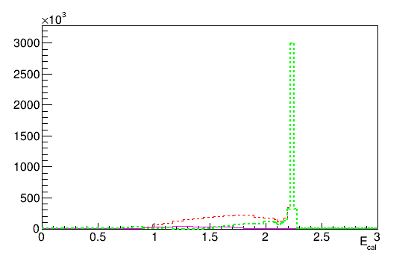
Pimi 2p2pi Multiplicity
Data
Genie
ONLY 1p1pi Events
Subtraction Histogram
2p2pi Multiplicity

Slide 18
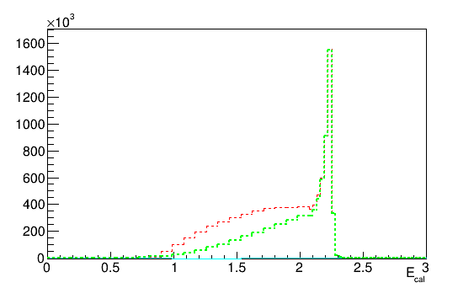
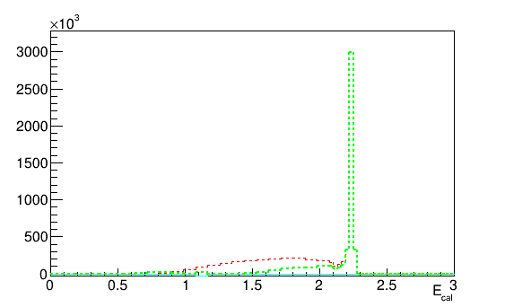
Pimi 1p3pi Multiplicity
Data
Genie
ONLY 1p1pi Events
Subtraction Histogram
1p3pi Multiplicity

Slide 19
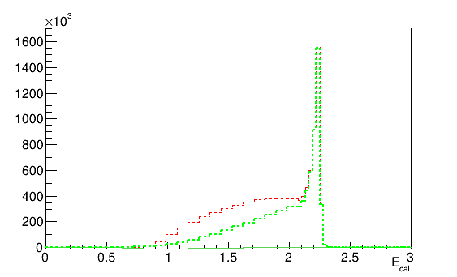
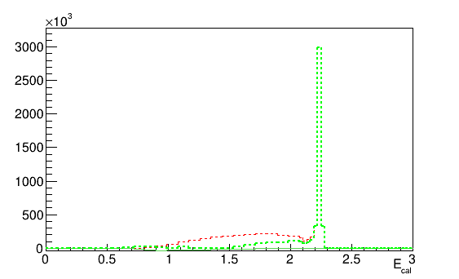
Pimi 3p1pi Multiplicity
Data
Genie
ONLY 1p1pi Events
Subtraction Histogram
3p1pi Multiplicity

Slide 20
C12 at 4461 GeV

Slide 21
Subtraction Plots

Slide 22
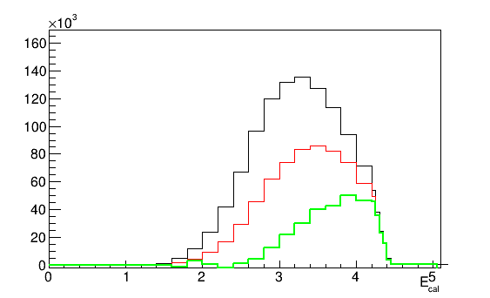
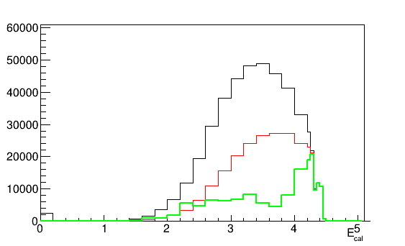
Pipl 1p1pi Events
DATA
GENIE
1+p 1+pi Events
ONLY 1p1pi Events
Subtraction Histogram

Slide 23
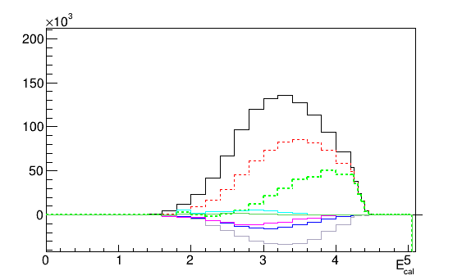
DATA
Pipl Subtraction Histogram
1+p 1+pi Events
1p1pi ONLY Events - -
Subtracted - -
1p2pi Events
2p1pi Events
2p2pi Events
1p3pi Events
3p1pi Events

Slide 24
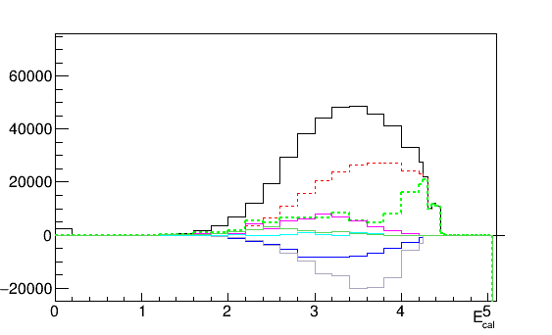
GENIE
Pipl Subtraction Histogram
1+p 1+pi Events
1p1pi ONLY Events - -
Subtracted - -
1p2pi Events
2p1pi Events
2p2pi Events
1p3pi Events
3p1pi Events

Slide 25
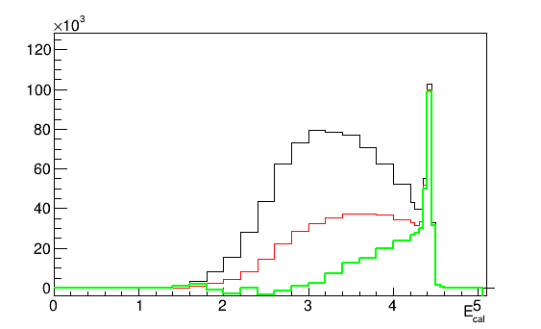
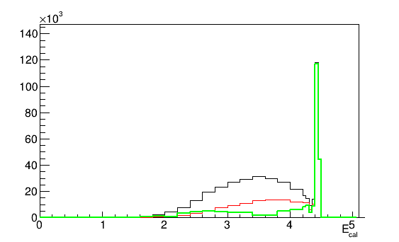
Pimi 1p1pi Events
DATA
GENIE
1+p 1+pi Events
ONLY 1p1pi Events
Subtraction Histogram

Slide 26
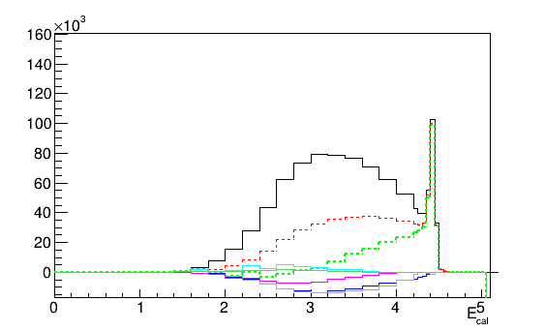
DATA
Pimi Subtraction Histogram
1+p 1+pi Events
1p1pi ONLY Events - -
Subtracted - -
1p2pi Events
2p1pi Events
2p2pi Events
1p3pi Events
3p1pi Events

Slide 27
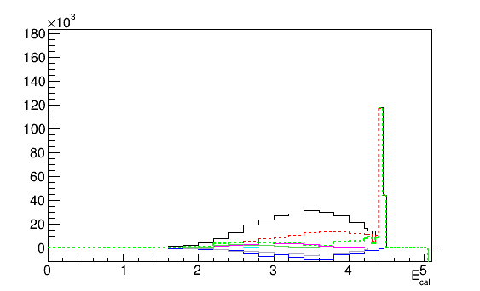
GENIE
Pimi Subtraction Histogram
1+p 1+pi Events
1p1pi ONLY Events - -
Subtracted - -
1p2pi Events
2p1pi Events
2p2pi Events
1p3pi Events
3p1pi Events

Slide 28
Multiplicity Plots

Slide 29
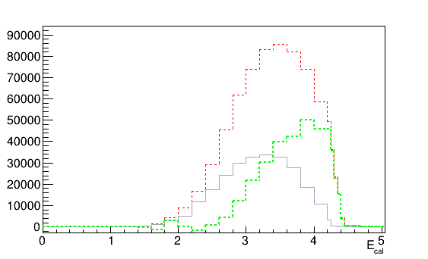
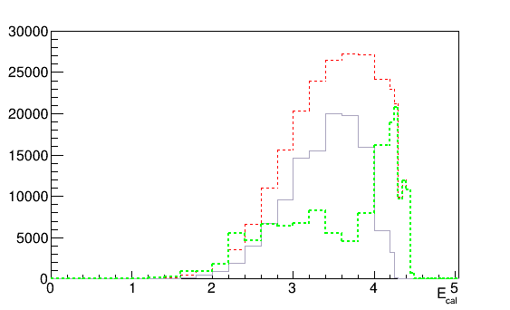
Pipl 1p2pi Multiplicity
Data
Genie
ONLY 1p1pi Events
Subtraction Histogram
1p2pi Multiplicity

Slide 30
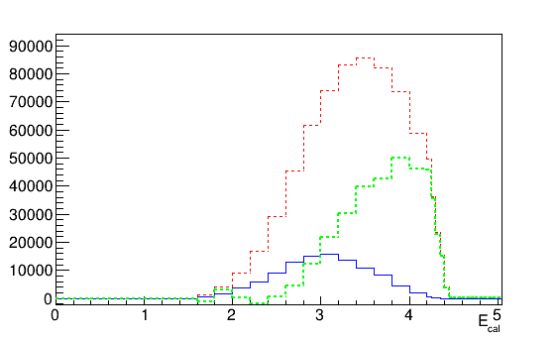
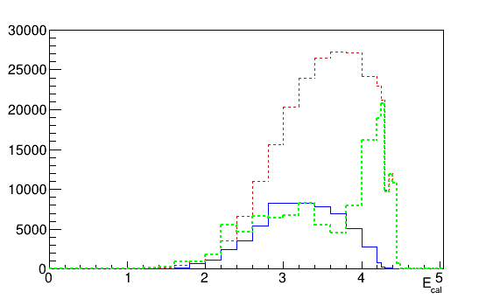
Pipl 2p1pi Multiplicity
Data
Genie
ONLY 1p1pi Events
Subtraction Histogram
2p1pi Multiplicity

Slide 31
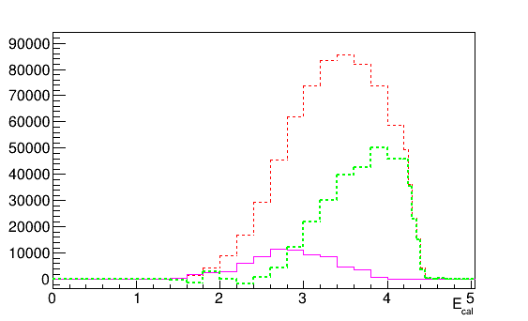
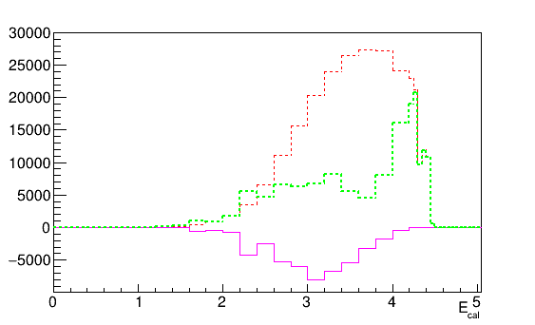
Pipl 2p2pi Multiplicity
Data
Genie
ONLY 1p1pi Events
Subtraction Histogram
2p2pi Multiplicity

Slide 32
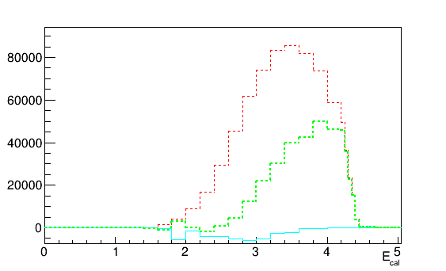
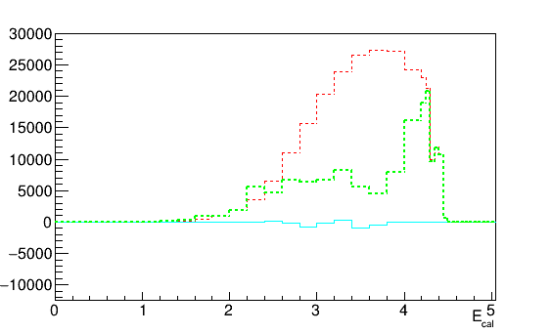
Pipl 1p3pi Multiplicity
Data
Genie
ONLY 1p1pi Events
Subtraction Histogram
1p3pi Multiplicity

Slide 33
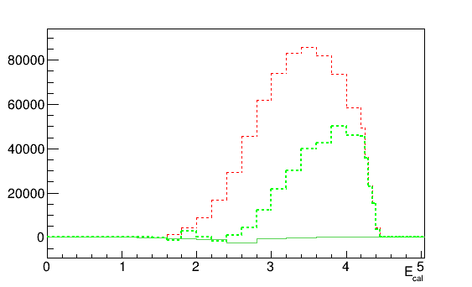
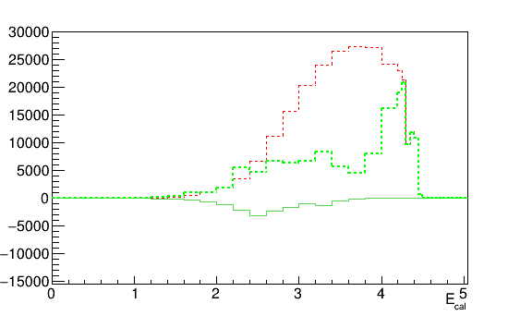
Pipl 3p1pi Multiplicity
Data
Genie
ONLY 1p1pi Events
Subtraction Histogram
3p1pi Multiplicity

Slide 34
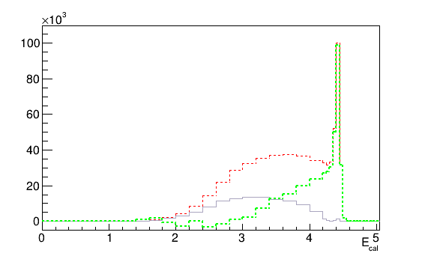
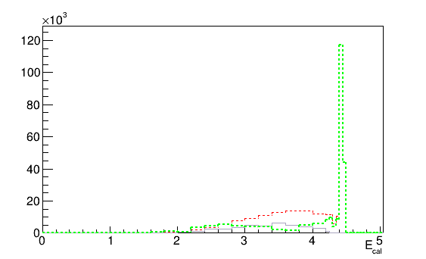
Pimi 1p2pi Multiplicity
Data
Genie
ONLY 1p1pi Events
Subtraction Histogram
1p2pi Multiplicity

Slide 35
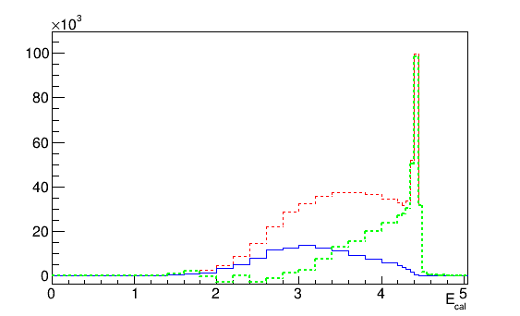
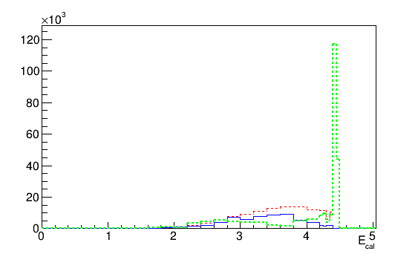
Pimi 2p1pi Multiplicity
Data
Genie
ONLY 1p1pi Events
Subtraction Histogram
2p1pi Multiplicity

Slide 36


Pimi 2p2pi Multiplicity
Data
Genie
ONLY 1p1pi Events
Subtraction Histogram
2p2pi Multiplicity

Slide 37


Pimi 1p3pi Multiplicity
Data
Genie
ONLY 1p1pi Events
Subtraction Histogram
1p3pi Multiplicity

Slide 38


Pimi 3p1pi Multiplicity
Data
Genie
ONLY 1p1pi Events
Subtraction Histogram
3p1pi Multiplicity

Slide 39
56Fe at 2261 GeV

Slide 40
Subtraction Plots

Slide 41


Pipl 1p1pi Events
DATA
GENIE
1+p 1+pi Events
ONLY 1p1pi Events
Subtraction Histogram

Slide 42

DATA
Pipl Subtraction Histogram
1+p 1+pi Events
1p1pi ONLY Events - -
Subtracted - -
1p2pi Events
2p1pi Events
2p2pi Events
1p3pi Events
3p1pi Events

Slide 43

GENIE
Pipl Subtraction Histogram
1+p 1+pi Events
1p1pi ONLY Events - -
Subtracted - -
1p2pi Events
2p1pi Events
2p2pi Events
1p3pi Events
3p1pi Events

Slide 44


Pimi 1p1pi Events
DATA
GENIE
1+p 1+pi Events
ONLY 1p1pi Events
Subtraction Histogram

Slide 45

DATA
Pimi Subtraction Histogram
1+p 1+pi Events
1p1pi ONLY Events - -
Subtracted - -
1p2pi Events
2p1pi Events
2p2pi Events
1p3pi Events
3p1pi Events

Slide 46

GENIE
Pimi Subtraction Histogram
1+p 1+pi Events
1p1pi ONLY Events - -
Subtracted - -
1p2pi Events
2p1pi Events
2p2pi Events
1p3pi Events
3p1pi Events

Slide 47
Multiplicity Plots

Slide 48


Pipl 1p2pi Multiplicity
Data
Genie
ONLY 1p1pi Events
Subtraction Histogram
1p2pi Multiplicity

Slide 49


Pipl 2p1pi Multiplicity
Data
Genie
ONLY 1p1pi Events
Subtraction Histogram
2p1pi Multiplicity

Slide 50


Pipl 2p2pi Multiplicity
Data
Genie
ONLY 1p1pi Events
Subtraction Histogram
2p2pi Multiplicity

Slide 51


Pipl 1p3pi Multiplicity
Data
Genie
ONLY 1p1pi Events
Subtraction Histogram
1p3pi Multiplicity

Slide 52


Pipl 3p1pi Multiplicity
Data
Genie
ONLY 1p1pi Events
Subtraction Histogram
3p1pi Multiplicity

Slide 53

Pimi 1p2pi Multiplicity
Data
Genie
ONLY 1p1pi Events
Subtraction Histogram
1p2pi Multiplicity

Slide 54


Pimi 2p1pi Multiplicity
Data
Genie
ONLY 1p1pi Events
Subtraction Histogram
2p1pi Multiplicity

Slide 55


Pimi 2p2pi Multiplicity
Data
Genie
ONLY 1p1pi Events
Subtraction Histogram
2p2pi Multiplicity

Slide 56


Pimi 1p3pi Multiplicity
Data
Genie
ONLY 1p1pi Events
Subtraction Histogram
1p3pi Multiplicity

Slide 57


Pimi 3p1pi Multiplicity
Data
Genie
ONLY 1p1pi Events
Subtraction Histogram
3p1pi Multiplicity

Slide 58
56Fe at 4461 GeV

Slide 59
Subtraction Plots

Slide 60


Pipl 1p1pi Events
DATA
GENIE
1+p 1+pi Events
ONLY 1p1pi Events
Subtraction Histogram

Slide 61

DATA
Pipl Subtraction Histogram
1+p 1+pi Events
1p1pi ONLY Events - -
Subtracted - -
1p2pi Events
2p1pi Events
2p2pi Events
1p3pi Events
3p1pi Events

Slide 62

GENIE
Pipl Subtraction Histogram
1+p 1+pi Events
1p1pi ONLY Events - -
Subtracted - -
1p2pi Events
2p1pi Events
2p2pi Events
1p3pi Events
3p1pi Events

Slide 63


Pimi 1p1pi Events
DATA
GENIE
1+p 1+pi Events
ONLY 1p1pi Events
Subtraction Histogram

Slide 64

DATA
Pimi Subtraction Histogram
1+p 1+pi Events
1p1pi ONLY Events - -
Subtracted - -
1p2pi Events
2p1pi Events
2p2pi Events
1p3pi Events
3p1pi Events

Slide 65

GENIE
Pimi Subtraction Histogram
1+p 1+pi Events
1p1pi ONLY Events - -
Subtracted - -
1p2pi Events
2p1pi Events
2p2pi Events
1p3pi Events
3p1pi Events

Slide 66
Multiplicity Plots

Slide 67


Pipl 1p2pi Multiplicity
Data
Genie
ONLY 1p1pi Events
Subtraction Histogram
1p2pi Multiplicity

Slide 68


Pipl 2p1pi Multiplicity
Data
Genie
ONLY 1p1pi Events
Subtraction Histogram
2p1pi Multiplicity

Slide 69


Pipl 2p2pi Multiplicity
Data
Genie
ONLY 1p1pi Events
Subtraction Histogram
2p2pi Multiplicity

Slide 70


Pipl 1p3pi Multiplicity
Data
Genie
ONLY 1p1pi Events
Subtraction Histogram
1p3pi Multiplicity

Slide 71


Pipl 3p1pi Multiplicity
Data
Genie
ONLY 1p1pi Events
Subtraction Histogram
3p1pi Multiplicity

Slide 72


Pimi 1p2pi Multiplicity
Data
Genie
ONLY 1p1pi Events
Subtraction Histogram
1p2pi Multiplicity

Slide 73


Pimi 2p1pi Multiplicity
Data
Genie
ONLY 1p1pi Events
Subtraction Histogram
2p1pi Multiplicity

Slide 74


Pimi 2p2pi Multiplicity
Data
Genie
ONLY 1p1pi Events
Subtraction Histogram
2p2pi Multiplicity

Slide 75


Pimi 1p3pi Multiplicity
Data
Genie
ONLY 1p1pi Events
Subtraction Histogram
1p3pi Multiplicity

Slide 76


Pimi 3p1pi Multiplicity
Data
Genie
ONLY 1p1pi Events
Subtraction Histogram
3p1pi Multiplicity

