Slide 1
Machine learning model to predict the cause of death
By Alicia, Claude, and Kathy

Slide 2
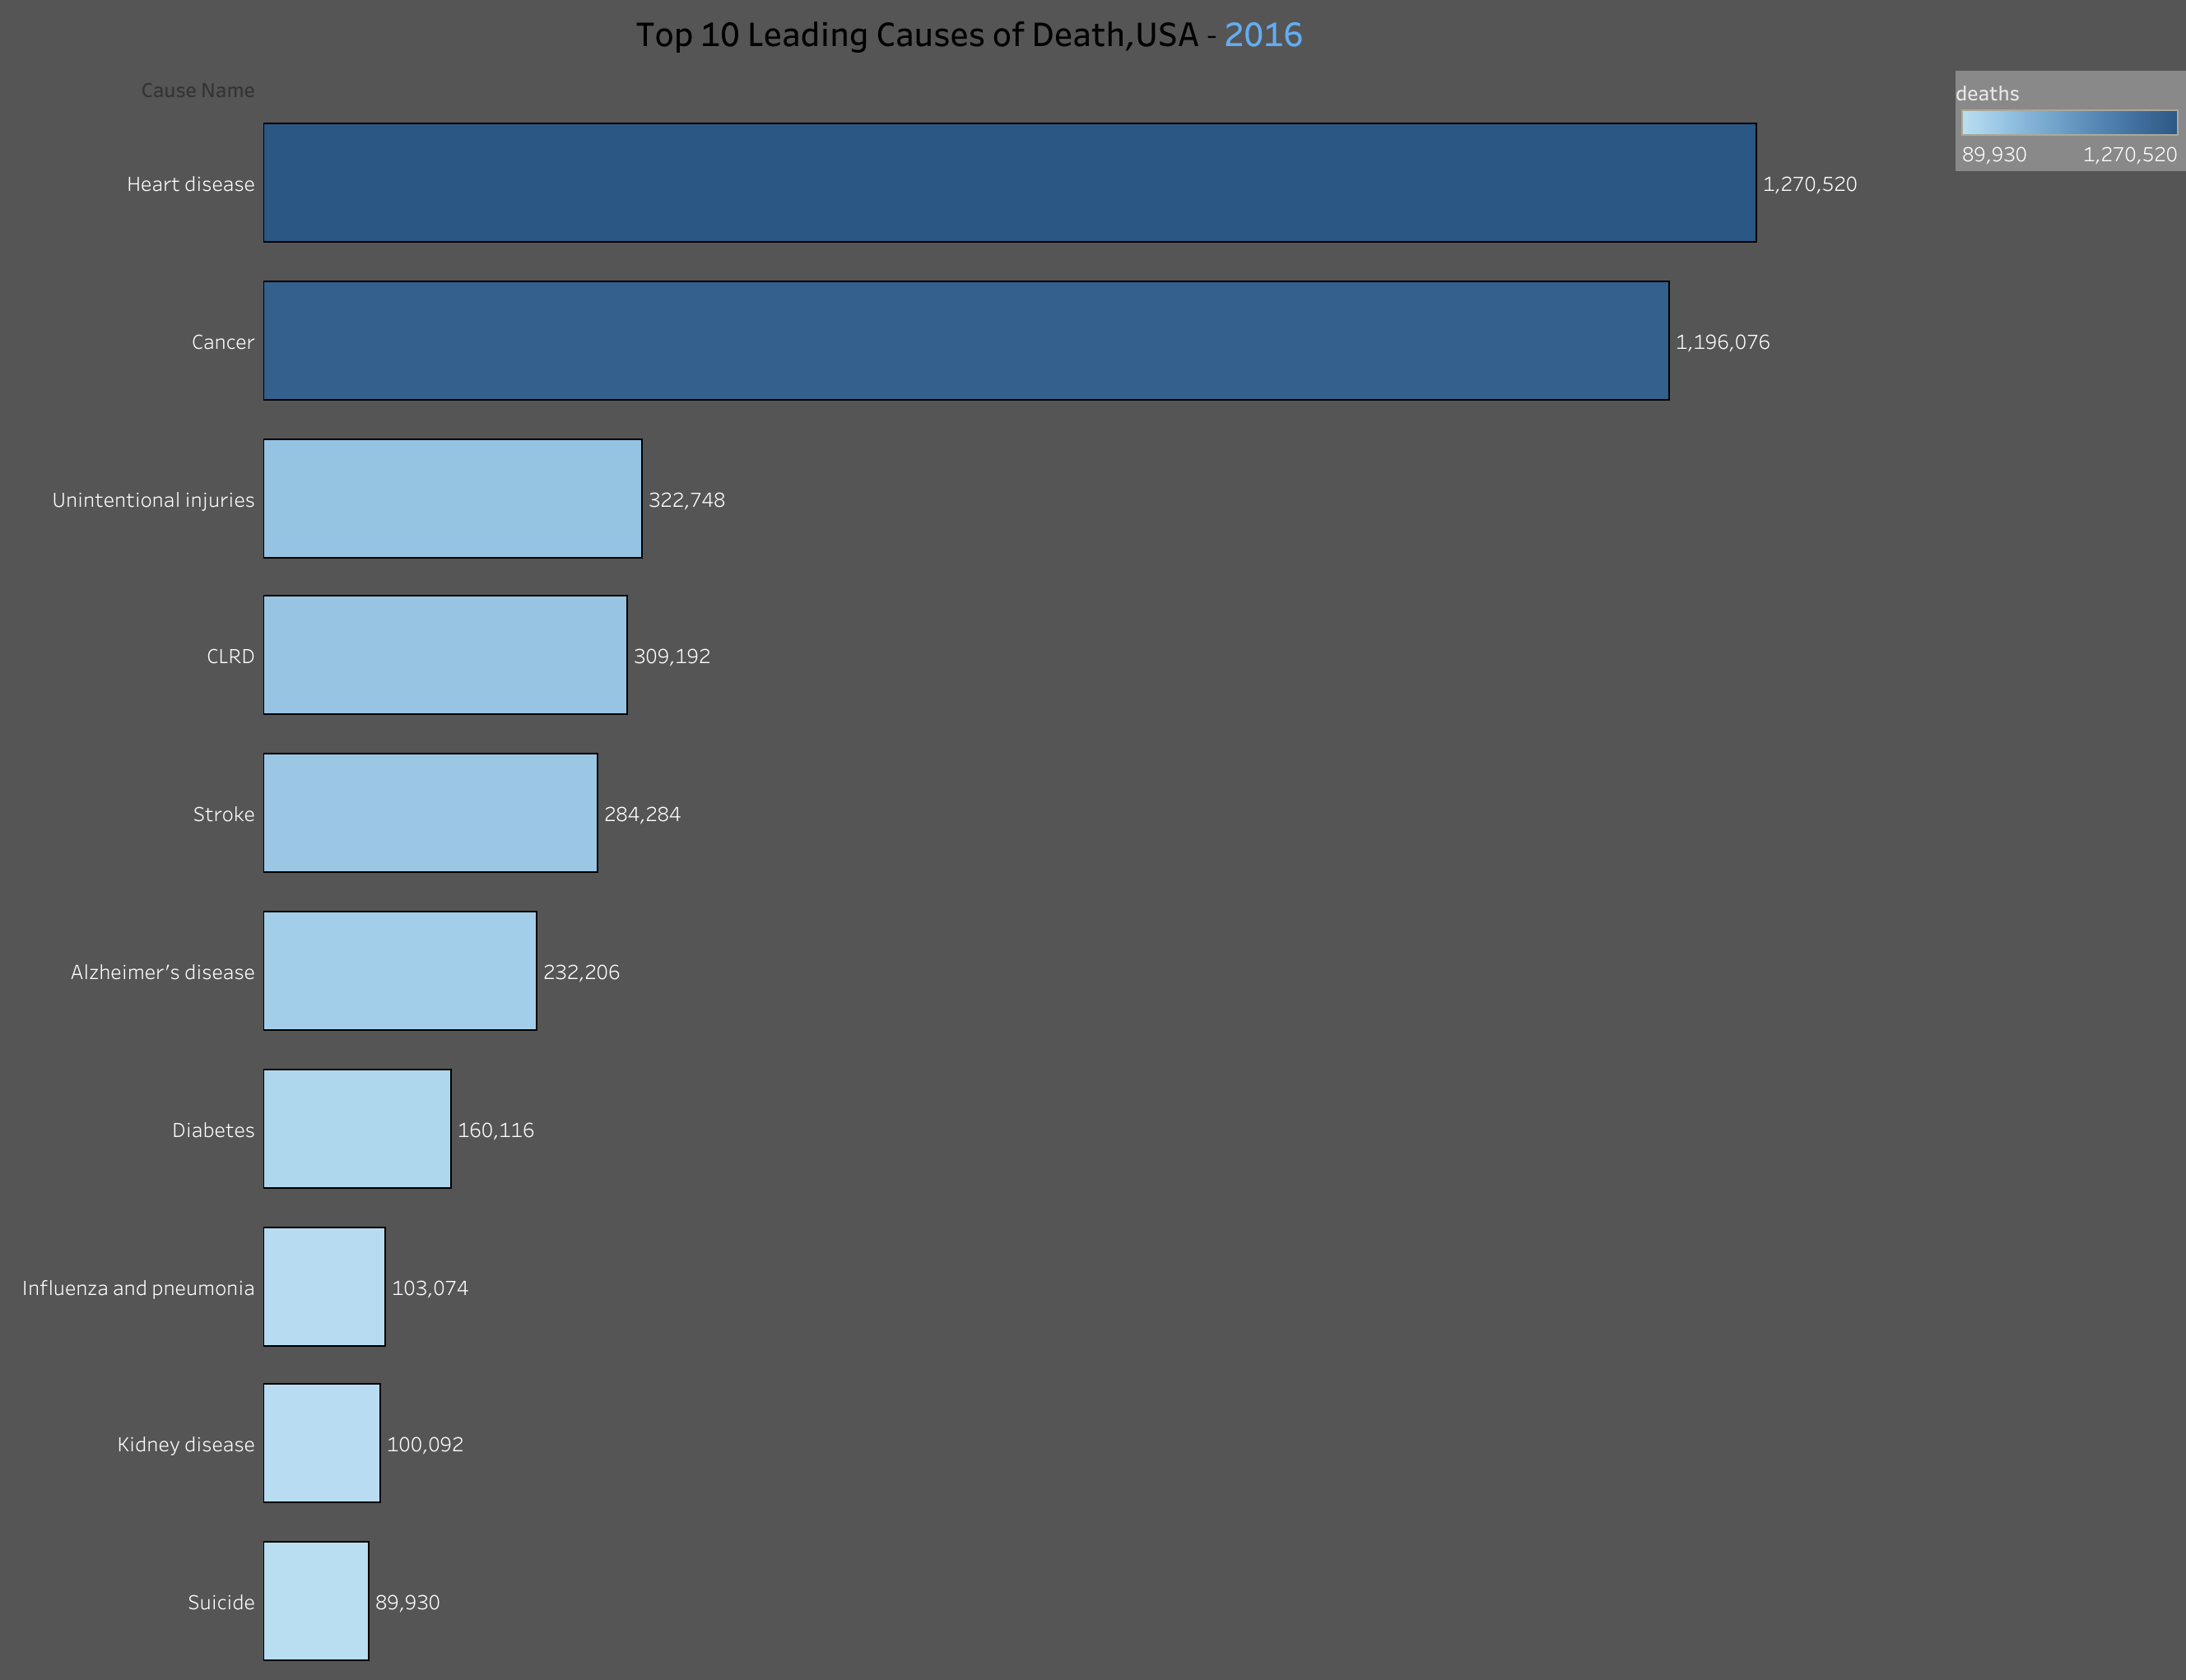
Top 10 Leading Causes of Death
Heart disease
Cancer
Unintentional Injuries
CLRD
Stroke
Alzheimer’s Disease
Influenza pneumonia
Kidney disease
Suicide

Slide 4

This Photo by Unknown Author is licensed under CC BY-SA-NC

Slide 5
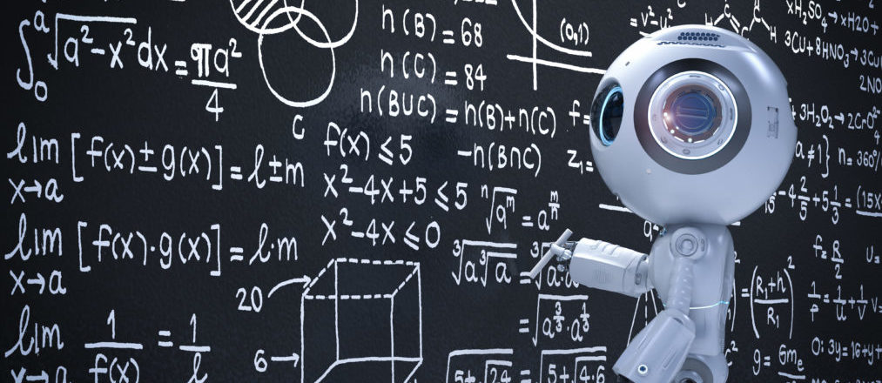
This Photo by Unknown Author is licensed under CC BY

Slide 6
Slide Title
Make Effective Presentations
Using Awesome Backgrounds
Engage your Audience
Capture Audience Attention

Slide 7
Slide Title
Product A
Product B
Feature 1
Feature 2
Feature 3
Feature 1
Feature 2
Feature 3

Slide 8
The End

