Slide 1
Distributed Search Engine
Alicia 1430003023
Supervisor: pHIlIPPE MEunIER
Observer: WEIFENG SU
EXAMINER: DYCE ZHAO

Slide 2
What I have done in my project?
Motivation
FYP I
Overview
Procedure
FYP II
New Features
New Problems

Slide 3
MOTIVATION

Slide 4
Motivation
Distributed is cool !
Search Engine is coooooooool!

Slide 5
FYP I – WHAT I HAVE DONE

Slide 6
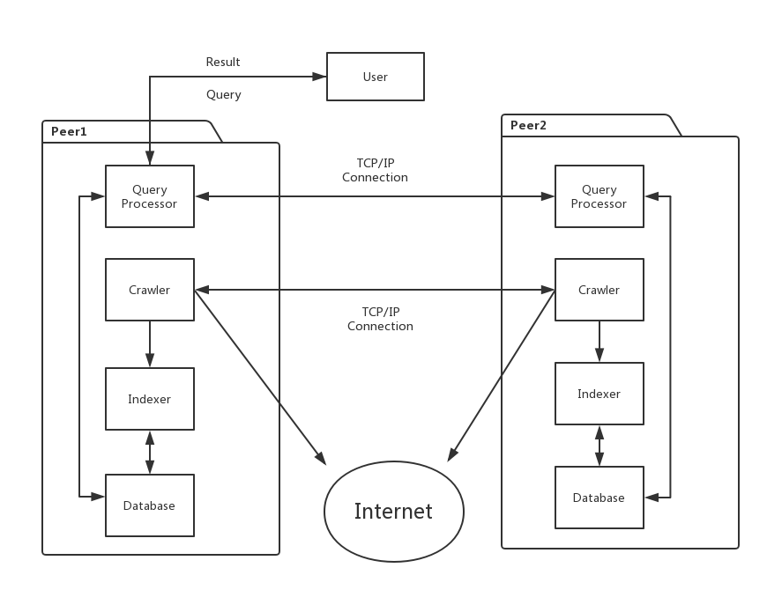
Structure of FYP I Distributed Search Engine
Peer 1
Peer 2
Internet

Slide 7
FYP I - PROCEDURE
Distributed Search
Indexing
Distributed Crawling

Slide 8
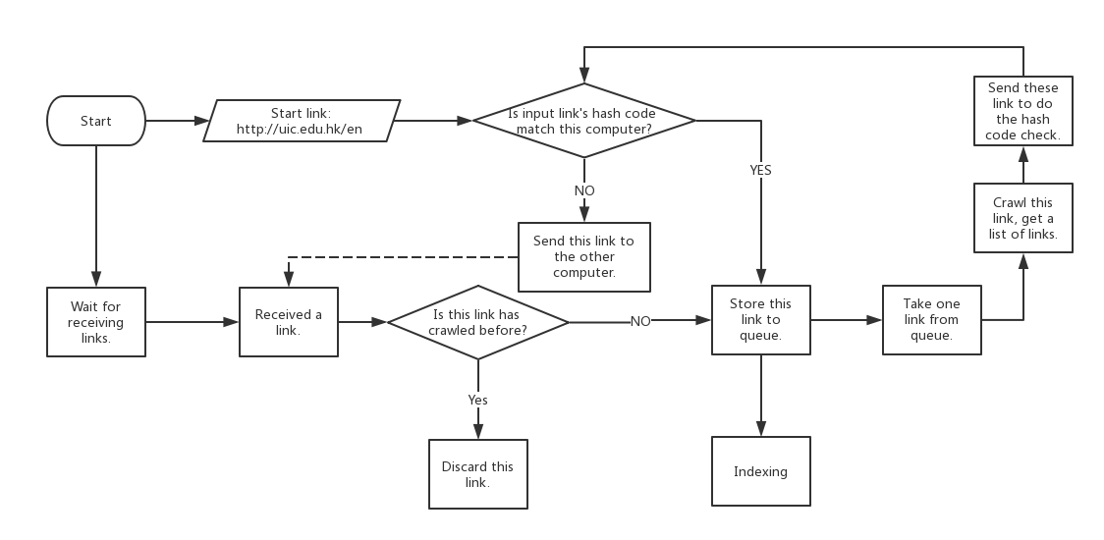
PROCEDURE – Distributed Crawling
Notes:
Threads!

Slide 9
PROCEDURE– Distributed Crawling
2 computers
5 hours
6 thousand pages

Slide 10
PROCEDURE- Indexing
Add URL + KEYWORDS in SQL database.
Since URL is primary key in database, for those URLs are not discovered for the first time just update the keywords in database.

Slide 11
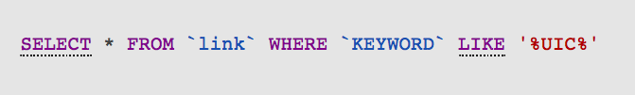
PROCEDURE– Distributed Search
Using the feature in SQL to find the matched URL:
This SQL sentence will search the result in database `link` where the KEYWORD contains “UIC” and regardless the capital and small.

Slide 12
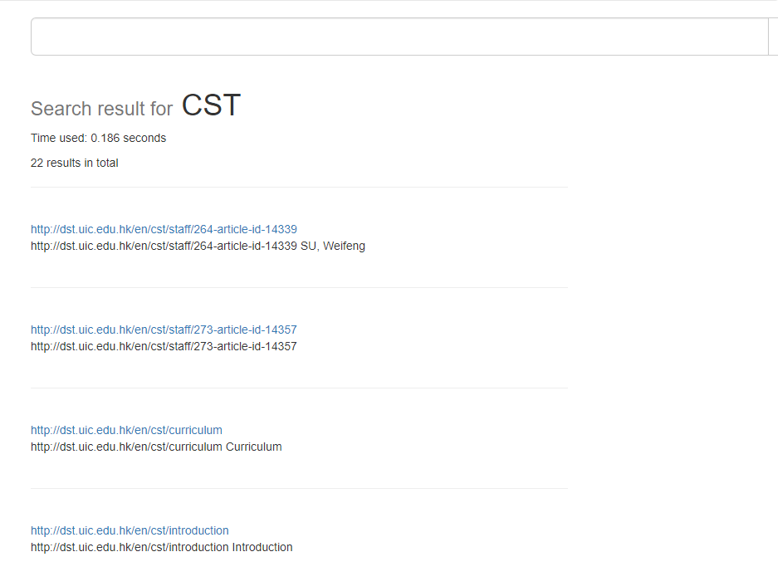

Slide 13
FYP II – What I have done
NEW FEATURES
Dynamic Size
Query Operator
Connection Refused
Mixed Client Name
NEW PROBLEMS

Slide 14
NEW FEATURES - DYNAMIC SIZE
Dynamic means the distributed size is changeable in this distributed network.
Any client could join or leave easily this network during crawling and searching.
We need a server to record all clients’ information.

Slide 15
NEW FEATURES - DYNAMIC SIZE
Increasing
Distributed Size = N
SERVER
0 | 0’s ip
1 | 1’s ip
… | …
N | N’s ip
CLIENT 0
CLIENT 1
CLIENT N
0 | 0’s ip
1 | 1’s ip
… | …
N | N’s ip
0 | 0’s ip
1 | 1’s ip
… | …
N | N’s ip
0 | 0’s ip
1 | 1’s ip
… | …
N | N’s ip
. . .

Slide 16
NEW FEATURES - DYNAMIC SIZE
Increasing
Distributed Size = N + 1
SERVER
0 | 0’s ip
1 | 1’s ip
… | …
N | N’s ip
N+1 | N+1’s ip
CLIENT 0
CLIENT 1
CLIENT N
CLIENT N+1
0 | 0’s ip
1 | 1’s ip
… | …
N | N’s ip
N+1 | N+1’s ip
0 | 0’s ip
1 | 1’s ip
… | …
N | N’s ip
N+1 | N+1’s ip
0 | 0’s ip
1 | 1’s ip
… | …
N | N’s ip
N+1 | N+1’s ip
0 | 0’s ip
1 | 1’s ip
… | …
N | N’s ip
N+1 | N+1’s ip
. . .

Slide 17
NEW FEATURES – DYNAMIC SIZE
Server
Store Clients’ Table
Send Clients’ Table
Each client will connect to server at first.
Server gets the connected client’s information.
Server updates the clients’ table.
Server sends the clients’ table to new client.
Server sends the updated clients’ table to previous client.

Slide 18
NEW FEATURES – DYNAMIC SIZE
Client
Four threads for implementing dynamic.
Listening Server
Listening Clients
Crawling
Searching
Crawling URL
Get new client message
Connect to new clients
Get URLs
Get query message
Check if clients leave
Searching in database

Slide 19
NEW FEATURES - DYNAMIC SIZE
Increasing
Step 0
Distributed Size = 3
SERVER
0 | 0’s ip
1 | 1’s ip
2 | 2’s ip
0
1
2
Internet
CLIENT 0
CLIENT 1
CLIENT 2
0 | 0’s ip
1 | 1’s ip
2 | 2’s ip
0 | 0’s ip
1 | 1’s ip
2 | 2’s ip
0 | 0’s ip
1 | 1’s ip
2 | 2’s ip

Slide 20
NEW FEATURES - DYNAMIC SIZE
Increasing
Step 1
Distributed Size = 3
SERVER
0 | 0’s ip
1 | 1’s ip
2 | 2’s ip
3 | 3’s ip
0
1
2
Internet
CLIENT 0
CLIENT 1
CLIENT 2
CLIENT 3
0 | 0’s ip
1 | 1’s ip
2 | 2’s ip
0 | 0’s ip
1 | 1’s ip
2 | 2’s ip
0 | 0’s ip
1 | 1’s ip
2 | 2’s ip

Slide 21
NEW FEATURES - DYNAMIC SIZE
Increasing
Step 2
Distributed Size = 3
SERVER
0 | 0’s ip
1 | 1’s ip
2 | 2’s ip
3 | 3’s ip
0
1
2
Internet
CLIENT 0
CLIENT 1
CLIENT 2
CLIENT 3
0 | 0’s ip
1 | 1’s ip
2 | 2’s ip
3 | 3’s ip
0 | 0’s ip
1 | 1’s ip
2 | 2’s ip
3 | 3’s ip
0 | 0’s ip
1 | 1’s ip
2 | 2’s ip
3 | 3’s ip
0 | 0’s ip
1 | 1’s ip
2 | 2’s ip
3 | 3’s ip

Slide 22
NEW FEATURES - DYNAMIC SIZE
Increasing
Step 3
Distributed Size = 3 + 1 = 4
SERVER
0 | 0’s ip
1 | 1’s ip
2 | 2’s ip
3 | 3’s ip
0
1
2
3
Internet
CLIENT 0
CLIENT 1
CLIENT 2
CLIENT 3
0 | 0’s ip
1 | 1’s ip
2 | 2’s ip
3 | 3’s ip
0 | 0’s ip
1 | 1’s ip
2 | 2’s ip
3 | 3’s ip
0 | 0’s ip
1 | 1’s ip
2 | 2’s ip
3 | 3’s ip
0 | 0’s ip
1 | 1’s ip
2 | 2’s ip
3 | 3’s ip

Slide 23
NEW FEATURES - DYNAMIC SIZE
Decreasing
Step 0
Distributed Size = 4
SERVER
0 | 0’s ip
1 | 1’s ip
2 | 2’s ip
3 | 3’s ip
0
1
2
3
Internet
CLIENT 0
CLIENT 1
CLIENT 2
CLIENT 3
0 | 0’s ip
1 | 1’s ip
2 | 2’s ip
3 | 3’s ip
0 | 0’s ip
1 | 1’s ip
2 | 2’s ip
3 | 3’s ip
0 | 0’s ip
1 | 1’s ip
2 | 2’s ip
3 | 3’s ip
0 | 0’s ip
1 | 1’s ip
2 | 2’s ip
3 | 3’s ip

Slide 24
NEW FEATURES - DYNAMIC SIZE
Decreasing
Step 1
Distributed Size = 4 - 1 = 3
SERVER
0 | 0’s ip
1 | 1’s ip
2 | 2’s ip
3 | 3’s ip
CLIENT 0
CLIENT 1
CLIENT 3
0 | 0’s ip
1 | 1’s ip
2 | 2’s ip
3 | 3’s ip
0 | 0’s ip
1 | 1’s ip
2 | 2’s ip
3 | 3’s ip
0 | 0’s ip
1 | 1’s ip
2 | 2’s ip
3 | 3’s ip

Slide 25
NEW FEATURES - DYNAMIC SIZE
Decreasing
Step 2
Distributed Size = 3
SERVER
0 | 0’s ip
1 | 1’s ip
3 | 3’s ip
CLIENT 0
CLIENT 1
CLIENT 3
0 | 0’s ip
1 | 1’s ip
3 | 3’s ip
0 | 0’s ip
1 | 1’s ip
3 | 3’s ip
0 | 0’s ip
1 | 1’s ip
3 | 3’s ip

Slide 26
NEW FEATURES - DYNAMIC SIZE
Decreasing
Step 3
Distributed Size = 3
SERVER
0 | 0’s ip
1 | 1’s ip
2 | 2’s ip
0
1
2
Internet
CLIENT 0
CLIENT 1
CLIENT 2
0 | 0’s ip
1 | 1’s ip
2 | 2’s ip
0 | 0’s ip
1 | 1’s ip
2 | 2’s ip
0 | 0’s ip
1 | 1’s ip
2 | 2’s ip

Slide 27
NEW FEATURES – QUERY OPERATER
Two query commands:
\and: Search “zhao \and jing”
\or: Search “judy \or weifeng”

Slide 28
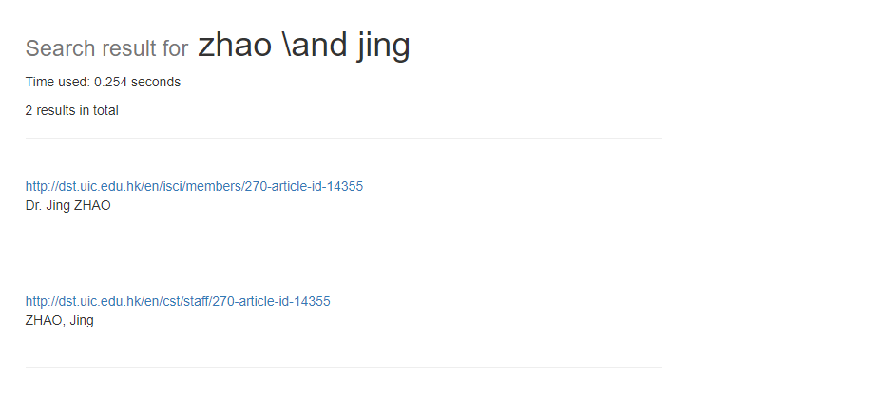
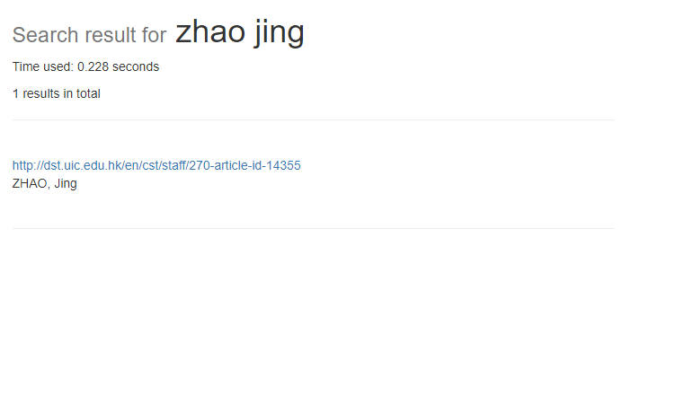
NEW FEATURES – QUERY OPERATER

Slide 29
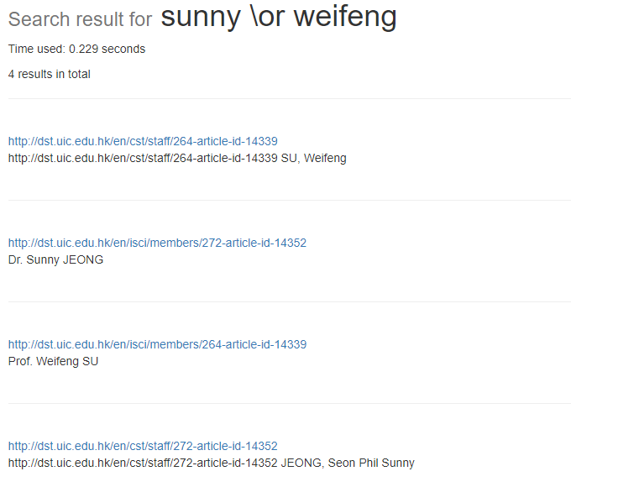
NEW FEATURES – QUERY OPERATER

Slide 30
NEW FEATURES – QUERY OPERATER
Why using \:
Avoid mixing the query “or” with the operator “or”.

Slide 31
NEW PROBLEMS
Connection Refused
The network of lab has firewall.
This distributed network can be only run in lab.
Mixed The Client Name
After a new client joined this distributed network, all old client will try to connect to this new client.
The connections are unordered, so the name of all old client has to be verified.

Slide 32
NEW PROBLEMS- MIXED NAME
Increasing
Step 2
Distributed Size = 3
SERVER
0 | 0’s ip
1 | 1’s ip
2 | 2’s ip
3 | 3’s ip
CLIENT 0
CLIENT 1
CLIENT 2
CLIENT 3
0 | 0’s ip
1 | 1’s ip
2 | 2’s ip
3 | 3’s ip
0 | 0’s ip
1 | 1’s ip
2 | 2’s ip
3 | 3’s ip
0 | 0’s ip
1 | 1’s ip
2 | 2’s ip
3 | 3’s ip
0 | 0’s ip
1 | 1’s ip
2 | 2’s ip
3 | 3’s ip

Slide 33
NEW PROBLEMS- MIXED NAME
Increasing
Step 3
Distributed Size = 3 + 1 = 4
SERVER
0 | 0’s ip
1 | 1’s ip
2 | 2’s ip
3 | 3’s ip
CLIENT 0
CLIENT 1
CLIENT 2
CLIENT 3
0 | 0’s ip
1 | 1’s ip
2 | 2’s ip
3 | 3’s ip
0 | 0’s ip
1 | 1’s ip
2 | 2’s ip
3 | 3’s ip
0 | 0’s ip
1 | 1’s ip
2 | 2’s ip
3 | 3’s ip
0 | 0’s ip
1 | 1’s ip
2 | 2’s ip
3 | 3’s ip

Slide 34
DEMO

Slide 35
THANK YOU

Slide 36
THANKS TO:
All 2014 CSTers and PHILIPPE!!

Slide 37
Q & A

