Slide 1
Application Projects

Slide 2
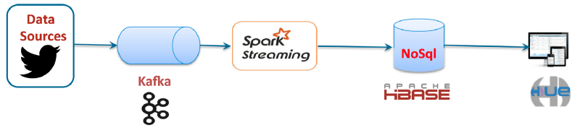
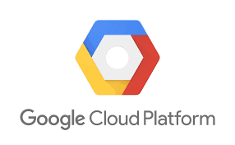

1st Application Project: Capture tweets in Real Time
Mostly following:
How to capture and store tweets in Real Time with Apache Spark and Apache Kafka. Using cloud Platforms such as Databricks and GCP (Part 1)
https://towardsdatascience.com/how-to-capture-and-store-tweets-in-real-time-with-apache-spark-and-apache-kafka-e5ccd17afb32

Slide 3
1st Application Project: Capture tweets in Real Time
First Steps for Next Wednesday February 6th
Create (or use) your Twitter account
(and follow! @mstc_ssr )
To get tweets, you must register in TwitterDevs and create an application.

Slide 4
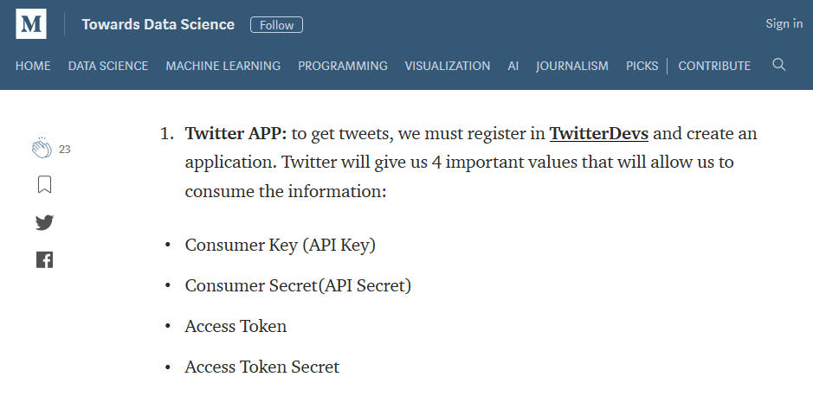
1st Application Project: Capture tweets in Real Time
https://towardsdatascience.com/how-to-capture-and-store-tweets-in-real-time-with-apache-spark-and-apache-kafka-e5ccd17afb32

Slide 5
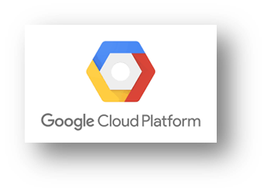
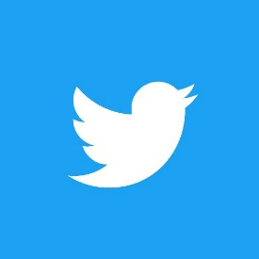

1st Application Project: Capture tweets in Real Time
So for next Wednesday February 6th try:
Register and Redeem your Google Cloud Platform (GCP)
Create a Compute Engine in GCP
Register in TwitterDevs and create an application.
Sign Up to Databrics Community Edition
https://community.cloud.databricks.com/login.html

