Slide 1
Salinity
Group 3 - Damaris, Astrid, Alicia, Rosa

Slide 2
How SALINITY relates to climate change:
Water density is determined by salinity and temperature
Ocean circulation is driven by the density of the water.
Water that has high salinity levels can become dense enough to sink which can affect the ocean circulation.
A density-controlled circulation is key to transporting heat maintaining Earth's climate
As the water in some areas gets fresher and others get saltier, the climate on earth can drastically change.
Our Topic is SALINITY:
What is SALINITY:
Salinity is the amount of salt in a body of water.
The increase of salinity in water can occur from weathering of rocks or the evaporation of ocean water.
There are processes that can decrease salinity such as precipitation or the input of fresh water.
Notes:
What is SALINITY:
Salinity is the amount of salt in a body of water. The increase of salinity in water can occur from many processes such as the weathering of rocks which can break down minerals such as salt or the evaporation of ocean water. However there are also processes that can decrease salinity such as precipitation or the input of fresh water.
How SALINITY relates to climate change:
Water density is determined by salinity and temperature and ocean circulation is driven by the density of the water. Water that has high salinity levels can become dense enough to sink to great depths which can in turn affect the ocean circulation. A density-controlled circulation is key to transporting heat in the ocean and maintaining Earth's climate as the ocean stores a lot of heat. As the water in some areas gets fresher and others get saltier, the climate on earth can drastically change.

Slide 3
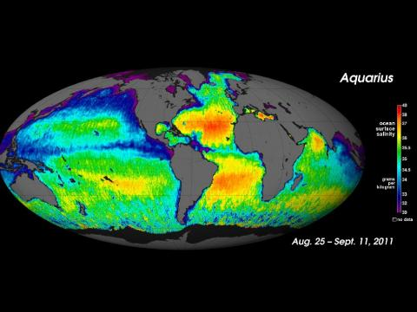
Explaining the data :
What does Aqua measure :
It was built to study the salt content of ocean surface waters.
It measures the salt concentration or changes in salinity.
The salinity sensor detects the microwave emissivity of the top 1 to 2 centimeters of ocean water.
The instrument collects data in a 386 kilometer-wide (240-mile)strip in an orbit designed to obtain a complete survey of global salinity of ice-free oceans every seven days.
Notes:
What does Aqua measure :
The aqua or the Aquarius/Satélite de Aplicaciones Científicas was built to study the salt content of ocean surface waters. It measures the salt concentration or changes in salinity. The salinity sensor detects the microwave emissivity of the top 1 to 2 centimeters of ocean water. It is a physical property that varies depending on temperature and saltiness. The instrument collects data in a 386 kilometer-wide (240-mile)strip in an orbit designed to obtain a complete survey of global salinity of ice-free oceans every seven days.

Slide 4
Rationale
Why visualize data?
We visualize data in order to have a clearer understanding of what our information means and make it easier for whoever is seeing this data to identify patterns or issues.
Why use these types of visualizations?
We use these types of visualizations for easier identification of changes in the salinity of water as the subtle or drastic changes in color tell whether the salinity is higher or lower in certain areas.
Why use python?
Python is a a general purpose and high level programming language, used to make apps, websites,etc. Due to its simple syntax rules, it makes it easier to understand and keeps the code base readable.

Slide 5
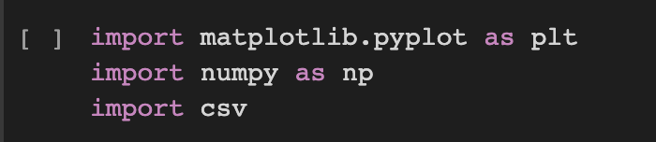
The first step is always to import coding libraries.
In our code, we used matplotlib and numpy to help make our maps, and csv to read our csv files.
Next, we opened our first csv file for the practical salinity units from December 2011 and got to work.

Slide 6
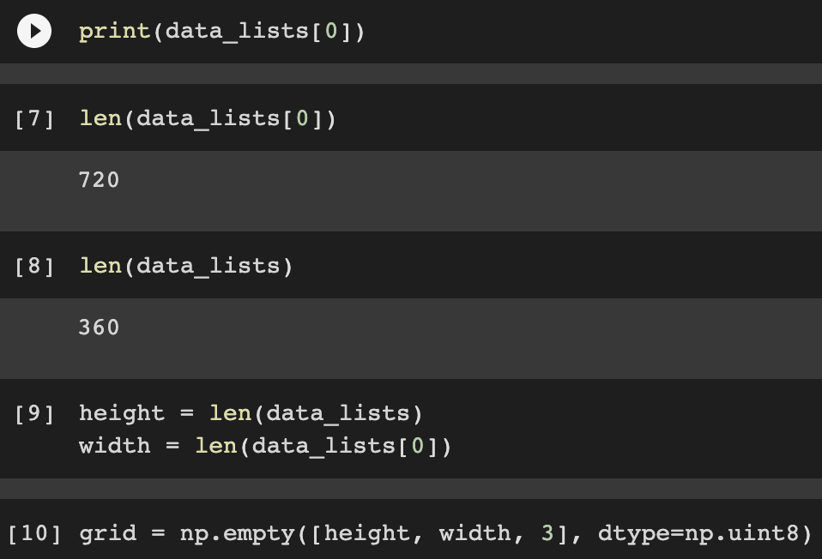
Then, we found out the length of our datalists and used those as the height and width in our visualization.
720 - height (columns)
360 - width(rows)

Slide 7
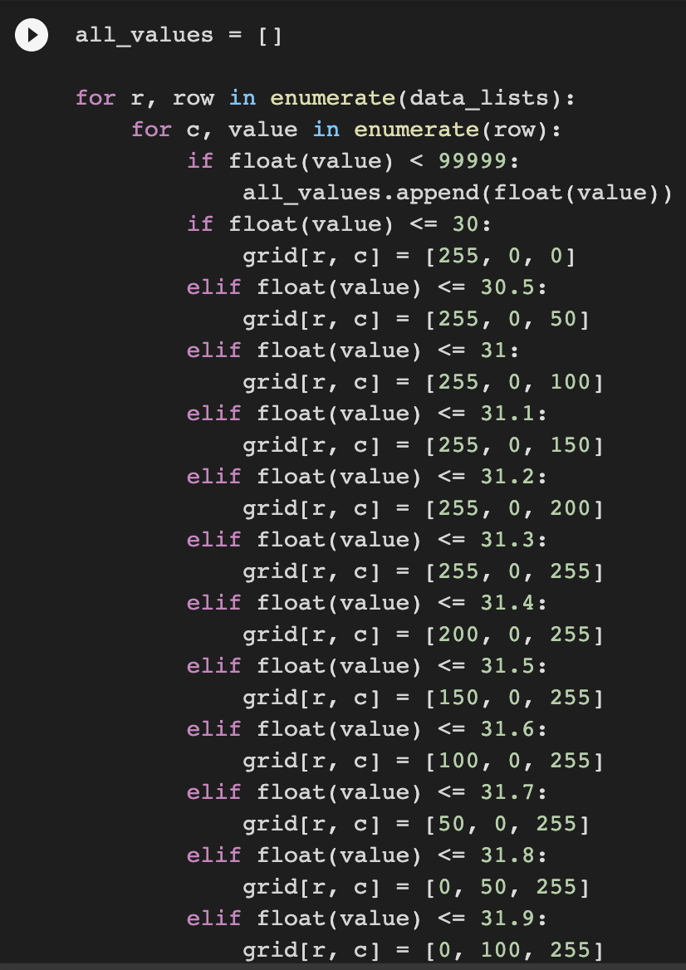
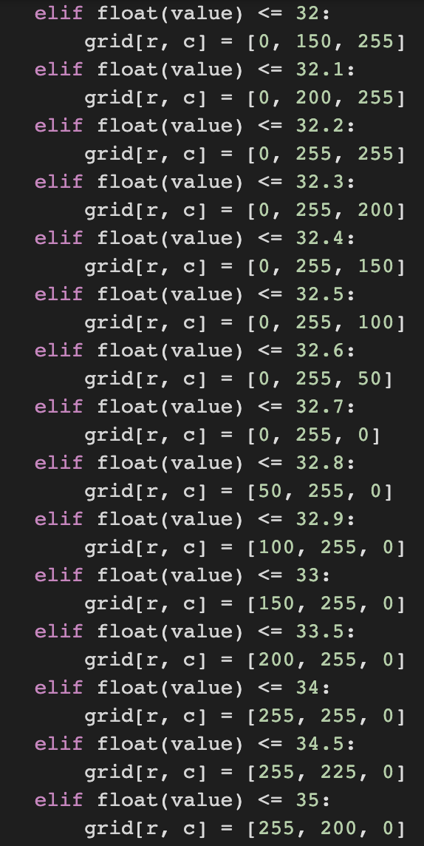
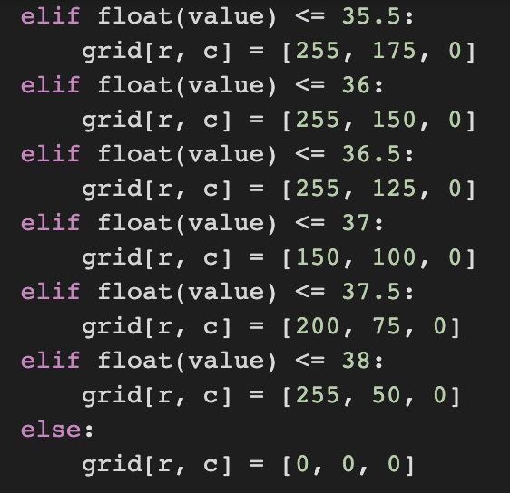
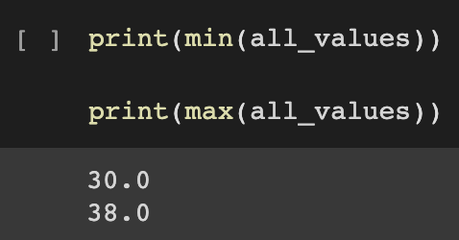
Then we started to create our conditionals, but before we could start with our if statements we needed to know the minimum and the maximum of all the values, so we used the min and the max function to find out that the minimum was 30, and the maximum was 38. Using that information, we created our if statements.

Slide 8
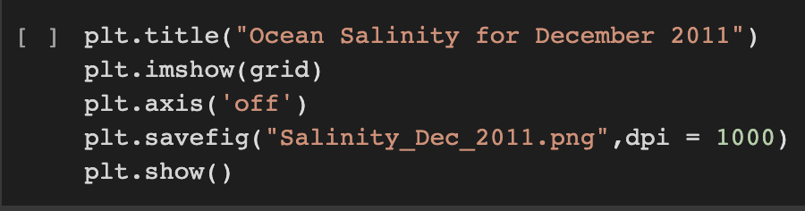
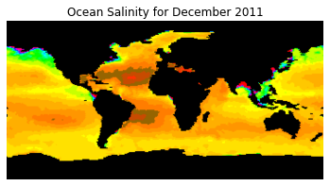
Finally, we titled our image and displayed it by using plt.show, and this was the final result.

Slide 9
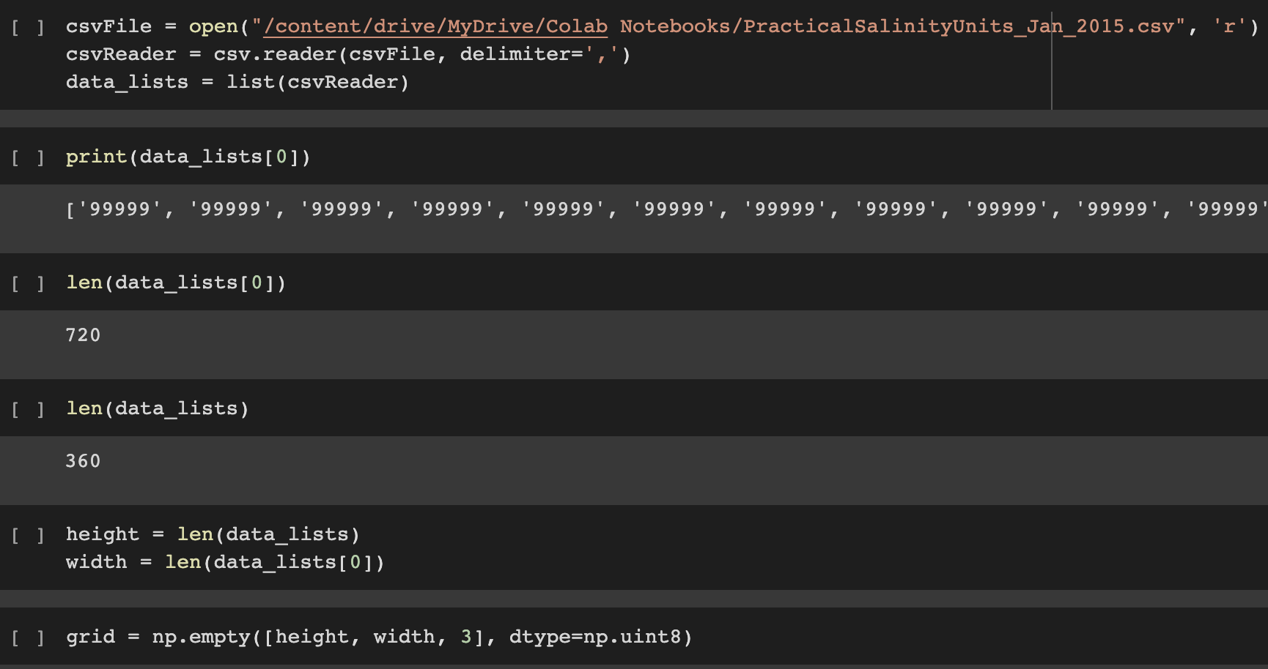
Notes:
Quick intro about how we used the same code for Jan 2015 and the only difference was opening a different csv file.

Slide 10
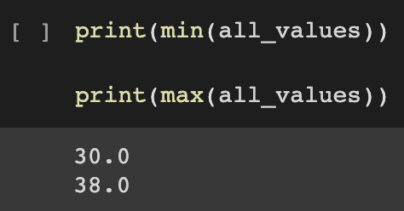
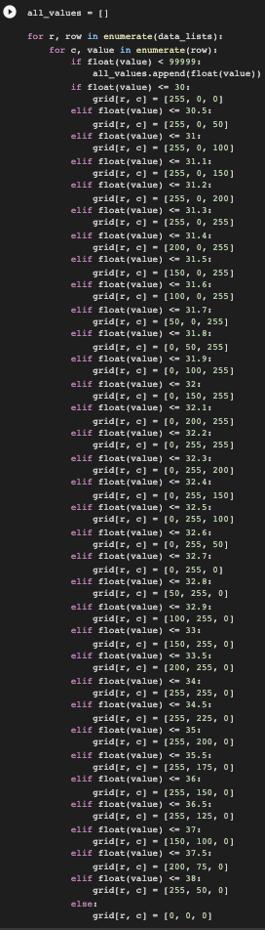
For January 2015, we quickly noticed that the file had the same maximum and minimum values, so it made us able to reuse the same if statements from earlier.

Slide 11
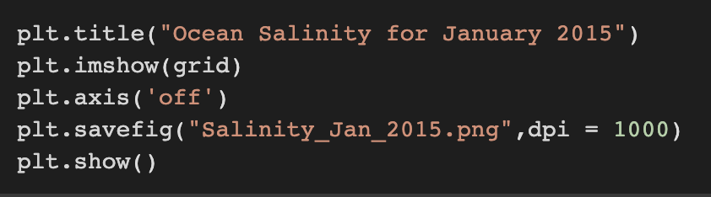
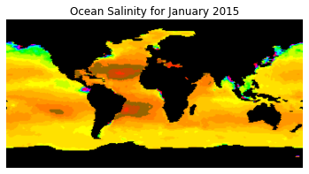
Finally, we titled our image and displayed it.

Slide 12

At first glance, both images look remotely similar, but after analyzing them for a little bit, you can notice that there is more ocean salinity in January 2015 than in December 2011.
More Salinity
Less Salinity

Slide 13
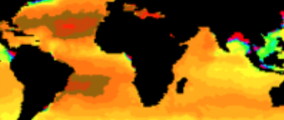
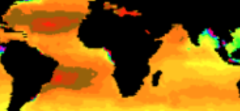
Scientific Conclusions
According to our data from December 2011 to January 2015, the salinity of the ocean has gradually increased over the years. Our visualization shows that areas like the Atlantic ocean, Indian ocean and the pacific ocean have a more drastic salinity increase than other areas around it as its color changes significantly.
December 2011 (Atlantic & Indian ocean)
January 2015 (Atlantic & Indian ocean)

Slide 14
Challenges and Solutions:
CHALLENGES:
SOLUTIONS:
Our biggest challenge was getting the different images. As you could see the images are very similar so there were several times where we kept getting the same results.
To solve this issue, we had to make our if statements use smaller numbers, and we had to run certain cells to make sure the computer was not reading the data from previous cells.In the end, we were able to receive our two images.

Slide 15
Next steps
After doing on this research on ocean salinity and the consequences an increasing salinity has on the environment, we think we should use this information to figure out the steps we can take as individuals to help lower ocean salinity and make the world a better environment to live in.

