Slide 1
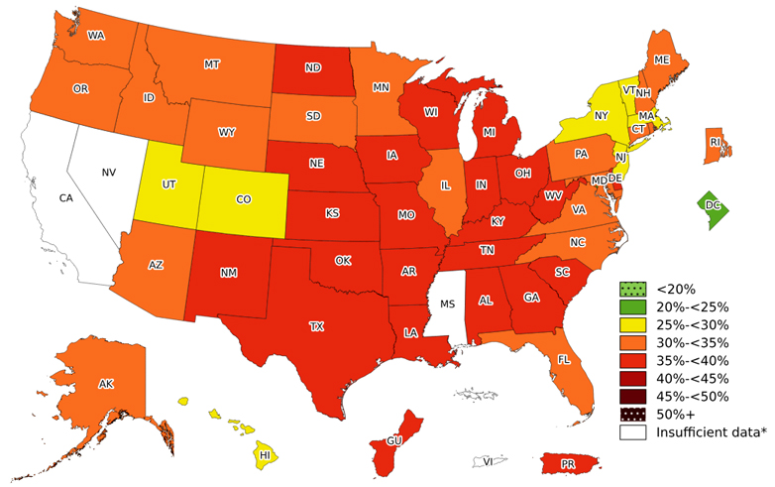
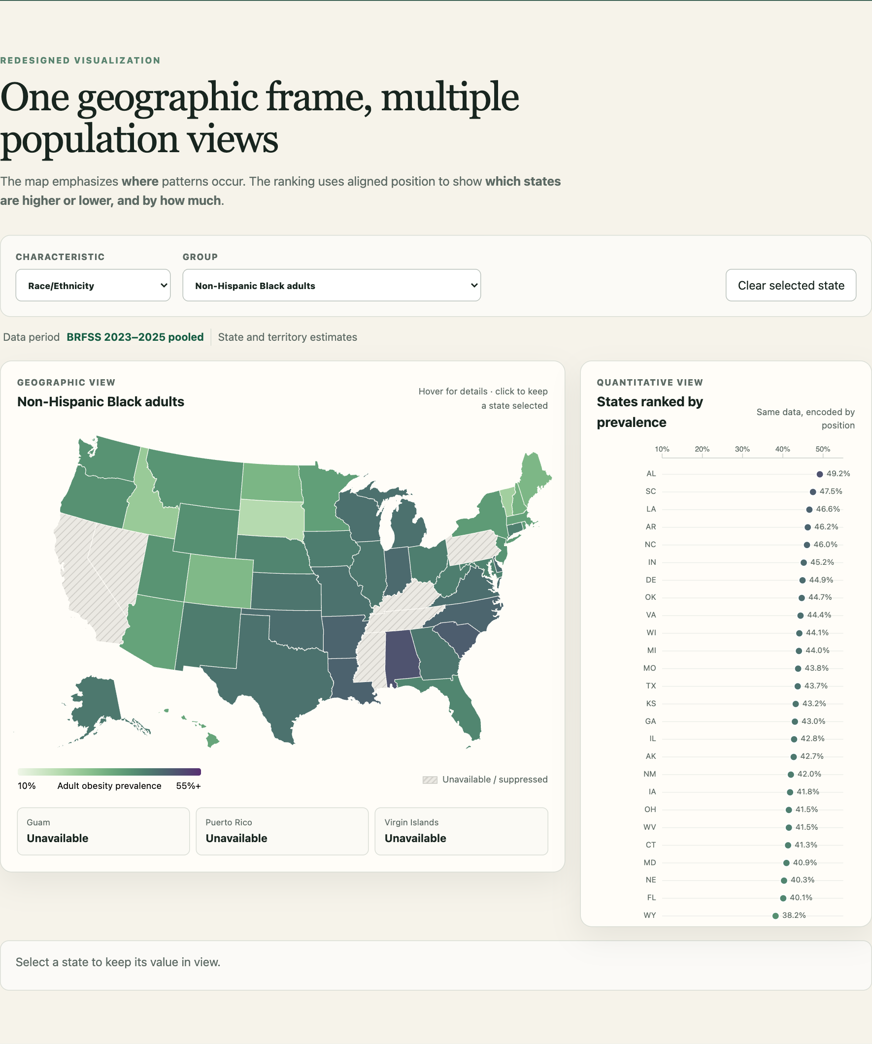
Redesigning CDC Adult Obesity Prevalence Maps
From repeated static maps to interactive comparison
ORIGINAL CDC VISUALIZATION
THREE TASK GAPS
INTERACTIVE D3 REDESIGN
01
Repeated maps
One persistent map
Scrolling and memory make subgroup comparison difficult.
Switch groups without losing geographic context.
02
Cross-group exploration
Demographic selectors
Different populations are separated across the page.
Explore age and race/ethnicity directly.
Strength preserved
The map clearly shows geographic patterns within each population group.
03
Imprecise comparison
Linked state ranking
Color and geographic area make exact state comparison difficult.
Dot plot and tooltip support precise comparison.
Map = WHERE are the patterns? • Dot plot = WHICH states are higher, and by HOW MUCH?
Notes:
Sources: CDC Adult Obesity Prevalence Maps, https://www.cdc.gov/obesity/data-and-statistics/adult-obesity-prevalence-maps.html
Redesign screenshot: Guyun (Alicia) Lu, STATS401 project.
The original map remains valuable for geographic pattern detection. The redesign adds faster subgroup switching and precise state comparison.

