Slide 1
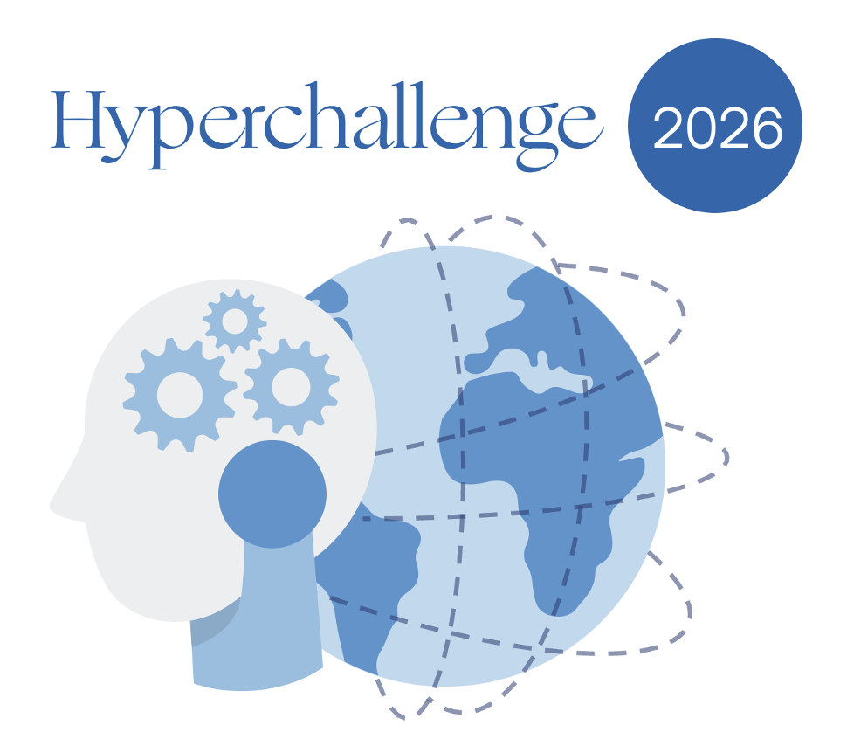
Name of the Team
Selected Use Case
EOSAI – Alicia Sanchez Lorente
CI_Data_Insights — Leveraging Historical Data to Improve New Business Decisions
Team Members
Main learning from experience
Alicia Sanchez Lorente · a.sanchezlorente@zurich.com
Building EU AI Act compliance as an architectural concern — not a post-hoc audit — is significantly cheaper and builds UW trust from day one. MCP + asyncio.gather or tool parallelization is the right pattern for enterprise AI tooling.
How your approach is solving the problem
EOS AI applies renewal-like intelligence to New Business decisions. When a UW receives a repeat submission, the agent surfaces full historical context, delta analysis, structural peers from a Knowledge Graph, and a risk score grounded in Zurich UW guidelines — all in under 3 minutes.
What the results of the prototype are
9,078 repeat customers identified (34% of book). Bind Rate validation: FAST_TRACK binds at 68% · STANDARD_UW 41% · FRESH_UW 12%. 18-tool ReAct agent operational with parallel execution. EU AI Act Art.10/12/13/14 compliant. Knowledge Graph with 10,232 nodes and 36,312 edges operational.
What are the next steps for scaling your solution
Phase 3 multi-agent system, feedback loop from UW decisions, temporal Knowledge Graph, EU AI Act Art. 43 conformity assessment, production infrastructure (PostgreSQL, React, K8s).

