Slide 1
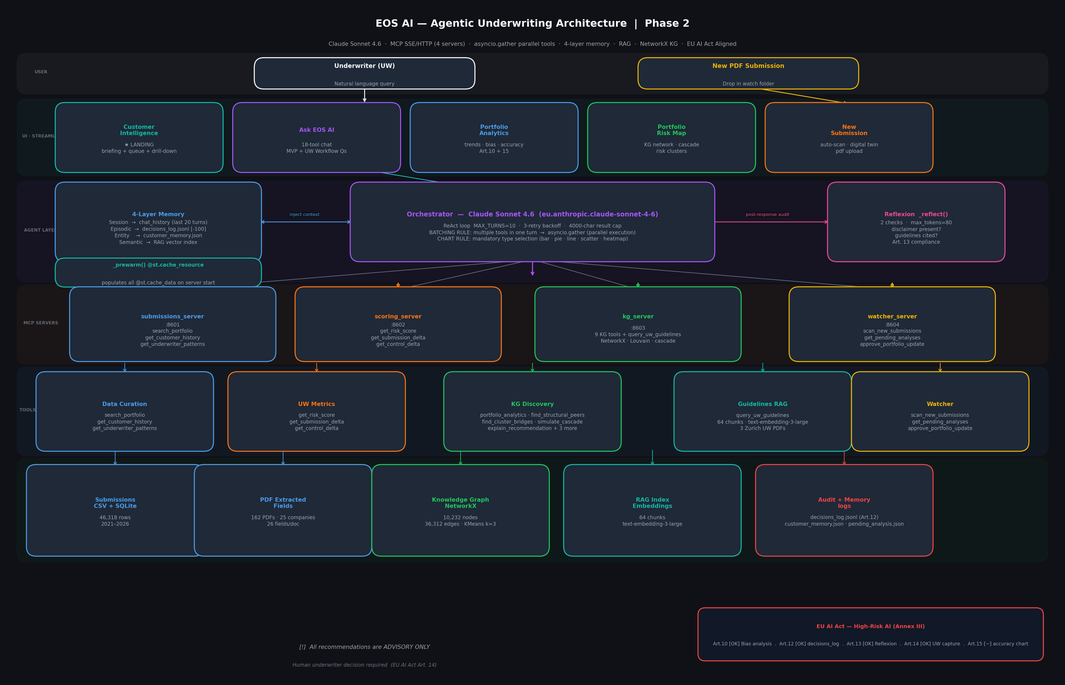
Problem Approach & Solution Design
From 80 minutes to 3 minutes — EOS AI for Repeat Submissions
Drawback
Zurich Specialties treats repeat customers as new business every year
UW spends in avg 55–80 min per submission doing manual research
46,318 submissions (2021–2026) contain the answer — unused
Advantage:
EOS AI: 18-tool ReAct agent (Claude Sonnet 4.6)
Knowledge Graph: 10,232 nodes · 36,312 edges
4 MCP servers · asyncio.gather parallel execution
RAG on 3 Zurich UW guideline PDFs
Event-driven watcher: auto-analyses new PDFs in 30s
EU AI Act Art.10/12/13/14/15 compliant from day 1

Slide 2
Results & Key Insights
Validated results on 9,078 repeat customers
Main Metrics :
⏱ 55–80 min → < 3 min per repeat submission
📊 34% of book are repeat customers (9,078 identified)
🎯 Bind rate proof: FAST_TRACK 68% · STANDARD_UW 41% · FRESH_UW 12%
Additional Key insights:
Knowledge Graph reveals hidden cascade risks (broker failure → portfolio contagion)
Digital twin matching: new submissions matched to structural peers in real time
Chain of thought visible to UW — no black box
Full audit trail in decisions_log.jsonl (EU AI Act Art. 12)

Slide 3
Next Steps & Recommendations
Production roadmap — three phases, clear governance
## Horizon 1 — Production Ready (0–3 months)
Docker/K8s for all 4 MCP servers · PostgreSQL · Azure AD SSO
CI/CD pipeline: lint → tests → staging → production
Observability: structured logging · token cost tracking · latency dashboards
Azure Key Vault for secrets · role-based access (UW / Team Lead / Admin)
## Horizon 2 — Scale & Reliability (3–6 months)
React + FastAPI frontend · WebSocket streaming · Agent Gateway with rate limiting
Kafka event-driven ingestion (replace 30s file watcher)
Neo4j persistent KG with timestamped edges · `snapshot_at(date)` queries
Azure AI Search managed vector store · automated RAG re-indexing on guideline updates
Cost at scale: **~$375/month** LLM · ~$200–500/month infrastructure
## Horizon 3 — Intelligent System (6–12 months)
**Multi-agent:** Orchestrator + Data Agent + Risk Agent + KG Agent + Governance Agent
Feedback loop from aggregated UW decisions (GDPR Art. 22 compliant)
External signals: threat intelligence feeds · financial news → KG enrichment
EU AI Act Art. 43 conformity assessment (third-party audit · ~€15–30K · 4–8 weeks)
Monthly drift detection · DPIA · RACI documented
"We built EU AI Act governance from day one. No surprises for legal."*

