Slide 1
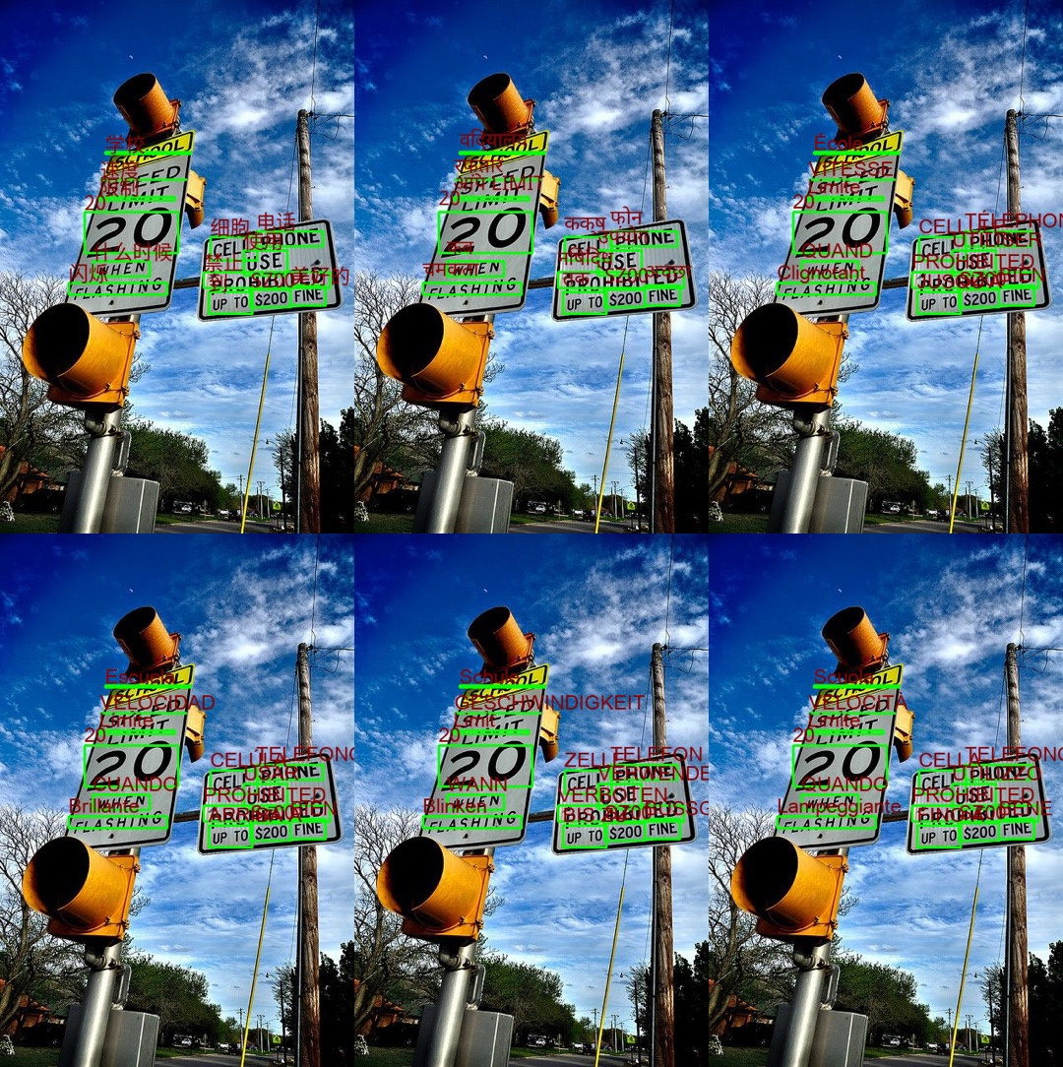
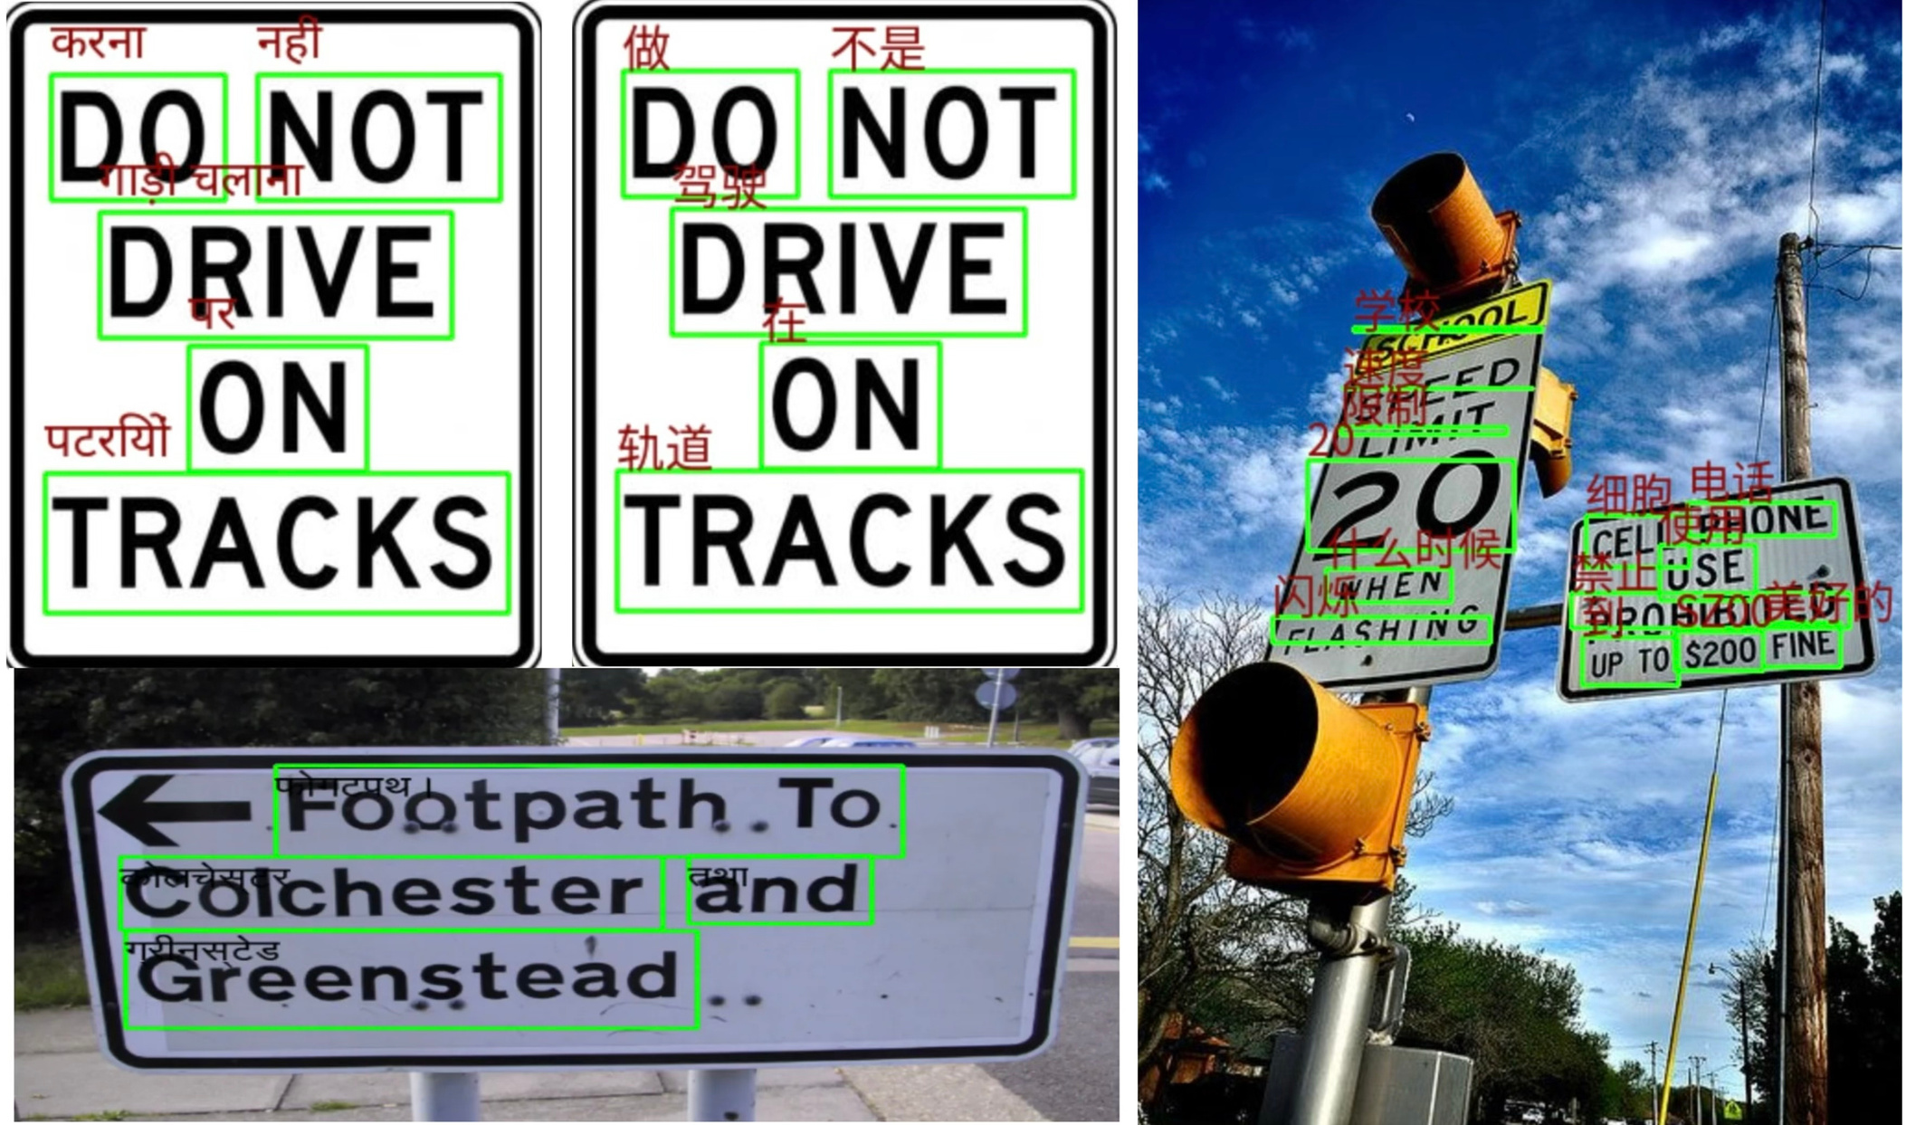
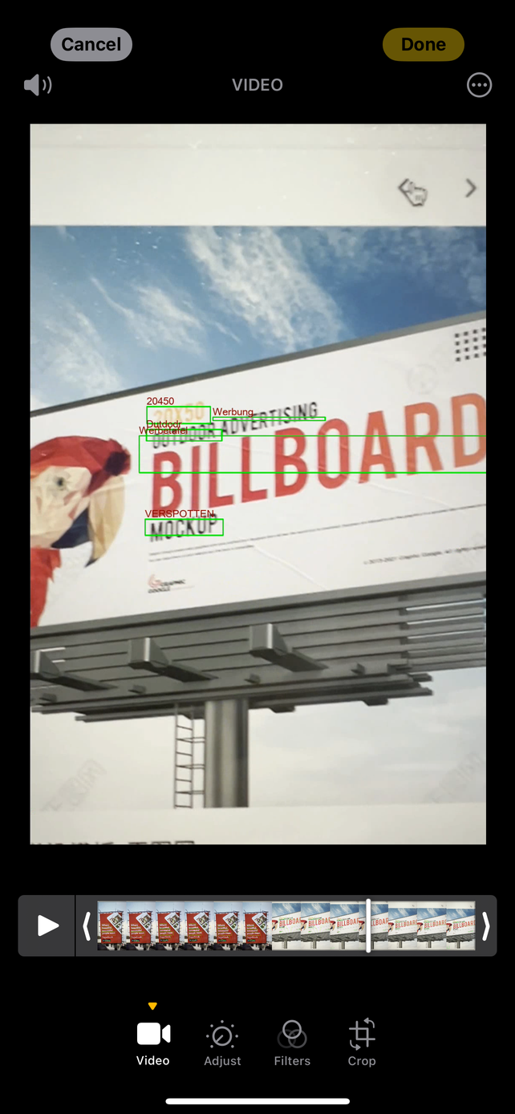

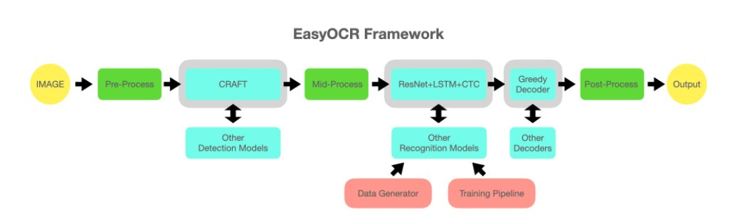
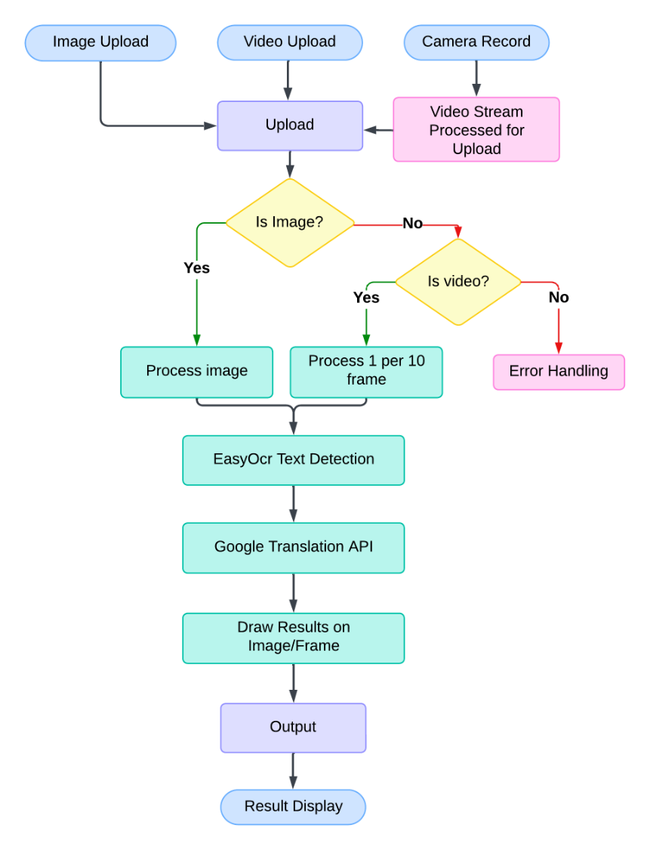
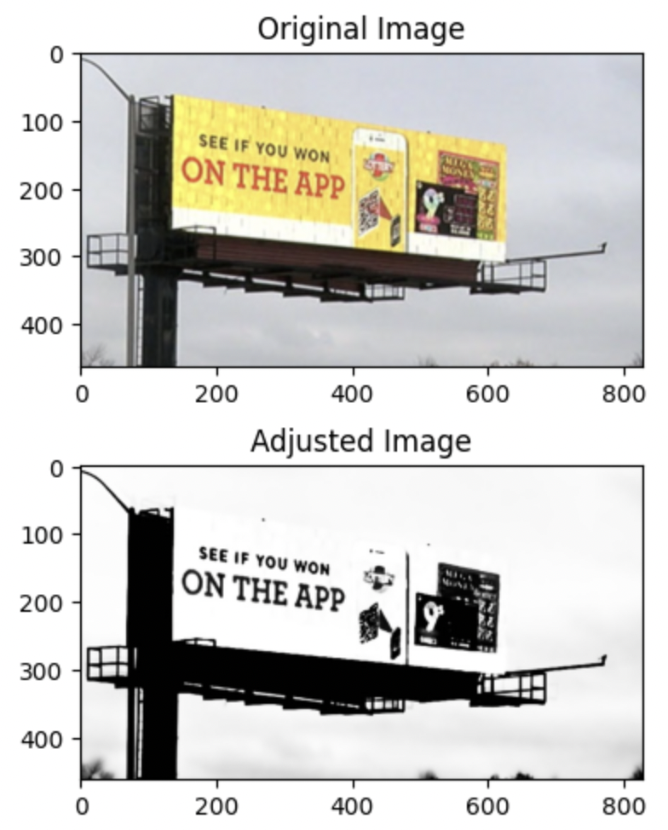
Real-Time Text Detection, Recognition, and Translation System for Video Streams
AUTHORS
AFFILIATIONS
Yiling Hu, Ziyang Liang, Derek Zhang, Yichi Zhang, Instructor: Prof. Jeongkyu Lee
Course project of CS5330 Pattern Recognition and Computer Vision, Khoury College of Computer Science, Northeastern University
A web app for real-time detection and translation of road signs and advertising boards
BACKGROUND (or Introduction)
APPROCHES (or Methods)
RESULTS (or Evaluations)
With the increasing demand for real-time information accessibility, there is a growing need for systems that can detect, recognize, and translate text from live video feeds in diverse environments. Such technology has the potential to aid travelers, provide accessibility tools for visually impaired individuals, support language learning, and automate document translation. This project addresses these needs by developing a robust, real-time system capable of processing text in various languages, fonts, orientations, and environmental conditions, using high-quality datasets and advanced text detection, recognition, and translation techniques.
This system detects, recognizes, and translates text in real-time from images using Python. Key steps include:
Our system was tested on a dataset of video streams and static images across diverse scenarios, including varying lighting conditions, complex backgrounds, and multilingual text.
The application demonstrated a high detection rate for clear and simple text and successfully translated it into the target language.
Challenges arose with handwritten or stylized fonts for non-latin languages such as , and further optimization is needed for faster real-time processing in low-resource environments.
Setup: Install libraries (EasyOCR, Pillow, Googletrans) for text detection and translation.
Text Detection: EasyOCR detects text in images and returns bounding boxes and text with confidence scores.
Translation: Googletrans API translates detected text to the target language.
Overlay Translation: Translated text is displayed above detected regions using PIL.
Display: The final image with highlighted and translated text is shown using OpenCV.
This approach provides efficient, multilingual text processing in various environments. We are training and fine-tuning it based on existing models.
Also, in order to increase processing speed, we avoid processing each single frame but process every nth frame based on video’s frame rate to balance speed and quality.
Figure 3. multilingual translations demos
Future Directions
Figure 4. EasyOCR Framework
Future developments aim to expand the system's capabilities beyond the current local web application running on CPU.
While the current version operates effectively for text detection and translation on a local setup, we envision optimizing the system for mobile devices to provide users with greater accessibility and portability.
Enhancing processing speed to enable real-time performance remains a key goal, particularly as we explore potential GPU-based solutions or lightweight optimizations.
Although cloud deployment is not currently feasible due to funding limitations, future support could allow us to leverage cloud resources for broader scalability.
Additionally, refining the application through collaboration with accessibility groups could help us tailor the system to meet diverse user needs and extend its impact to a wider audience.
Figure 1. multi input result demos
Figure 2. UI demos
PROBLEM STATEMENT
Low-Quality Inputs: Processing noisy or blurred video streams presents significant challenges for accurate text detection and recognition.​
Complex Environments: Dynamic and cluttered backgrounds often occlude text, making it difficult to extract and translate information effectively.​
Hardware Limitations: Real-time performance is constrained by the computational power of local devices, especially when using CPU-based solutions without access to GPU acceleration.​
Multilingual Translation: Supporting accurate and efficient translations for non-Latin scripts, stylized fonts, and handwritten text requires advanced models and substantial optimization.​
Scalability Challenges: Limited funding restricts the adoption of cloud-based solutions, which could otherwise enhance system scalability and enable broader user accessibility.
References
EAST: An Efficient and Accurate Scene Text Detector, Zhou et al., CVPR 2017: A fast, accurate text detector for real-time applications.
Scene Text Detection with Supervised Pyramid Context Network, Jin et al., AAAI 2018: Text detection method designed for complex backgrounds.
Character Region Awareness for Text Detection (CRAFT), Baek et al., CVPR 2019: Enhances accuracy by detecting individual character regions.
An End-to-End TextSpotter with Explicit Alignment and Attention, He et al., CVPR 2018: Combines detection and recognition in a unified pipeline.
Attention-Based Extraction of Structured Information from Street View Imagery, Ma et al., ICCV 2015: Focuses on extracting structured text information from street images.
Neural Machine Translation by Jointly Learning to Align and Translate, Bahdanau et al., ICLR 2015: Introduces the attention mechanism in machine translation.
Figure 4. Webapp’s working flowchart
Figure 5. Image processing for fine tune demo
CS 5330 Pattern Recognition and Computer Vision in Fall 2024

