Slide 1
Windowing and Page Navigation Developer’s Guide to Windows 10
Zheng Guifeng

Slide 2
Agenda
Layout
Navigation
Handling Back Navigation

Slide 3
Layout

Slide 4
Minimum size
Minimum size of the window on resize
ApplicationView.GetForCurrentView(). SetPreferredMinSize(new size(width, height)))
Check return value (ENUM)

Slide 5
Resize
Programmatic window resize
ApplicationView.GetForCurrentView(). TryResizeView(new size(width, height)))
Check return value (Boolean)

Slide 6
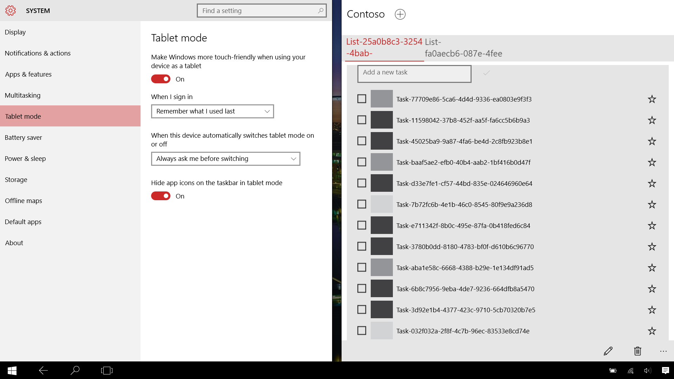
Understanding immersive mode
Non-resizable on mobile
Window is always full screen on Mobile
Full screen on tablets/convertibles when in Tablet mode
Limited sizing options
On Tablet, apps can be docked left or right, or on large displays at one of the corners
Full screen mode for apps on Desktop
Developer can now request Full Screen
Developer can now test Full Screen

Slide 7
Windowing
Windows.ApplicationModel.Core .CoreApplication.CreateNewView()
Windows.UI.ViewManagement .ApplicationViewSwitcher.SwitchAsync()
Windows.UI.ViewManagement .ApplicationViewSwitcher.TryShowAsStandaloneAsync()
Available across all of Windows 10
New view must call Window.Activate()

Slide 8
Navigation

Slide 9
Frame.Navigate
Send to a type
Pass a string
Navigation service
Part of Template 10 project template
private void Goto2(object sender, Windows.UI.Xaml.RoutedEventArgs e)
{
var app = App.Current as Common.BootStrapper;
var nav = app.NavigationService;
nav.Navigate(typeof(Views.Page2), "My parameter value");
}

Slide 10
Navigation parameters
Page.OnNavigatedTo()
Standard in Windows
ViewModel.OnNavigatedTo
With Template 10 project template
public override void OnNavigatedTo(string parameter,
NavigationMode mode, IDictionary<string, object> state)
{
this.Parameter = parameter?.ToString() ?? "Empty";
}

Slide 11
Demo: Navigation parameters

Slide 12
Handling Back Navigation

Slide 13
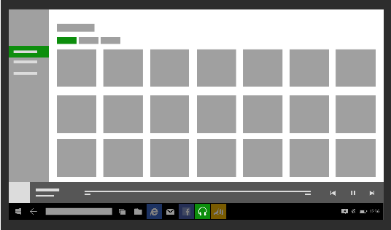
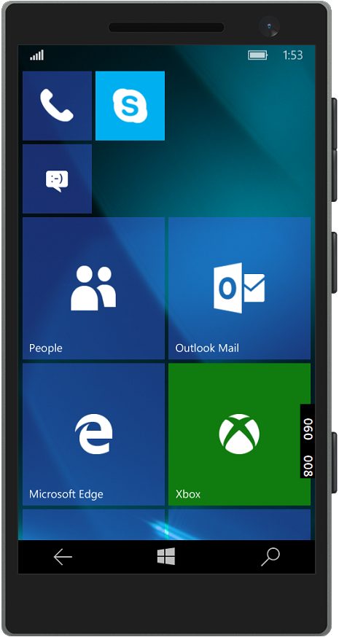
Shell-drawn back button for Mobile and Tablet

Slide 14
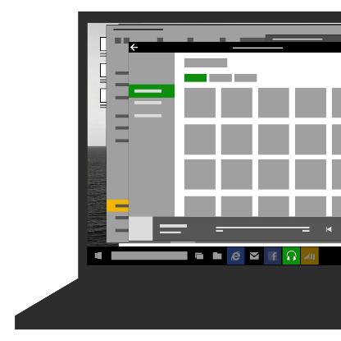

Desktop, Windowed mode: Opt-in, shell-drawn back button on Title Bar
if (Frame.CanGoBack)
{
// Setting this visible is ignored on Mobile and when in tablet mode! Windows.UI.Core.SystemNavigationManager.GetForCurrentView().AppViewBackButtonVisibility = AppViewBackButtonVisibility.Visible;
}

Slide 15

Desktop, Windowed mode: Or provide your own on-canvas Back Button

Slide 16
If the user has nowhere to go back to, remove the back button from your UI

Slide 17
Back Navigation
Back navigates back within app page history, then to previous app
Essentially same as Phone 8.1
Backing out does not close the app
Back out from launch page causes app to suspend
And, a new scenario for tablet
In split screen, there is a [back stack] for each side of the screen
BackRequested UWP API event
Windows.UI.Core.SystemNavigationManager.GetForCurrentView().BackRequested += OnBackRequested;

Slide 18
Standard BackRequested handler
protected override void OnLaunched(LaunchActivatedEventArgs e)
{
...
// Handle Back Requests
SystemNavigationManager.GetForCurrentView().BackRequested += App_BackRequested;
}
public event EventHandler<BackRequestedEventArgs> OnBackRequested;
private void App_BackRequested(object sender, BackRequestedEventArgs e)
{
if (OnBackRequested != null) { OnBackRequested(this, e); }
// Check that no-one has already handled this
if (!e.Handled)
{
// Default is to navigate back within the Frame
Frame frame = Window.Current.Content as Frame;
if (frame.CanGoBack)
{
frame.GoBack();
// Signal handled so that system doesn't navigate back through app stack
e.Handled = true;
}
}
}

Slide 19
Back support
Support gestures
Windows + backspace
Hardware back button
Keyboard back button
Mouse back button
Some guidance
Don’t strand users
Don’t hijack back

Slide 20
Demo: Back Navigation

Slide 21
Review
Layout
Navigation
Handling Back Navigation

