Slide 1
Adaptive Code Developer’s Guide to Windows 10
Zheng Guifeng

Slide 2
Agenda
Compilation Conditionals
Platform Extension SDKs
Adaptive Code
Adaptive Code and API Versions
Declaring limitations on where your app can run

Slide 3
What are Adaptive Apps?
Windows apps adapt to different versions of the platform
Windows apps adapt to different types of devices
Windows apps adapt to different screen sizes
Adaptive UI handles different screens
Adaptive Code can "light up" your app to conditionally execute code only when running on specific device families and/or particular versions of platform/extension APIs
Conditionally take advantage of unique device capabilities
Use newer APIs while still supporting down-level clients

Slide 4
Compilation Conditionals

Slide 5
Windows 8.1 Universal: Shared code, two binaries
Windows Binary
Phone Binary

Slide 6
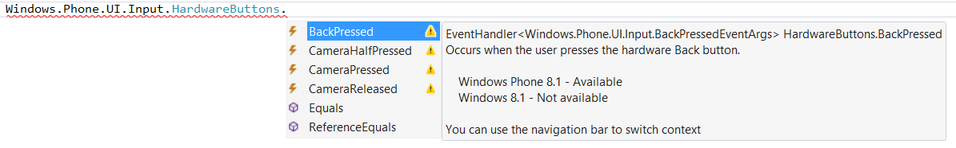
Not all APIs were available everywhere

Slide 7
Compilation directives
C# Syntax
#if WINDOWS_PHONE_APP Windows.Phone.UI.Input.HardwareButtons
.BackPressed += this.HardwareButtons_BackPressed; #endif
C++ Syntax
#if WINAPI_FAMILY==WINAPI_FAMILY_PHONE_APP _backPressedEventToken = HardwareButtons
::BackPressed += ref new EventHandler <BackPressedEventArgs^> (this,
&NavigationHelper::HardwareButton_BackPressed); #endif

Slide 8
Adaptive code in UWP: Introducing Platform Extension SDKs

Slide 9
Windows universal
Desktop PC
Mobile
Xbox
IoT
IoT headless
Surface Hub
Holographic
2 in 1
Phablet
Phone
Raspberry Pi
Surface Hub
HoloLens
Home Automation
Band
Xbox
Tablet

Slide 10
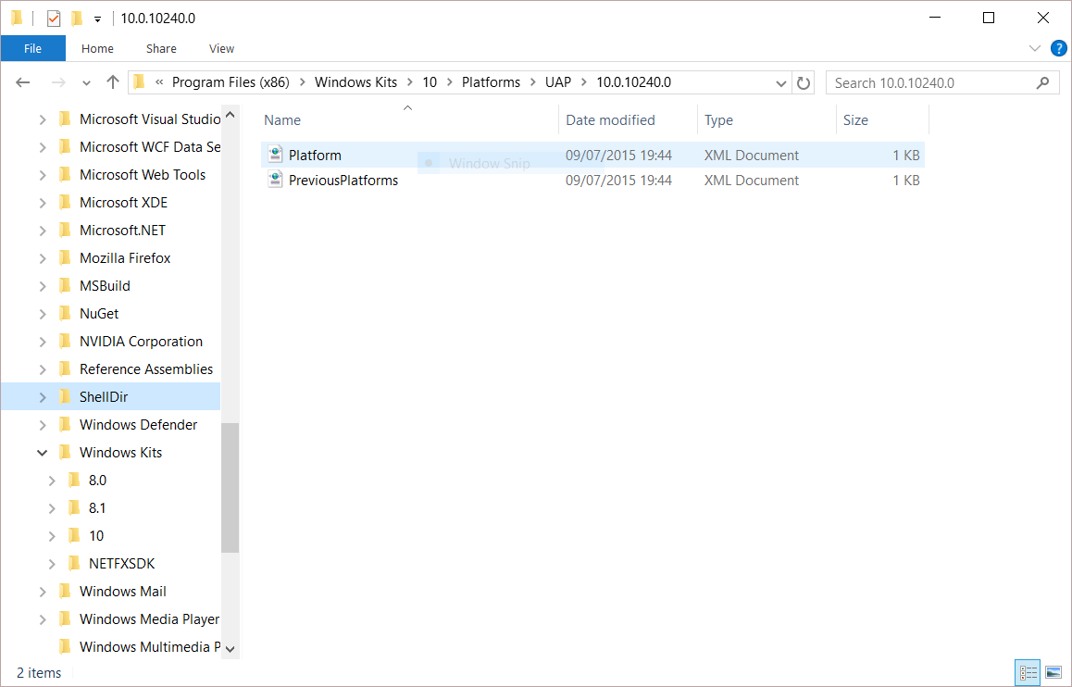
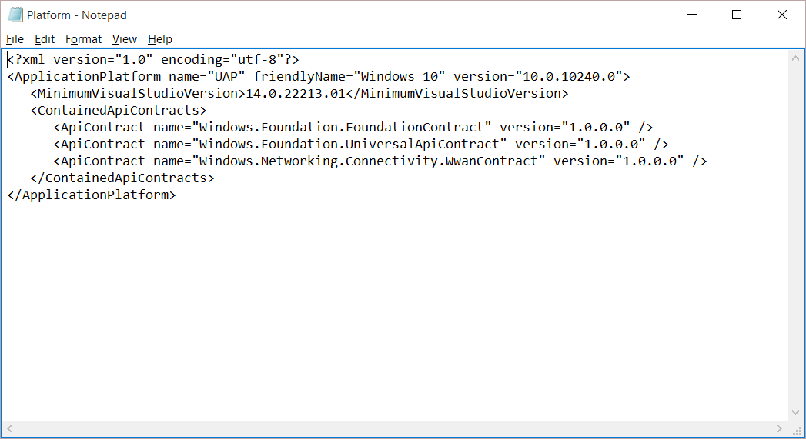
Universal Windows Platform
A single API surface
A guaranteed API surface
The same on all devices
Universal Windows Platform
Windows Core
Desktop
Device
Phone
Device
Xbox
Device

Slide 11
Many UWP apps will not need to use any device family-specific APIs, but for those that do, we have Platform extension SDKs

Slide 12
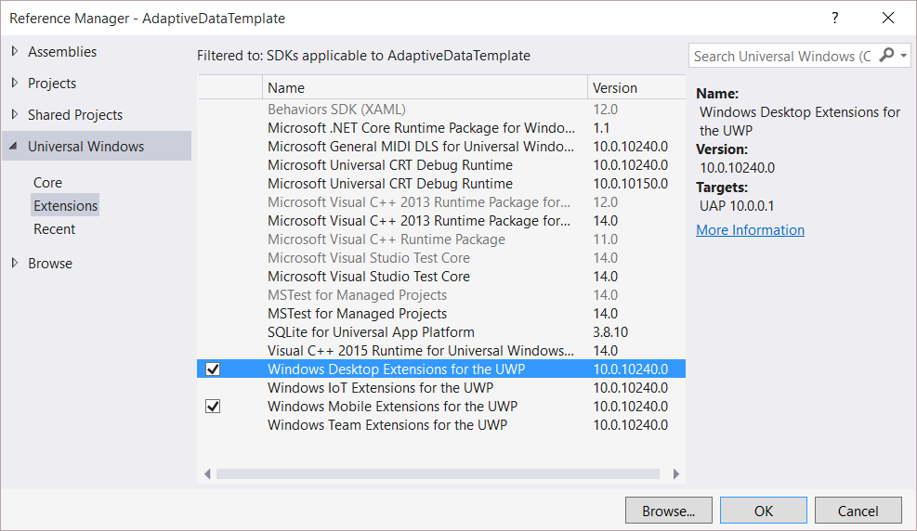
Platform extensions
Device-specific API
Family-specific capabilities
Compatible across devices
Unique update cadence
Windows App
Desktop
extension
Phone
extension
Xbox
extension
Universal Windows Platform
Windows Core
Desktop
Device
Phone
Device
Xbox
Device

Slide 13
Platform extensions don't invalidate binaries on other devices

Slide 14
Testing for capabilities
Windows.Foundation.Metadata.ApiInformation
IsApiContractPresent
IsEnumNamedValuePresent
IsEventPresent
IsMethodPresent
IsPropertyPresent
IsReadOnlyPropertyPresent
IsTypePresent
IsWriteablePropertyPresent

Slide 15
Test capabilities at runtime
var api = "Windows.Phone.UI.Input.HardwareButtons";
if (Windows.Foundation.Metadata.ApiInformation.IsTypePresent(api))
{
Windows.Phone.UI.Input.HardwareButtons.CameraPressed += CameraButtonPressed;
}

Slide 16
The ApiInformation API tests for availability of a type or contract at runtime

Slide 17
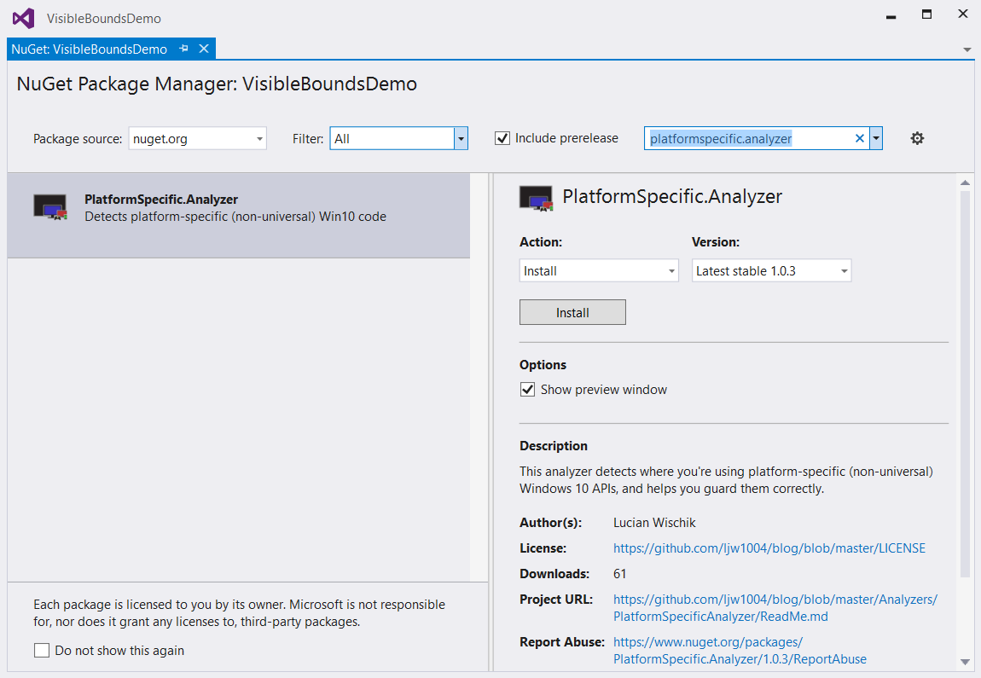
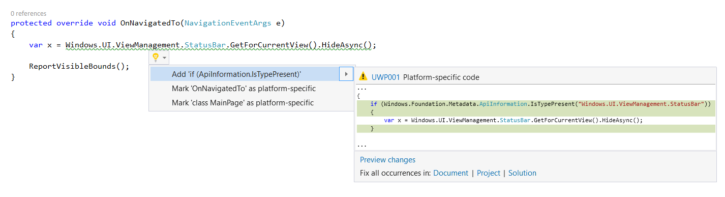
PlatformSpecific.Analyzer NuGet package

Slide 18
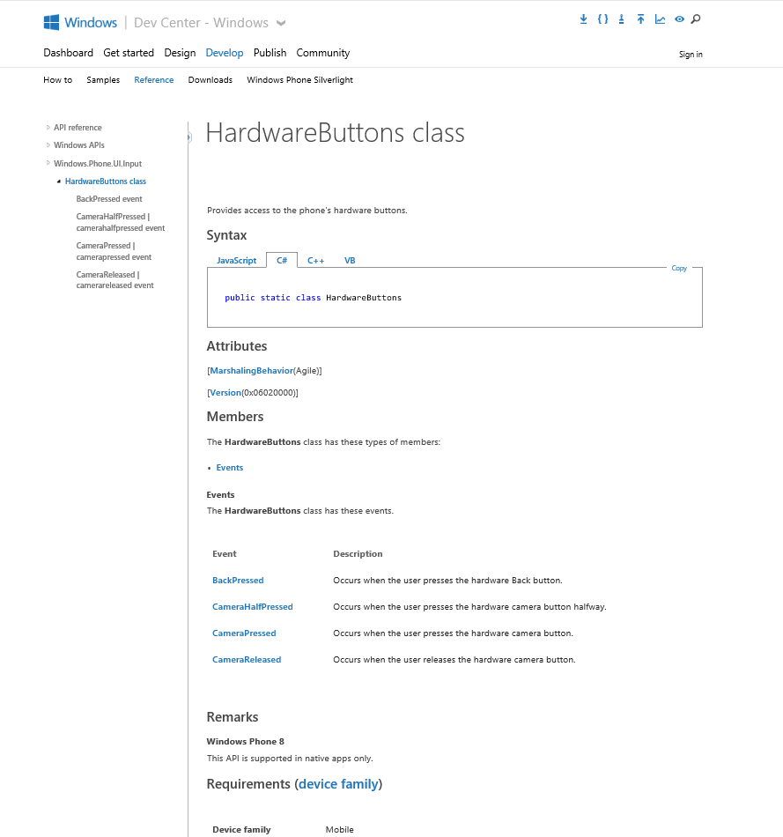
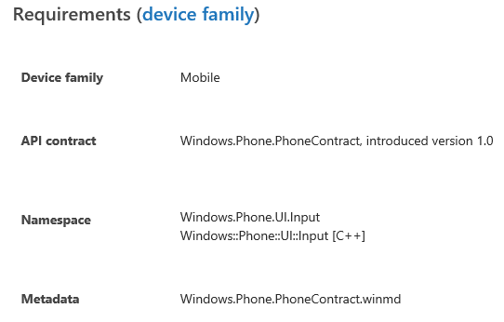
Identifying the Extension SDK
MSDN docs:

Slide 19
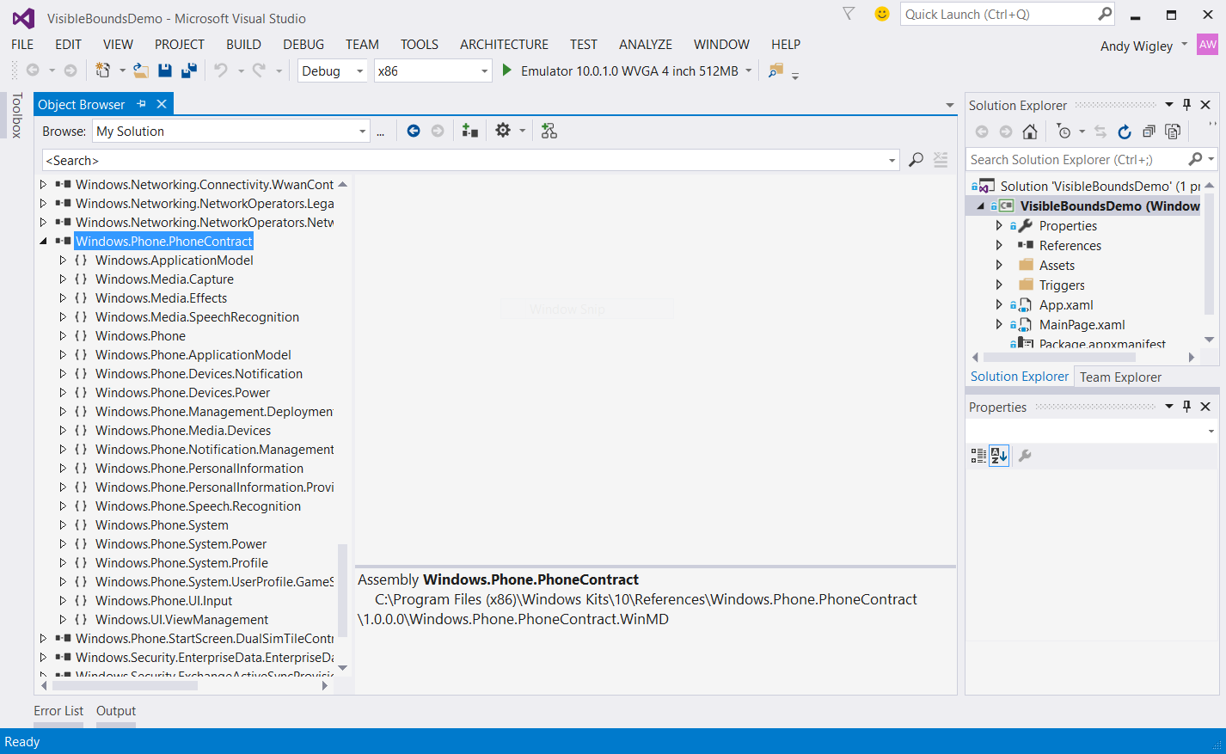
Exploring API Contracts

Slide 20
Demo: Api Information

Slide 21
Adaptive Code used to call specific API versions

Slide 22
Using Specific Versions of an API
Adaptive code techniques can also be used for handling different revisions of an API
You write your app against a UWP version, but ‘n’ months later, UWP v.Next ships to users machines
Applies to Extension SDKs and Packages as well – new versions may offer new functionality
You want to keep supporting customers who haven’t updated yet, but take advantage of up-level APIs for those who have

Slide 23
Gate use of up-level APIs
var contract = "Devices.Scanners.ScannerDeviceContract";
int majorVersionRequired = 3;
if (Windows.Foundation.Metadata.ApiInformation. IsApiContractPresent(contract, majorVersionRequired ))
{
// Call the API that is present in V3 and above
...
}
else
{
// Your original code supporting users who haven’t upgraded yet
...
}

Slide 24
Declaring limitations on where your app can run

Slide 25
Declare Device Family Dependencies
Runs on all UWP device families:
<Dependencies>
<TargetDeviceFamily Name="Windows.Universal" minVersion="10.0.10240.0" maxVersionTested="10.5.0.0" />
</Dependencies>
Runs on all UWP, but limitations apply to Desktop:
<Dependencies>
<TargetDeviceFamily Name="Windows.Desktop" minVersion="10.2.0.0" maxVersionTested="10.4.0.0" />
<TargetDeviceFamily Name="Windows.Universal" minVersion="10.0.10240.0" maxVersionTested="10.5.0.0" />
</Dependencies>
Runs only on Mobile device family:
<Dependencies>
<TargetDeviceFamily Name="Windows.Mobile" minVersion="10.1.0.0" maxVersionTested="10.2.0.0" />
</Dependencies>

Slide 26
Package Dependency
<Dependencies>
<PackageDependency
Name="Microsoft.WinJS 1.0"
Publisher="CN=Microsoft Corporation, O=Microsoft Corporation, L=Redmond, S=Washington, C=US"
minVersion ="1.5.0.0" />
</Dependencies>

Slide 27
Review
Compiler Conditionals
Platform Extension SDKs
Adaptive Code
Adaptive Code and API Versions
Declaring limitations on where your app can run

