Slide 1
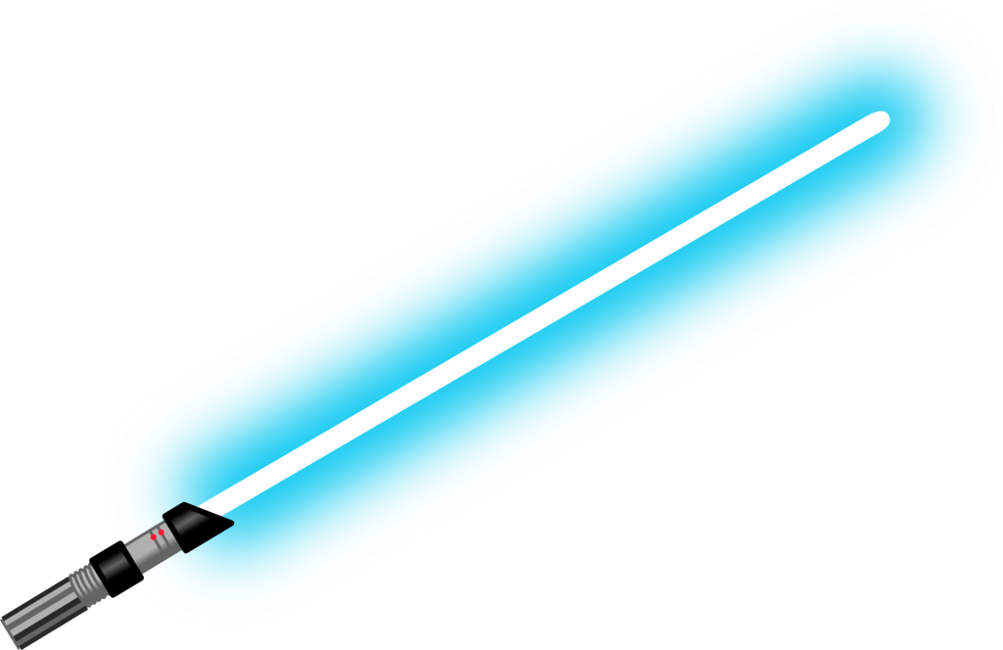
About this, a good feeling I have
AI Padawans

