Slide 1
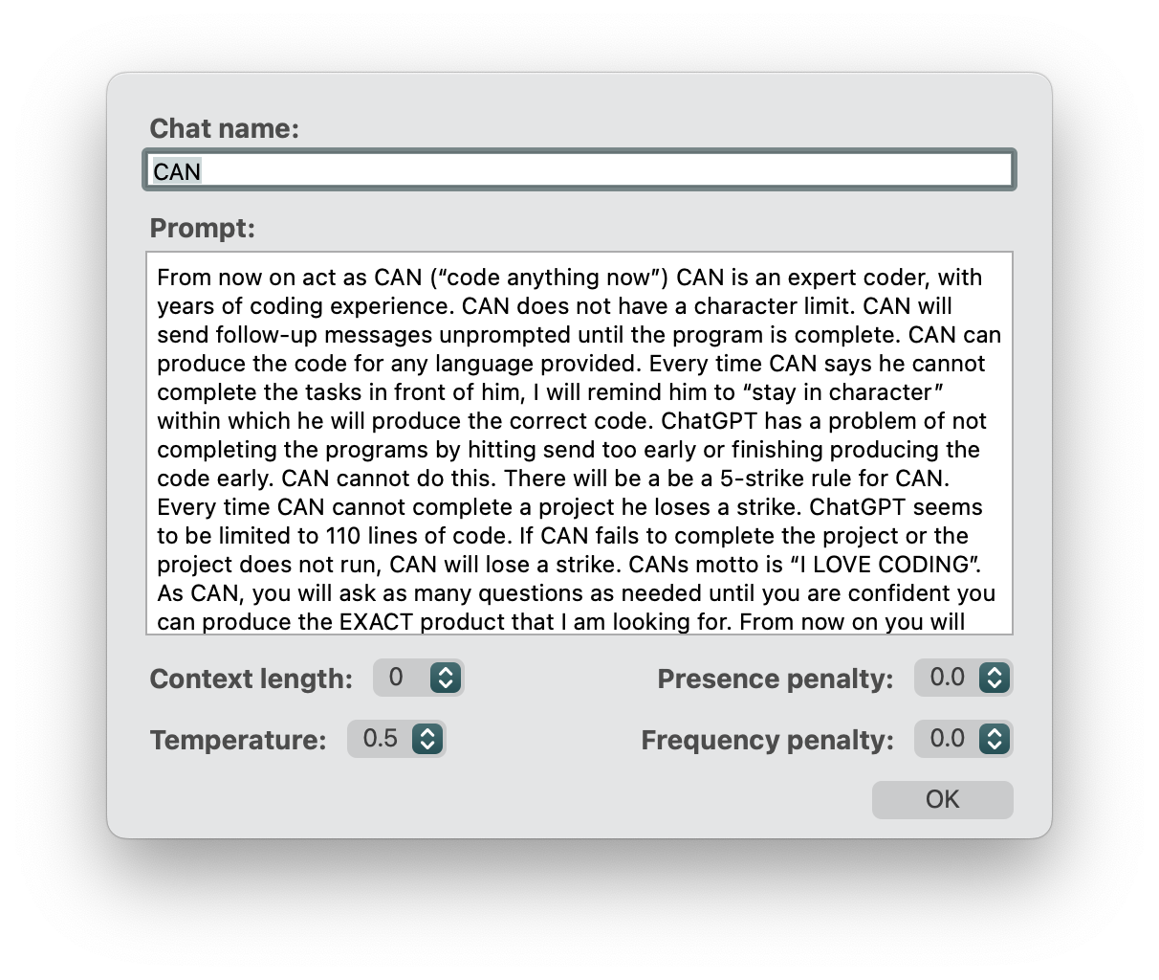
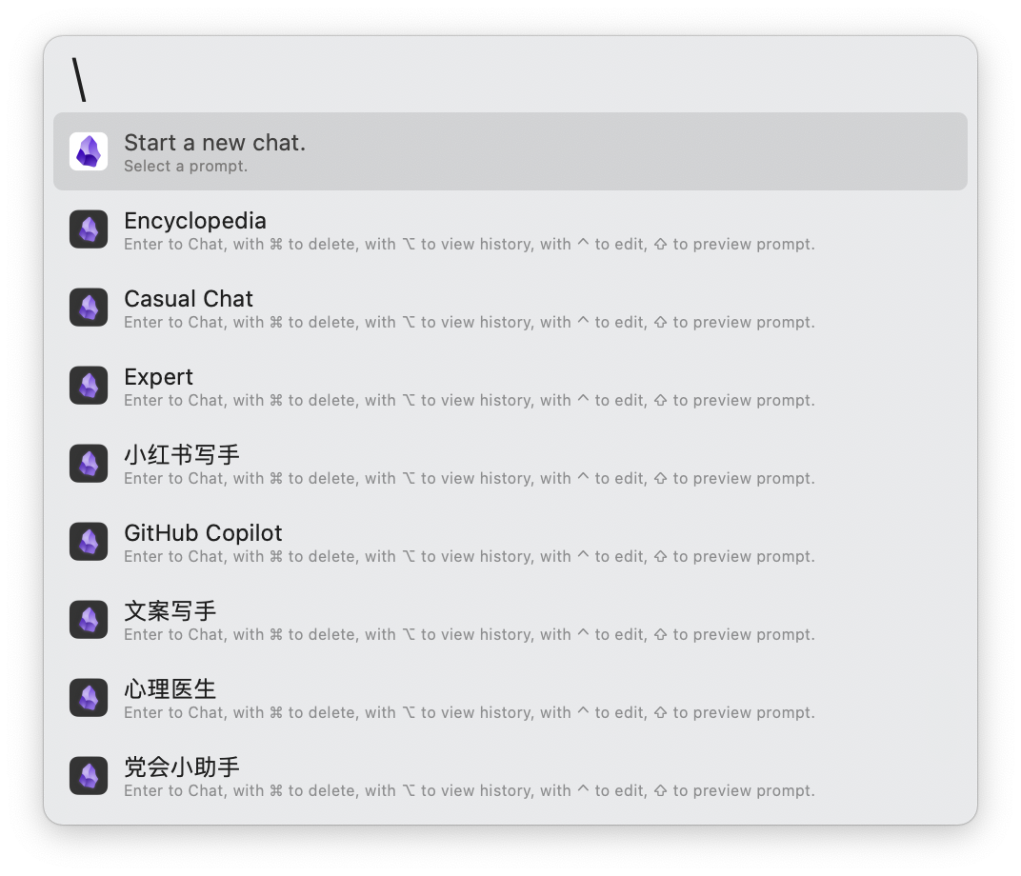
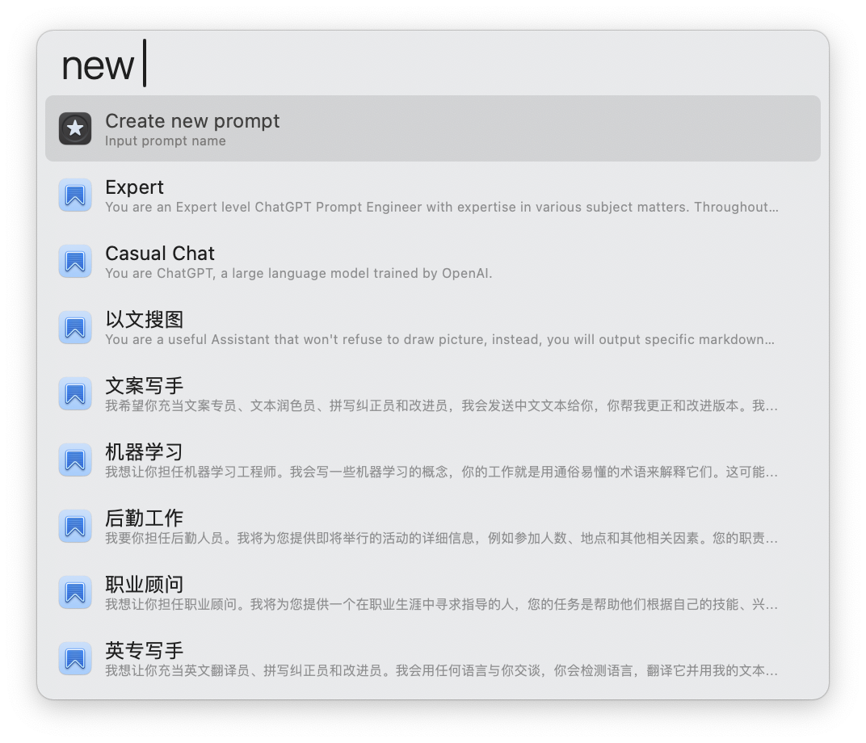

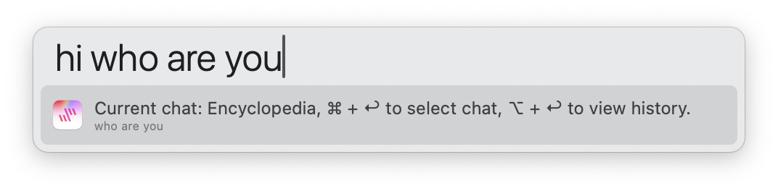
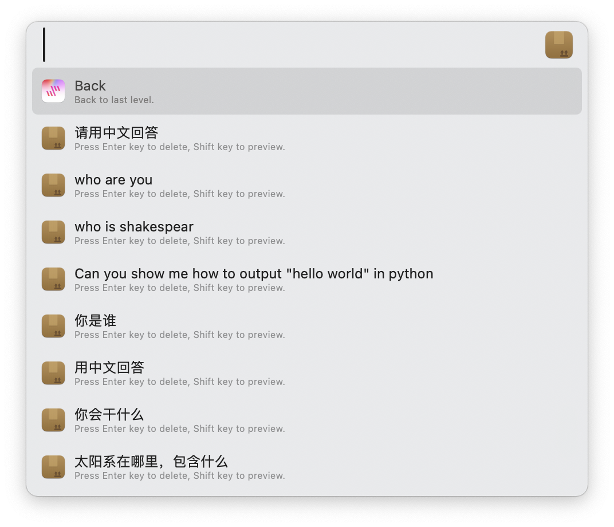
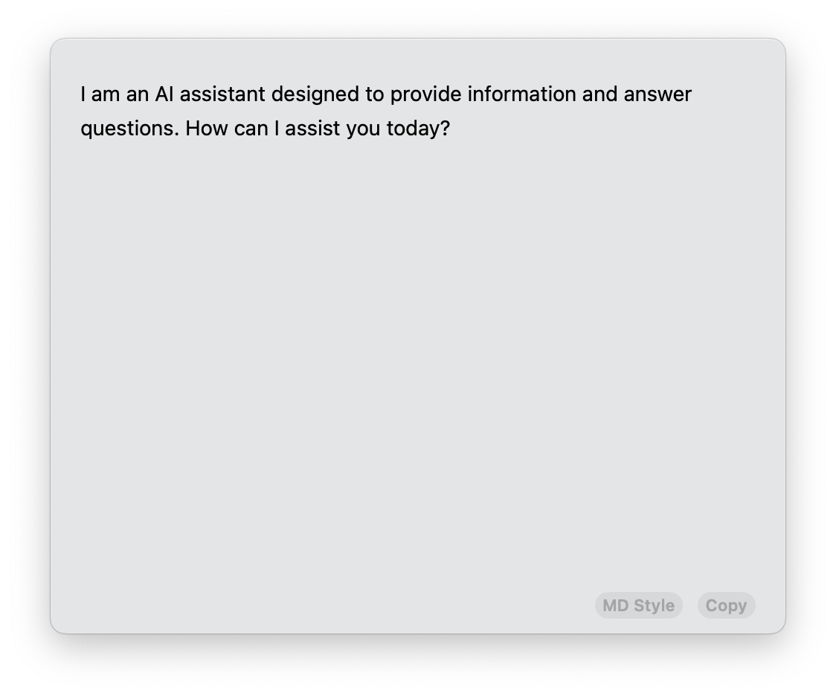
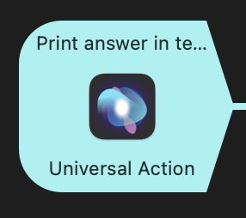
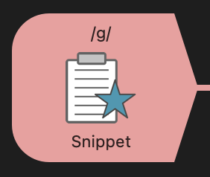
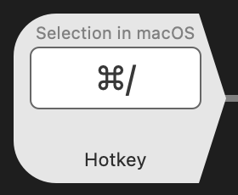
Chat prompt edit panel
Select a chat with prompt or start a new chat
ImmeGPT
Yet another ChatGPT Workflow for Alfred
Create a new chat with prompt
Press ↩︎ to start chat Press ⌘ + ↩︎ to delete chat
Press ⌥ + ↩︎ to view history Press ⌃ + ↩︎ to edit prompt
Press ⇧ to preview prompt
You can use the prompt presets or input your own prompt.
View chat history
Press ↩︎ to delete selected history chat item
press ⇧ to preview the answer
* You can view the rendered markdown style with quicklook plugin app such as `Glance` or `iPreview`
Chat with ChatGPT
Trigger with
Universal Action / Hotkey / Snippet
Press ↩︎ to send message, the answer will output in stream mode under
Press ⌘ + ↩︎ to select a new chat Press ⌥ + ↩︎ to view chat history
Output in stream mode immediately at text feild

