Slide 1

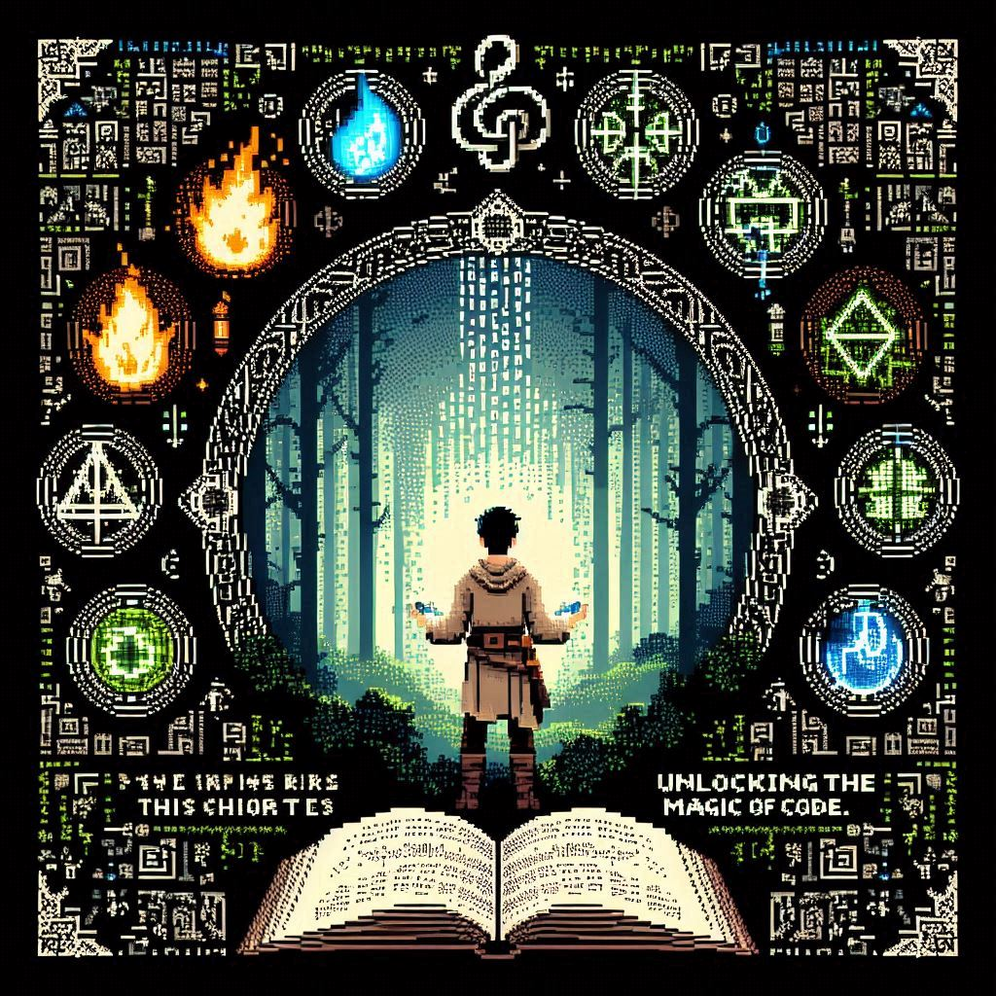
Python
Mage
Unlocking the Magic of Code
By Alison C Rita & ChatGpt

Slide 2
01
Introduction to Python Programming

Slide 3
Welcome to the World of Python Magic
Welcome to Pythonia, a land where code is magic and every line you write weaves spells that can change the digital world. As an apprentice in the Python Mage's guild, you'll learn to harness the power of Python, a versatile and powerful language of magic.
Setting Up Your Magical Workbench
To get started on your journey as a Python Mage, you'll need to set up your magical workbench (computer) and gather the necessary tools (software).
Installing Python
First, visit the official Python website and download the latest version of Python. Follow the installation instructions for your operating system to install your magical toolkit.

Slide 4
Choosing an Integrated Development Environment (IDE)
An Integrated Development Environment (IDE) is a magical workshop where you can write, test, and debug your code. Here are some popular IDEs for Python:
PyCharm: A powerful IDE with many features, perfect for both beginners and advanced users.
Visual Studio Code (VS Code): A lightweight, versatile editor with many extensions for Python development.
Jupyter Notebook: An interactive notebook ideal for data analysis and visualization.
IDLE: The default Python IDE, simple and straightforward for beginners.

Slide 5
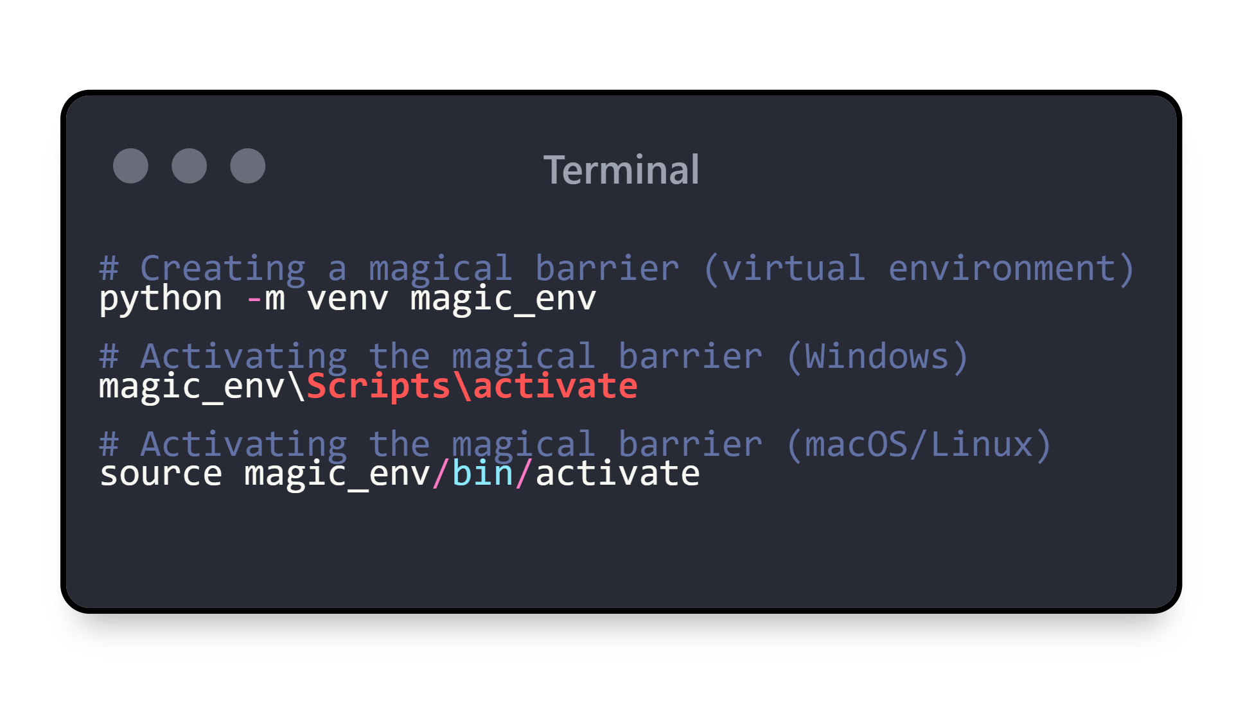
Setting Up a Virtual Environment
A virtual environment is like a magical barrier that keeps your spells (code) contained and prevents conflicts between different projects. Here’s how to create and activate one:
In your terminal or command prompt, cast these spells:

Slide 6
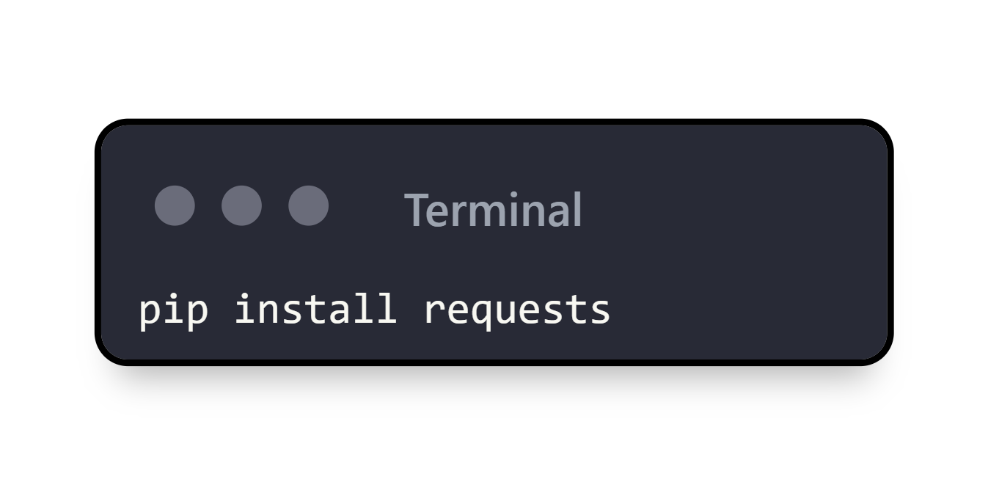
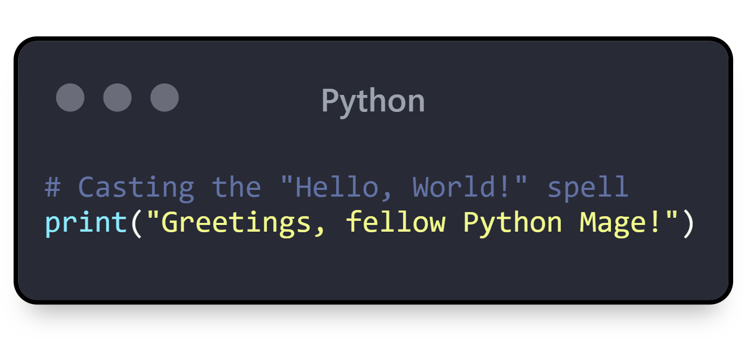
Installing Enchantments (Packages)
You can install additional magical tools using pip, the Python package manager. For example:
Casting Your First Spell
Let's start with a simple spell that prints a message to the console, your magical crystal ball:
Save this code in a scroll (file) named hello.py and run it by typing python hello.py in your terminal.

Slide 7
02
Python Fundamentals

Slide 8
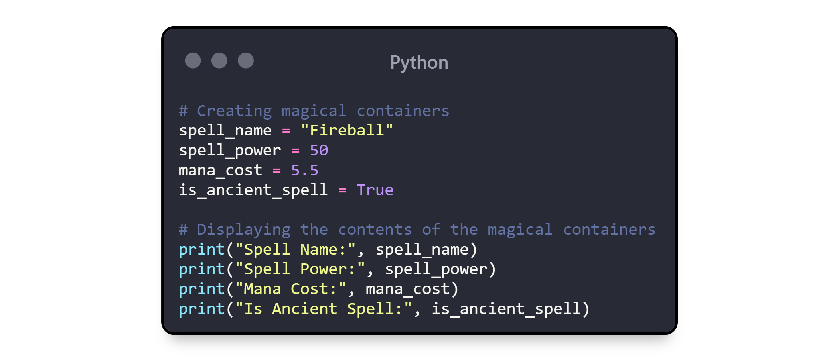
Understanding Magical Components
(Variables and Data Types)
Variables are like magical containers that store data. You don't need to declare the data type explicitly; Python, the magical language, infers it automatically.

Slide 9
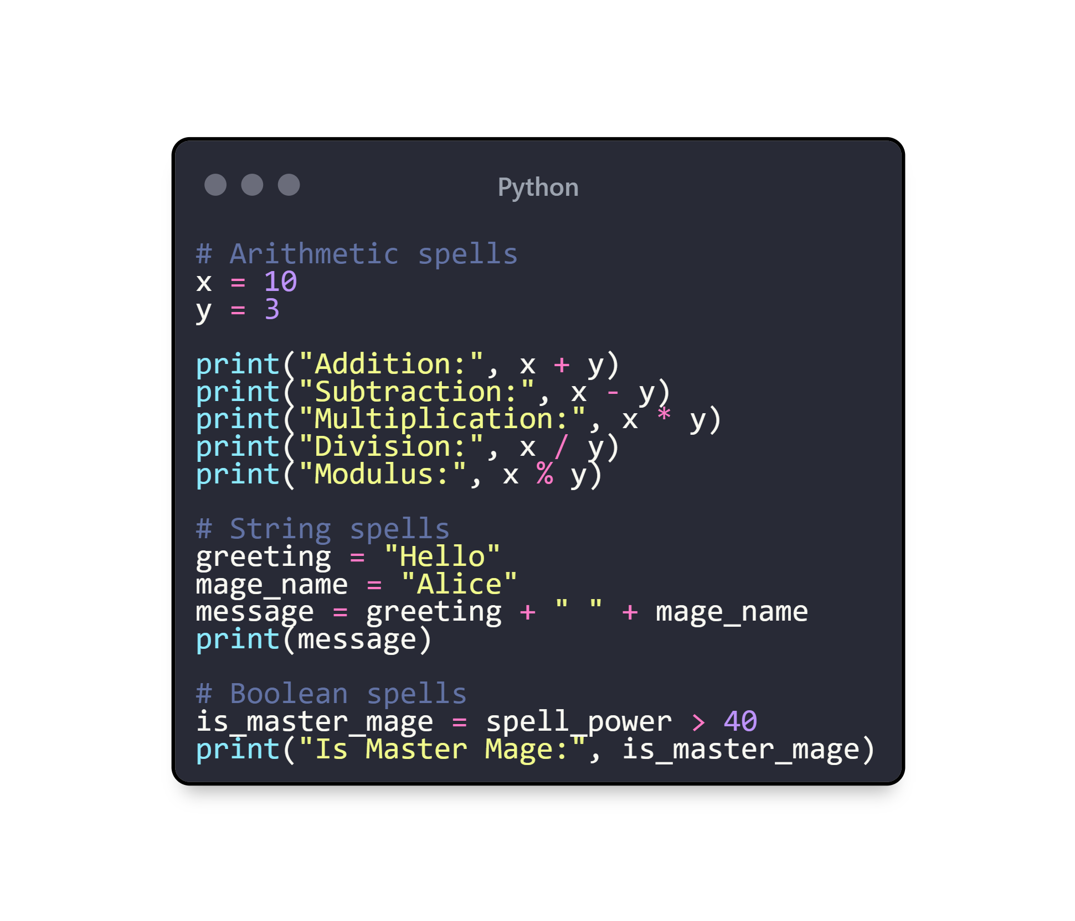
Common Magical Components
Strings: Textual spells, e.g., "Incantation“
Integers: Whole number values, e.g., 42
Floats: Decimal number values, e.g., 3.14
Booleans: True or false values, e.g., True or False
Performing Magical Operations
You can perform various operations on your magical components:

Slide 10
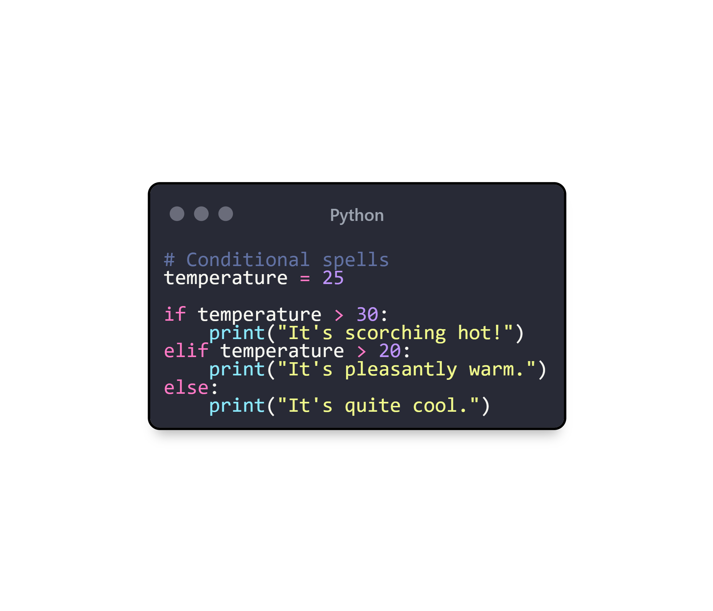
Controlling the Flow of Magic
Control flow statements allow you to control the execution of your spells based on conditions and loops.
Conditional Statements
Use if, elif, and else to perform different actions based on conditions:

Slide 11
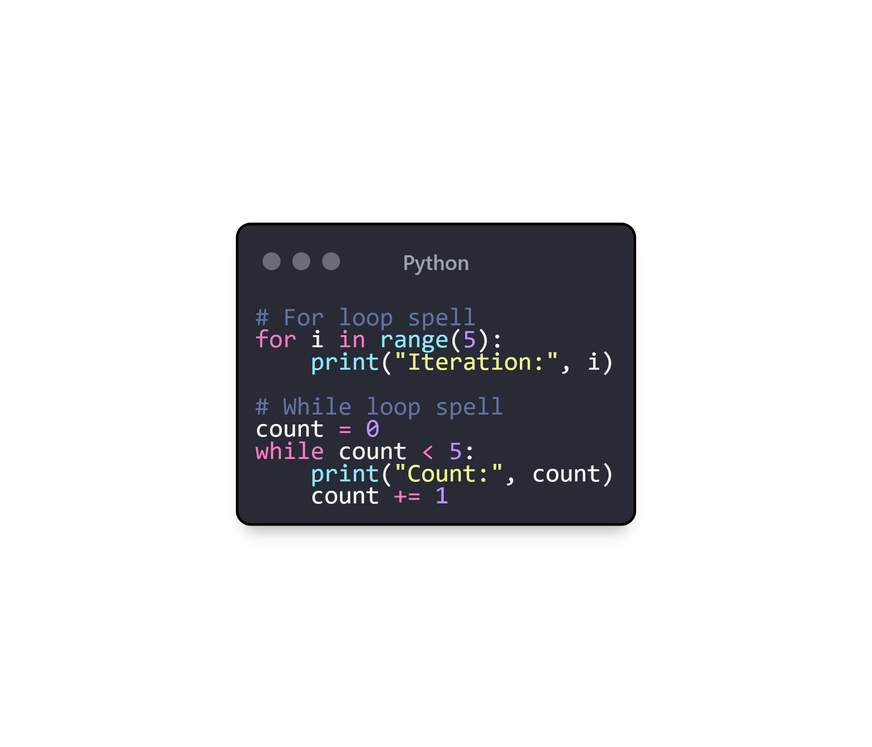
Loops
Use for and while loops to repeat actions:

Slide 12
03
Functions and Modules

Slide 13
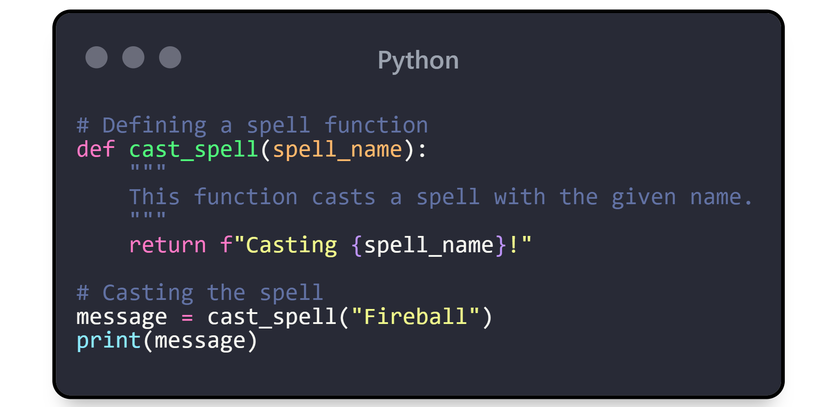
Creating Reusable Spells (Functions)
Functions allow you to encapsulate code into reusable blocks, like casting spells multiple times. A function is defined using the def keyword, followed by the function name and parentheses ().
Function Basics
Let's start by creating a simple function:
In this example:def starts the function definition.
cast_spell is the name of the function.
spell_name is a parameter (a variable passed to the function)
.The function returns a string indicating the spell being cast.

Slide 14
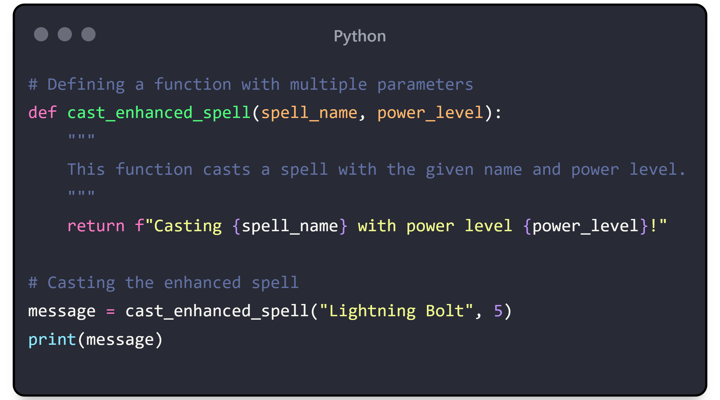
Multiple Parameters
You can define functions with multiple parameters:
Here, cast_enhanced_spell takes two parameters: spell_name and power_level.

Slide 15
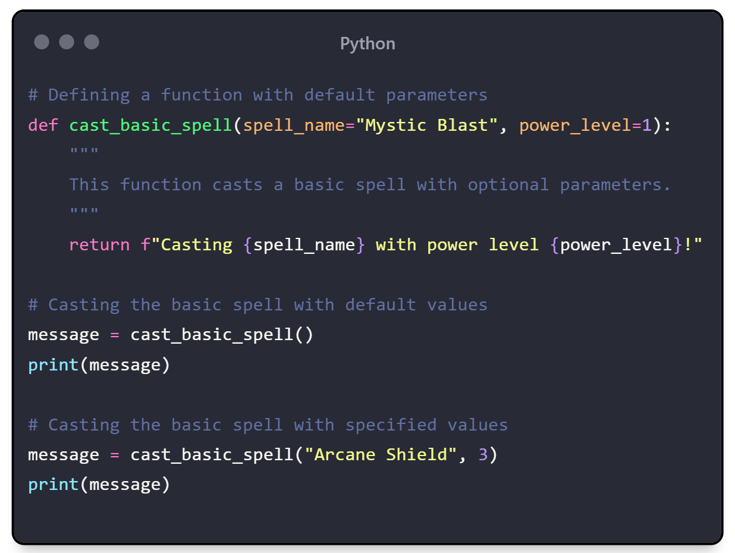
Default Parameters
You can also set default values for parameters:
If no arguments are provided, the function uses the default values.

Slide 16
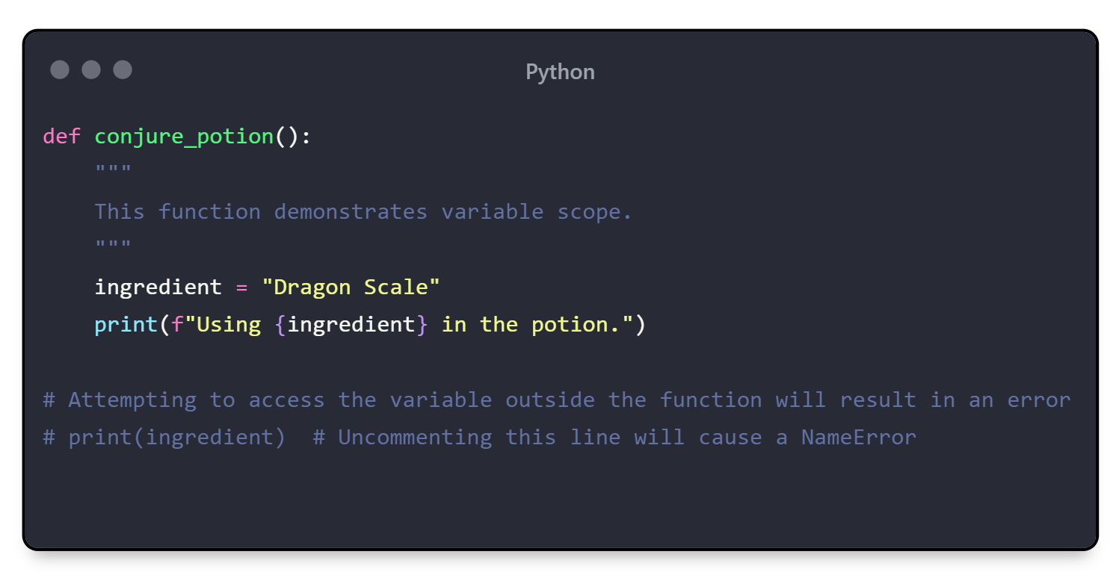
Function Scope and Lifetime
Variables defined inside a function are local to that function and cannot be accessed outside of it. This is known as the function's scope.

Slide 17
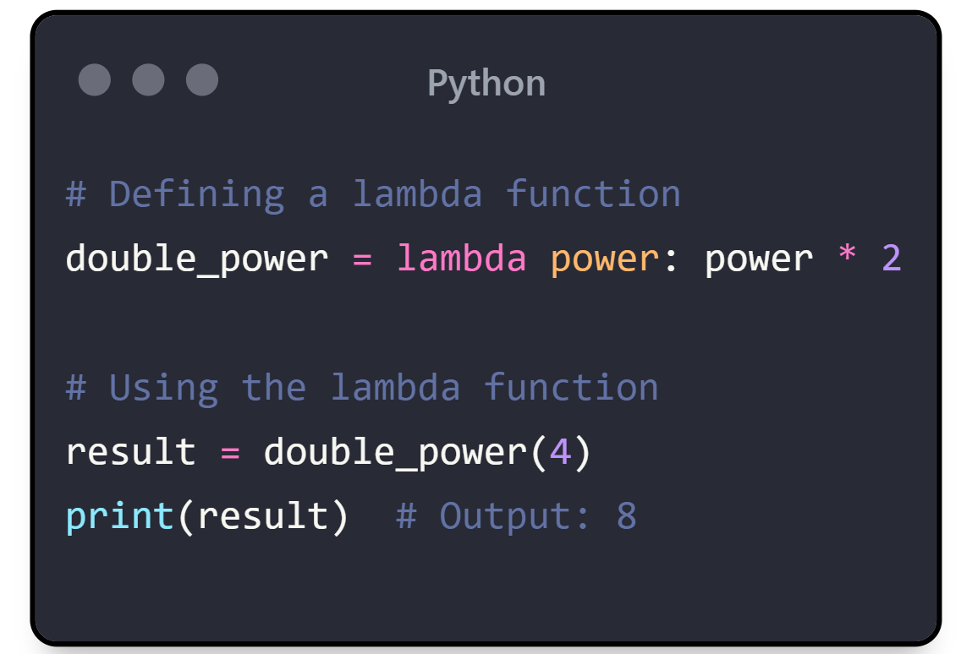
Lambda Functions
For simple functions, Python provides a shorthand: lambda functions. They are small anonymous functions defined using the lambda keyword.
Lambda functions are useful for short, throwaway functions used in expressions.

Slide 18
Conclusion: Mastering the Basics and Beyond

Slide 19
Reflecting on Your Journey
Congratulations, young Python Mage! You've traversed the enchanted lands of Pythonia, mastering the basics of Python programming. From casting your first spell with a simple print statement to organizing your magical knowledge using functions, you've laid a strong foundation for your future coding adventures.
As you continue your journey, remember that the world of Python is vast and full of wonders. Each new concept you learn is like discovering a new spell that expands your magical arsenal. Keep practicing, experimenting, and exploring, and soon you'll become a master mage of the Python language.
Disclaimer

Slide 20

📜 Disclaimer 📜
The contents of this ebook are for educational purposes only. 📚✨ Created with the help of ChatGPT and formatted by my 100% human hands 👐 for a course project. 🎓
Thank You!!!

