Slide 1
Dictionaries and hash tables
Terence Parr
MSDS program University of San Francisco

Slide 2
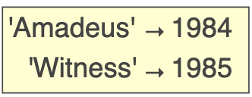
Dictionaries map keys to values
If we arrange two lists side-by-side and kind of glue them together, we get a dictionary (type is dict)
Dictionaries map one value to another, just like a dictionary in the real world maps a word to a definition
Here are two sample dictionaries:
Index by key to get the value; e.g., movies['Amadeus']
movies = {'Amadeus':1984, 'Witness':1985}

Slide 3
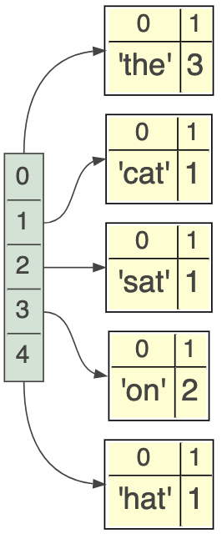
A simple implementation
To track a collection of key→value pairs, we can use a list of tuples such as: d = [('the', 3), ('cat', 1), ('sat', 1), ('on', 2), ('hat', 1)]
The key operation for a dict is to look up a value by its key
How would you implement this?
Linearly search through the list of tuples and compare the first value and the tuple to the key of interest; return the associated value if key is found

Slide 4
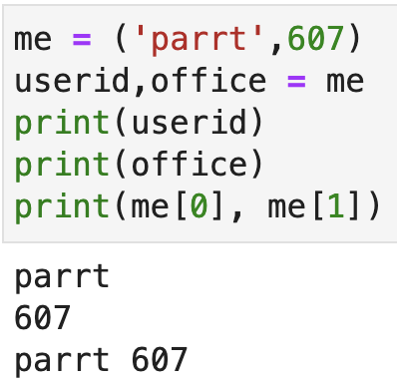
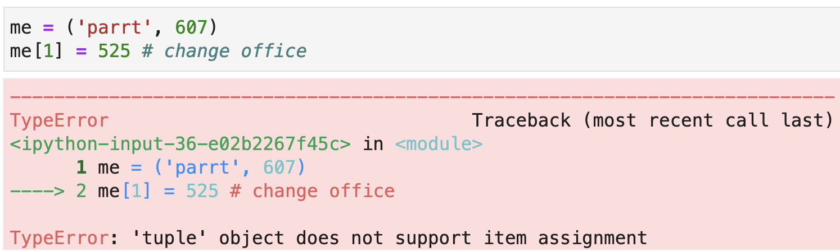
Review: tuples
A tuple is an immutable list and uses parentheses rather than square brackets for notation
Tuples are often used to group related elements:

Slide 5
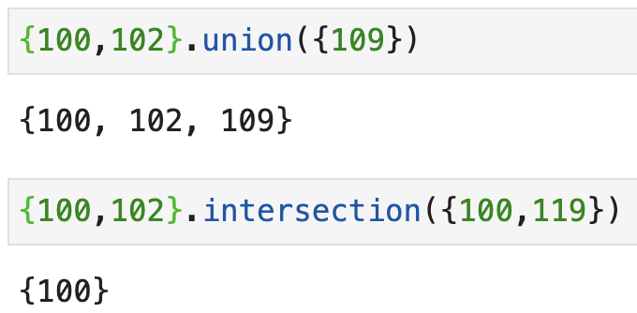
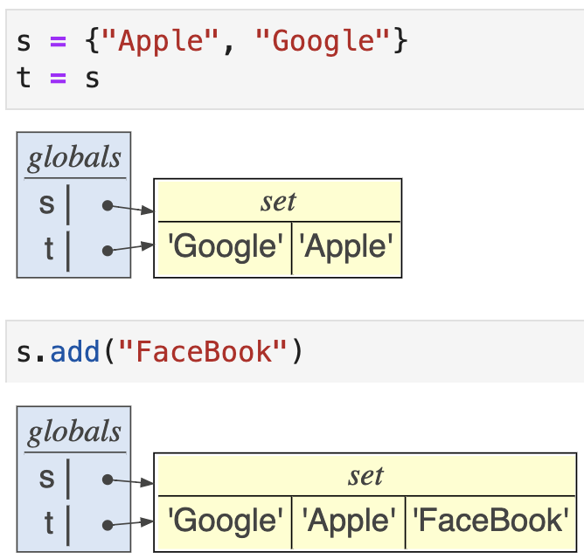
Sets
A set is just an unordered, unique collection of elements; here is an example using integers: ids = {100, 103, 121, 102, 113, 113, 113, 113}
We can do lots of fun set arithmetic:
Watch out for aliasing!

