Slide 1
Streams/pipes/redirection in the terminal
Terence Parr
MSDS program University of San Francisco

Slide 2

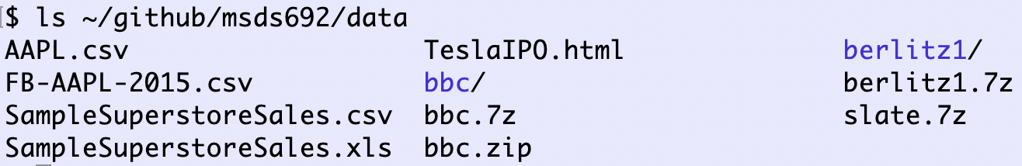
Streams are a unifying concept in UNIX
Files, websites, keyboards, … can all be accessed as streams
Every UNIX process has:
a current working directory
standard input (defaults to keyboard input)
standard output (defaults to terminal output)
(standard error)

Slide 3
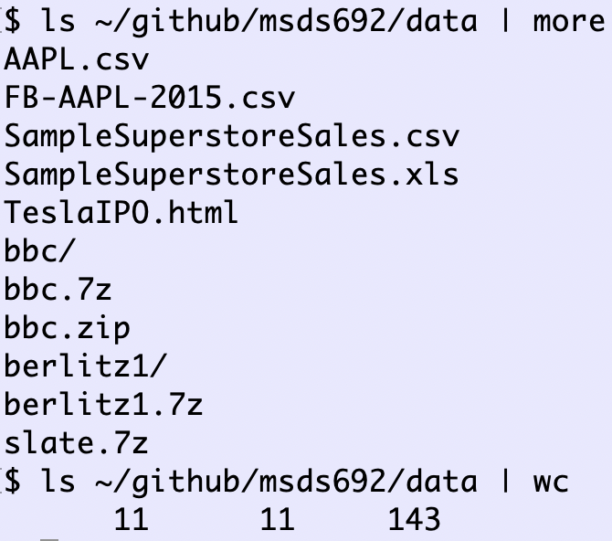
UNIX has lots of commands we can mix and match to solve problems without new code
To combine programs, we need to send the output of one program to the input of another
This lets us transform or simplify data in multiple steps
The mechanism for passing the standard output of one program to the standard input of another program is called a pipe
Examples to right pipe the output of ls to the input of more and then wc

Slide 4
Simple data science pipe example
Sometimes it’s easier to search big data files from the command line, instead of writing code
Here’s how to find all records in a CSV file associated with Backhoe bulldozers:

Slide 5
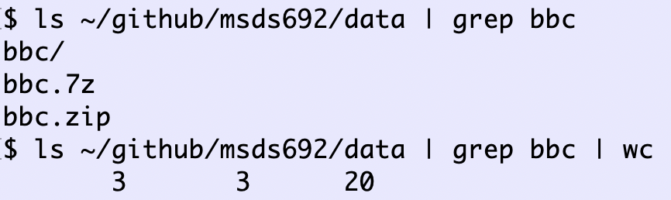
Deeper pipelines
Pipe the output of ls to grep (search for string in line) and send that output to wc, which counts how many filenames contain “bbc”

Slide 6
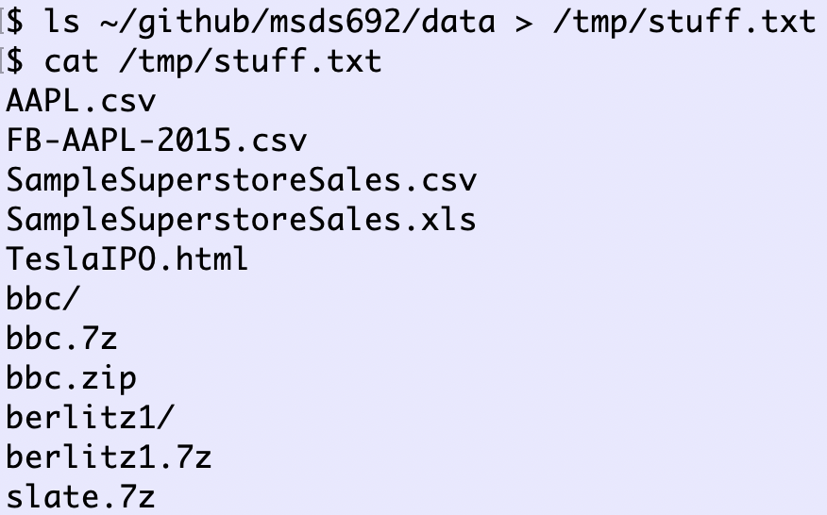
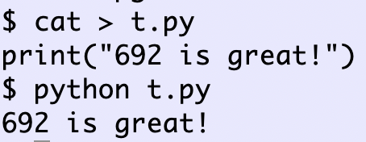
I/O redirection
Pipes connect the input/output of processes
Redirection:
< file hooks process standard input to file
> file hooks process standard output to file
I’m hitting control-D (EOF) here to indicate end of input

Slide 7
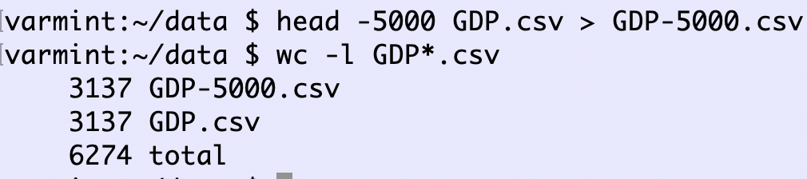
Data science redirection example
When developing a model or performing an analysis, it’s often good to start with a small subset of the data to speed up development
Here’s how to get the first 5000 rows of data from a CSV file into another file without having to write code:

Slide 8
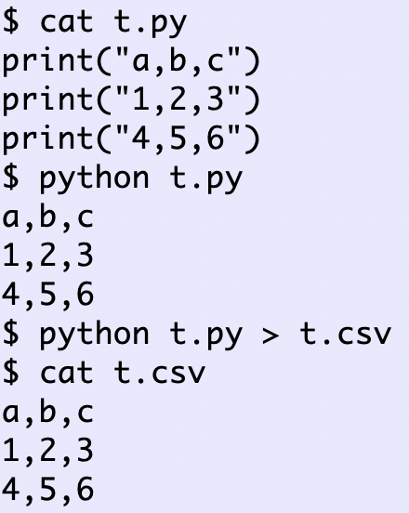
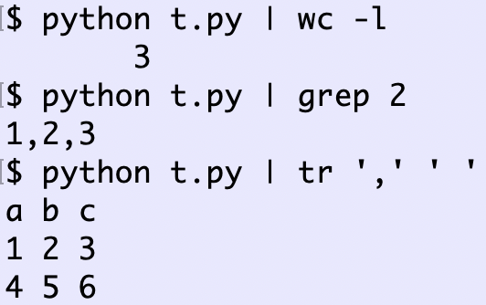
Redirecting Python output
The print() function in Python generate standard output, which we can redirect or pipe to another process

Slide 9
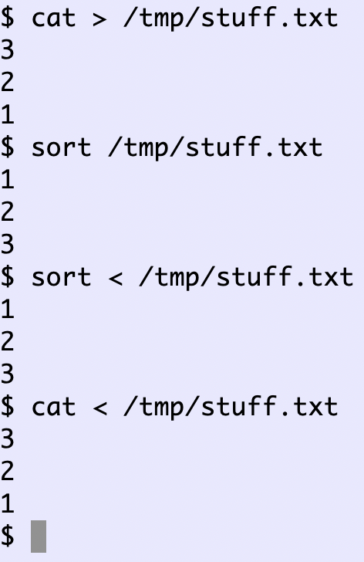
Redirecting standard input
Less common but still useful
Many commands take both commandline arguments and redirection: sort, cat, wc etc…
I type 3 2 1 then hit control-D (EOF)

Slide 10
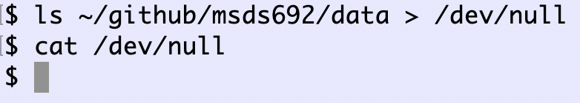
Throwing away program output
file /dev/null is a special “device” that accepts input and does nothing with it
(This is what happens when I talk to my cat Bonkers)
It’s a great way to hide all of that debugging output you have in your program

Slide 11
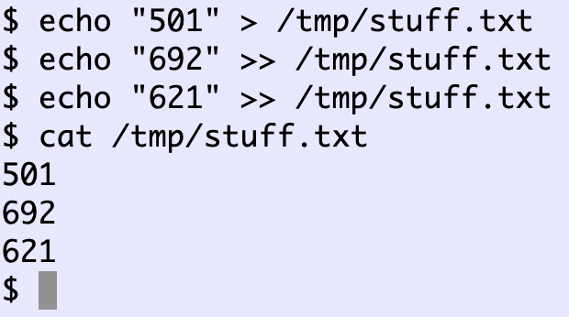
Appending standard output
If you want to send the output of multiple commands to a file, you can use the append redirection operator, which looks >>

Slide 12
Summary
pipe “|” hooks output of one process to input of another: a | b | c
redirect program output to a file using “>”
redirect and append program output to a file using “>>”
open file and send contents as standard input to a program using ‘<‘ operator
Redirect both: prog < infile > outfile
Redirect to first program then pipes then redirect: a < infile | b | c | d > outfile

