Slide 1
Hashtables
Implementations for dictionaries and sets
Terence Parr
MSDS program University of San Francisco
See https://github.com/parrt/msds692/blob/master/notes/hashtable.ipynb and https://github.com/parrt/msds692/blob/master/notes/dict.ipynb

Slide 2
Speed matters
In data science, data sets are often very large
Being able to find elements of interest quickly is more challenging in this environment
Searching through all elements can be prohibitively slow
We will need to trade some increased complexity and data structure set up time for increased look up speed

Slide 3
How to search big collections quickly
Hashtables are data structures that efficiently implement search/lookup operations for sets and dictionaries
Sets and dictionaries are abstract data structures, hashtables are concrete implementations of those structures
Simple lists of elements and lists of tuples work but are slow
Hashtable’s key idea: partition the search space into well-defined regions so we don’t have to search linearly through the entire collection to find an element
We use a (hash) function of the values to partition into buckets

Slide 4
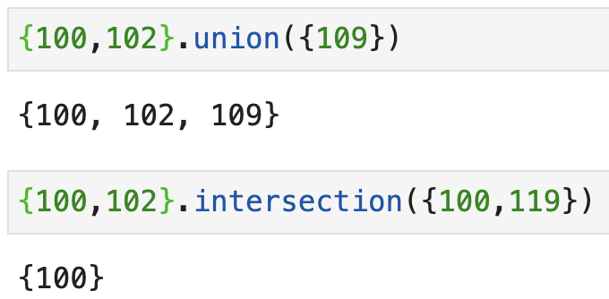
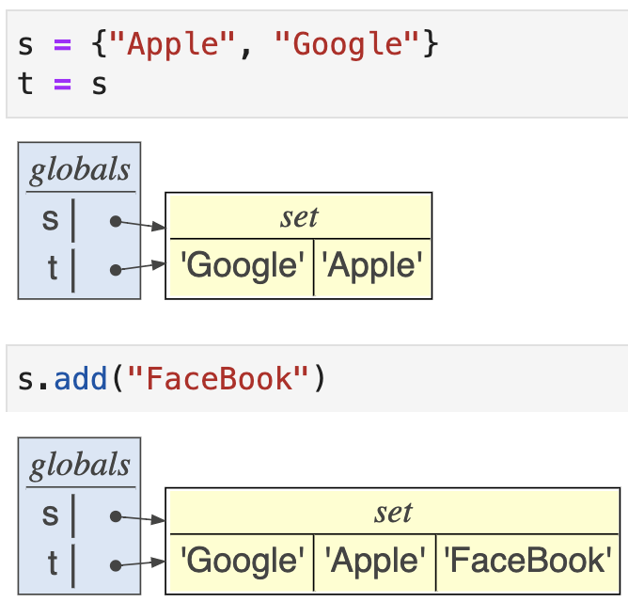
Review: Sets
A set is just an unordered, unique collection of elements; here is an example using integers: ids = {100, 103, 121, 102, 113, 113, 113, 113}
We can do lots of fun set arithmetic:
Watch out for aliasing!

Slide 5
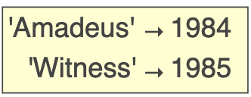
Review: Dictionaries map keys to values
If we arrange two lists side-by-side and kind of glue them together, we get a dictionary (type is dict)
Dictionaries map one value to another, just like a dictionary in the real world maps a word to a definition
Here is a sample dictionary:
Index by key to get the value; e.g., movies['Amadeus']
movies = {'Amadeus':1984, 'Witness':1985}

Slide 6
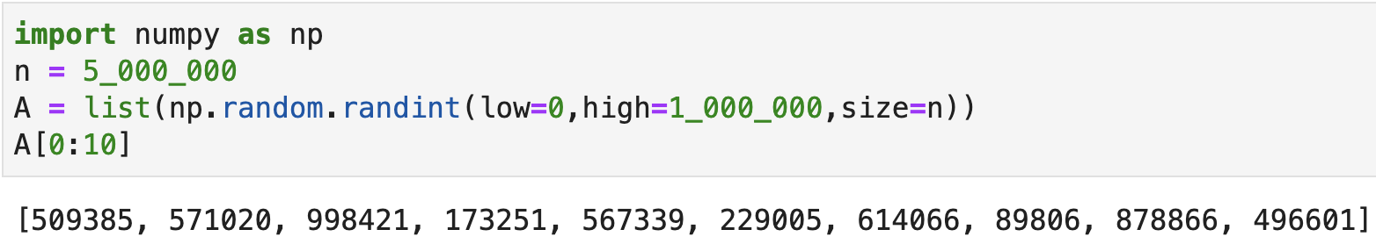
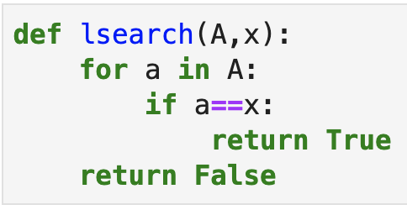
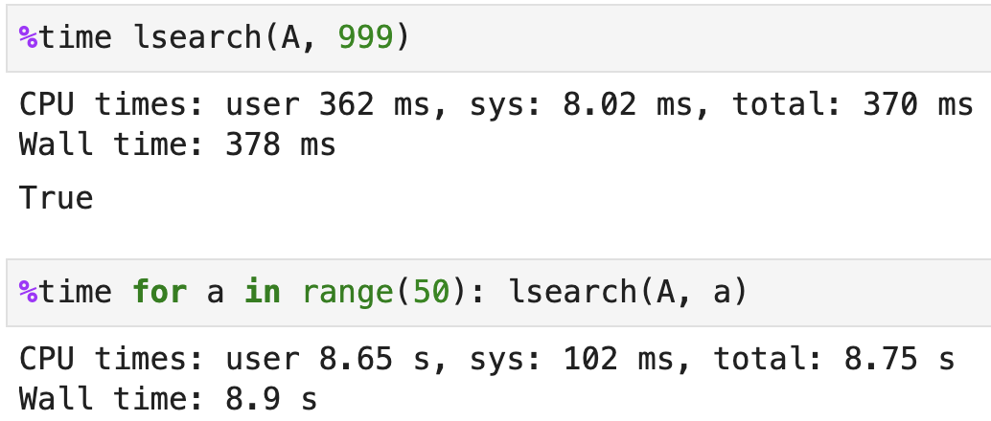
List implementation for sets
Searching linearly is pretty slow

Slide 7
Can we do better than linear search?
Rather than search through every element, let’s partition the set of numbers into 10 buckets so that, on average, we only need to search 1/10 of the elements
We partition with a hash function that operates on set values
We are effectively using something about the value to hint at the location
E.g., where does Eric Erickson live in US?
Imagine a hash function that gave the postal code given a name (set value)

Slide 8
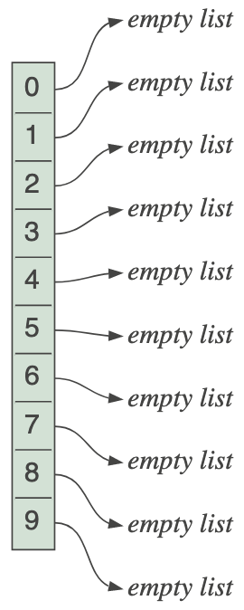
Partitioning requires a new data structure
Rather than a list of set values, we need a list of regions called buckets where each bucket is a list of values
The hash of a value leads to the bucket index
For sets of integers, let’s use the value modulo 10 to uniquely place values into one of 10 buckets, indexed 0..9

Slide 9
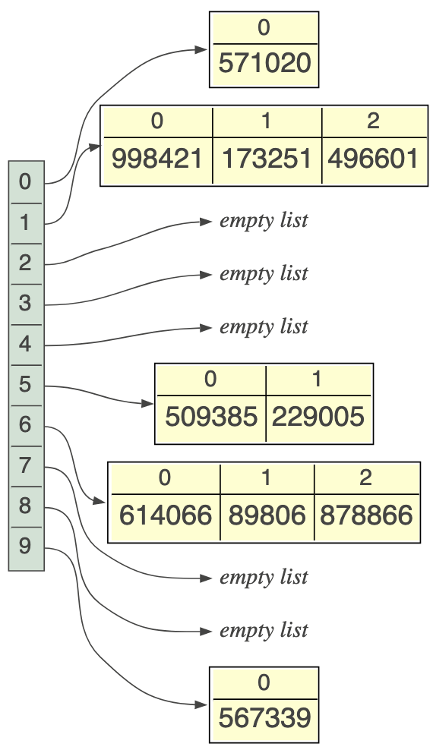
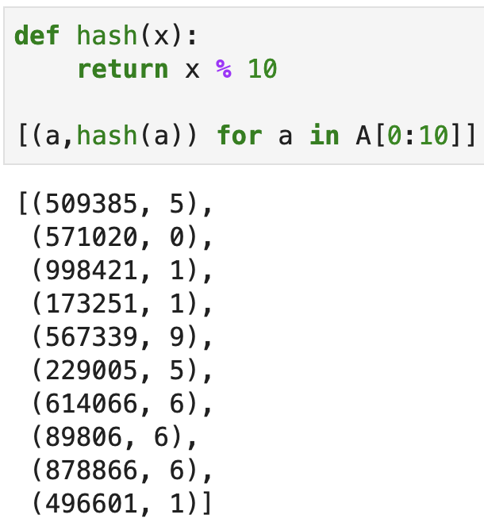
Partitioning with modulo hash

Slide 10

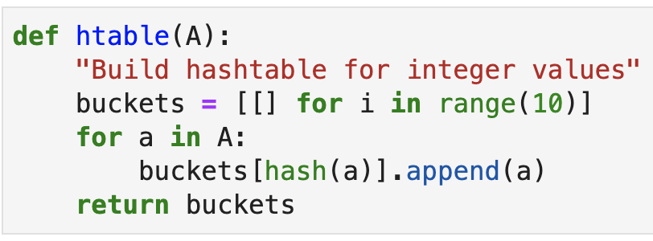

Hashtable construction
Make 10 empty buckets (lists)
Add each set element to correct bucket
Amounts to appending element to one of 10 lists

Slide 11
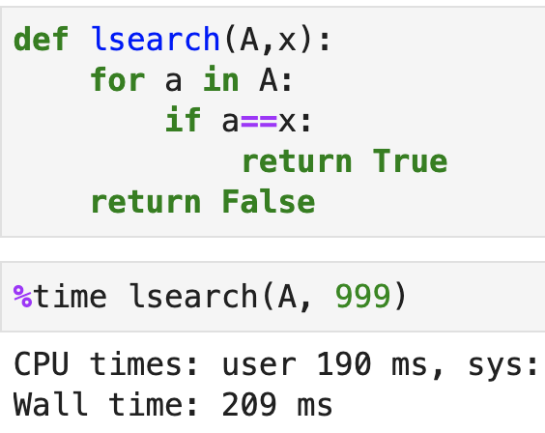
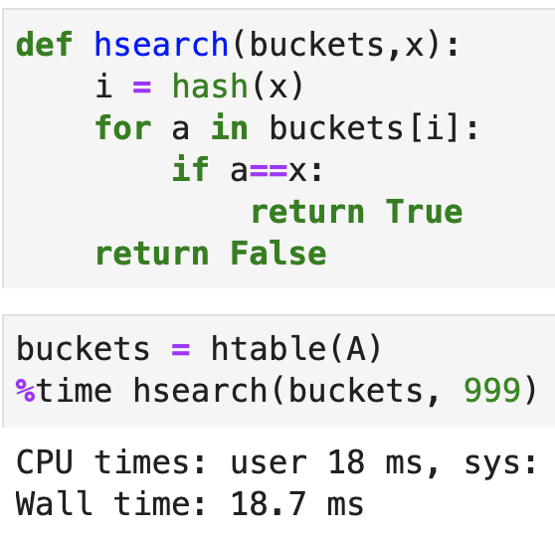
Searching hashtable set implementation
To find x, look in the bucket indicated by hash(x)
Linear
Hashtable

Slide 12
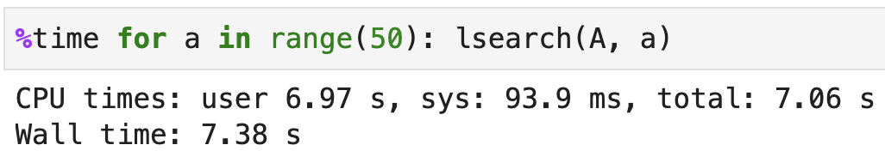
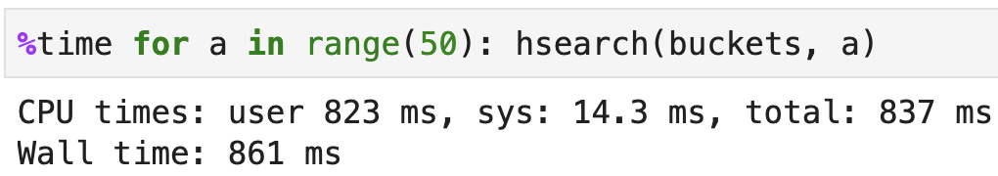
Speed difference is dramatic
Linear
Hashtable

Slide 13


Exercise
What would happen if we used a hash function like these?

Slide 14
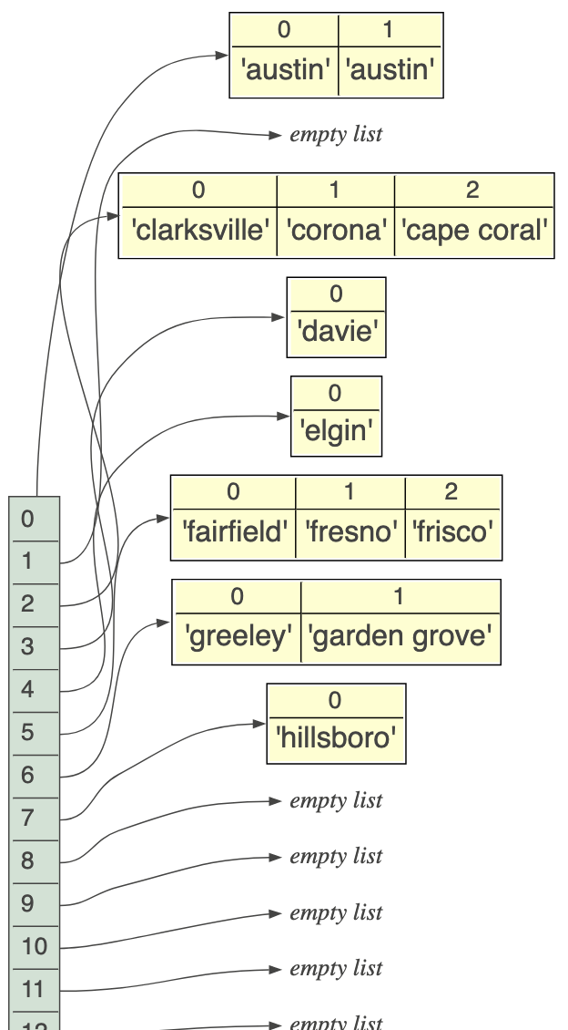
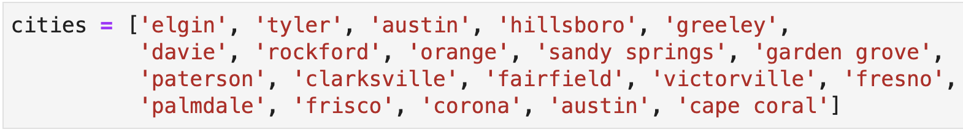
Sets of strings
Hashtables work for any value for which we can define a good hash function, one that partitions the space evenly
What hash function am I using here?
Hash is distance of char code from ‘a’s code

Slide 15
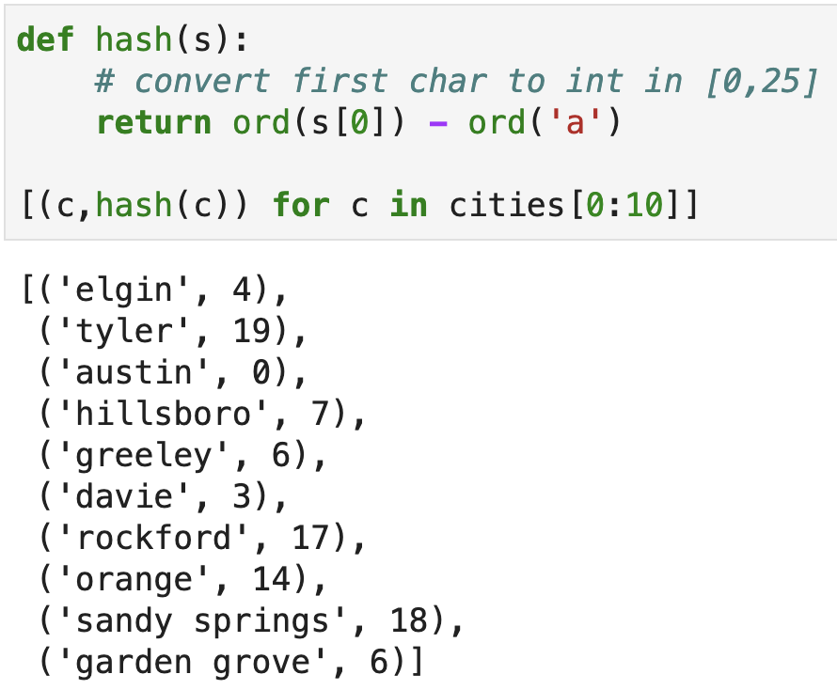
Hashing strings

Slide 16
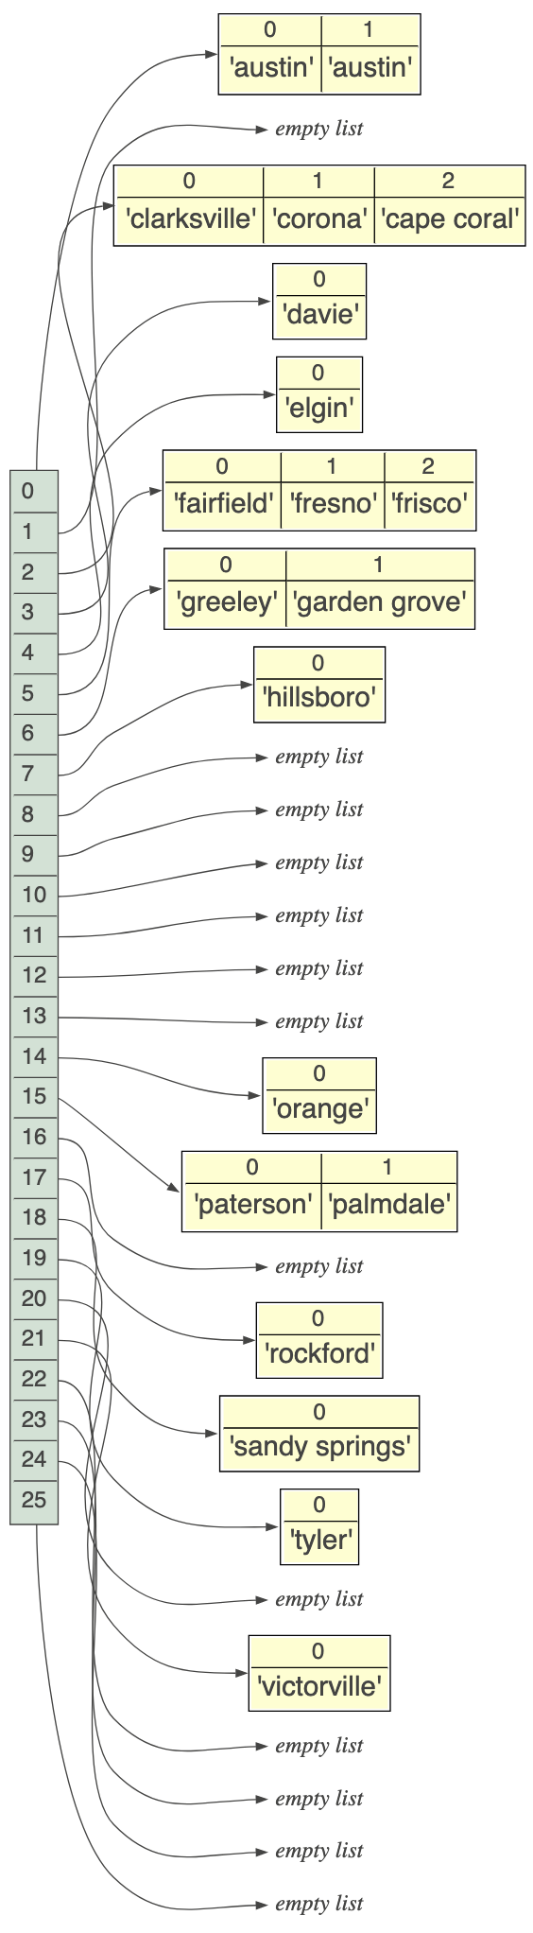
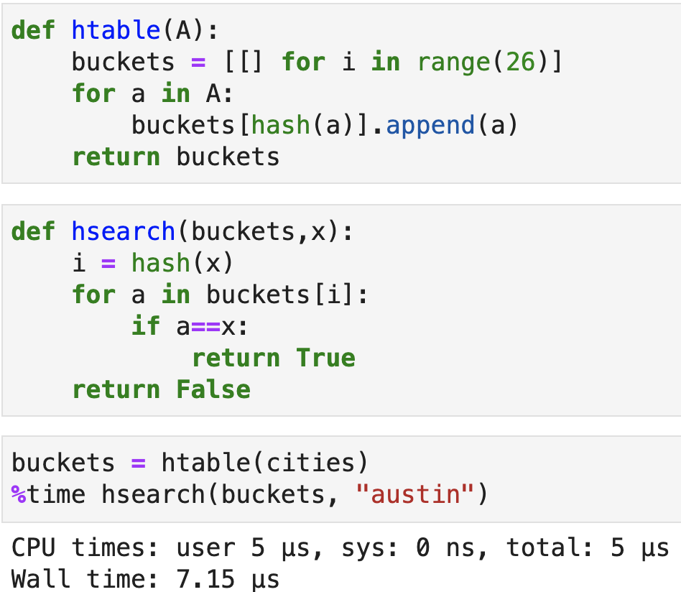
Hashtable impl. differs only in buckets

Slide 17
An important implementation detail
The hash function does not directly give the bucket index: it converts values to integers, then we make sure that the hash value fits into the table by doing modulo the number of buckets
For our int sets, the hash(x) is just x; the modulo 10 just puts it in one of 10 buckets
Same for strings; the hash(x) is in 0..25 but we could stick it into 10 buckets by taking modulo 10

Slide 18
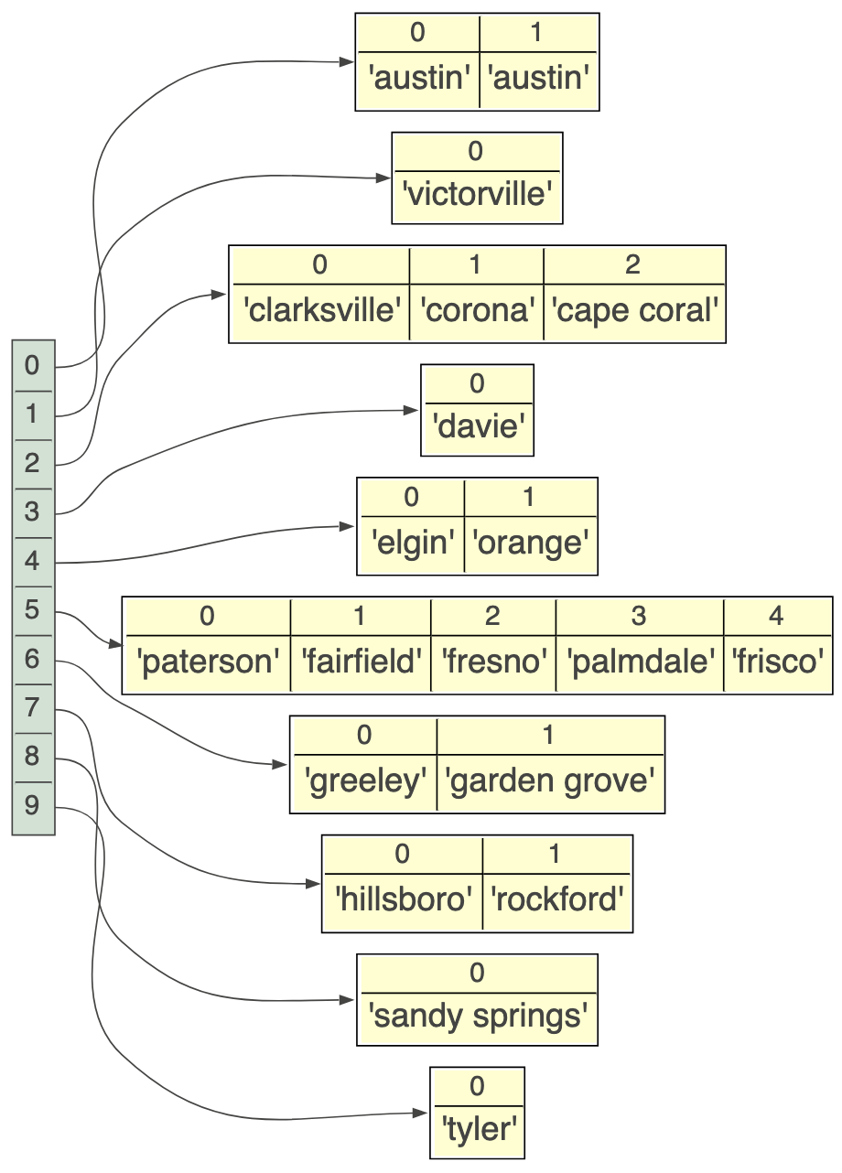
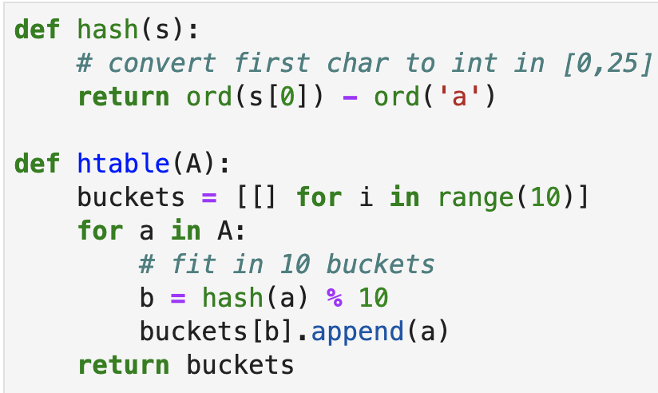
Hash vs bucket index
Compute the hash and mod with the number of buckets we have
Previously:

Slide 19
How much faster are hash tables?
With a uniform distribution, we would expect roughly N/B associations in each bucket for B buckets and N total elements in the dictionary
A complexity of N/B is much better than N and, with sufficiently large B, we would say that N/B approaches 1, giving complexity O(1) versus O(n)

Slide 20
Dictionary implementations

Slide 21
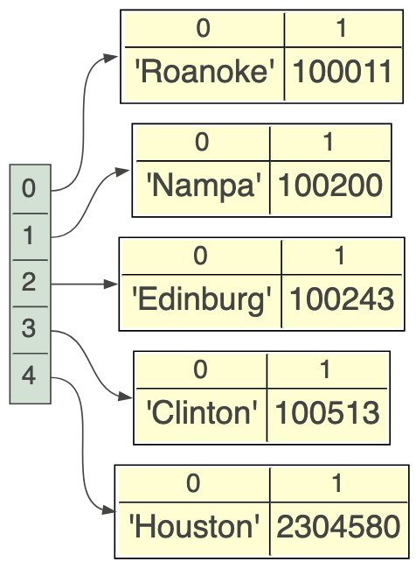
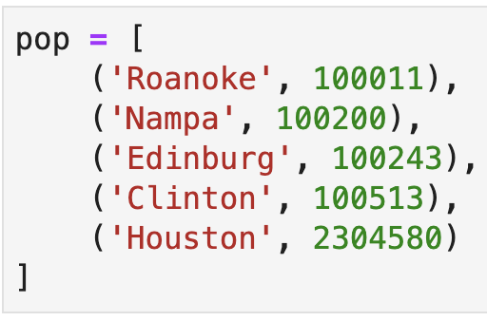
A simple dictionary implementation
Let’s represent the set of key→value pairs as a list of tuples:
The key operation is to look up a value by key
How would you implement this?
Linearly search through the list of tuples and compare the first value and the tuple to the key of interest; return the associated value if key is found

Slide 22
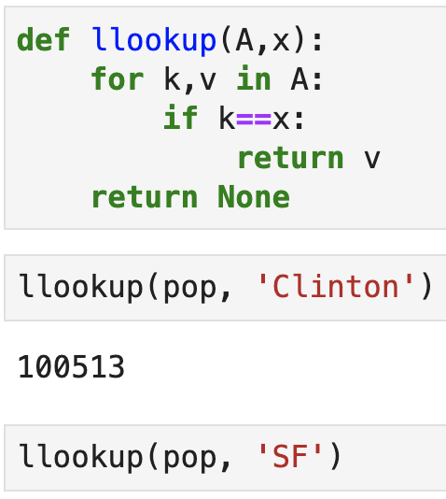
Linear lookup
Looking for a key is a simple matter of examining the first element of every tuple stored in the list
Return None if the key is not found

Slide 23
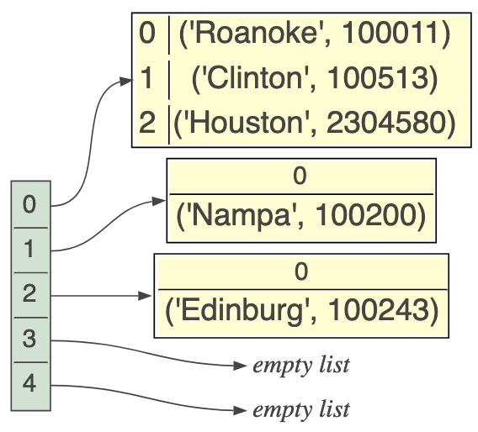
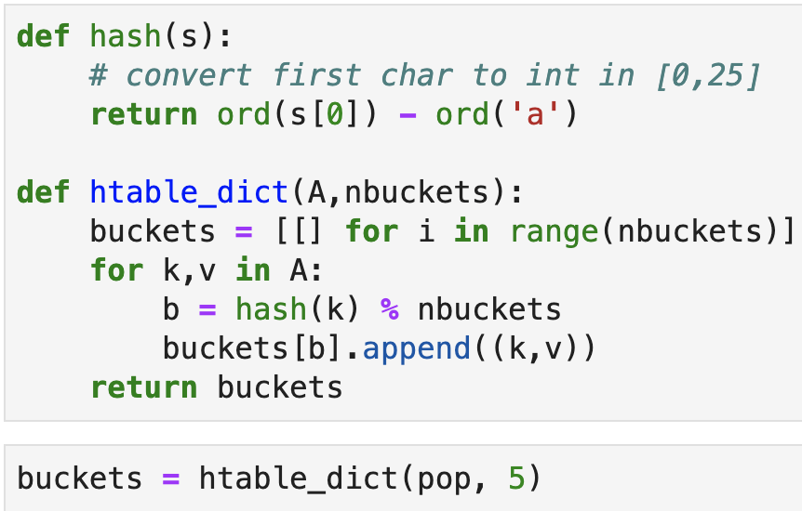
Hashtable dictionary implementation
First bucket has 3 pairs
Split pairs into, say, 5 buckets (use our string hash function)

Slide 24
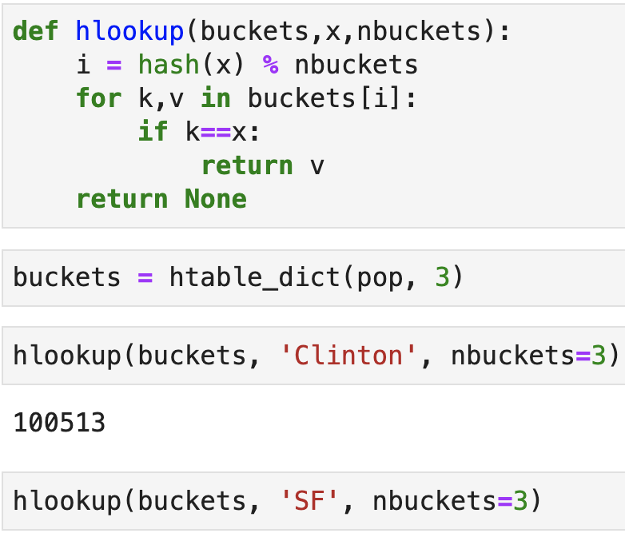
Hashtable key look up
Compute the hash, modulo a number of buckets, to get the bucket index
Linear search within the bucket
If key found, return value
Else return None

Slide 25
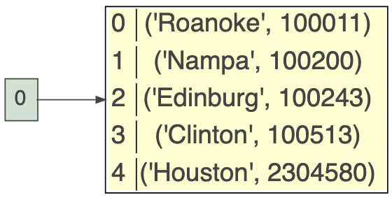

Degenerate case of one bucket
With only one bucket, all pairs hash to the same bucket, which means doing a linear search of all elements to look up a key
One and only bucket

Slide 26
Some details relevant to the search project

Slide 27
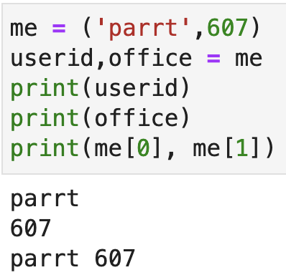
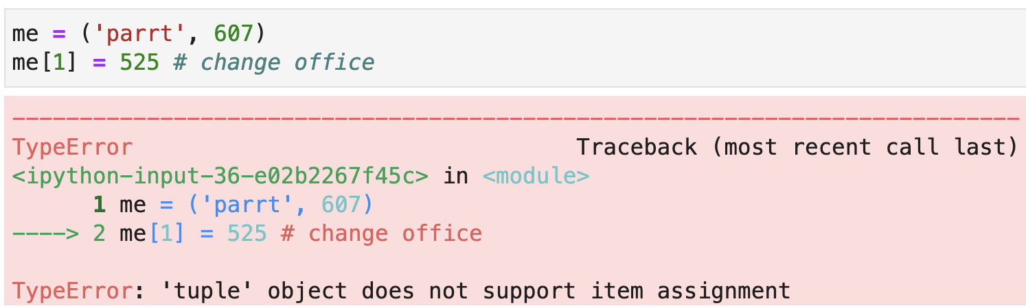
Review: tuples
A tuple is an immutable list and uses parentheses rather than square brackets for notation
Tuples are often used to group related elements:

Slide 28
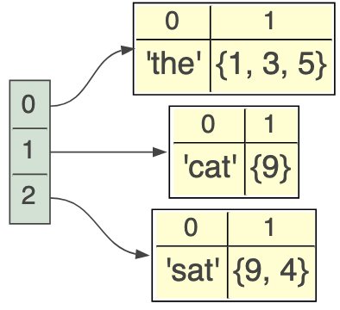
Values can be anything including sets
The tuples used to represent key and value pairs are immutable, but the pair’s value can point at a mutable data structures such as a set
Consider a simple list of tuples implementation that maps words to sets of integers

Slide 29
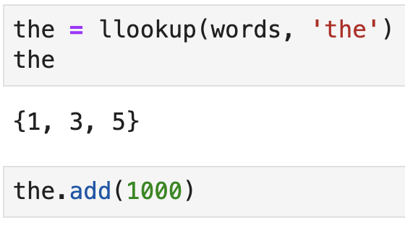
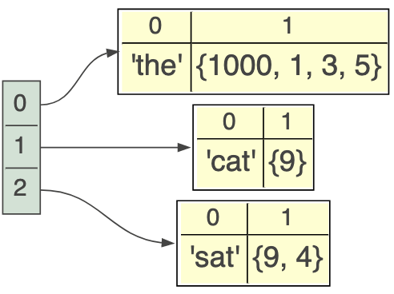
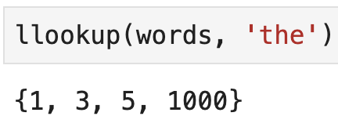
Modifying dictionary set values
If you extract a mutable value from a data structure, you can modify it without having to delete and add an updated version

Slide 30
Summary
Dictionaries and sets are typically implemented with a form of hashtable because the key lookup operation is so much faster
The speed comes from a partitioning of the search space into a large number of small regions, which are searched linearly
If we make enough buckets so that at most there are three keys in each bucket, lookup takes three operations no matter how many keys have been added to the dictionary

