Slide 1
Streams/pipes/redirection in the terminal
Terence Parr
MSDS program University of San Francisco

Slide 2
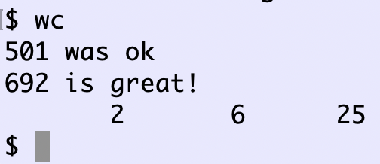
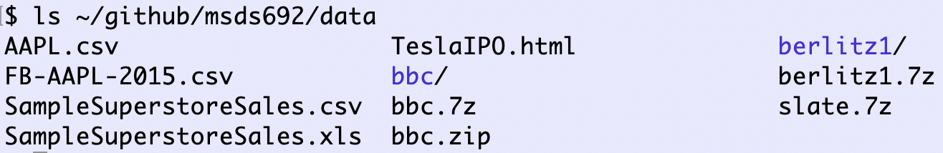
Streams are a unifying concept in UNIX
Files, networks, keyboards, … can all be accessed as streams
Every UNIX process has:
a current working directory
standard input (defaults to keyboard input)
standard output (defaults to terminal output)
(standard error)

Slide 3
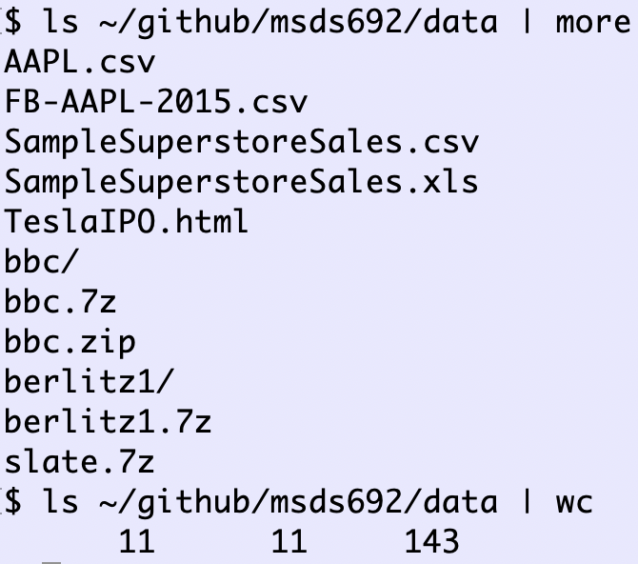
UNIX has lots of commands we can mix and match to solve problems without new code
To combine programs, we need to send the output of one program to the input of another
This lets us transform or simplify data in multiple steps
The mechanism for passing the standard output of one program to the standard input of another program is called a pipe
Here’s an example piping the output of ls to the input of more and then wc:

Slide 4
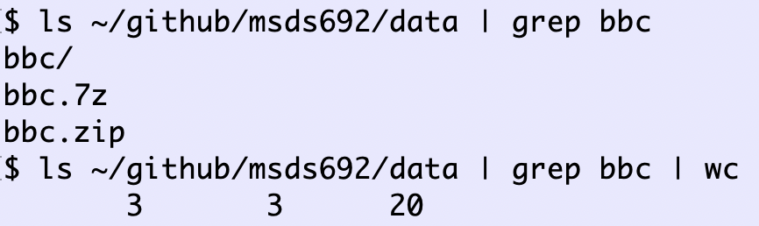
Deeper pipelines
Pipe the output of ls to grep (search for string in line) and send that output to wc, which counts how many filenames contain “bbc”

Slide 5
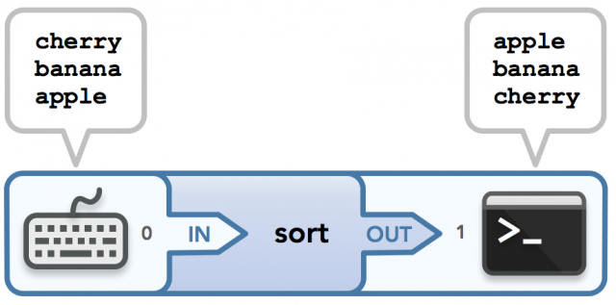
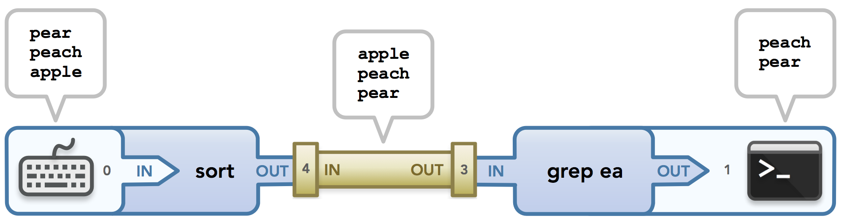
Nice visualizations from rozmichelle
See http://www.rozmichelle.com/pipes-forks-dups/

Slide 6
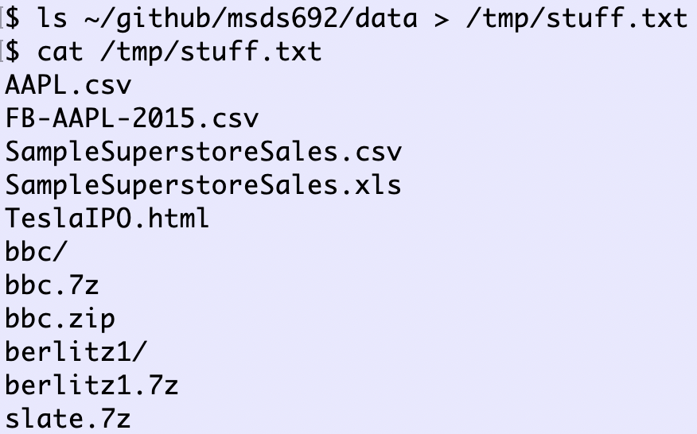
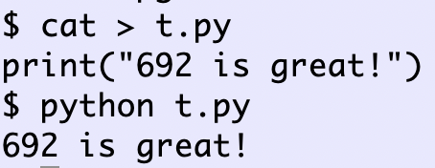
I/O redirection
Pipes connect process input/output
Redirection:
< file hooks process standard input to file
> file hooks process standard output to file
I’m hitting control-D (EOF) here to indicate end of input

Slide 7
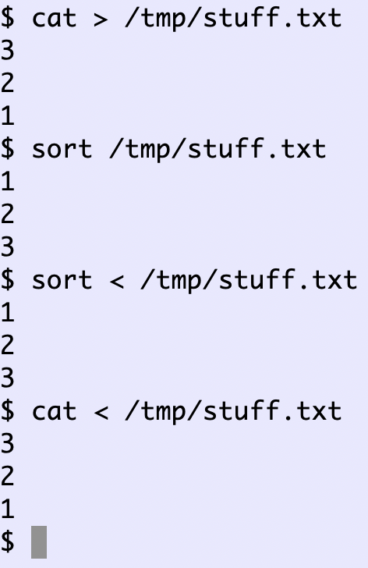
Redirecting standard input
Less common but still useful
Many commands take both commandline arguments and redirection: sort, cat, wc etc…
Control-D (EOF)

Slide 8
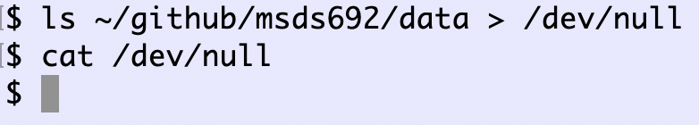
Throwing away program output
file /dev/null is a special “device” that accepts input and does nothing with it
It’s a great way to hide all of that debugging output you have in your program

Slide 9
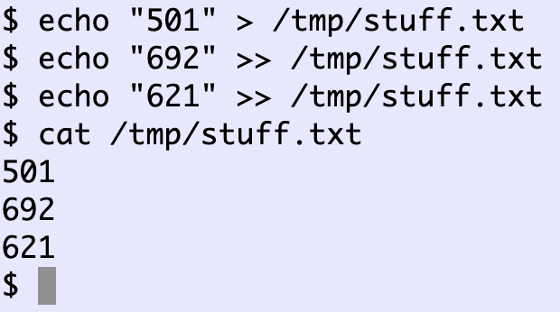
Appending standard output
If you want to send the output of multiple commands to a file, you can use the append redirection operator, which looks >>

Slide 10
Summary
pipe “|” hooks output of one process to input of another a | b | c
redirect program output to a file using “>”
redirect and append program output to a file using “>>”
open file and send contents as standard input to a program using ‘<‘ operator
Redirect both: prog < infile > outfile
Pipe then redirect: a < infile | b | c | d > outfile

