Slide 1
Hash tables
Implementations for dictionaries and sets
Terence Parr
MSDS program University of San Francisco

Slide 2
How to search big collections quickly
Hashtables are data structures that efficiently implement search/lookup operations for sets and dictionaries
Sets and dictionaries are abstract data structures, hashtables are concrete implementations of those structures
Simple lists of elements and lists of tuples work but are slow
Hashtable’s key idea: partition the search space into well-defined regions so we don’t have to search linearly through the entire collection to find an element
We use a (hash) function of the values to partition into buckets

Slide 3
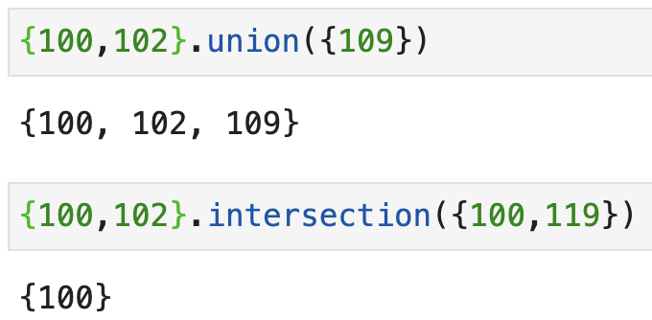
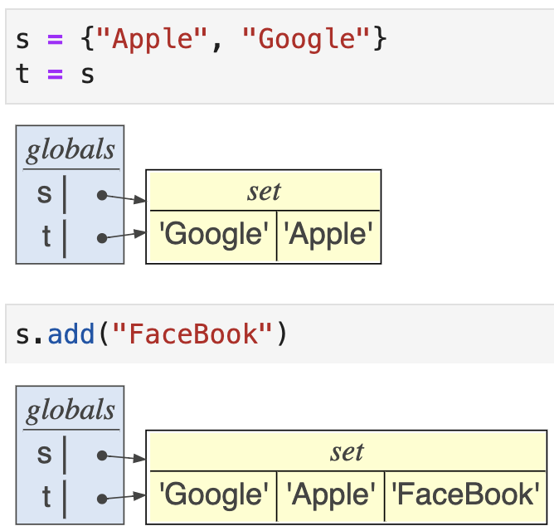
Review: Sets (default Python implementation)
A set is just an unordered, unique collection of elements; here is an example using integers: ids = {100, 103, 121, 102, 113, 113, 113, 113}
We can do lots of fun set arithmetic:
Watch out for aliasing!

Slide 4
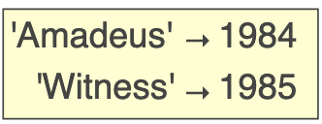
Review: Dictionaries map keys to values
If we arrange two lists side-by-side and kind of glue them together, we get a dictionary (type is dict)
Dictionaries map one value to another, just like a dictionary in the real world maps a word to a definition
Here is a sample dictionary:
Index by key to get the value; e.g., movies['Amadeus']
movies = {'Amadeus':1984, 'Witness':1985}

Slide 7
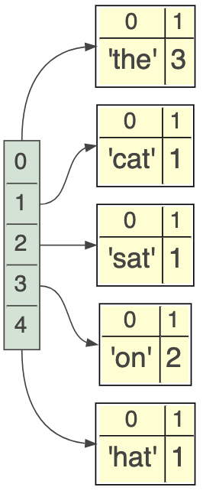
A simple implementation
To track a collection of key→value pairs, we can use a list of tuples such as: d = [('the', 3), ('cat', 1), ('sat', 1), ('on', 2), ('hat', 1)]
The key operation for a dict is to look up a value by its key
How would you implement this?
Linearly search through the list of tuples and compare the first value and the tuple to the key of interest; return the associated value if key is found

Slide 8
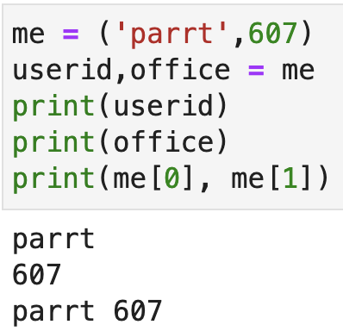
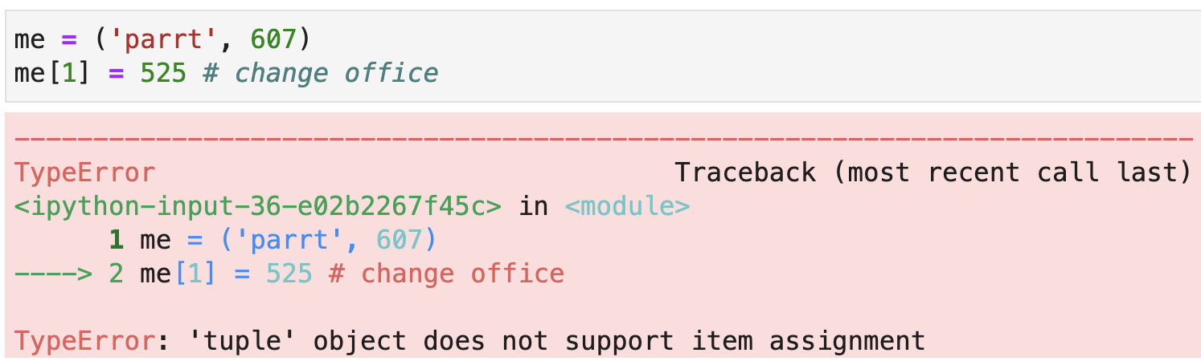
Review: tuples
A tuple is an immutable list and uses parentheses rather than square brackets for notation
Tuples are often used to group related elements:

