Slide 1
Network sockets
Terence Parr
MSDS program University of San Francisco

Slide 2
Goal
A program running on a computer can access any of the files on the disk (with sufficient permissions)
How does the program access data on a different computer?
We do it all time with the web. A web browser shows a file that actually comes from a different computer
We need background on networks so we understand how to:
pull data from a network
create a Web server to provide data services

Slide 3
Questions
What exactly is the web?
What are the components?

Slide 4

From pipes to sockets
Separate processes on the same computer may share data and synchronize via pipes; For example: ls | grep Aug
That pipes the output of ls to the input of grep using the UNIX pipe() function; sets up a one-way data flow from one process to another

Slide 5

What about connecting processes on separate computers?
Python provides access to OS sockets that allow two or more processes on the same or different computers to send/receive data very much like a 2-way phone connection
We can treat sockets just like files or any other stream of data from a programming perspective
Have to keep in mind that it is across a slow link on a network versus in memory on the same machine

Slide 6
Physical layer
Most of your laptops are connected by radio (WiFi) to a radio transceiver that sends data over a wired connection (Ethernet)
That transceiver sends data down to a central server room that has a fiber-optic connection to an Internet service provider
The data from there could go by satellite or fiber-optic cable under the ocean, depending on source and target locations
You can think of this as the electrical plumbing of the Internet
This layer we can simply assume exists and knows how to transmit data, albeit at different rates and with different latency

Slide 7
Internet protocol: IP
The lowest level abstraction above the hardware
Please distinguish IP protocol from ethernet, wireless, or any other physical networking mechanism
This is a data protocol that sits on top of some physical network

Slide 8
IP is an addressing, fragmentation protocol
It breaks all communications into packets, chunks of data up to 65536 bytes long.
Packets are individually routed from source to destination.
IP is allowed to drop packets; i.e., it is an unreliable protocol.
There are no acknowledgements and no retransmissions.
There is no flow-control saying "You're sending data too fast!"

Slide 9
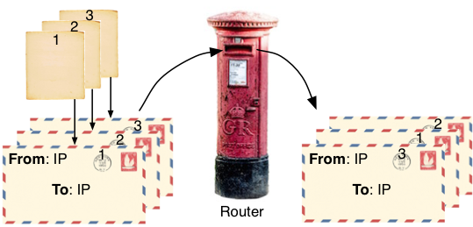
IP is fire-and-forget like a postal letter
You write a multi-page letter (this is the data you are sending)
Put each page of letter inside different envelope (the IP packet)
Address envelope (using an IP address)
Put return address on the envelope (your local IP address)
Send letter
We have no way of knowing whether an IP packet was received. If we send a second letter one day after the first, the second one may be received before the first.

Slide 10
IP Addresses
IP uses IP addresses to define source/target
IPs are 32 bit numbers represented as four 8-bit numbers separated by periods, such as 172.16.198.184
When you try to visit www.cnn.com in your browser, the computer must first translate www.cnn.com to an IP address
Then the browser can make a connection to the web server on the target machine identified by the IP address
You can think of this as the "phone number" of a machine

Slide 11
Special addresses
Behind firewalls, people often use 192.168.x.y or 10.10.10.x and use NAT (network address translation) in their firewall to translate an outside address (a real IP) to the special IPs behind the wall
In this case there is an external or public IP address and a private IP address
My varmint.cs.usfca.edu machine has public IP 138.202.170.154 but internal IP 10.10.10.51
127.0.0.1 is a way to say localhost or "my machine"

Slide 12
Privacy issue
A good security feature is to hide your machines from outside
For example, all machines from within IBM's firewall probably look like the exact same IP address to the outside world (such as in web server log files)
That is one reason you cannot use an IP address to identify users for a web server application

Slide 13
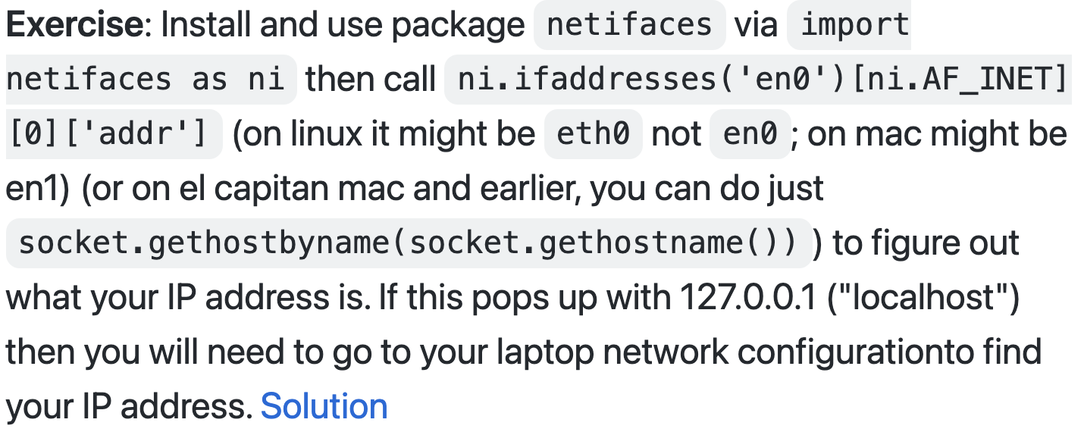
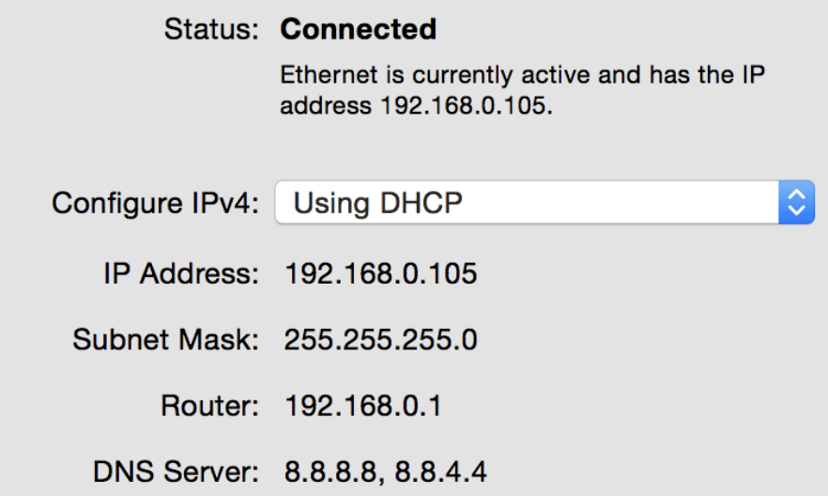
Exercise: Python code to find IP address
Solutions are in https://github.com/parrt/msds692/tree/master/notes/code/sockets

Slide 14
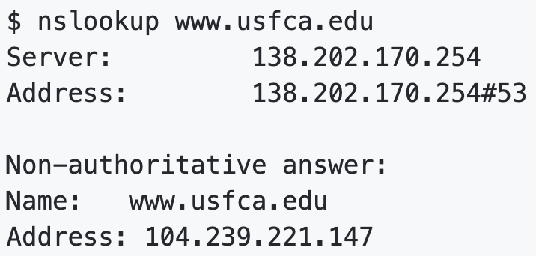
DNS -- Domain Name Service
DNS is a distributed database that maps domain names to IP addresses using a series of distributed DNS servers
It is really just a dictionary that maps a name to an IP address
Here is an example query using a UNIX tool

Slide 15
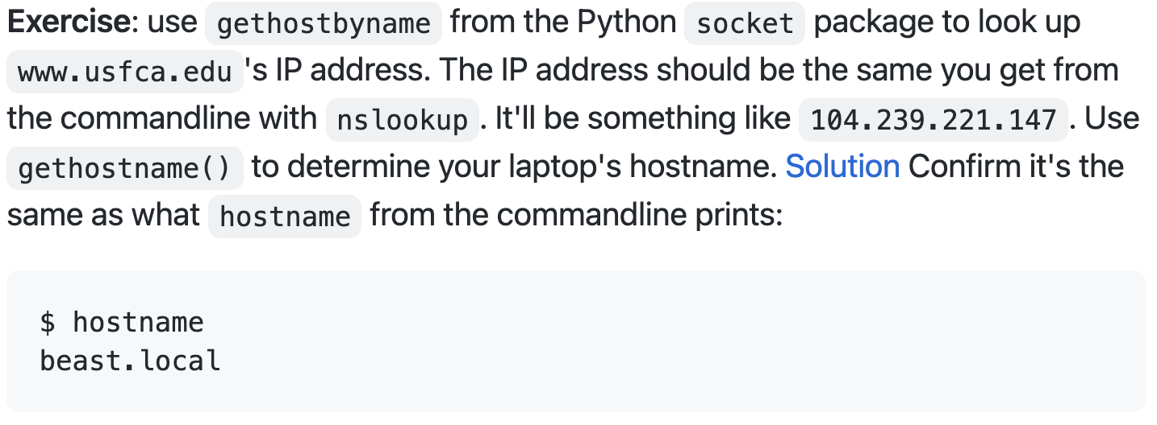
Exercise
Solutions are in https://github.com/parrt/msds692/tree/master/notes/code/sockets

Slide 16
Caching, etc…
DNS lookup is distributed so there isn't a single point of failure
A single server would also get absolutely pounded by requests from the net and would be extremely expensive to maintain
There are caches etc. that reduce the load on the DNS servers
If we didn't have DNS, we would all have to memorize a constantly shifting set of IP addresses (as before smart phones)

Slide 17
TCP/IP
TCP (Transmission Control Protocol) is another protocol, a reliable but slower one, sitting on top of IP. Believe it or not it comes from the 1970s
Reliable (fault tolerant). TCP automatically deals with lost packets before delivering a complete "file" to a recipient
Stream-oriented connections. We can treat the connection like a stream/file rather than packets
Packets are ordered into the proper sequence at the target machine via use of sequence numbers
Control-flow prevents buffer overflows etc...

Slide 18
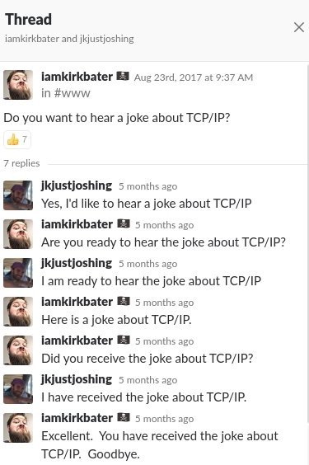
TCP is like a phone connection
TCP is like a phone connection versus the simple "fire and forget" letter stateless style of IP
TCP connections are open for the duration of a communication (i.e., until you close the connection)

Slide 19
Sockets
If the IP address is like an office building's main phone number, socket numbers are like the extension numbers for offices and are often called the port
The IP address and socket number uniquely identify an "office" (server process)
You will see unique identifiers like 192.168.2.100:80 where 80 is the port
We open sockets to ports in order to communicate with servers
Terms socket and port are often synonymous in common speech

Slide 20
Special port numbers
Ports range from 1..65535
Ports 1..255 are reserved for common, publicly-defined servers:
80: HTTP (web)
110: POP (mail)
25: SMTP (mail)
22: SSH (remote shell connections)
Ports 1..1024 require root/superuser privileges to use

Slide 21
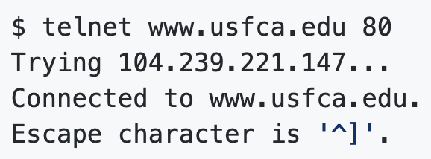
Connected to a port from commandline
You can use telnet (putty on windows) to connect to remote ports to manually speak the protocol
The most successful and long-lived protocols are simple and text based
For example, here is how I connect to port 80, the Web server, at the University:
To escape/quit, use control-] and then quit.

Slide 22
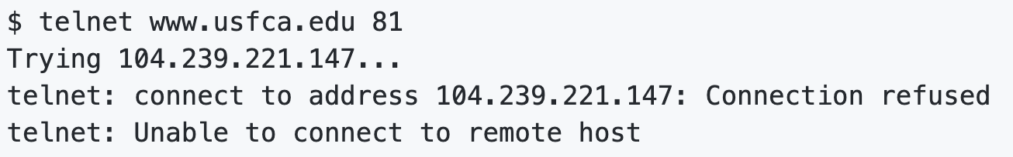
Nobody’s home
Just like in an office, it is possible that no process is listening at a port; i.e., there is no server waiting for requests at that port

Slide 23
Exercise
First, brew install telnet then use the telnet program from the commandline to connect to the following ports:
www.cs.usfca.edu 80
www.openpayments.us 80

Slide 24
Ya gotta speak the right language
Just because you can open a connection to a port doesn't mean you can speak the right language
Processes at ports all speak a specific, predefined, agreed-upon protocol like HTTP
To effectively communicate you need to know both the address and the protocol
Exercise: Use telnet to open a socket to www.usfca.edu:80 and type hi or some other text after connecting. The server should respond with Client sent a bad request

Slide 25
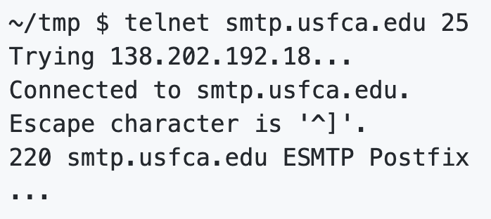
Sending mail the hard way
To send a piece of email, you need a mail client (even if it's telnet) that connects to an SMTP (Simple Mail Transfer Protocol by Jonathan B. Postel, 1982) and provides a packet of email with a target email address user@domain.com

Slide 26
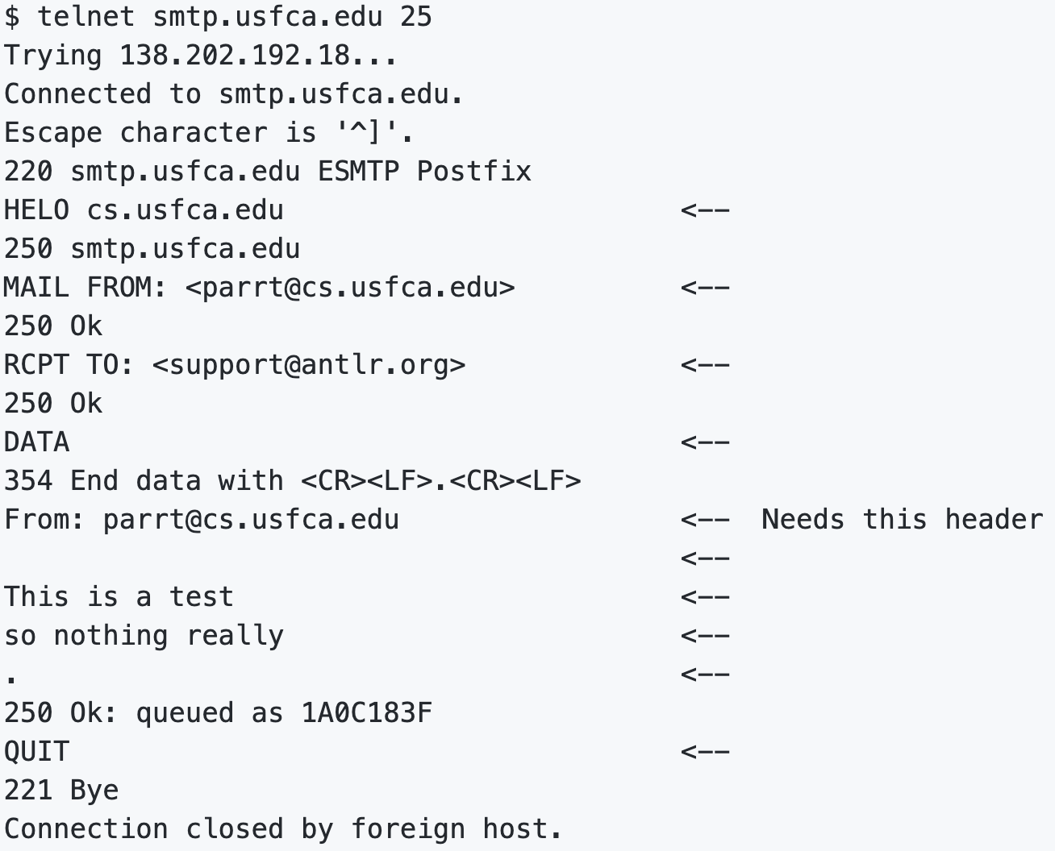
Sample SMTP
You have to type lines marked with <--

