Slide 1
Representing text in a computer
Notebook version: https://github.com/parrt/msds692/blob/master/notes/chars.ipynb
Terence Parr
MSDS program University of San Francisco

Slide 2
What are characters?
Data scientists must be able to load data from files and the Internet into memory; often the data is in text form
Characters are lexical elements that represent words or sounds in a natural language; text is just a bunch of characters
As with everything else computers represent text using numbers, assigning a unique number to each character
The way we represent text and memory is often different than in files, so we have to be careful when collecting files from around the world

Slide 3
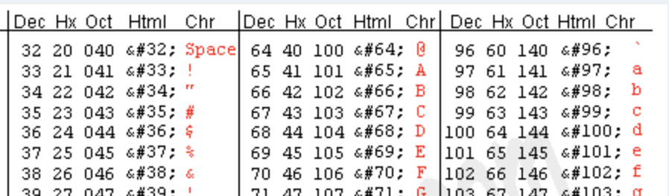
American characters
Americans encode the English character set (upper and lower case, numbers, punctuation, and some other characters like newlines and tab) using 7-bit ascii codes: numbers <= 127
"abc" is represented by three bytes, one byte per character
It is a very dense encoding, meaning very few bits are wasted
The encoding is called ASCII and is just a mapping from characters to numbers
See http://www.asciitable.com/

Slide 4
A first attempt at non-English characters
For a very long time, other languages were out of luck
Other countries started using the remaining 128..255 numeric values to encode characters; e.g. accented letters like ś and ŝ
This was called the Latin-1 character set
The problem was that many countries used 201 and to represent different characters; e.g., Russian characters were often mapped to numbers using the KOI8-R set that overlapped with 0..255 used by ASCII and Latin-1
See https://en.wikipedia.org/wiki/ISO/IEC_8859-1

Slide 5
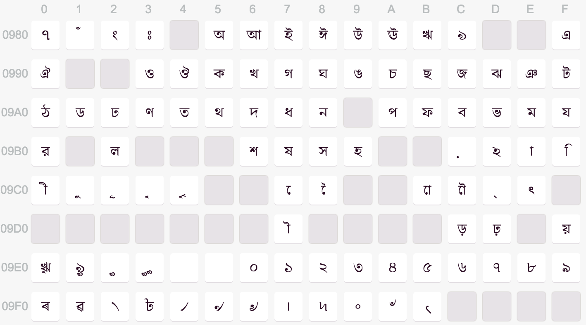
Enter Unicode
Unicode is a standard that maps characters for just about any human language to numeric values (called code points)
For example, here is a piece of the Bengali code points
Reading left to right, the first character is 980+0, the second is 980+1, etc...
Notation U+0981 is hexadecimal, base 16, is used because all possible values within 4 hexadecimal digits (2 bytes)
See https://docs.python.org/3/howto/unicode.html

Slide 6
Unicode in Python
Python strings are a string of Unicode characters (code points)
Worst-case each character requires two bytes (16 bits) whereas ASCII requires just one byte (8 bits)
Python 3 does seem to do some optimization, keeping strings as 1-byte-per-char as long as possible, until we introduce a non-ASCII character
We can verify string size with the getsizeof function

Slide 7
Checking string memory requirements
from sys import getsizeof
print(getsizeof('')) # 49 bytes of overhead for string object
print(getsizeof('a'))
print(getsizeof('ab'))
print(getsizeof('abc'))
print(getsizeof('Ω')) # add non-ASCII char & overhead goes up
print(getsizeof('ΩΩ')) # each unicode char costs 2 bytes
print(getsizeof('ΩΩΩ'))
49
50
51
52
76
78
80

Slide 8
Unicode character names
import unicodedata
print(unicodedata.name(chr(9999)))
print(unicodedata.name(chr(9991)))
# sequence "\N" means named entity
print("\N{GREEK CAPITAL LETTER OMEGA}")
print("\N{PENCIL}")
print("\N{TAPE DRIVE}")
PENCIL
TAPE DRIVE
Ω
✏
✇

Slide 9
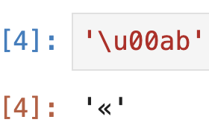
Converting character codes to chars
The chr() function converts an integer to a character
You will see notation \xFF, which means FF in hexadecimal (all bits on) or 255 in decimal
A byte takes at most 2 hexadecimal digits, which is why we tend to use hexadecimal
\uABCD notation is used to express 2-byte (16 bit) Unicode chars
d
ፋ
ô 'ô'
print(chr(100))
print(chr(4939))
print(chr(244), repr(chr(244)))

Slide 10
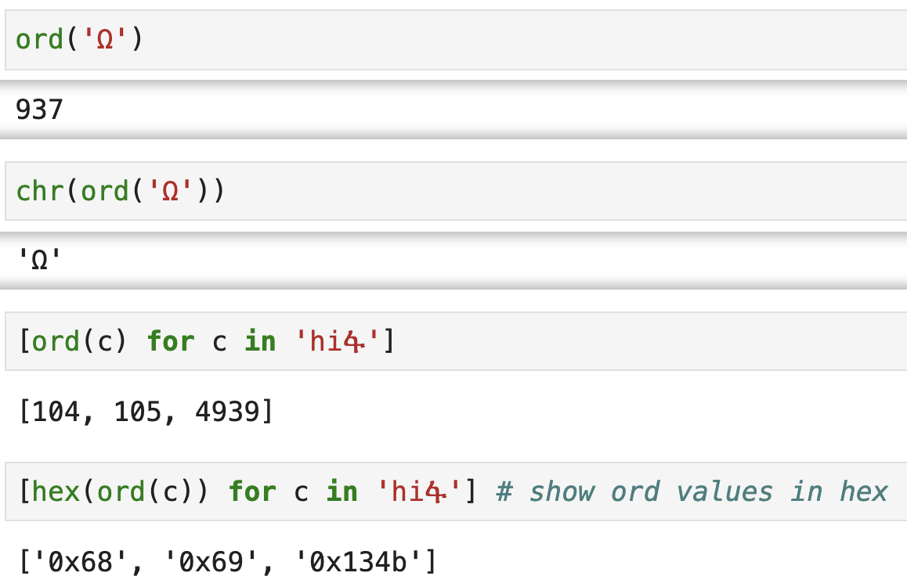
Chars to integer code points

Slide 11
Exercise
Repeat for yourself the notebook cells above starting with the getsizeof stuff to get used to playing with non-English characters, converting them to and from their code points (ordinal values)
You can cut/paste some stuff from the notebook version of this lecture: https://github.com/parrt/msds692/blob/master/notes/chars.ipynb

Slide 12
Text file encoding
Now, let's make a distinction between strings in memory and text files stored on the disk

Slide 13
ASCII text files
Storing Python strings with ASCII chars, codes that fit into 8 bits (1 byte), into a file is easy
The sequence of character codes is stored in the file one byte per character
That is a very dense encoding
Using a compression algorithm we could make the file smaller but it would no longer be a text file

Slide 14
Storing UNICODE into text files
For 16-bit Unicode, we could store each character as to bytes in the file, but it wastes a lot of space; English characters would require double the space, for example!
Instead of blindly storing two bytes per character, we should optimize for the case where characters fit into one byte
We use such an encoding called UTF-8: Unicode Transformation Format that is optimized for ASCII char

Slide 15
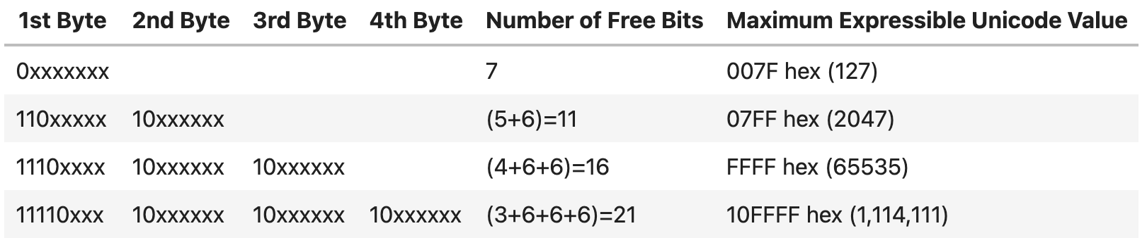
UTF-8
UTF-8 degenerates to ASCII for ASCII chars
The details don’t matter for us, but the table below summarizes how many bytes are required for each Unicode value
It’s just an efficient way to store Unicode characters in a file; remember that in a string in memory, we should think of characters is always taking exactly 2 bytes (16 bits)

Slide 16
Other file encodings
There are non-UTF-8 encodings of strings for files
For example, on a Japanese machine, the encoding might be euc-jp, which is optimized for the Japanese character set. (Wikipedia says "EUC-JP is a variable-width encoding used to represent the elements of three Japanese character set standards,...")
Bottom line: If you are reading text from a file, you must know the encoding in order to communicate; A file from Japan might not have the same encoding as a file created locally on your US machine, even with identical text content

Slide 17
Saving text into files

Slide 18
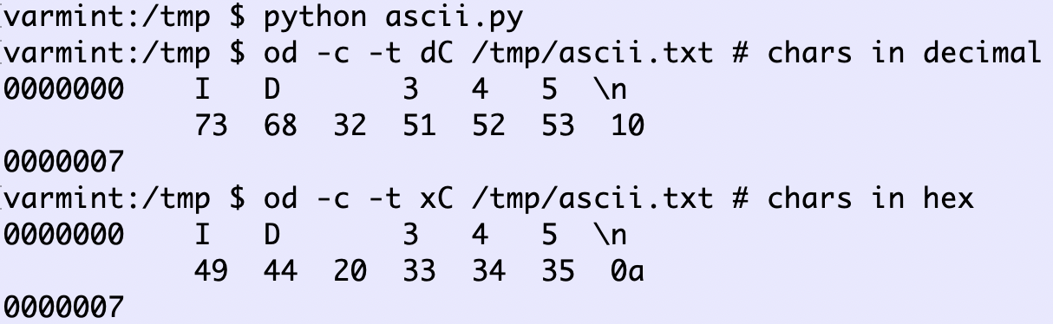
Writing ASCII text to a file
with open("/tmp/ascii.txt", mode="w") as f:
f.write("ID 345\n")
Please note that 345 is a sequence of three characters not the binary value 345

Slide 19
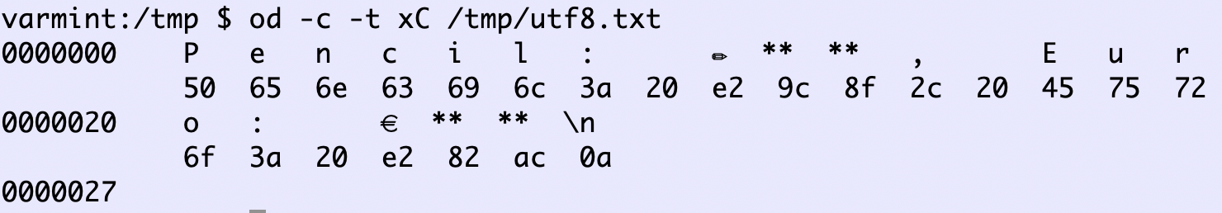
Writing non-ASCII char to a file
# Write a UTF-8-encoded text file
with open('/tmp/utf8.txt', encoding='utf-8', mode='w') as f:
f.write('Pencil: \N{PENCIL}, Euro: \u20ac\n')
# or use actual character: # f.write('Pencil: ✏, Euro: €\n')
The ** mean "Hi, I'm a byte that is part of the preceding character shown"

Slide 20
Reading Unicode encoded as UTF-8
The encoding used to read must match encoding used to write
If you use the wrong encoding you get the wrong strings:
with open('/tmp/utf8.txt', encoding='utf-8', mode='r') as f:
s = f.read()
print(s)
Pencil: ✏, Euro: €
with open('/tmp/utf8.txt', encoding='latin-1', mode='r') as f:
…
Pencil: â, Euro: â¬

Slide 21
Exercise
Test out those two simple Python programs to make sure you can write and read Unicode characters to and from files. But change the string so your code saves two characters: VICTORY HAND followed by HEAVY CHECK MARK or some other fun characters
Use the od command to dump the characters in the file
You can cut/paste some stuff from the notebook version of this lecture: https://github.com/parrt/msds692/blob/master/notes/chars.ipynb

Slide 22
Language within a text file
Besides knowing that a file is text and how it is encoded, we also need to know the format or language followed by the characters; there are many different formats (syntax):
comma-separate values (CSV)
XML
JSON
HTML
Natural language text, such as an email message or tweet
Python, JavaScript, Java, C++, any programming language
Examples of non-text-based formats: mp3, png, jpg, mpg, ...

Slide 23
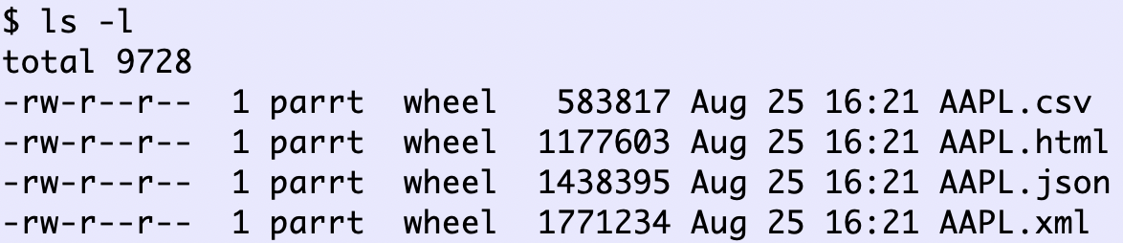
Some formats have a lot of overhead
Take a look at the sizes to represent the same data in four different formats for your pipeline project (AAPL stock prices):
CSV is the least flexible but the most dense text format

