Slide 1
Exploring the Interplay of Lifestyle, Academic, and Psychological Factors on Mental Health Outcomes in University Students
(using Logistic Regression)

Slide 2
INTRODUCTION
University life is a period marked by significant academic challenges, lifestyle adjustments, and psychological transformations. During this transitional phase, students often face multiple stressors such as academic pressure, financial burdens, sleep disturbances, and changes in dietary habits. These factors can significantly influence their mental well-being and academic performance.
In recent years, there has been an alarming increase in mental health concerns among students, particularly suicidal ideation, often stemming from a complex mix of personal, environmental, and academic variables. This case study seeks to analyze the relationship between various socio-demographic, lifestyle, academic, and psychological variables—including age, study satisfaction, sleep duration, CGPA, work pressure, and family history of mental illness—on the presence of suicidal thoughts.

Slide 3
Objectives:
To examine the impact of academic factors (CGPA, academic pressure, study satisfaction) on students' mental health outcomes.
To assess lifestyle variables (dietary habits, sleep duration) and their association with stress and suicidal ideation.
To evaluate the role of financial and work-related pressures in influencing students' psychological well-being.
To identify the prevalence of suicidal thoughts and their correlation with other factors such as family history of mental illness and personal stressors.
To provide insights for educational institutions to design better mental health support and wellness programs targeting at-risk students.

Slide 4
Why this study is important?
This dataset is important because it captures the complex relationship between student mental health and academic performance. By analyzing factors like stress, lifestyle, family background, and emotional well-being, the dataset can help identify patterns that lead to poor academic outcomes or serious mental health risks. It allows educators, psychologists, and policymakers to better understand student challenges and develop effective support systems to improve both mental well-being and academic success.

Slide 5
METHODOLOGY
The analysis follows a structured approach, adapted for logistic regression using Python libraries such as pandas, scikit-learn, seaborn, and matplotlib.
1. Data Collection and Preparation
2. Model Specification and Representation
3. Prediction of Values
4. Interpretation of Results.

Slide 6
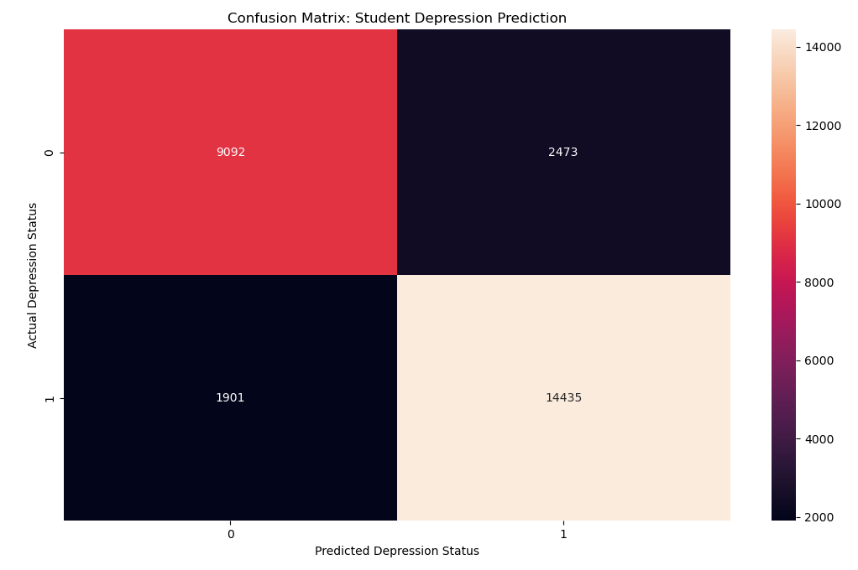
ACTUAL VS PREDICTORS
Confusion Matrix shows the Actual vs. Predicted values for a classification model, where the x-axis represents the Predicted Depression Status and the y-axis represents the Actual Depression Status. It helps evaluate the performance of the model by comparing how many predictions were correct or incorrect. This matrix helps in understanding errors like false positives (predicting depression when there isn’t) and false negatives (missing actual depression), which is important in sensitive fields like mental health prediction.

Slide 7
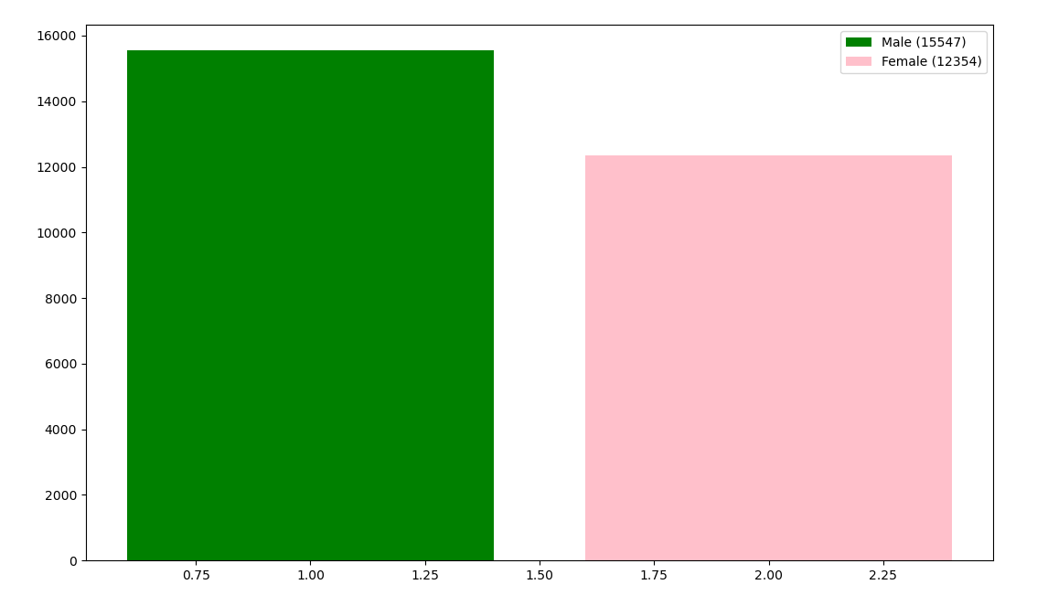
Gender Difference

Slide 8
Code: (Open)
from pandas import read_csv
from sklearn.linear_model import LogisticRegression
from sklearn.metrics import accuracy_score, confusion_matrix
import seaborn
import matplotlib.pyplot as plt
df = read_csv("./student_depression_dataset.csv", index_col=0)
dfclean = df.replace({"Male":0, "Female":1, "Others": -1, "Unhealthy": 0, "Moderate": 1, "Healthy": 2, "'More than 8 hours'": 9,"'5-6 hours'": 5.5, "'Less than 5 hours'": 4,"'7-8 hours'": 7.5, "?": 0, "Yes": 1, "No": 0, "Pass": 1, "Fail": 0}).infer_objects(copy=False)
M=0
F=0
for i in dfclean["Gender"]:
print(i)
if i == 1:
F+=1
elif i == 0:
M+=1
X = dfclean[["Study Satisfaction" ,"Financial Stress", "Dietary Habits", "Age", "Sleep Duration", "suicidal thoughts", "Family History of Mental Illness" , "CGPA", "Academic Pressure"]]
y = df["Depression"]
print(X)
model = LogisticRegression()
model.fit(X, y)
predicshun = model.predict(X)
cmatrix = confusion_matrix(y, predicshun)
plt.figure(figsize=(8, 6))
seaborn.heatmap(cmatrix, annot=True, fmt="d")
plt.xlabel('Predicted Depression Status')
plt.ylabel('Actual Depression Status')
plt.title('Confusion Matrix: Student Depression Prediction')
plt.show()
plt.clf()
plt.bar([1], [M], color="green", label=f"Male ({M})")
plt.bar([2], [F], color="pink", label=f"Female ({F})")
plt.legend()
plt.show()
acc = accuracy_score(y, predicshun)
#acc = accuracy_score(sss, y)
print(y)
print("Accuracy" ,acc*100, "%")
print("Intercept:", model.intercept_)

Slide 9
CONCLUSION
This study explored the impact of academic, lifestyle, and psychological factors on suicidal thoughts among students using logistic regression. By analyzing variables such as academic pressure, financial stress, sleep duration, and family history of mental illness, we identified key contributors to mental health risks.
The model revealed that academic and financial pressures, along with family mental health history, were significant predictors of suicidal ideation. Conversely, healthy sleep patterns and study satisfaction showed protective effects.
These findings highlight the urgent need for mental health support systems within academic institutions. Targeted interventions can be designed based on these predictors to help students cope with stress and improve their well-being.

