Slide 1


Restaurant Rating Prediction
A Machine Learning-Based Approach for Predicting Restaurant Ratings

Slide 2
Objective
Develop a predictive model for estimating restaurant ratings based on structured data.
Use various machine learning algorithms to identify patterns influencing restaurant ratings.
Deploy the model on AWS using CI/CD automation tools.

Slide 3
Benefits
Helps customers make informed decisions about dining options.
Provides restaurant owners with insights to improve their services.
Automates and streamlines the rating prediction process.
Ensures a scalable and maintainable deployment environment.

Slide 4
Data Description
Data includes features such as:
restaurant_name (str)
restaurant_location (str)
restaurant_category (str)
restaurant_type (str)
is_online_order_available (bool)
is_table_booking_available (bool)
cost_for_two (float)
number_of_votes (int)
cuisines_offered (str)
rate (float)

Slide 5
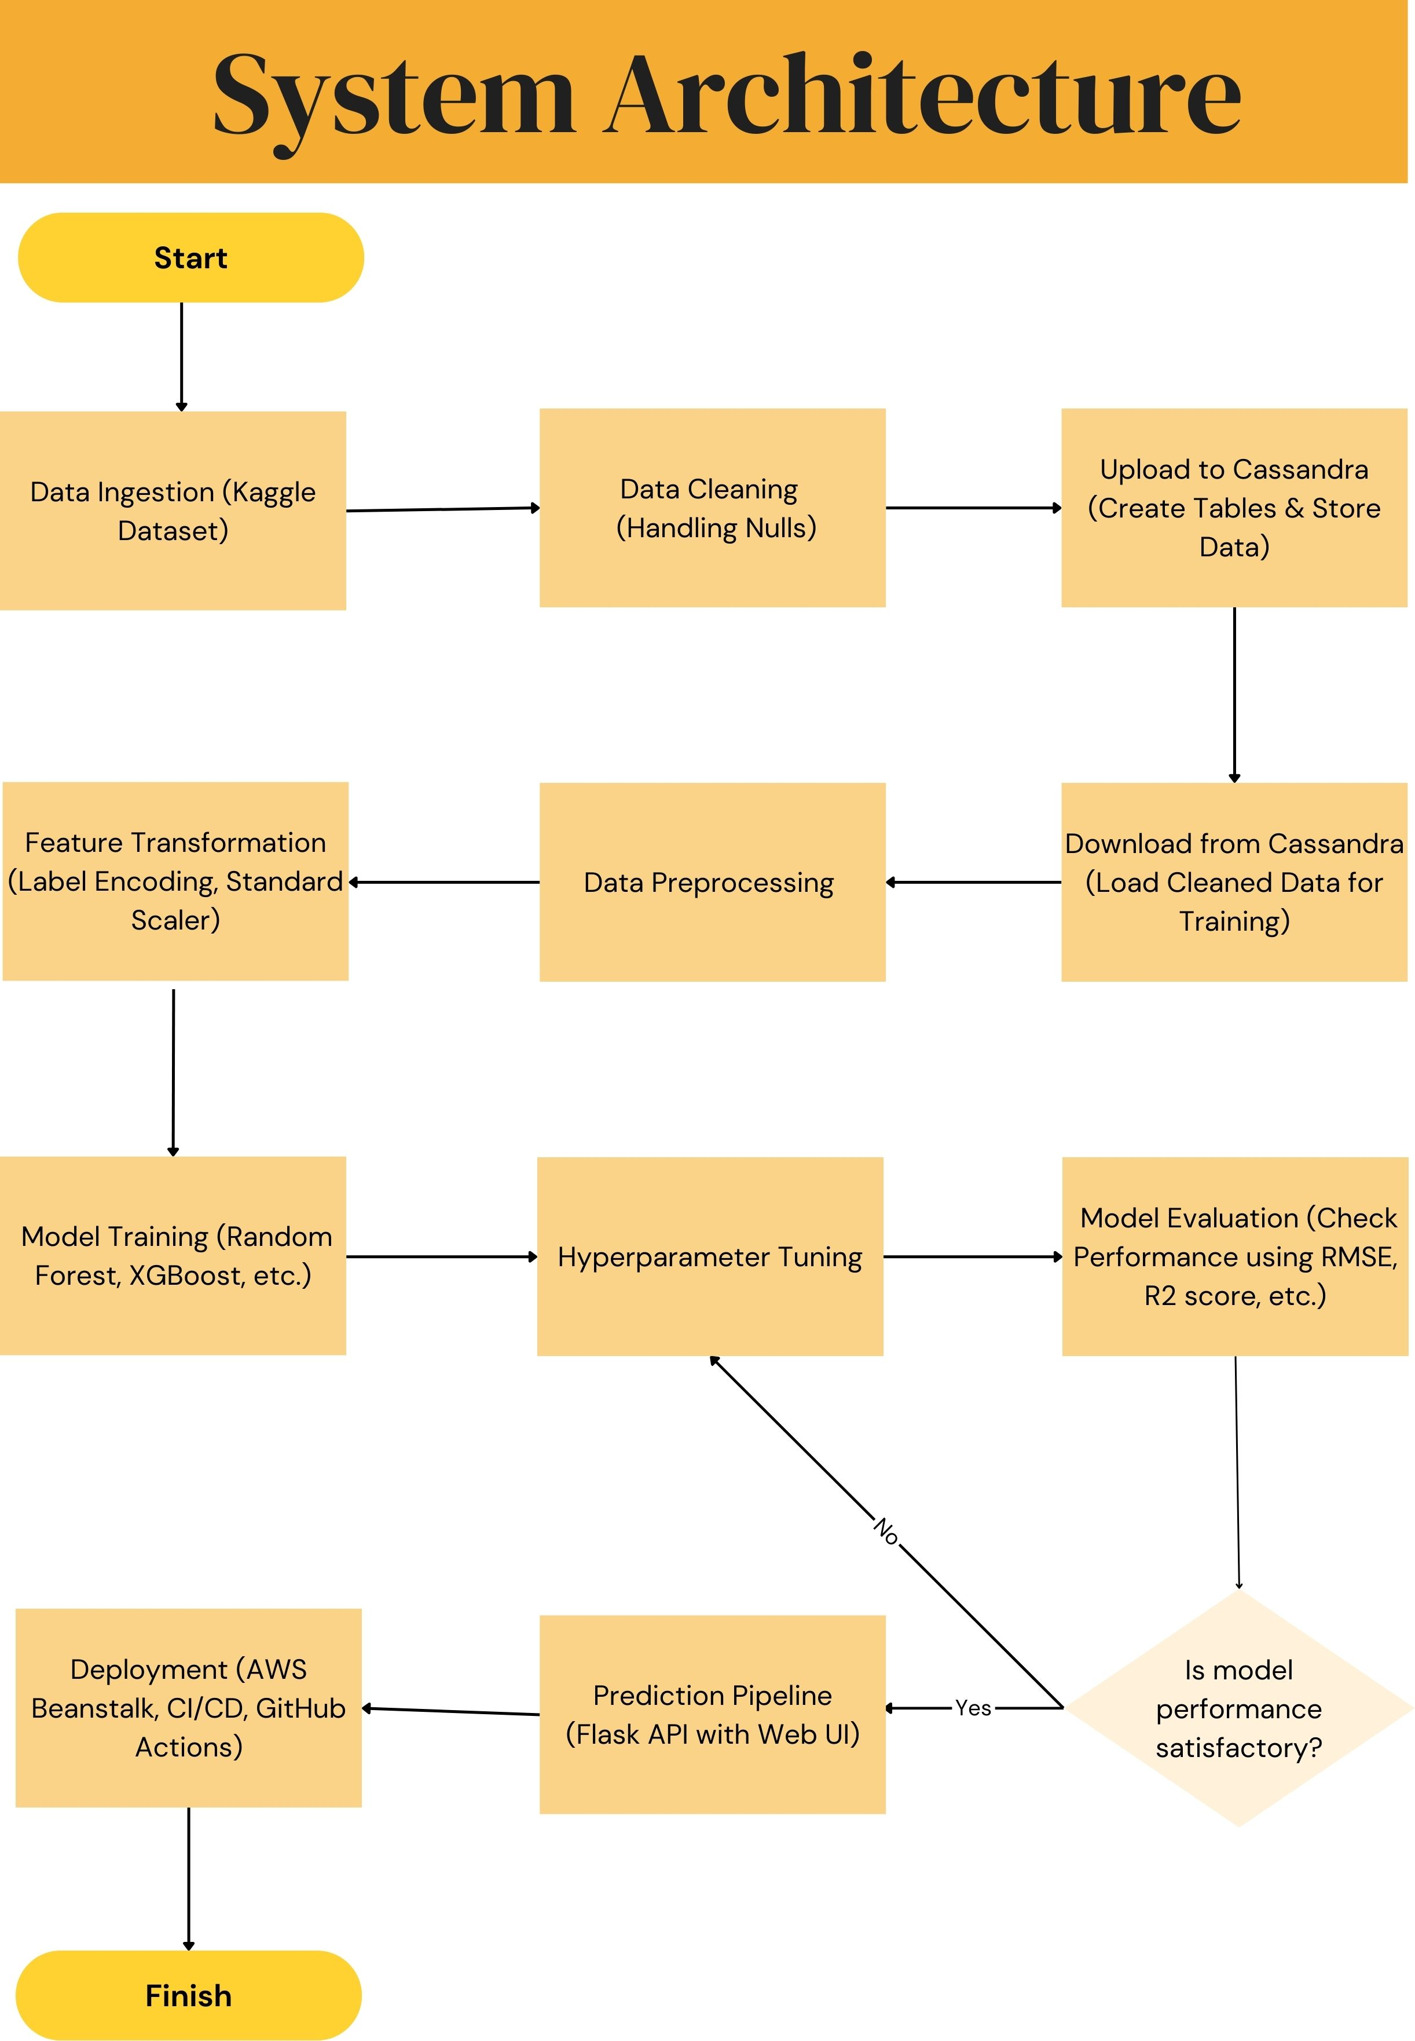
Architecture

Slide 6
Data Processing & Validation
Data Cleaning: Handling missing values, removing duplicates.
Feature Encoding: Converting categorical values into numerical values.
Scaling: Standardizing numerical features for model performance.
Feature Selection: Identifying the most important features for prediction.

Slide 7
Model Training & Evaluation
Model Selection
Random Forest, Decision Tree, K-Neighbors Regressor, Gradient Boosting Regressor.
Hyperparameter tuning for optimization.
Evaluation Metrics
R2 Score to measure model performance.
Feature Importance Analysis
Identifying significant features to enhance interpretability.
Comparison of Models
Selecting the best-performing model for deployment.

Slide 8
Deployment Process
Model Loading: Load the trained model into the deployment environment.
Data Ingestion: Receive new restaurant data for prediction.
Preprocessing: Apply necessary transformations to match model expectations.
Prediction: Use the trained model to estimate ratings.
Result Interpretation: Output ratings for analysis and decision-making.
Integration & Monitoring: Deploy via API (Flask) and monitor performance.

Slide 9
Deployment Tools & Infrastructure
Deployment: AWS (Cloud-based deployment).
Automation & CI/CD: CodePipeline and GitHub Actions.
Model Hosting: Flask API.
Database Management: Cassandra.
Version Control: GitHub.
Development Tools: Visual Studio Code, Jupyter Notebook.

Slide 10
Event Logging
System logs every event for tracking internal processes.
Logs include model training, data preprocessing, and prediction outcomes.
Supports debugging and monitoring.

Slide 11
Error Handling
Identifies and logs errors encountered during processing.
Provides clear explanations of failures.
Ensures robustness by handling edge cases effectively.

Slide 12
Q&A
Q1: What data was used?
Structured restaurant-related features.
Q2: What machine learning models were tested?
Random Forest, Decision Tree, K-Neighbors Regressor, Gradient Boosting Regressor.
Q3: How is the system deployed?
AWS with Flask API, CodePipeline, and GitHub Actions.
Q4: How is logging handled?
System logs every step, aiding debugging and monitoring.
Q5: What are the future improvements?
Adding NLP for review analysis, enhancing accuracy.

