Slide 1
Introduction to Statistics and Data
Ayan Seal

Slide 2

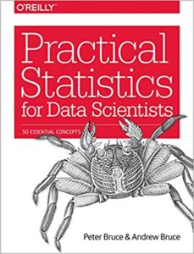
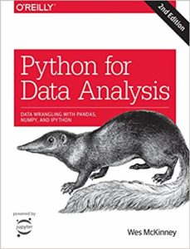

Course Name: Introduction to Data Science
Course Code: CS2004
Books:
Marks (100)
Quiz 1: 10
Mid-Semester: 25
Quiz 2: 10
End-Semester:35
Lab: 20

Slide 3
Timetable
Monday (class): 12 pm to 1 pm
Tuesday (class): 9 am to 10 am
Wednesday (lab): 4 pm to 6 pm
Thursday (class): 10 am to 11 am

Slide 4
What are Statistics?
Statistics is a branch of applied mathematics that involves the collection, description, analysis, and inference of conclusions from quantitative data. The mathematical theories behind statistics rely heavily on differential and integral calculus, linear algebra, and probability theory.
Statisticians, people who do statistics, are particularly concerned with determining how to draw reliable conclusions about large groups and general phenomena from the observable characteristics of small samples that represent only a small portion of the large group or a limited number of instances of a general phenomenon.

Slide 5
Cont’d…
In statistics, we generally want to study a population. You can think of a population as a collection of persons, things, or objects under study. To study the population, we select a sample. The idea of sampling is to select a portion (or subset) of the larger population and study that portion (the sample) to gain information about the population. Data are the result of sampling from a population.

Slide 6
Cont’d…
From the sample data, we can calculate a statistic. A statistic is a number that represents a property of the sample. For example, if we consider one math class to be a sample of the population of all math classes, then the average number of points earned by students in that one math class at the end of the term is an example of a statistic. The statistic is an estimate of a population parameter. A parameter is a number that is a property of the population. Since we considered all math classes to be the population, then the average number of points earned per student over all the math classes is an example of a parameter.

Slide 7
Cont’d…
Population: all math classes
Sample: One of the math classes
Parameter: Average number of points earned per student over all math classes
One of the main concerns in the field of statistics is how accurately a statistic estimates a parameter. The accuracy really depends on how well the sample represents the population. The sample must contain the characteristics of the population in order to be a representative sample. We are interested in both the sample statistic and the population parameter in inferential statistics.

Slide 8
Example
Determine what the key terms refer to in the following study. We want to know the average (mean) amount of money first year college students spend at ABC College on school supplies that do not include books. We randomly survey 100 first year students at the college. Three of those students spent $150, $200, and $225, respectively.
Answer:
Population: All the first year college students at ABC College
Sample: 100 first year students who are surveyed at the college.
Parameter: Average amount of money a first year college student spent on school supplies that do not include books.
Statistics: Average amount of money these 100 first year college student spent on school supplies that do not include books.
Variable: The amount of money a first year ABC College student spend on school supplies that do not include books.
Data: The amount that we collected from these 100 students, like $150, $200, and $225.

Slide 9
Two major areas of statistics
The two major areas of statistics are known as descriptive statistics, which describes the properties of sample and population data, and inferential statistics, which uses those properties to test hypotheses and draw conclusions.

Slide 10
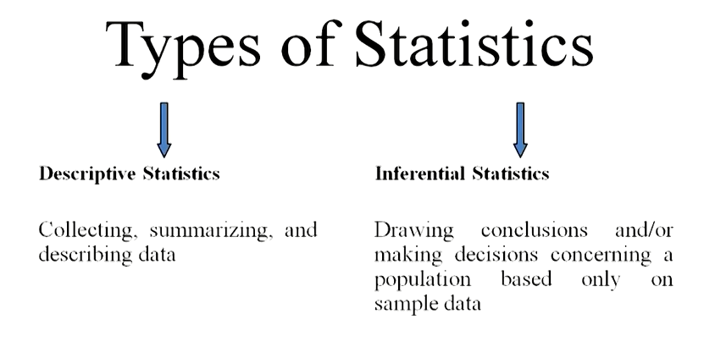
Cont’d…

Slide 11
Common statistical tools and procedures
Some common statistical tools and procedures include the following:
Descriptive
Mean (average)
Variance
Skewness
Kurtosis
Inferential
Liner regression analysis
Analysis of variance (ANOVA)
Logit/Probit models
Null hypothesis testing

Slide 12
Example
If you were to take three exams in your math classes and obtain scores of 86, 75, and 92, you would calculate your mean score by adding the three exam scores and dividing by three (your mean score would be 84.3 to one decimal place). If, in your math class, there are 40 students and 22 are men and 18 are women, then the proportion of men students is 22/40 and the proportion of women students is 18/40. Mean and proportion are discussed in more detail in later chapters.

Slide 13
Descriptive Statistics
Descriptive statistics are brief informational coefficients that summarize a given data set, which can be either a representation of the entire population or a sample of a population. Descriptive statistics are broken down into measures of central tendency and measures of variability (spread). Measures of central tendency include the mean, median, and mode, while measures of variability include standard deviation, variance, minimum and maximum variables, kurtosis, and skewness.

Slide 14
Cont’d…
Descriptive statistics summarizes or describes the characteristics of a data set.
Descriptive statistics consists of three basic categories of measures: measures of central tendency, measures of variability (or spread), and frequency distribution.
Measures of central tendency describe the center of the data set (mean, median, mode).
Measures of variability describe the dispersion of the data set (variance, standard deviation).
Measures of frequency distribution describe the occurrence of data within the data set (count).

Slide 15
Inferential Statistics
Inferential statistics are tools that statisticians use to draw conclusions about the characteristics of a population from the characteristics of a sample and to decide how certain they can be of the reliability of those conclusions.
Based on the sample size and distribution of the sample data statisticians can calculate the probability that statistics, which measure the central tendency, variability, distribution, and relationships between characteristics within a data sample, provide an accurate picture of the corresponding parameters of the whole population from which the sample is drawn.

Slide 16
Cont’d…
Inferential statistics are used to make generalizations about large groups, such as estimating average demand for a product by surveying a sample of consumers' buying habits, or to attempt to predict future events, such as projecting the future return of a security or asset class based on returns in a sample period.

Slide 17
Cont’d…
Regression analysis is a common method of statistical inference that attempts to determine the strength and character of the relationship (or correlation) between one dependent variable (usually denoted by Y) and a series of other variables (known as independent variables).
The output of a regression model can be analyzed for statistical significance, which refers to the claim that a result from findings generated by testing or experimentation is not likely to have occurred randomly or by chance but are instead likely to be attributable to a specific cause elucidated by the data. Having statistical significance is important for academic disciplines or practitioners that rely heavily on analyzing data and research.

Slide 18
What is the difference between descriptive and inferential statistics?
Descriptive statistics are used to describe or summarize the characteristics of a sample or data set, such as a variable's mean, standard deviation, or frequency.
Inferential statistics, in contrast, employs any number of techniques to relate variables in a data set to one another, for example using correlation or regression analysis. These can then be used to estimate forecasts or infer causality.

Slide 19
Who uses statistics?
Statistics are used widely across an array of applications and professions. Any time data are collected and analyzed, statistics are being done. This can range from government agencies to academic research to analyzing investments.

Slide 20
Glossary
Average: also called mean; a number that describes the central tendency of the data
Categorical Variable: variables that take on values that are names or labels
Data: a set of observations (a set of possible outcomes); most data can be put into two groups: qualitative (an attribute whose value is indicated by a label) or quantitative (an attribute whose value is indicated by a number). Quantitative data can be separated into two subgroups: discrete and continuous. Data is discrete if it is the result of counting (such as the number of students of a given ethnic group in a class or the number of books on a shelf). Data is continuous if it is the result of measuring (such as distance traveled or weight of luggage)
Numerical Variable: variables that take on values that are indicated by numbers
Parameter: a number that is used to represent a population characteristic and that generally cannot be determined easily

Slide 21
Cont’d…
Population: all individuals, objects, or measurements whose properties are being studied
Probability: a number between zero and one, inclusive, that gives the likelihood that a specific event will occur
Proportion: the number of successes divided by the total number in the sample
Representative Sample: a subset of the population that has the same characteristics as the population
Sample: a subset of the population studied
Statistic: a numerical characteristic of the sample; a statistic estimates the corresponding population parameter.
Variable: a characteristic of interest for each person or object in a population

Slide 22
Data
Data are units of information, often numeric, that are collected through observation. In a more technical sense, data are a set of values of qualitative or quantitative variables about one or more persons or objects,^{[1]} while a datum (singular of data) is a single value of a single variable
Data Types are an important concept of statistics, which needs to be understood, to correctly apply statistical measurements to your data and therefore to correctly conclude certain assumptions about it.
Having a good understanding of the different data types, also called measurement scales, is a crucial prerequisite for doing Exploratory Data Analysis (EDA), since you can use certain statistical measurements only for specific data types.
Data science is all about experimenting with raw or structured data. Data is the fuel that can drive a business to the right path or at least provide actionable insights that can help strategize current campaigns, easily organize the launch of new products, or try out different experiments.

Slide 23
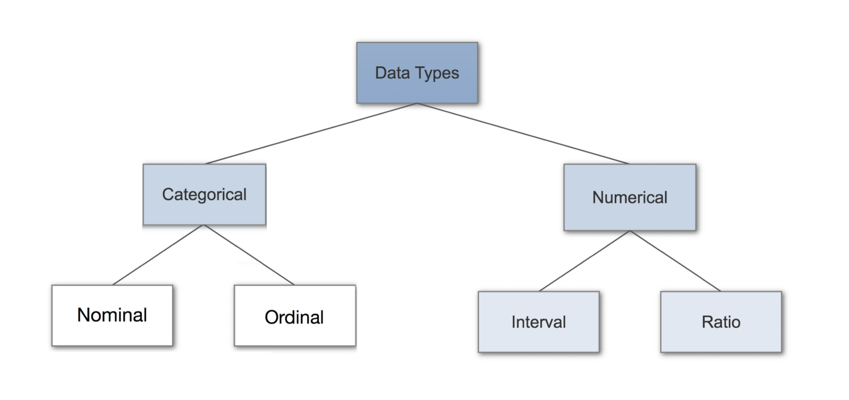
Data Types in Statistics

Slide 24
Categorical Data
Qualitative or Categorical data describes the object under consideration using a finite set of discrete classes. It means that this type of data can’t be counted or measured easily using numbers and therefore divided into categories. The gender of a person (male, female, or others) is a good example of this data type.
These are usually extracted from audio, images, or text medium. Another example can be of a smartphone brand that provides information about the current rating, the color of the phone, category of the phone, and so on. All this information can be categorized as Qualitative data.

Slide 25

Nominal Data
Nominal values represent discrete units and are used to label variables, that have no quantitative value. Just think of them as “labels”. Note that nominal data that has no order. Therefore if you would change the order of its values, the meaning would not change. You can see two examples of nominal features below:
The left feature that describes if a person is married would be called “dichotomous”, which is a type of nominal scales that contains only two categories.

Slide 26
Cont’d…
These are the set of values that don’t possess a natural ordering. Let’s understand this with some examples. The color of a smartphone can be considered as a nominal data type as we can’t compare one color with others.
It is not possible to state that ‘Red’ is greater than ‘Blue’. The gender of a person is another one where we can’t differentiate between male, female, or others. Mobile phone categories whether it is midrange, budget segment, or premium smartphone is also nominal data type.

Slide 27

Ordinal Data
Ordinal values represent discrete and ordered units. It is therefore nearly the same as nominal data, except that it’s ordering matters. You can see an example below:
Note that the difference between Elementary and High School is different than the difference between High School and College. This is the main limitation of ordinal data, the differences between the values is not really known. Because of that, ordinal scales are usually used to measure non-numeric features like happiness, customer satisfaction and so on.

Slide 28
Cont’d…
These types of values have a natural ordering while maintaining their class of values. If we consider the size of a clothing brand then we can easily sort them according to their name tag in the order of small < medium < large. The grading system while marking candidates in a test can also be considered as an ordinal data type where A+ is definitely better than B grade.
These categories help us deciding which encoding strategy can be applied to which type of data. Data encoding for Qualitative data is important because machine learning models can’t handle these values directly and needed to be converted to numerical types as the models are mathematical in nature.

Slide 29
Numerical Data
This data type tries to quantify things and it does by considering numerical values that make it countable in nature. The price of a smartphone, discount offered, number of ratings on a product, the frequency of processor of a smartphone, or ram of that particular phone, all these things fall under the category of Quantitative data types.
The key thing is that there can be an infinite number of values a feature can take. For instance, the price of a smartphone can vary from x amount to any value and it can be further broken down based on fractional values.

Slide 30
Discrete vs. Continuous
Discrete
The numerical values which fall under are integers or whole numbers are placed under this category. The number of speakers in the phone, cameras, cores in the processor, the number of sims supported all these are some of the examples of the discrete data type.
Continuous
The fractional numbers are considered as continuous values. These can take the form of the operating frequency of the processors, the android version of the phone, wifi frequency, temperature of the cores, and so on.

Slide 31

Interval Data
Interval values represent ordered units that have the same difference. Therefore we speak of interval data when we have a variable that contains numeric values that are ordered and where we know the exact differences between the values. An example would be a feature that contains temperature of a given place like you can see below:
The problem with interval values data is that they don’t have a „true zero“. That means in regards to our example, that there is no such thing as no temperature. With interval data, we can add and subtract, but we cannot multiply, divide or calculate ratios. Because there is no true zero, a lot of descriptive and inferential statistics can’t be applied.

Slide 32

Ratio Data
Ratio values are also ordered units that have the same difference. Ratio values are the same as interval values, with the difference that they do have an absolute zero. Good examples are height, weight, length etc.

