Slide 1
Security through Simplicity or why you can‘t trust cell phones, and what we are doing about it.
Dr. Paul Gardner-Stephen,
Shuttleworth Telecommunications Fellow,
Senior Lecturer, Flinders University.
paul.gardner-stephen@flinders.edu.au

Slide 2

Verification is impossible
Smart-phone and computers contain billions of transistors and billions of lines of code.
Spectre and Meltdown etc demonstrate that even large multi-nationals can no longer verify correct function of modern processors.
Endless software vulnerabilities demonstrate the same for the operating systems and software.
Closed-source designs mean independent verification is impossible due to lack of required information.

Slide 3
Rational Trust Impossible
For trust to be rational, it must depend on evidence ...
… but we have just shown that verification of modern complex systems is impossible.
Conclusion: We cannot rationally trust modern computers or smart-phones, because we cannot verify that they cannot be used against us.

Slide 4
The Problem is Real (1)
(1) “SPEAKE(a)R: Turn Speakers into Microphones for Fun and Profit” (Guri et al, 2016).
Use headphones (i.e., things mean to produce sound, not record it!) to record audio from several metres away
https://arxiv.org/ftp/arxiv/papers/1611/1611.07350.pdf
https://www.youtube.com/watch?v=ez3o8aIZCDM

Slide 5
The Problem is Real (2)
BadUSB: Infect a wide range of USB devices to do all manner of evil (Security Research Labs, 2014)
“To make matters worse, clean up after an incident is hard: … The USB thumb drive, from which the operating system is reinstalled, may already be infected, as may the hard-wired web-cam or other USB components inside the computer. A BadUSB device may even have replaced the computer’s BIOS”
https://srlabs.de/bites/usb-peripherals-turn/
https://opensource.srlabs.de/projects/badusb
http://www.abc.net.au/news/2018-06-13/trump-kim-summit-press-kit-included-usb-fan-dont-use-it/9866192

Slide 6
The Problem is Real (3)
Intel Management Engine critical vulnerability (Intel, 2017)
  Empty password gets you in!
“An unprivileged network attacker could gain system privileges to provisioned Intel manageability SKUs: Intel® Active Management Technology (AMT) and Intel® Standard Manageability (ISM).”
AMT and ISM give complete control of a system!
https://www.intel.com/content/www/us/en/security-center/advisory/intel-sa-00075.html

Slide 7
The Problem is Real (4)
Meltdown, Spectre and SpectreNG
Access data from other processes without permission, e.g., extract passwords, keys etc.
https://arxiv.org/abs/1801.01203
New variants continue to be discovered, e.g.:
https://newsroom.intel.com/editorials/addressing-new-research-for-side-channel-analysis/
Direct result of complex processor architectures.
Requires hardware replacement (& thus years) to fix!

Slide 8
The Problem is Real (5)
Samsung Phone Backdoor (Replicant, 2014)
Cellular modem able to read, write, delete files on smart-phones.
Cellular modem firmware can be remotely updated via cellular network.
https://redmine.replicant.us/projects/replicant/wiki/SamsungGalaxyBackdoor

Slide 9
The Problem is Real (6)
“Smart” devices are now pervasive
  TVs, cars, fridges etc.
All susceptible to subversion (or purposeful application) to observe, record and violate privacy
http://www.abc.net.au/news/2017-03-08/ways-your-technology-is-already-spying-on-you/8334960
What if someone combined it with SPEAKE(a)R? ...

Slide 10
Complexity is the enemy
In all these cases complexity is a key ingredient.
Security through “extra layers” makes the problem worse (e.g., Intel Management Engine)
https://twitter.com/thekitze/status/999549624598884353
Security versus convenience is a well-known trade-off.
We need to talk instead about the trade-off between security versus complexity.

Slide 11
The Necessity of Simplicity
“Make things as simple as possible, but not simpler.”
(Albert Einstein, common paraphrase)
Is a particular complexity required or merely desirable or convenient?

Slide 12
The Curse of Moore‘s Law
Moore‘s law means it is cheaper to add complexity to try to solve a problem.
Requires discipline to keep hardware and software simple, because complexity sells and is easy and often cheaper to add.
Utility not functionality should be the goal:
  Utility = fitness for mission, i.e., uses for something
  Functionality = the set of functions, rather than uses
https://www.schneier.com/essays/archives/1999/11/a_plea_for_simplicit.html

Slide 13
640KB ought to be enough
“I've said some stupid things and some wrong things, but not that. No one involved in computers would ever say that a certain amount of memory is enough for all time.”
(Bill Gates, Microsoft)
But perhaps it ought to be true, at least for many use-cases:
  8-bit and DOS software (all <640KB) was useful
  Simple enough to be verified by a small team

Slide 14
Security through Simplicity Program:
Creating a smart-phone that is designed for security, and
simple enough to be verified,
and thus
simple enough to be trusted,
yet still useful enough in practice.

Slide 15
Target use-cases
Secure telephony (voice & SMS)
Secure basic productivity
  Simple word-processing, spreadsheets, image viewing etc
Secure basic connectivity
  Simple email client and limited web browser etc
Secure field data collection and situation awareness
Basic entertainment functionality
  Games, music etc, without compromising security
  Reduce risk of substitution with insecure hardware

Slide 16
System Architecture (1)
Commodore 64 derived architecture
  Brings large entertainment and productivity software library to avoid “still-born” effect.
    Recreational software important for user acceptance.
    New software titles continue to be produced, e.g., Sam‘s Journey.
  Existing software titles not network aware, so work off-line and isolated, without security risk.
  Existing development tools and software development expertise spanning 35 years.
  Software and architecture simple enough to be verified.

Slide 17
System Architecture (2)
Productivity software, e.g., GEOS
  Originally designed for air-plane in-seat entertainment system
  GEOS was 3rd most popular operating system in 1987 (behind only MS-DOS and MacOS)
  Extremely small, and therefore easily verifyable: <30KB OS, apps typically <64KB
  Boot from cold in < 3 seconds!
Modest adjustments to improve usability
  e.g. increase screen resolution

Slide 18
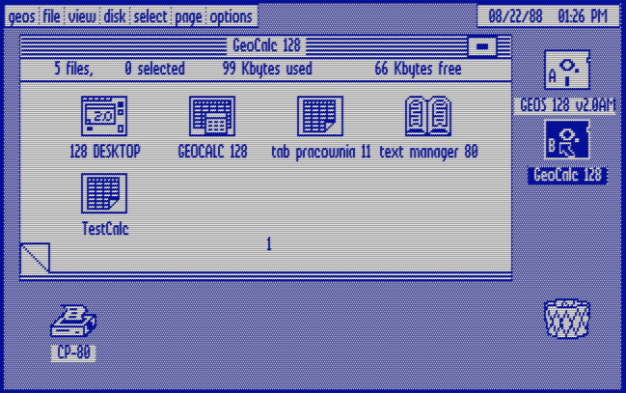
GEOS Applications

Slide 19
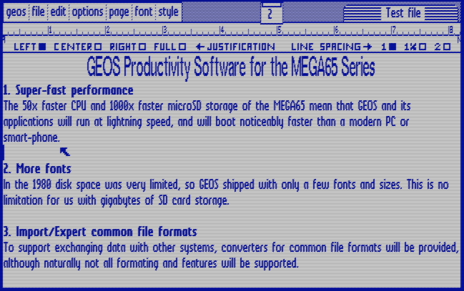
GEOS Applications

Slide 20
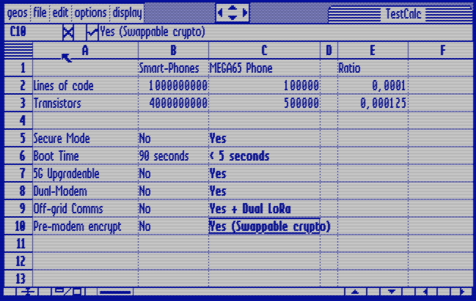
GEOS Applications

Slide 21
System Architecture (3)
Implement core system in FPGA
  Enhanced 6502 processor
  VIC-IV video controller
  Hardware/VHDL design fully open for verficability
Minimise trust of commodity peripherals
  Cellular modem, Wi-Fi, Bluetooth etc all connected via simple interfaces, e.g., UART.
  Isolation from microphones and speakers
  Physical and software-controlled power-cut facility

Slide 22
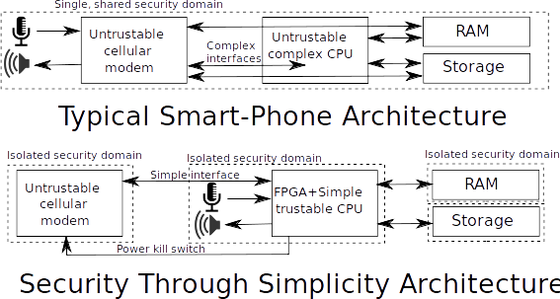
System Architecture (3)

Slide 23
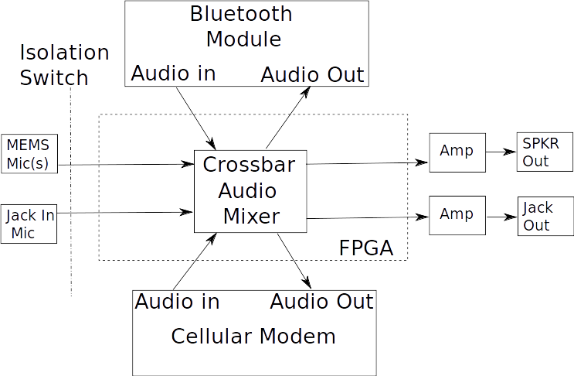
Protected Audio Paths

Slide 24
Soft and Hard Power Kill
Power rails to all untrusted/sensitive components each under software control from FPGA
  e.g., cut power to all radios during crypto
Physical indicator LEDs of power rail status
Physical power switches as extra level of security
  100% certainty that power is cut, when required

Slide 25
Modular Comms Platform
Two miniPCIe slots for cellular or other modems.
  Industry standard form-factor and modules available
Simultaneous operation of both slots.
Iridium SBD module option gives global communications reach.

Slide 26
Security Compartments
System operates in “normal” and “secure” modes.
Multi-tasking by task-swapping: Only ever one program resident.
Secure compartments completely self-isolated:
  Power cut to radios and bulk storage to resist data exfiltration.
  Hypervisor disabled: Nothing can interfere with running compartment!
User intervention required to exit compartments.
  Out of band memory inspector allows verification of data being passed out of secure compartment

Slide 27
Progress to date
Simplicity also means simple to develop!
  Total effort to date < 4 person-years
MEGA65 Commodore 64 Computer implemented in VHDL for FPGA
Lab-bench telephony proof-of-concept
  Initiate cellular calls using 4G cellular modem via touch interface. https://www.youtube.com/watch?v=ur68vTVv1Ws
  Dialer only ~16KB, written in BASIC – easy to verify!
Boots in < 5 seconds from cold, thanks to simplicity
Estimate TLR 2. Focus has been on eliminating technical risks via partial bench prototype. Key software systems remain to be implemented before repeatable laboratory tests possible.

Slide 28
Progress to date
System architecting and preliminary design
Enhanced Commodore 64 implemented in VHDL
  Can run a wide variety of legacy software
Partial secure container implementation
Partial bench prototype hardware
  Screen, touch interface, cellular modem, FPGA
Partial telephony software implementation
  Can make and receive calls, including FPGA audio processing
Focus on eliminating technical risks.

Slide 29
Next Steps
Complete core telephony functions
  SMS, Contacts management, audio encryption
Power management, including power cut switches
Build small quantity of portable, usable prototypes
Secure container manager
Software manager / launcher / installer
Stage 1: Obtain funds to evaluate, assess and plan to raise TLR to 3 (software) / 5 (hardware)
Stage 2: Sales of consumer model and/or Defence Innovation Hub or similar to fund TLR 4+ (software) / 6+ (hardware)
Focus on proof-of-concept of complete functionality.

Slide 30
Questions?
Dr. Paul Gardner-Stephen,
Senior Lecturer, Flinders University.
Shuttleworth Telecommunications Fellow.
paul.gardner-stephen@flinders.edu.au
+61 427 679 796

