Slide 1
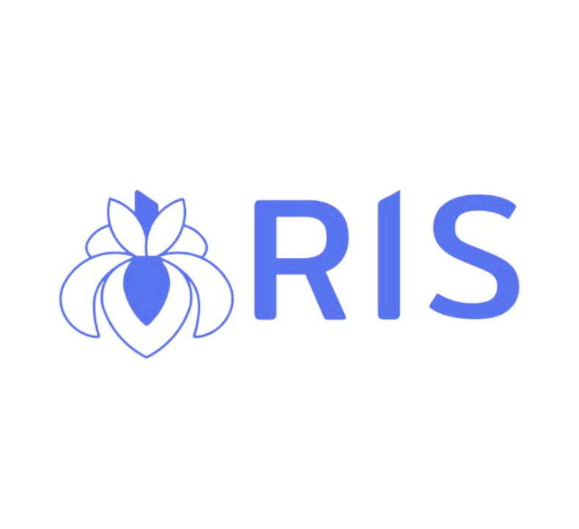

HUMAN RESOURCES INTELLECTUAL SYSTEM
Ali Hasanov – Introduction to Industrial Project

Slide 2

Introduction
In a world driven by technology, the HR industry is undergoing a transformation, and IRIS aims to be at the forefront of this change.
This application is designing to empower HR professionals and organizations by leveraging advanced AI technologies.

Slide 3
Objectives
Our primary objective is to simplify the recruitment process through the application of AI.
By harnessing intelligent algorithms, IRIS will compare CVs and job requirements, prepare job-related questions, and rank applicants based on these comparisons.
Let's delve deeper into how IRIS addresses the needs and requirements of our users.

Slide 4

User Needs and Requirements
Our application will serve a diverse range of users including HR professionals, recruitment agencies, and organizations of all sizes.
We have collaborated closely with HR professionals in Azerbaijan to understand their needs:
Efficiency in processing and comparing CVs against job requirements.
Accuracy in understanding job requirements and matching them with CVs.
Reliability in delivering consistent and error-free results.
A user-friendly interface for seamless navigation.
Customization options to tailor the AI assistant to specific needs.
Strong emphasis on security, confidentiality, and data protection.
Insights and analytics for informed decision-making.

Slide 5

System Functionality
IRIS offers a comprehensive set of functionalities:
CV Checking: Extracts key information from CVs and compares it to job requirements.
Form Checking: Analyzes form responses against job criteria.
Job-Related Questionnaire Creation: Generates relevant questions based on job requirements.
Applicant Ranking: Ranks candidates based on CV and form comparisons.
AI-Powered Recommendations: Offers insights to guide HR professionals.
User Management: Allows control over profiles, job postings, submissions, and settings.
Data Analytics and Reporting: Provides data-driven insights for strategic planning.
Integration Capabilities: Seamlessly integrates with existing HR systems and tools.
Head Hunting: Identifies potential candidates for job vacancies.

Slide 6

Constraints
A few constraints to consider:
Adequate Processing Power and Storage to handle large data volumes.
Basic User Proficiency in using digital HR systems.
Stable Internet Connection for cloud-based functions.
The quality of data impacts the effectiveness of AI recommendations.

Slide 7

AI Integration
The heart of IRIS is the integration of OpenAI's Davinci model.
Davinci powers CV comparison, question generation, and insightful recommendations.
This integration enhances accuracy, efficiency, and decision-making.

Slide 8

Use Cases and Scenarios
How can IRIS be used effectively?
Efficiently screening job applicants.
Crafting job-specific questions to evaluate candidates.
Ranking and recommending candidates based on comprehensive analyses.
Tailoring requirements for specific roles.

Slide 9
Benefits
Benefits of using IRIS:
Time and Effort Savings: Streamlining recruitment processes.
Improved Decision-Making: Data-driven insights lead to informed choices.
Enhanced Candidate Matching: More accurate alignment of skills and roles.
Strategic Insights: Valuable analytics for HR strategies.

Slide 10

Future Enhancements
Our roadmap includes exciting enhancements:
Integration of Enhanced AI Models for even more accurate results.
Increased Customization Options to cater to diverse needs.
Advanced Analytics and Predictive Insights for proactive decision-making.
Expanded Integration Capabilities to align with evolving HR technologies.

Slide 11

Conclusion
In conclusion, IRIS is poised to revolutionize the HR industry through AI-powered innovation.
With a focus on efficiency, accuracy, and customization, we aim to empower HR professionals and organizations in making smarter decisions.

Slide 12

Thank You !

