Slide 1
Cryptography

Slide 2
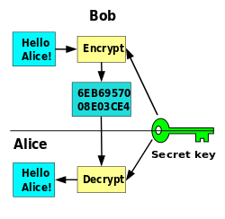
Cryptography

Slide 3
Cryptography
Cryptography is the study of secure communications techniques that allow only the sender and intended recipient of a message to view its contents.
ABC (meaningful message)-> ZYX(cipher)

Slide 4
Symmetric
vs
Asymmetric
Cryptography

Slide 5
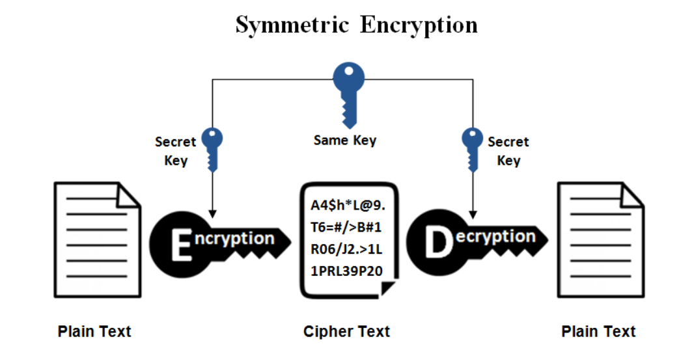

Slide 6
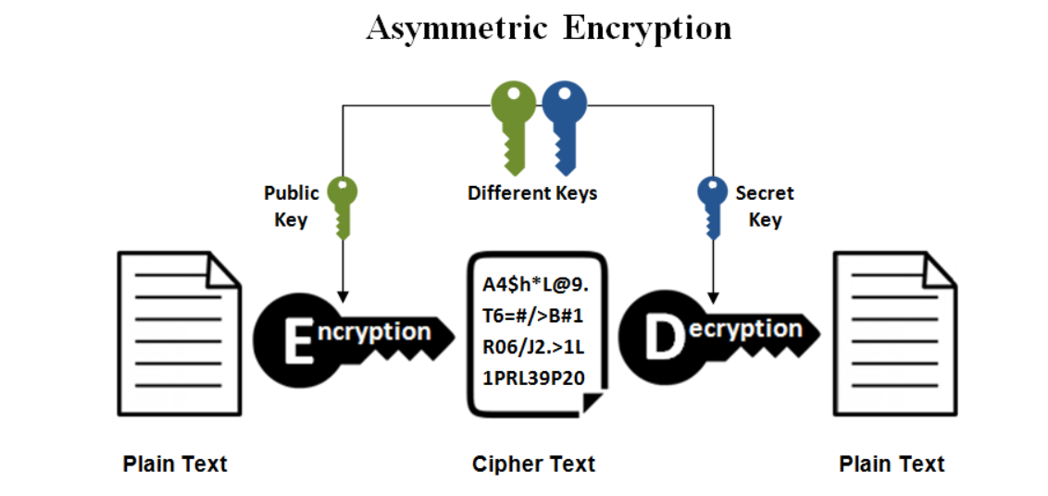

Slide 7
What is AES?
●
AES is an encryption standard chosen by the National Institute of Standards and Technology(NIST), USA to protect classified information. It has been accepted world wide as a desirable algorithm to encrypt sensitive data.
It is a block cipher which operates on block size of 128 bits for both encrypting as well as decrypting.
Each Round performs same operations.
●
●

Slide 8
Why AES?
In 1990's the cracking of DES algorithm became possible.
Around 50hrs of bruteforcing allowed to crack the message.
NIST started searching for new feasible algorithm and proposed its requirement in 1997.
In 2001 Rijndael algorithm designed by Rijment and Daemon of Belgium was declared as the winner of the competition. [1,2]
It met all Security, Cost and Implementation criteria. [3]
●
●
●
●
●

Slide 9
How Does it works?
AES basically repeats 4 major functions to encrypt data. It takes 128 bit block of data and a key and gives a ciphertext as output. The functions are:
●
I. Substitute Bytes
II. Shift Rows
III. Mix Columns
IV. Add Key

Slide 10
How Does it work?
E(m,k)
D(n,k)
m(128bits)
E
n(128bits)
n(128bits)
D
m(128bits)
k
k
Here, E = encryption function for a symmetric block cipher m = plaintext message of size 128 bits
n = ciphertext
k = key of size 128 bits which is same for both encryption and decryption
D = Decryption function for symmetric block cipher

Slide 11
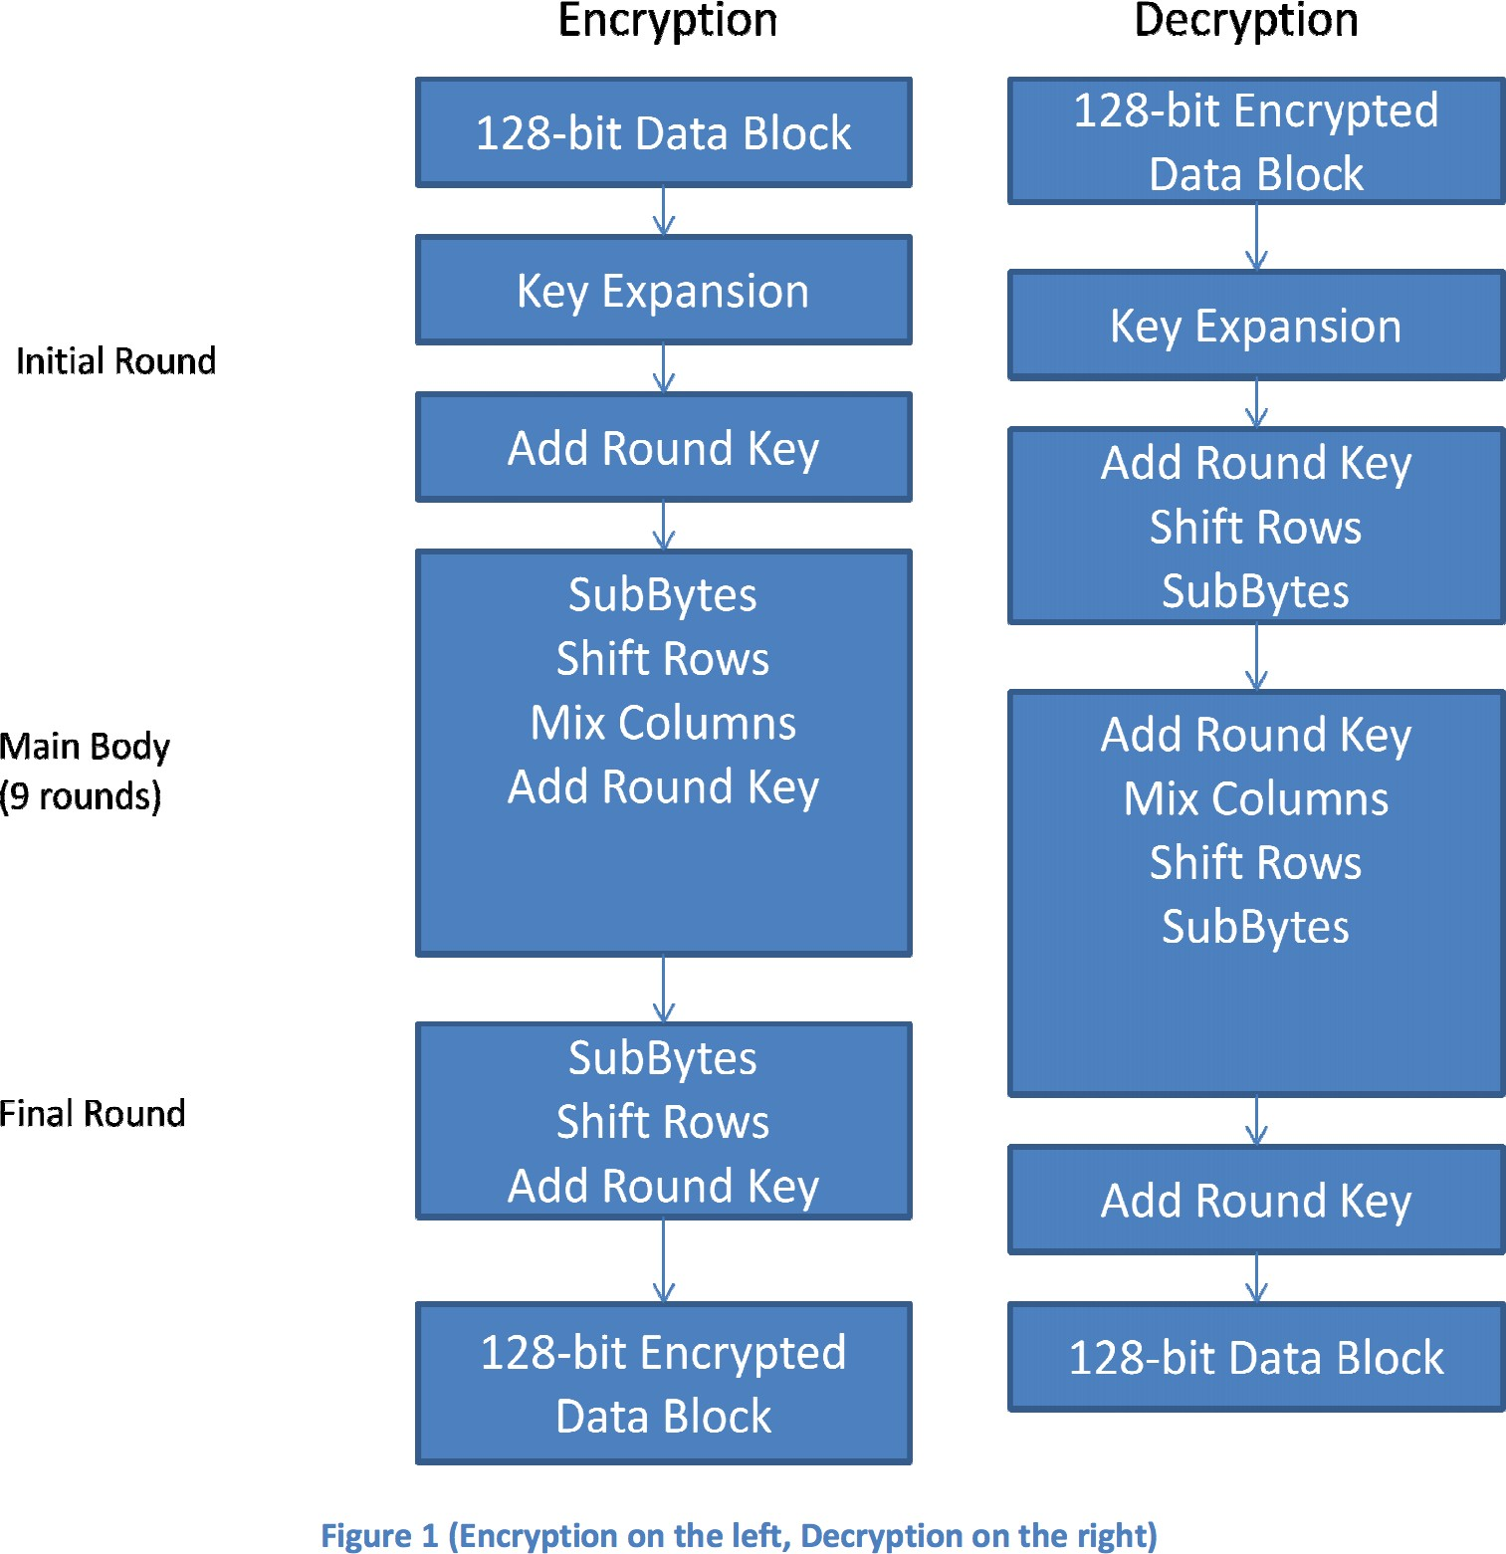
Steps for encryption and decryption

Slide 12
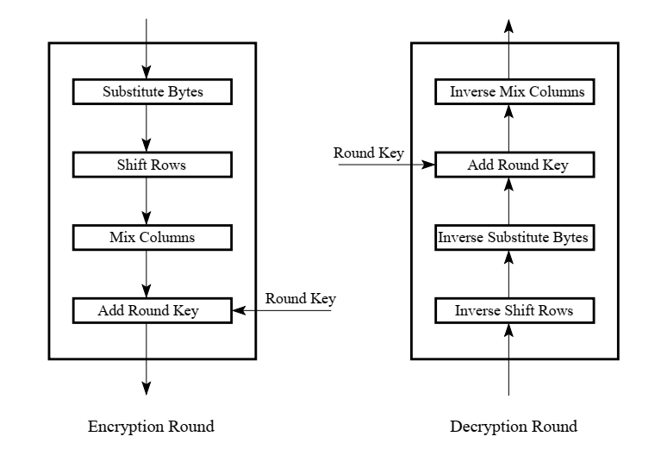
How Does it work?

Slide 13
Analysis of Steps
●
KeyExpansions - In the key Expansion process the given 128 bits cipher key is stored in [4]x[4] bytes matrix (16*8 = 128 bits) and then the four column words of the key matrix is expanded into a schedule of 44 words (44*4=176) resulting in 11 round keys (176/11 = 16 bytes or 128 bits).
Number of round keys = Nr + 1. Where Nr is the number of rounds (which is 10 in case of 128 bits key size) So here the round keys = 11.
●

Slide 14
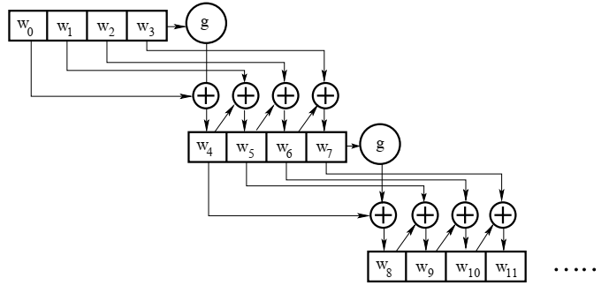
Analysis of Steps

Slide 15
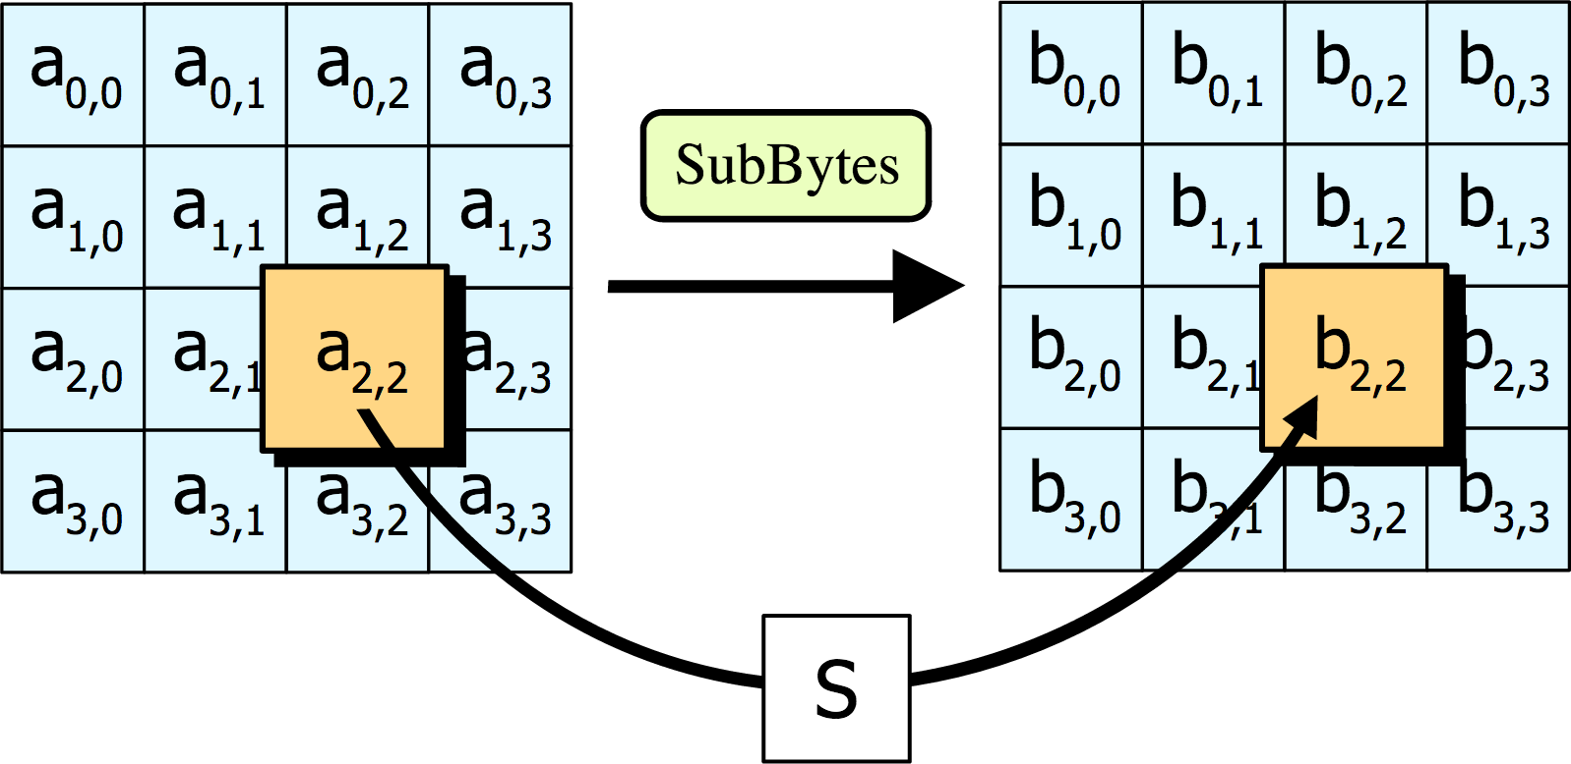
Analysis of Steps
●
SubBytes - Each element of the matrix is replaced by the an element of s-box matrix.

Slide 16
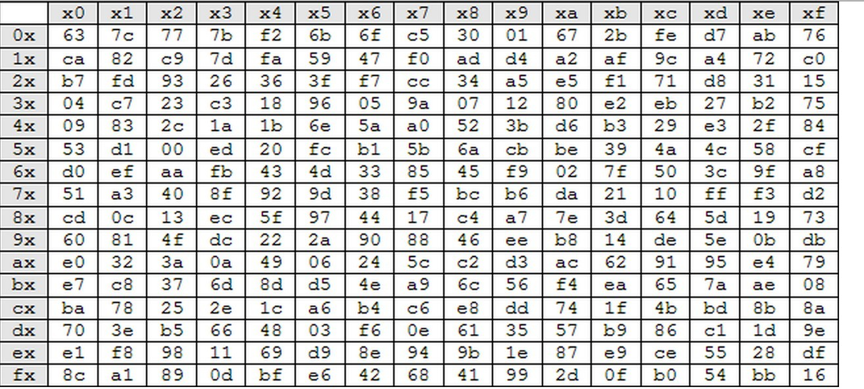
Analysis of Steps
SubBytes
For an element {d1} corresponding value is {3e}
●
Rijndael S-box

Slide 17
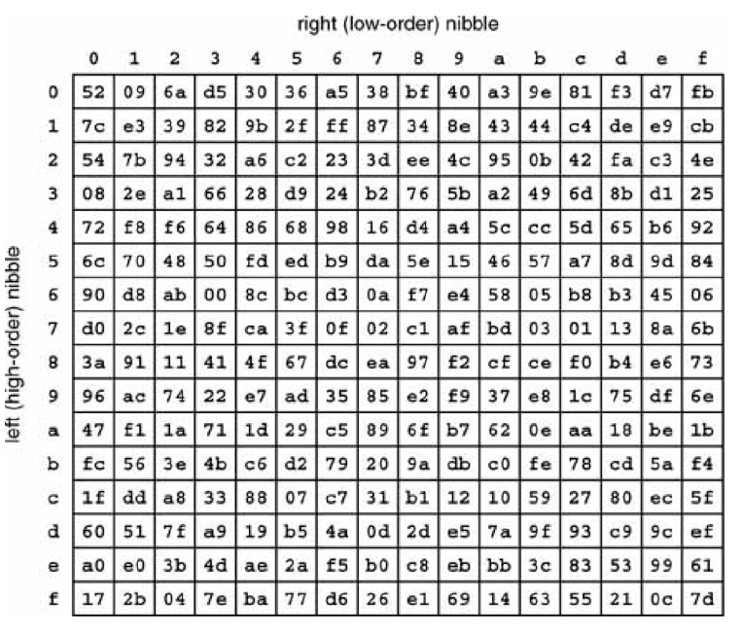
Analysis of Steps
Inverse SubBytes
●
Rijndael S-box

Slide 18
Analysis of Steps
SubBytes
The S-box is a special lookup table which is constructed by Galois fields.
The Generating function used in this algorithm is GF(2^8)
i.e. 256 values are possible
The elements of the sbox are written in hexadecimal system
●
●
●
●
●

Slide 19
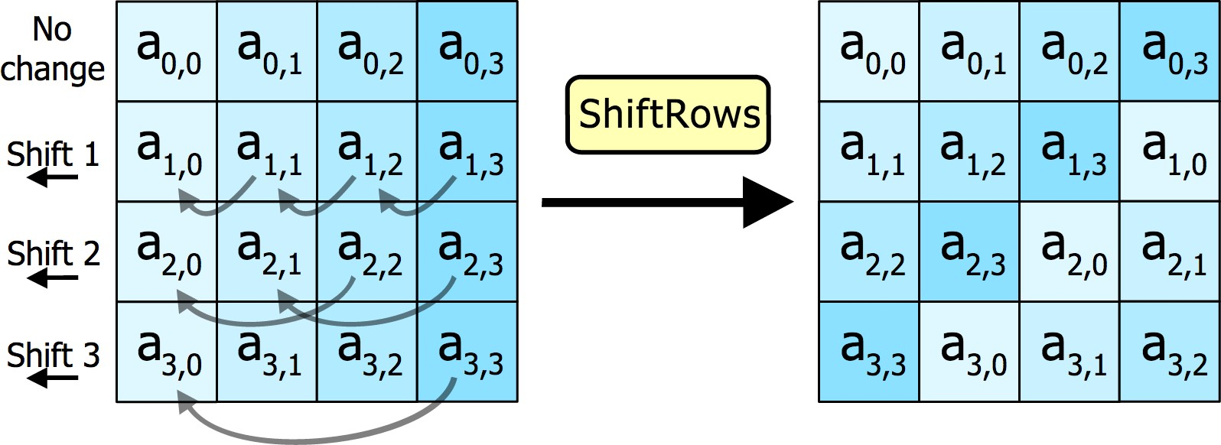
Analysis of Steps
Shift Rows
In this step rows of the block are cylindrically shifted in left direction.
The first row is untouched , the second by one shift, third by two and fourth by 3.
●
●
●

Slide 20
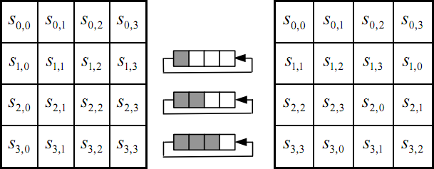
Analysis of Steps
●
Shift Rows
Resulting matrix after shift operation

Slide 21
Analysis of Steps
Mix columns
This is the most important part of the algorithm
It causes the flip of bits to spread all over the block
In this step the block is multiplied with a fixed matrix. The multiplication is field multiplication in galois field.
For each row there are 16 multiplication, 12 XORs and a 4 byte output.
●
●
●
●
●
●

Slide 22
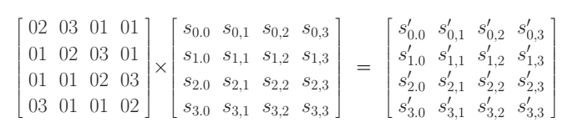
Analysis of Steps
●
Mix Columns

Slide 23
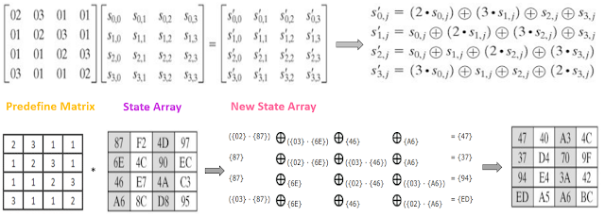

Slide 24
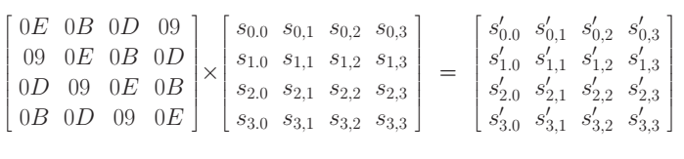
Analysis of Steps
●
Inverse Mix Columns

Slide 25
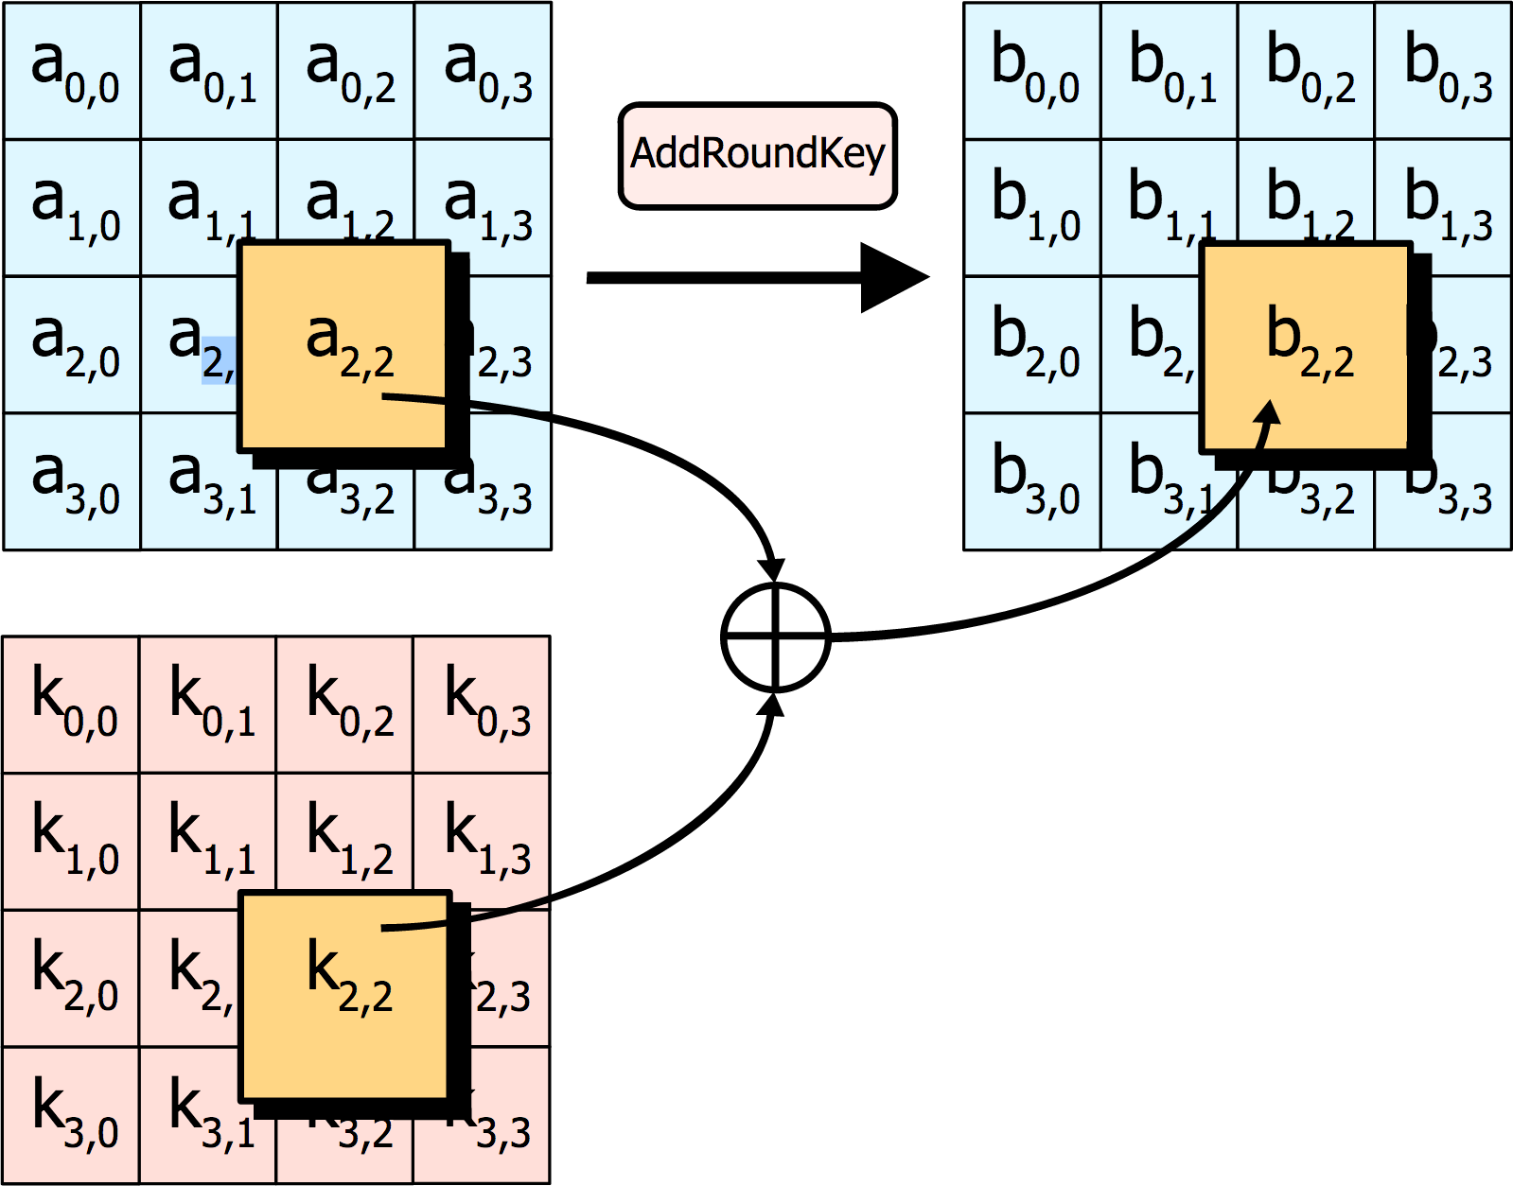
Analysis of Steps
●
Add round key

Slide 26
Analysis of Steps
Add round key
In this step each byte is XOR-ed with corresponding element of key's matrix.
●
●

Slide 27
Analysis of Steps
In the last round of Encryption the mix column step is skipped.
●

Slide 28
Self Study
Rationale behind the steps
Sbox and Inverse Sbox table generation

Slide 29
RSA
RSA is one of the oldest asymmetric encryption algorithm
The acronym "RSA" comes from the surnames of Ron Rivest, Adi Shamir and Leonard Adleman
The security of RSA relies on the practical difficulty of factoring the product of two large prime numbers, the "factoring problem".

Slide 30
RSA algorithm steps
Key-Generation
Step-1: Select two large prime numbers p and q where p ≠ q.
Step-2: Calculate n = p * q.
Step-3: Calculate Ф(n) = (p-1) * (q-1).
Step-4: Select e such that, e is relatively prime to Ф(n), i.e. gcd(e, Ф(n)) = 1 and 1 < e < Ф(n)
Step-5: Calculate d = e ⁻¹ mod Ф(n) or ed = 1 mod Ф(n).
Step-6: Public key = {e, n}, private key = {d, n}.

Slide 31
Example
Step – 1: Select two prime numbers p and q where p ≠ q.
Example, Two prime numbers p = 13, q = 11.
Step – 2: Calculate n = p * q.
Example, n = p * q = 13 * 11 = 143.
Step – 3: Calculate Ф(n) = (p-1) * (q-1).
Example, Ф(n) = (13 – 1) * (11 – 1) = 12 * 10 = 120.
Step – 4: Select e such that, e is relatively prime to Ф(n),
i.e. gcd(e, Ф(n)) = 1 and 1 < e < Ф(n).
Example, Select e = 13, gcd (13, 120) = 1.
See Euler’s Totient

Slide 32
Step – 5: Calculate d = e ⁻¹ mod Ф(n) or e * d = 1 mod Ф(n)
Example, Finding d: e * d mod Ф(n) = 1
13 * d mod 120 = 1
(How to find: d *e = 1 mod Ф(n)
d = ((Ф(n) * i) + 1) / e
d = (120 + 1) / 13 = 9.30 (∵ i = 1)
d = (240 + 1) / 13 = 18.53 (∵ i = 2)
d = (360 + 1) / 13 = 27.76 (∵ i = 3)
d = (480 + 1) / 13 = 37 (∵ i = 4))
Step – 6: Public key = {e, n}, private key = {d, n}.
Example, Public key = {13, 143}
and private key = {37, 143}.

Slide 33
2. Encryption
Find out cipher text using the formula,
C = P^{e} mod n where, P < n.
Example, Plain text P = 13. (Where, P < n)
C = P^{e} mod n = 13¹³ mod 143 = 52.

Slide 34
3. Decryption
P = C^{d} mod n. Plain text P can be obtain
using the given formula.
Example, Cipher text C = 52
P = C^{d} mod n = 52³⁷ mod 143 = 13.

Slide 35
References
AES Proposal: Rijndael, Joan Daemen, Vincent Rijmen
The Design of Rijndael, Joan Daemen, Vincent Rijmen
https://csrc.nist.gov/csrc/media/publications/fips/197/final/documents/fips-197.pdf

