Slide 1
Keylogger
Understanding the Threat

Slide 2
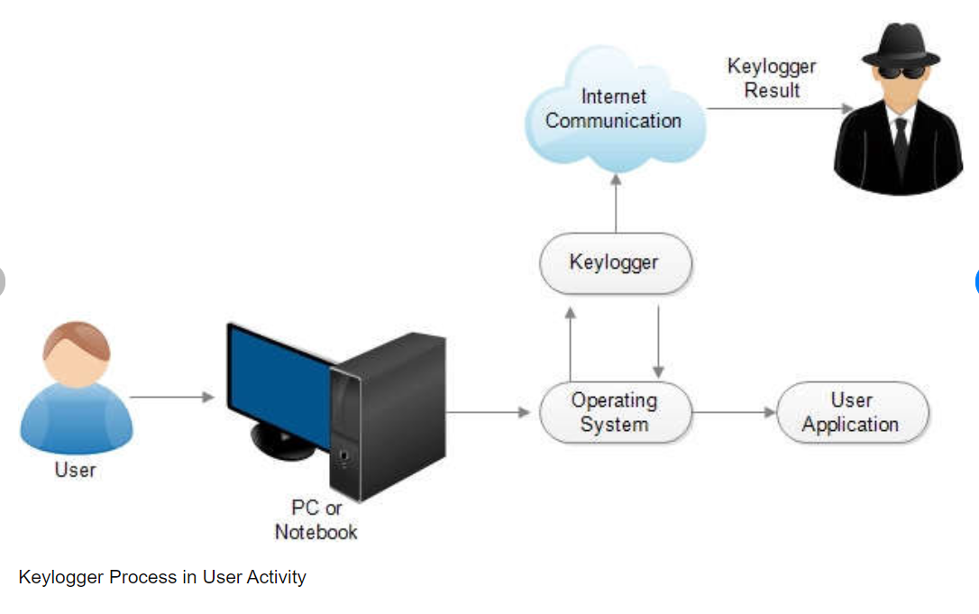
Subtitle: Safeguarding Your Digital Privacy
Introduction
Definition of Keylogger
Purpose of the Presentation

Slide 3
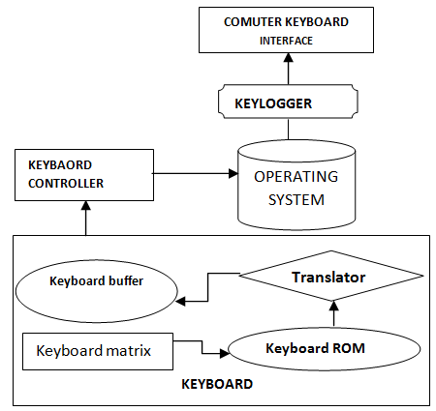
Subtitle: Safeguarding Your Digital Privacy
How Keyloggers Work
Explanation of Keylogger Functionality
Types of Keyloggers (Hardware vs. Software)

Slide 4
Subtitle: Safeguarding Your Digital Privacy
Methods of Keylogging
Keystroke Logging
Keystroke Logging
Screen Logging
Clipboard Logging
Screen Logging
Clipboard Logging

Slide 5
Subtitle: Safeguarding Your Digital Privacy
Purposes of Keyloggers
Malicious Intent: Theft of Personal Information,
Passwords, Credit Card Details
Monitoring: Employee Surveillance, Parental
Control
Keystroke Logging
Monitoring

Slide 6
Subtitle: Safeguarding Your Digital Privacy
Detection and Prevention
Antivirus Software
Antivirus Software
Firewall
Regular System Scans
Avoiding Suspicious Links and
Downloads
Firewall
Regular System Scans
Avoiding Suspicious Links and Downloads

Slide 7
Subtitle: Safeguarding Your Digital Privacy
Legal and Ethical Considerations
Laws Surrounding Keyloggers
Ethical Implications of Using Keyloggers
Laws Surrounding Keyloggers
Ethical Implications of Using Keyloggers

Slide 8
Subtitle: Safeguarding Your Digital Privacy
Case Study: Stuxnet
Brief Overview of Stuxnet Attack
Role of Keyloggers in the Attack
Brief Overview of Stuxnet Attack
Role of Keyloggers in the Attack

Slide 9
Subtitle: Safeguarding Your Digital Privacy
Protecting Against Keyloggers
Strong Passwords
Strong Passwords
Two-Factor Authentication
Encryption
Security Updates
Two-Factor Authentication
Encryption
Security Updates

Slide 10
Subtitle: Safeguarding Your Digital Privacy
Conclusion
Recap of Key Points
Importance of Vigilance
Q&A

Slide 11
Q&A
Open the floor for questions and discussion

Slide 12
Thank You
MOHAMADHA ALIFIYA M

