Slide 1
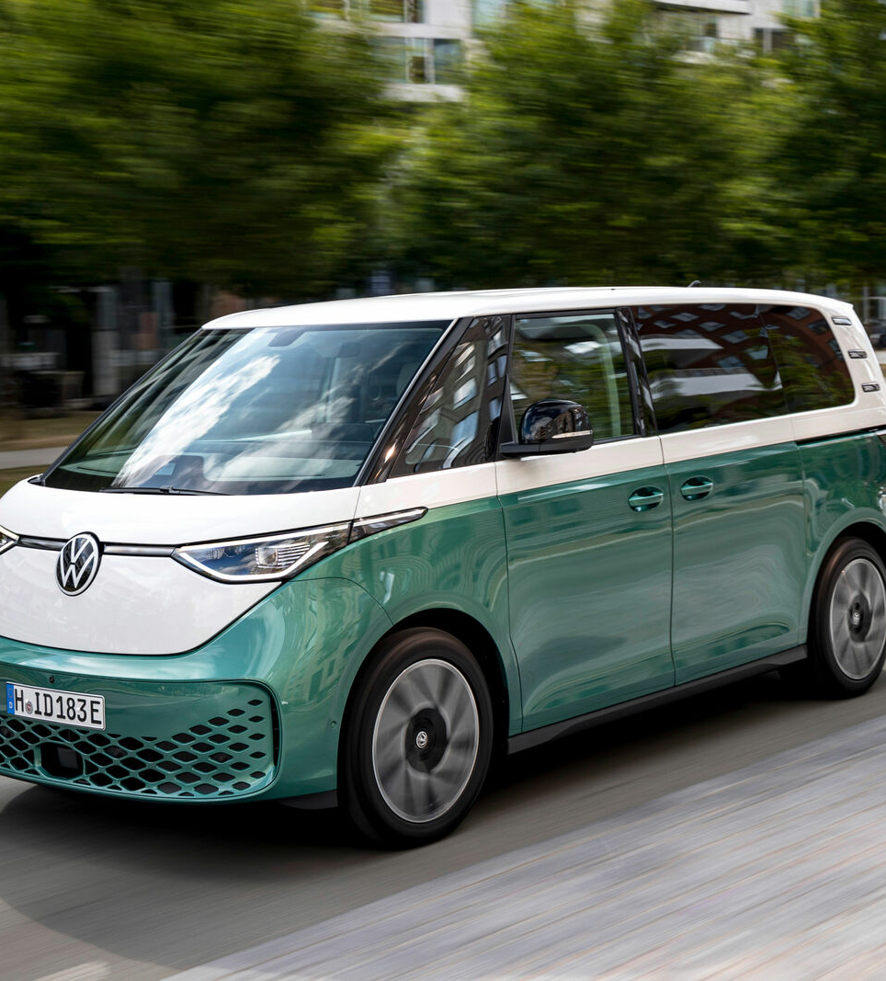
BACHELOR THESIS · COLLOQUIUM
Reading the battery of a VW ID. Buzz through the OBD-II port
Identification and Interpretation of BMS Signals Through CAN Bus Reverse Engineering on the Volkswagen ID. Buzz
Muhamad Alif Izzuwan Bin Ibrahim
Electrical Engineering and Electromobility · Technische Hochschule Ingolstadt
Examiners: Prof. Dr. Hans-Georg Schweiger · Prof. Dr. Werner Huber
Supervisor: M.Sc. Markus Gregor
1 / 15
Photo: Volkswagen AG
Notes:
Good morning. My thesis asks a simple question: can you read what the battery of a modern electric car knows about itself, using only the diagnostic socket under the dashboard, without opening anything? The car is THI's Volkswagen ID. Buzz. I will first explain in two slides how the car's internal network works, because the whole method follows from one architectural detail. Then the setup, the results for each of my four research questions, and finally what the method cannot do yet.

Slide 2
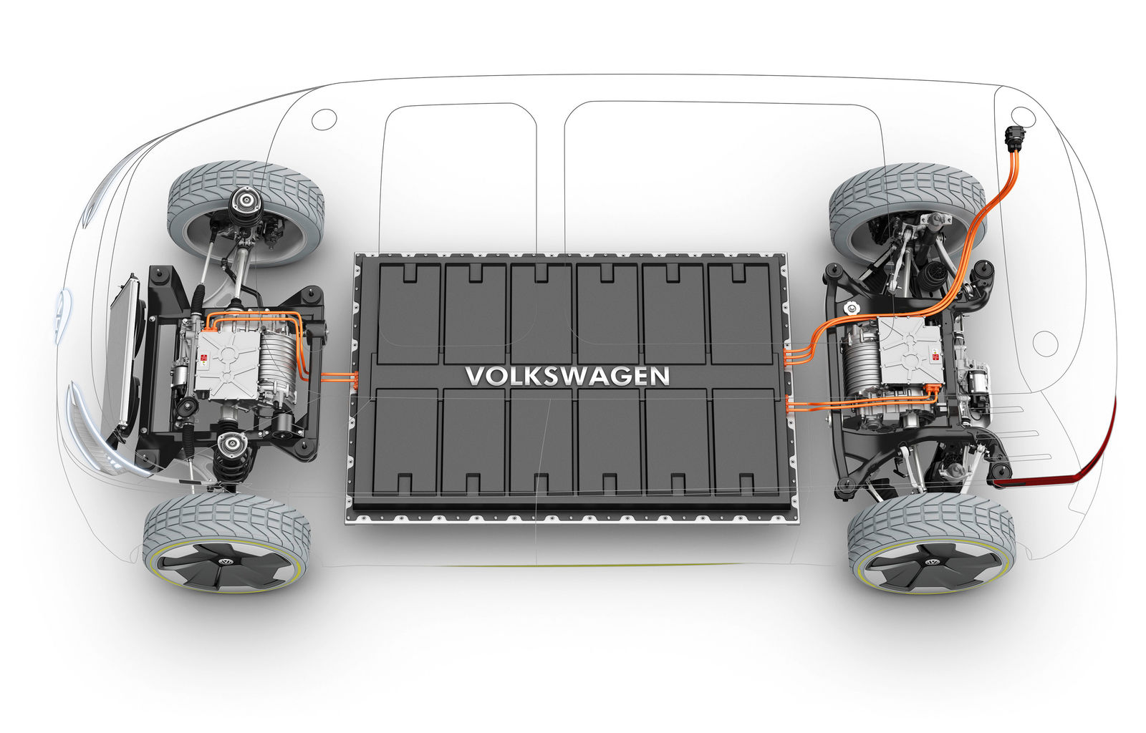
MOTIVATION
The battery computes a detailed picture of its own state, and almost none of it leaves the car
Traction battery
77 kWh net · ≈ 350 V · 288 NMC cells in 12 modules
Battery-management system (BMS)
measures every cell voltage and temperature, estimates the state of charge, sets the power limits
Who needs that data outside the car
used-EV assessment · fleet monitoring · ageing research · post-crash battery inspection
Illustration: Volkswagen AG media portal
2 / 15
Notes:
The high-voltage battery is the most expensive part of the car, and its management system continuously knows a lot: state of charge, every cell voltage, temperatures, how much power it may deliver. That information decides range, lifetime and safety. Anyone outside the car who wants it, for example to judge a used vehicle, to monitor a fleet, or to inspect a battery after a crash, has no official access to it. Volkswagen does not publish how to read it. That gap is what this thesis works on.

Slide 3
BACKGROUND · CAN BUS
Inside the car, control units share one two-wire line, and every message is only a number plus up to 8 bytes
Think of a radio channel
Every unit hears every message. A message carries a topic number, not an address.
The bytes are visible.
Their meaning is not: the dictionary that maps bytes to volts and degrees belongs to the manufacturer.
CAN-H
CAN-L
BMS
Drive unit
Climate
Gateway
One frame on the bus, as the logger records it
065
3E 4A 00 52 1C 07 9B 10
identifier:
what it is
data: up to 8 bytes
no units, no names
3 / 15
Notes:
For anyone not from communications engineering, the CAN bus is the car's internal network: two twisted wires that every control unit is connected to. It behaves like a radio channel. Every unit hears every message, and a message does not say who it is for, it says what it is about, through an identifier number. The payload is at most eight bytes on this car. What you record is exactly what is shown here: a number and some bytes. Without the manufacturer's dictionary you can see that a message arrives, but not what it means. Recovering that meaning is what reverse engineering means in this thesis.

Slide 4
RESEARCH QUESTION 1 · WHY LISTENING FAILS
On the MEB platform a gateway keeps the battery's bus away from the diagnostic socket
INSIDE THE CAR · PRIVATE BUSES
OUTSIDE · DIAGNOSTIC BUS
central
gateway
Like a reception desk: it does not relay the internal phone calls, but it puts you through if you ask for an extension.
battery / powertrain CAN
BMS
cell supervision
drive unit
OBD-II
socket
comfort / chassis CAN
climate
body
✕ battery broadcasts: not forwarded
✓ addressed diagnostic requests: forwarded, and answered
4 / 15
Notes:
This is the architectural detail everything follows from. On Volkswagen's MEB platform the buses are separated into domains, joined only by a central gateway. The battery-management system talks on a private bus behind it. Classic reverse engineering plugs a logger into the bus where the battery talks and listens. But the only bus I can reach without opening the car is the one at the diagnostic socket, and the gateway does not pass the battery's messages there. What it does pass are diagnostic requests, because workshops must be able to talk to every control unit. That is the open door. Research question one asks exactly this: which bus is at the socket, and why the battery frames are not on it.

Slide 5
RESEARCH QUESTION 1 · EVIDENCE
Listening at the socket for 533 s recorded 14,921 frames, and every one came from the logger itself, none from the car
14,921
unsolicited frames on 0x065 – 0x06F: the logger's own GNSS/IMU messages
0
broadcast frames from the car, and none from the battery
Passive reverse engineering has nothing to work on here.
Unsolicited frames per 11-bit identifier, log 00000039
5 / 15
Notes:
I did not take the gateway isolation on faith; I tested it. From March I recorded the socket and analysed the traffic the way the literature does: bit maps, counters, candidate 16-bit signals. In this recording there are almost fifteen thousand unsolicited frames on six identifiers, 0x065 to 0x06F. In the thesis, Section 4.1.1, I read them as traffic the gateway forwards. While building the decoder after submission I found that these identifiers are the logger's own internal GNSS and IMU channel; they do not come from the car at all. That makes the answer to research question one stronger, not weaker: not a single broadcast frame of the vehicle, and certainly none of the battery, reaches the socket. The battery's frames stay on the private side of the gateway, passive methods have no input, and that is why the method changed from listening to asking.

Slide 6
METHOD · DIAGNOSTIC REQUEST (UDS)
So the logger asks instead: one question frame out, one answer frame back
CANedge2 logger
gateway
BMS
“read value 1E3B, please”
“1E3B = 05 D5”
Fits in one frame (≤ 7 bytes)
answer arrives complete: pack voltage, cell voltages, temperatures, SOC …
Longer answer (VIN, pack current …)
split over several frames; the BMS waits for a “go on” frame (flow control) that this logger cannot send, so only the first piece is recorded
ReadDataByIdentifier, service 0x22 of ISO 14229 (UDS), carried by ISO 15765-2 (ISO-TP)
6 / 15
Notes:
Here is the new approach in its simplest form. The logger sends one frame that says: please give me value number 1E3B. The gateway passes it to the battery-management system, which answers with the bytes of that value. This is a standard workshop service called Read Data By Identifier. The identifier, D-I-D, is just the number of a value in the control unit's catalogue. One constraint matters for the results later: a CAN frame holds eight bytes, so an answer longer than seven data bytes must be split into pieces, and the receiver has to send a small flow-control frame before the rest comes. My logger can only send fixed frames from a list; it cannot react. So long answers arrive truncated. Keep that in mind; it explains six of my eight failures.

Slide 7
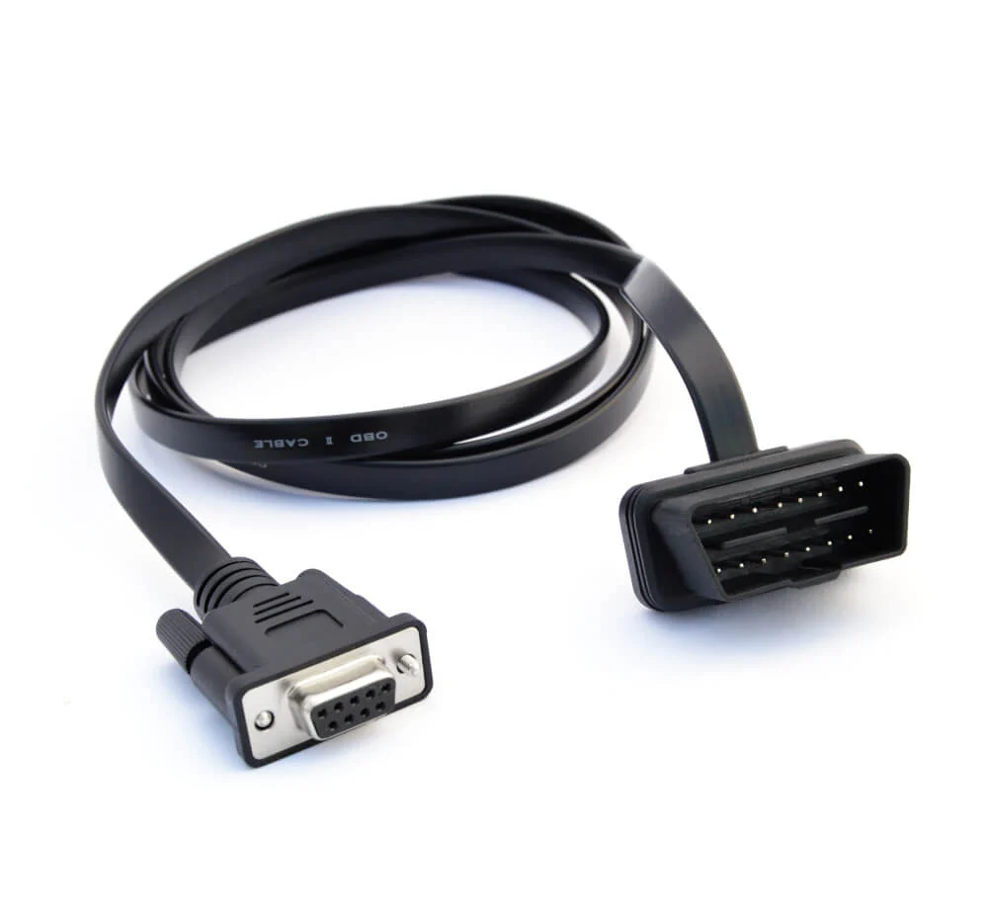
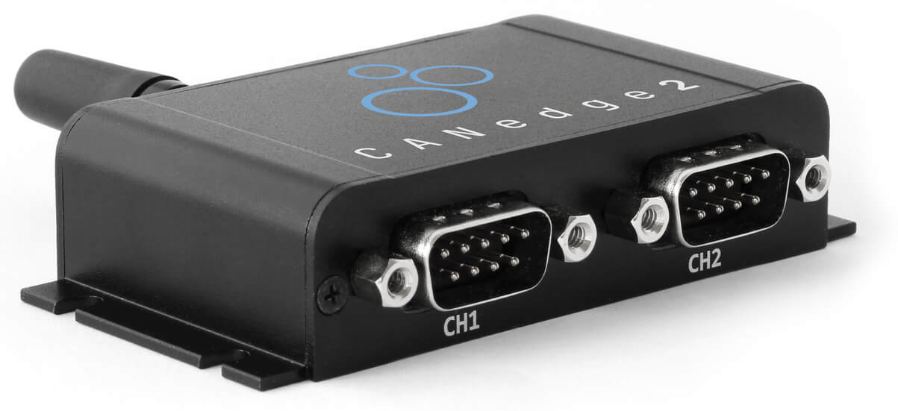
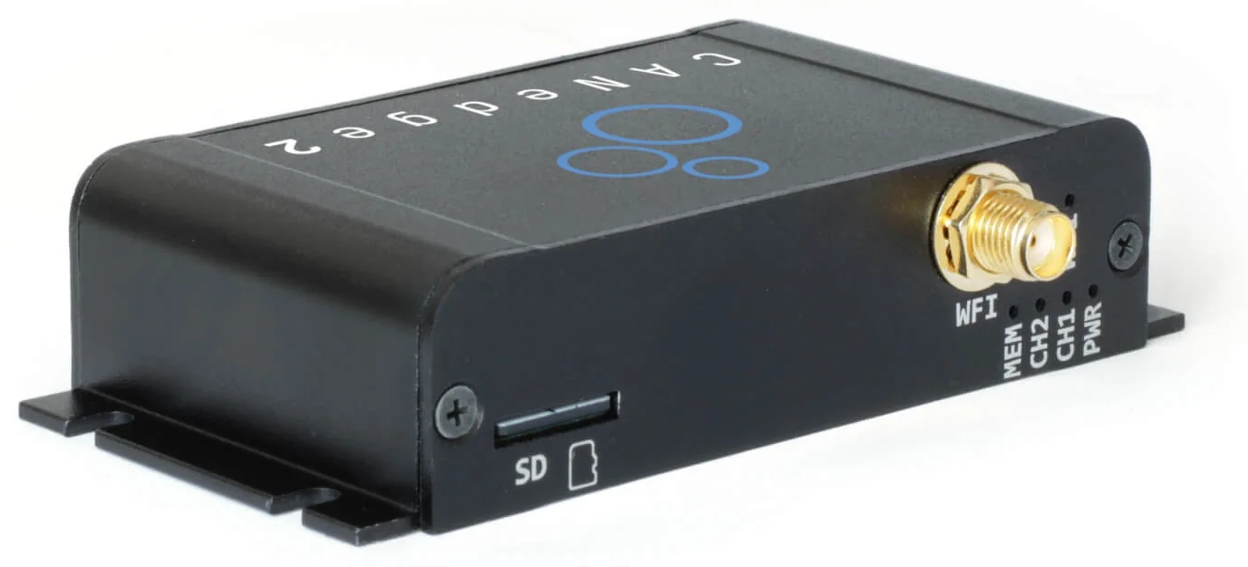
MATERIALS
One logger on the OBD-II socket asks, listens and records on one clock, with no laptop on the bus
CANedge2: CAN logger with SD card, can transmit a fixed request list
OBD-II → DB9 cable: CAN-H, CAN-L, GND, 12 V
500 kbit/s
Classical CAN
60 identifiers
per request cycle
10 s cycle
requests 150 ms apart
3 sessions
identical outcome
Product photos: CSS Electronics (logger), buyzero.de (cable)
7 / 15
Notes:
The hardware is deliberately minimal. A CANedge2 logger, connected to the diagnostic socket through a plain OBD-to-DB9 cable: no splitter, no second tester, no laptop on the bus. The logger opens an extended diagnostic session with the BMS, keeps it alive, and sends sixty read requests every ten seconds, spaced 150 milliseconds apart so the bus is never flooded. Because the logger also records its own transmissions, one file holds the question and the answer on the same time base. All recordings were taken with the car switched on, drive-ready, but standing still. Three independent sessions gave the same outcome.

Slide 8
METHOD · HYPOTHESIS, NOT SPECIFICATION
A list written for the VW ID.3 supplied the candidates; every entry had to pass three tests on the ID. Buzz
60
52
49
2 + ≈12
identifiers requested
answered
carry a usable value
confirmed
taken from a public ID.3 list:
number, byte layout, formula
Does the ID. Buzz know
this identifier at all?
Does the ID.3 formula still
give a sensible quantity?
Is the value true, checked
against something independent?
HYPOTHESIS
RESEARCH QUESTION 2
RESEARCH QUESTION 3
RESEARCH QUESTION 4
The list is community-compiled, unvalidated and made for a different car. Treating it as a specification would have reproduced its errors.
8 / 15
Notes:
Volkswagen publishes neither the identifiers nor their formulas. What exists is a list compiled by the diagnostics community for the related ID.3. I treated that list as a hypothesis to be tested, not as a specification. Every identifier had to pass three gates, and they are my research questions two, three and four. Does the Buzz answer it? Does the ID.3 formula turn the bytes into a sensible quantity? And is that quantity actually true when checked against something the decoder could not have produced? The funnel shows how many survived each gate: sixty asked, fifty-two answered, forty-nine usable, and only two directly confirmed plus about a dozen confirmed through physical relations. The next slides go through the gates one by one.

Slide 9
RESEARCH QUESTION 2 · REACHABILITY
52 of 60 identifiers answered, and every failure traces back to the measurement setup, not to the car
49 answered with a usable value
47 from the BMS, 2 from drive unit and climate
3 answered “not available”
code 0x0FFE: an empty cell slot, explained on slide 12
6 only the first piece arrived
answer > 7 bytes; the logger cannot ask for the rest
×
2 no answer at all
gateway identifiers, queried without a diagnostic session
×
×
One square = one identifier · outcome identical in all three sessions
9 / 15
Notes:
Research question two: what is reachable through the gateway without unlocking anything? Each square is one requested identifier. Forty-nine answered with a usable value. Three answered with a special code that I will explain in a moment. Six arrived only as a first piece: these are exactly the identifiers whose answers are longer than seven bytes, like the VIN or the pack current, so this is the logger's limitation, predicted before the measurement. Two gateway identifiers never answered; the gateway itself was reachable, because another of its identifiers answered every time, but I had not opened a diagnostic session on it. The important point: the same squares fail in every session, so the failures are systematic and explained, not random loss.

Slide 10
RESEARCH QUESTION 3 · DECODING
One answer, decoded byte by byte, gives the voltage of the whole battery pack: 373.25 V
QUESTION
SAME SESSION, OTHER VALUES
03
22
1E 3B
55 55 55 55
State of charge
72.8 – 73.2 %
3 bytes
follow
read data
which value
padding
Pack voltage
373.25 – 373.75 V
ANSWER
Cell voltage (28 sampled)
3.888 – 3.890 V
05
62
1E 3B
05 D5
aa aa
Battery temperature
16.0 – 16.4 °C
5 bytes
follow
positive
reply
echo
the value
unused
Discharge limit
800 A
Operation mode
drive-ready
0x05D5 = 1493 → 1493 / 4 = 373.25 V
Speed
0 km/h
10 / 15
Notes:
This is what decoding means in practice. The question: 03 says three bytes follow, 22 is the read service, 1E 3B is the identifier, the rest is Volkswagen's padding. The answer: 62 is 22 plus 40 hexadecimal, which the standard defines as a positive response; then the identifier is echoed, which lets every answer be matched to its question; then the value, 05 D5, which is 1493. The ID.3 list says divide by four: 373.25 volts. For most identifiers the ID.3 formula transferred to the Buzz unchanged, and the table shows values from the same session, read 53 to 54 times each. But a plausible number is not yet a proven number; that is research question four. First, three things the list got wrong or did not contain.

Slide 11
RESEARCH QUESTION 3 · FINDING 1 OF 3
The highest- and lowest-cell identifiers carry a voltage the ID.3 list never mentions, scaled by 1/4096
ANSWER OF 0x1E34, “LOWEST CELL”
07 62 1E 34
3E 25
00
60
112 / 112
reads across three sessions name cell 96 as the lowest cell.
The highest cell wanders with the noise; the lowest does not.
Lesson learned
A first decoding read the wrong byte and reported “cell 62” as both highest and lowest: impossible, and that is how it was caught.
header + echo
new: voltage
0x3E25 / 4096
= 3.884 V
in the list:
cell 0x60 = 96
WHY 1/4096 IS RIGHT: THE EXTREMES MUST ENCLOSE EVERY SAMPLED CELL
BMS min … max
28 cells read one by one
3.880 V
3.885 V
3.890 V
3.895 V
11 / 15
Notes:
First finding. The community list describes these two identifiers only as the number of the highest and lowest cell, the last byte. But the answer has four data bytes. I found that the first two are the cell voltage itself, divided by 4096, a factor that differs from the 1000 used by the single-cell identifiers, so it could not have been guessed. The proof is a relation the decoder knows nothing about: a maximum and a minimum over all cells must enclose every individual cell I sampled, and they do. With an arbitrary scale factor they would not. Also: cell 96 is the lowest cell in every one of 112 reads. And honestly, my first attempt read the wrong byte and named the same cell as highest and lowest. That impossibility is what exposed it.

Slide 12
RESEARCH QUESTION 3 · FINDINGS 2 AND 3
0x0FFE is not a 5.09 V cell but the code for “no cell here”, and three arguments say the pack measures exactly 96 cells
96
cell-voltage channels
measured
0x0FFE → “5.094 V”
N = 95
369.5 V
N = 96
373.4 V
N = 97
377.2 V
93
96
97
100
104
teal = cell present · red = 0x0FFE · white = not sampled
1 From above
2 From below
3 From the pack voltage
slots 97, 100 and 104 return 0x0FFE in 100 % of reads: the largest 12-bit value minus one, a reserved “not available” code
the BMS itself names cell 96 as its lowest cell in 112 of 112 reads, so cell 96 exists
373.5 V / 3.8891 V per cell = 96.0; any other count misses the measured band
Volkswagen publishes 288 cells in 12 modules; 96 series groups means three cells in parallel per group.
12 / 15
Notes:
Two more findings. Some cell slots return the raw value 0FFE. Under the list's formula that would be 5.09 volts, impossible for a lithium-ion cell. 0FFE is one below the largest 12-bit value, a typical reserved code. So the identifier is not broken, it is correctly reporting that there is no cell there. I wrote down an explicit criterion for this: bit-exact in every read, at the top of the field, physically impossible. Second, the number of cells is not published. Three independent arguments agree: slot 97 and above are empty; the BMS names cell 96 as existing; and the pack voltage divided by the mean cell voltage is 96.0, while 95 or 97 would miss the measured band by about four volts. With Volkswagen's 288 cells, that means three cells in parallel per group.

Slide 13
RESEARCH QUESTION 4 · HOW TRUE IS IT?
Only two signals are confirmed against the real world; the rest rest on physics or on plausibility
A
directly validated
2 signals
operation mode = drive-ready, speed = 0 km/h: matches what was observed in the car
B
indirectly validated
≈ 12 signals
pack voltage, cell voltages, cell extremes, temperatures: tied by relations no formula was fitted to (V_pack / V_cell = 96.0, extremes enclose samples)
C
plausible, unconfirmed
the remainder
state of charge, power limits, pack current, 12 V, outdoor temperature, odometer: sensible magnitude, no independent reference
D
invalid or unexplained
6 signals
three 0x0FFE slots, A/C compressor status, two unanswered
13 / 15
Notes:
Research question four is the one I think matters most. Any formula can turn a raw integer into something that looks like a voltage. So for each signal I asked: what is known about it independently of the formula? Only two signals reach class A: the car was visibly switched on and standing still, and the decoded operating mode and speed say exactly that. About a dozen are in class B: no external reference, but they satisfy physical relations they were not fitted to, like the integer ratio of pack to cell voltage. That fixes them relative to each other, though a common error factor would survive. State of charge is class C: sensible, but I had no reference, for example the dashboard reading, recorded at the same moment. I report this distribution as a result, not as a weakness to hide.

Slide 14
DISCUSSION · LIMITS AND OUTLOOK
The method works at a standstill; current, charging and battery health are the next step
LIMIT IN THIS WORK
WHAT REMOVES IT
All recordings stationary: current and power never left idle
Drive at 50 and 100 km/h, accelerate, brake, DC fast charge
Logger cannot send flow control: 6 long answers truncated, incl. pack current
Read them with an ISO-TP-capable tester
Gateway queried without a diagnostic session: 2 silent identifiers
Open a session on the gateway, or address the right unit
State of health not requested; protected identifiers need security access
Only with manufacturer cooperation, not by bypassing it
Application: after a crash, SOC, cell spread and temperatures read non-invasively through the socket.
14 / 15
Notes:
What the method cannot do yet. Everything was recorded standing still, so current and power stayed near zero and their formulas could only be checked for plausibility. Driving and fast-charging scenarios fix that directly. The truncated answers, including pack current, need a tester that handles multi-frame transport; that is a property of my logger, not of the car. The two silent gateway identifiers need a diagnostic session on the gateway. And state of health I did not request; some identifiers are protected by a seed-and-key security access, which should only be opened with the manufacturer, not bypassed. A practical use is post-crash inspection: the safety-relevant battery state can be read without opening anything.

Slide 15
CONCLUSION
Asking instead of listening reaches the battery through a production gateway
RQ 1
The socket carries the diagnostic bus; the gateway keeps the battery's broadcasts private. Not one broadcast frame of the car reached the socket.
RQ 2
Without unlocking: 52 of 60 identifiers answer, identically in every session; all 8 failures trace back to the logger or the session setup.
RQ 3
The ID.3 formulas mostly transfer; three things they lack were found: the 1/4096 cell extremes, the 0x0FFE code, the 96-cell count.
RQ 4
2 signals validated against the real world, ≈ 12 by physical relations; the rest are plausible and are reported as such.
Thank you. I look forward to your questions.
15 / 15
Notes:
To conclude. The battery data of the ID. Buzz cannot be overheard at the socket, but it can be asked for, with one logger and no second device on the bus. Fifty-two of sixty identifiers answer, and every failure is explained. The ID.3 list transfers mostly, and I found three things it does not contain. And I graded every value by the evidence behind it, which shows honestly that only two are validated against the outside world, about a dozen by physics. The contribution is therefore a working acquisition method, a measured transfer rate of the ID.3 list, and three new encodings. Thank you.

