Slide 1
HanabiHack
Team “SATA”

Slide 2
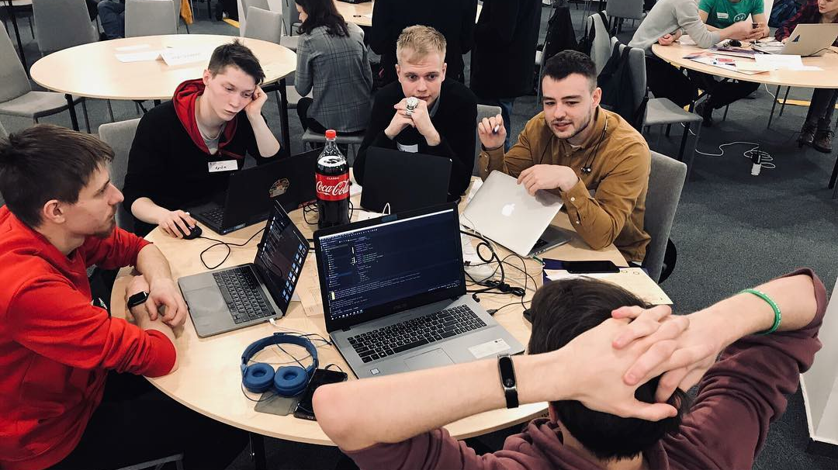
About case

Slide 3
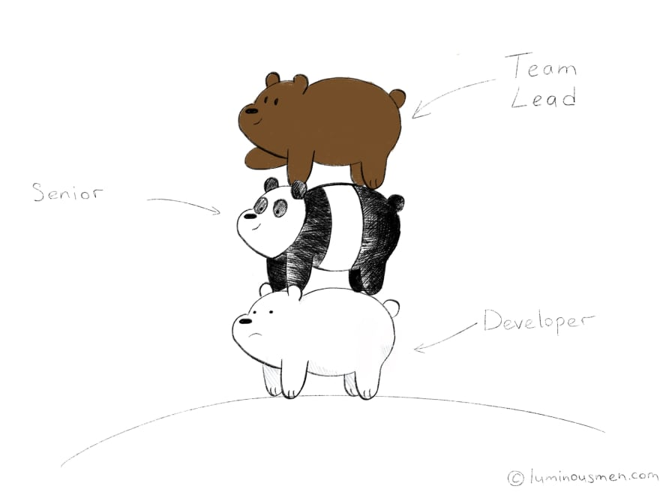
Problems

Slide 4
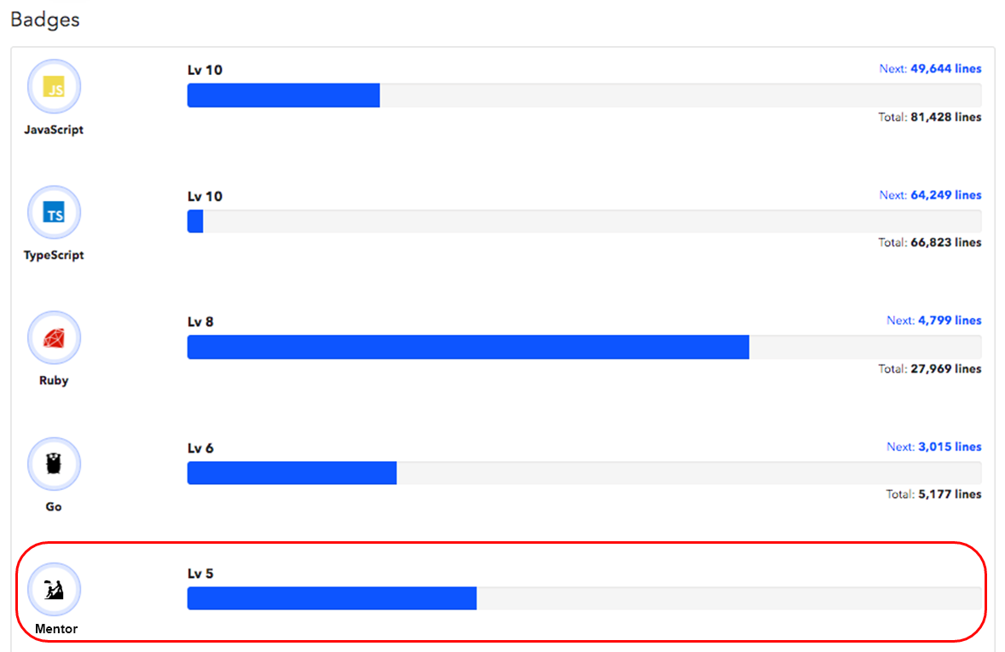
New Metric

Slide 5
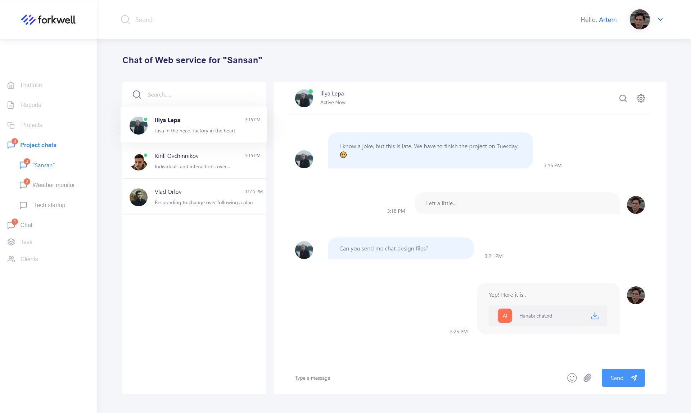
Chat in the project

Slide 6
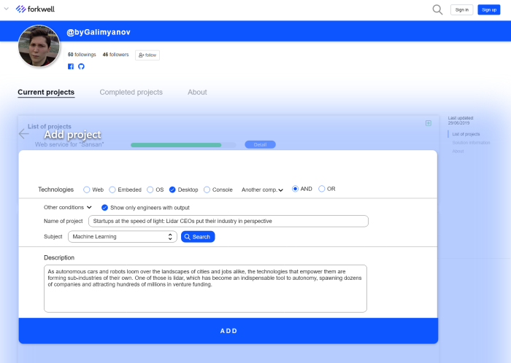
Tasks

Slide 7
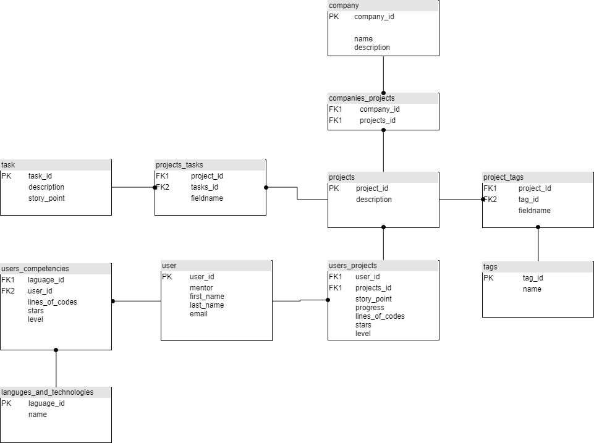
Database scheme

Slide 8
ありがとう

