Slide 1
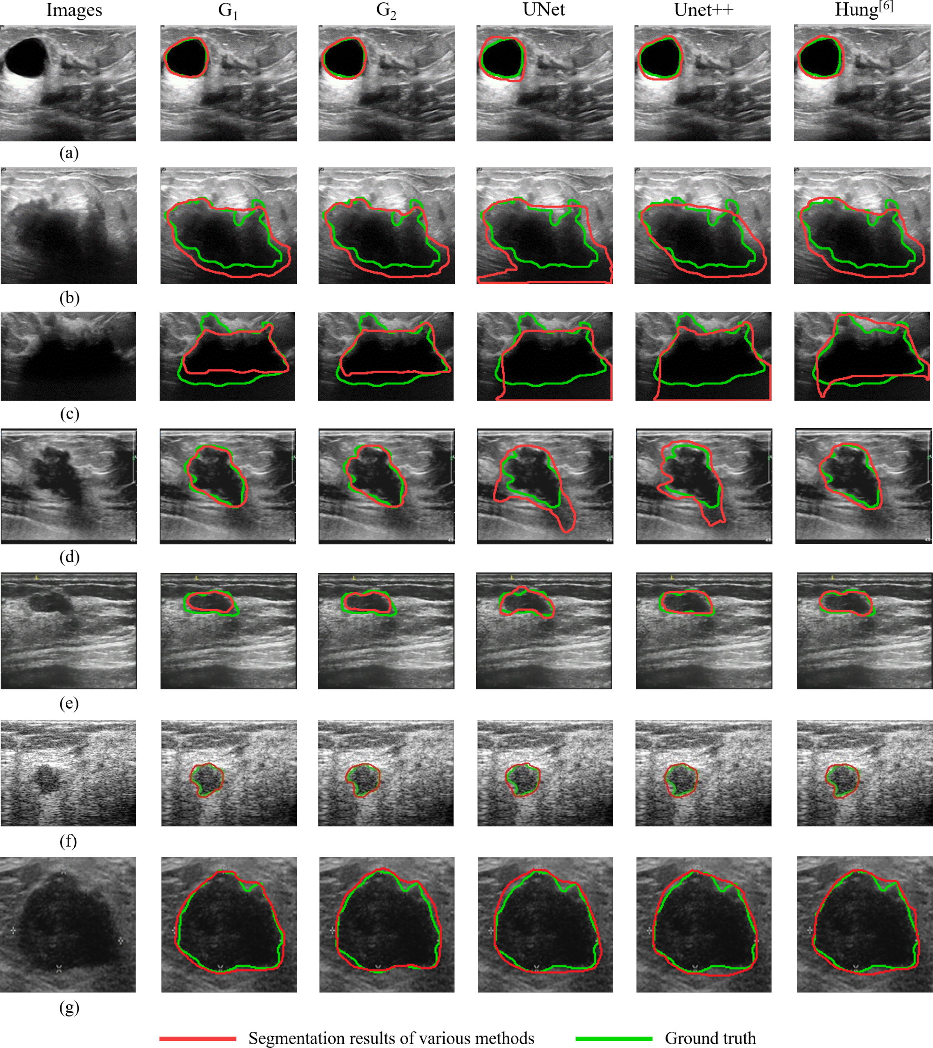





From paper
With Unlabeled
100% labeled
Not possible
Not possible

Slide 2





From paper
With Unlabeled
100% labeled
Not possible
Not possible

Slide 3





From paper
With Unlabeled
100% labeled
Not possible
Not possible

Slide 4
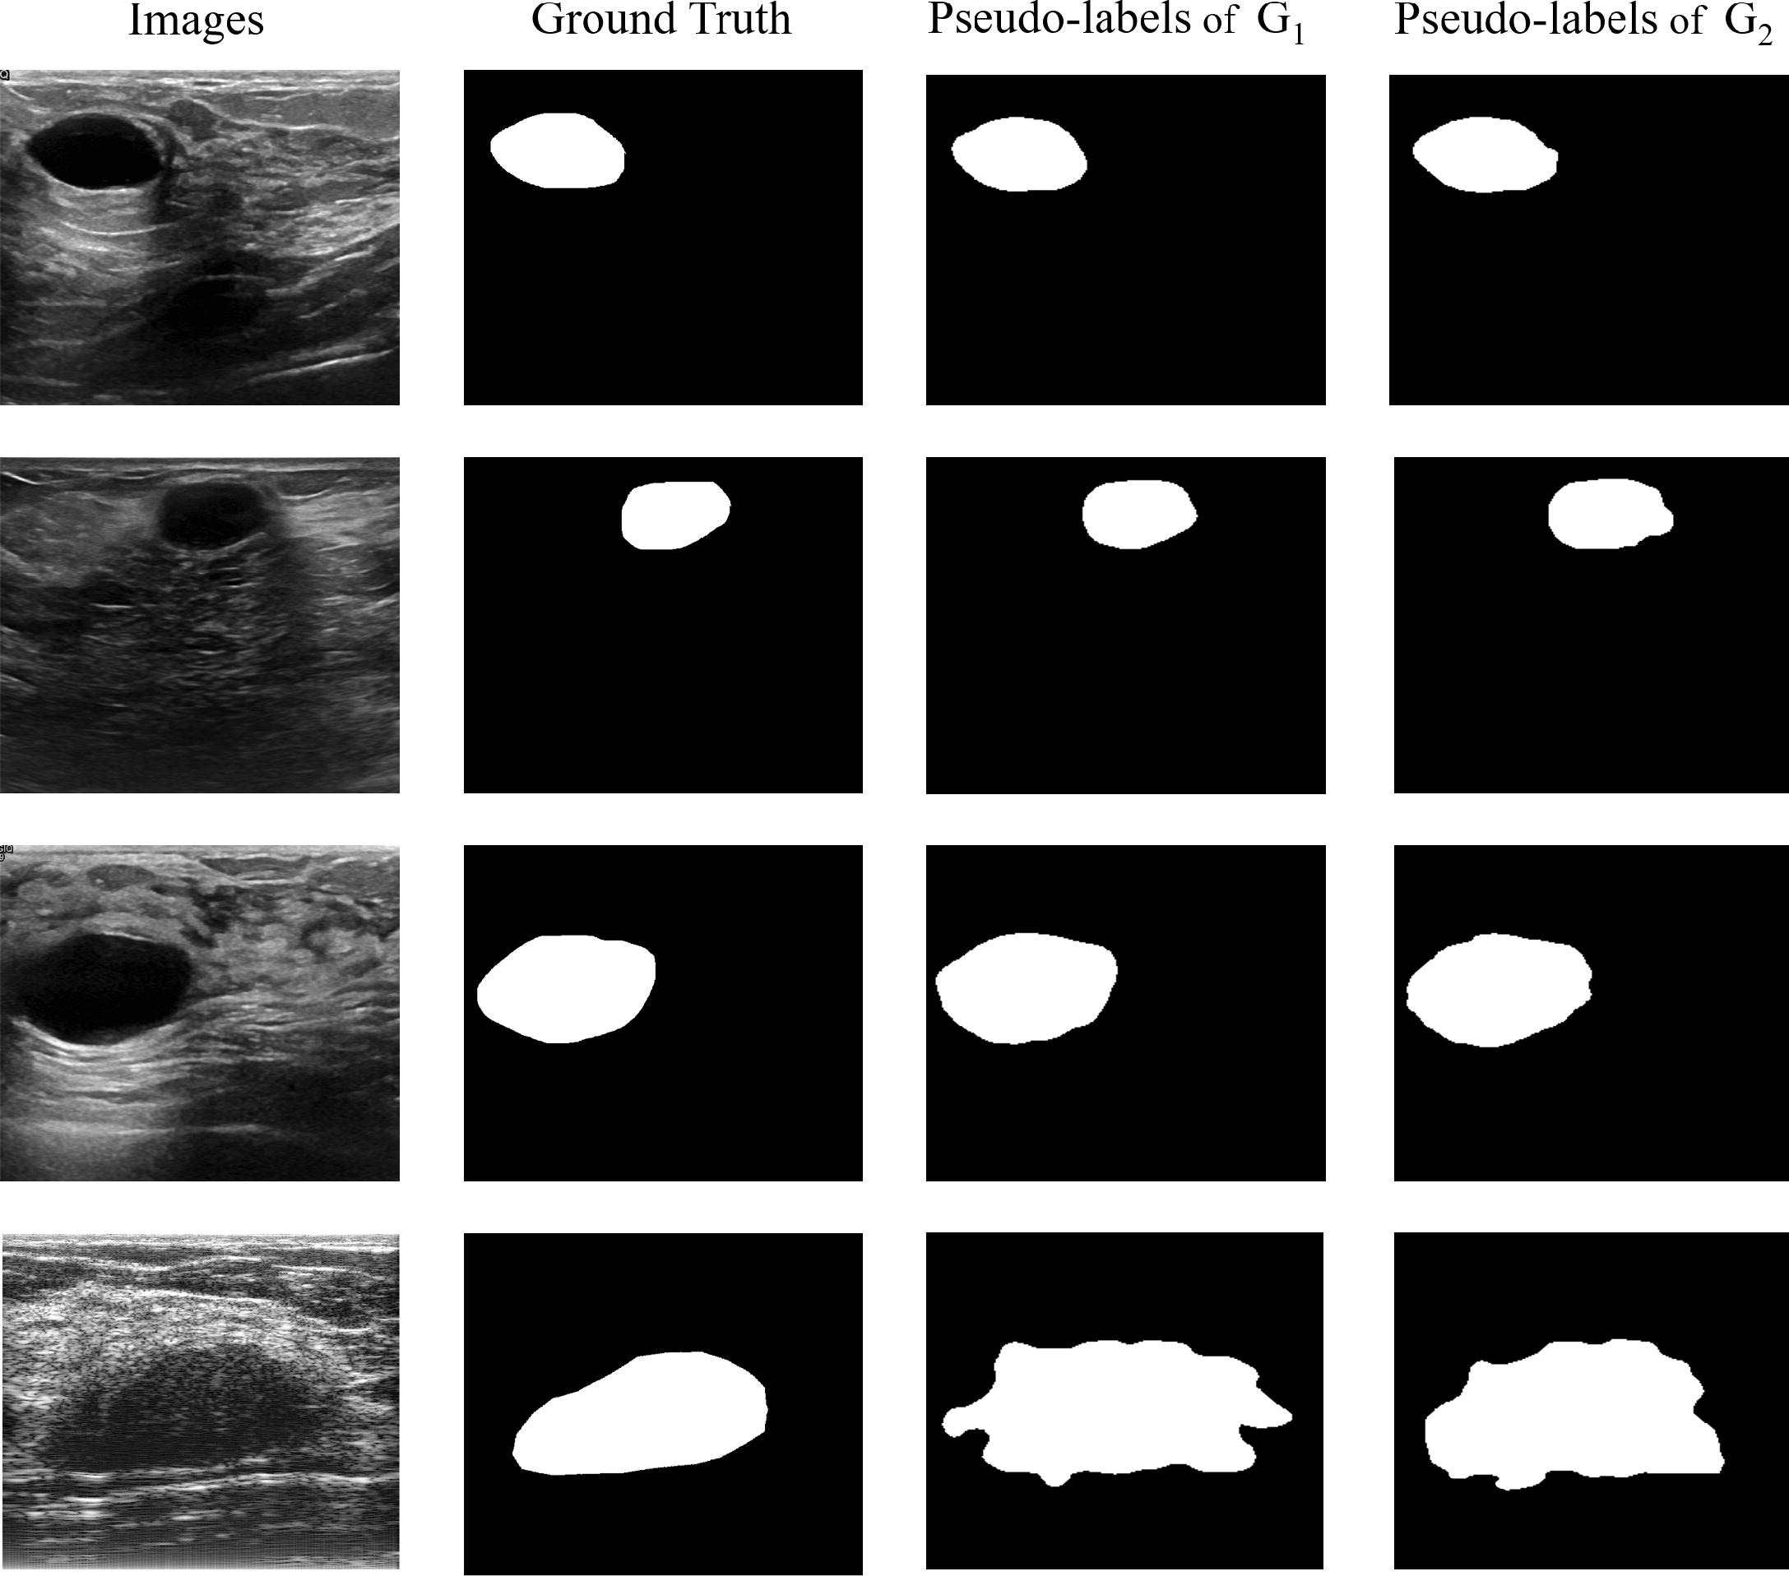

From paper
Results

