Slide 1
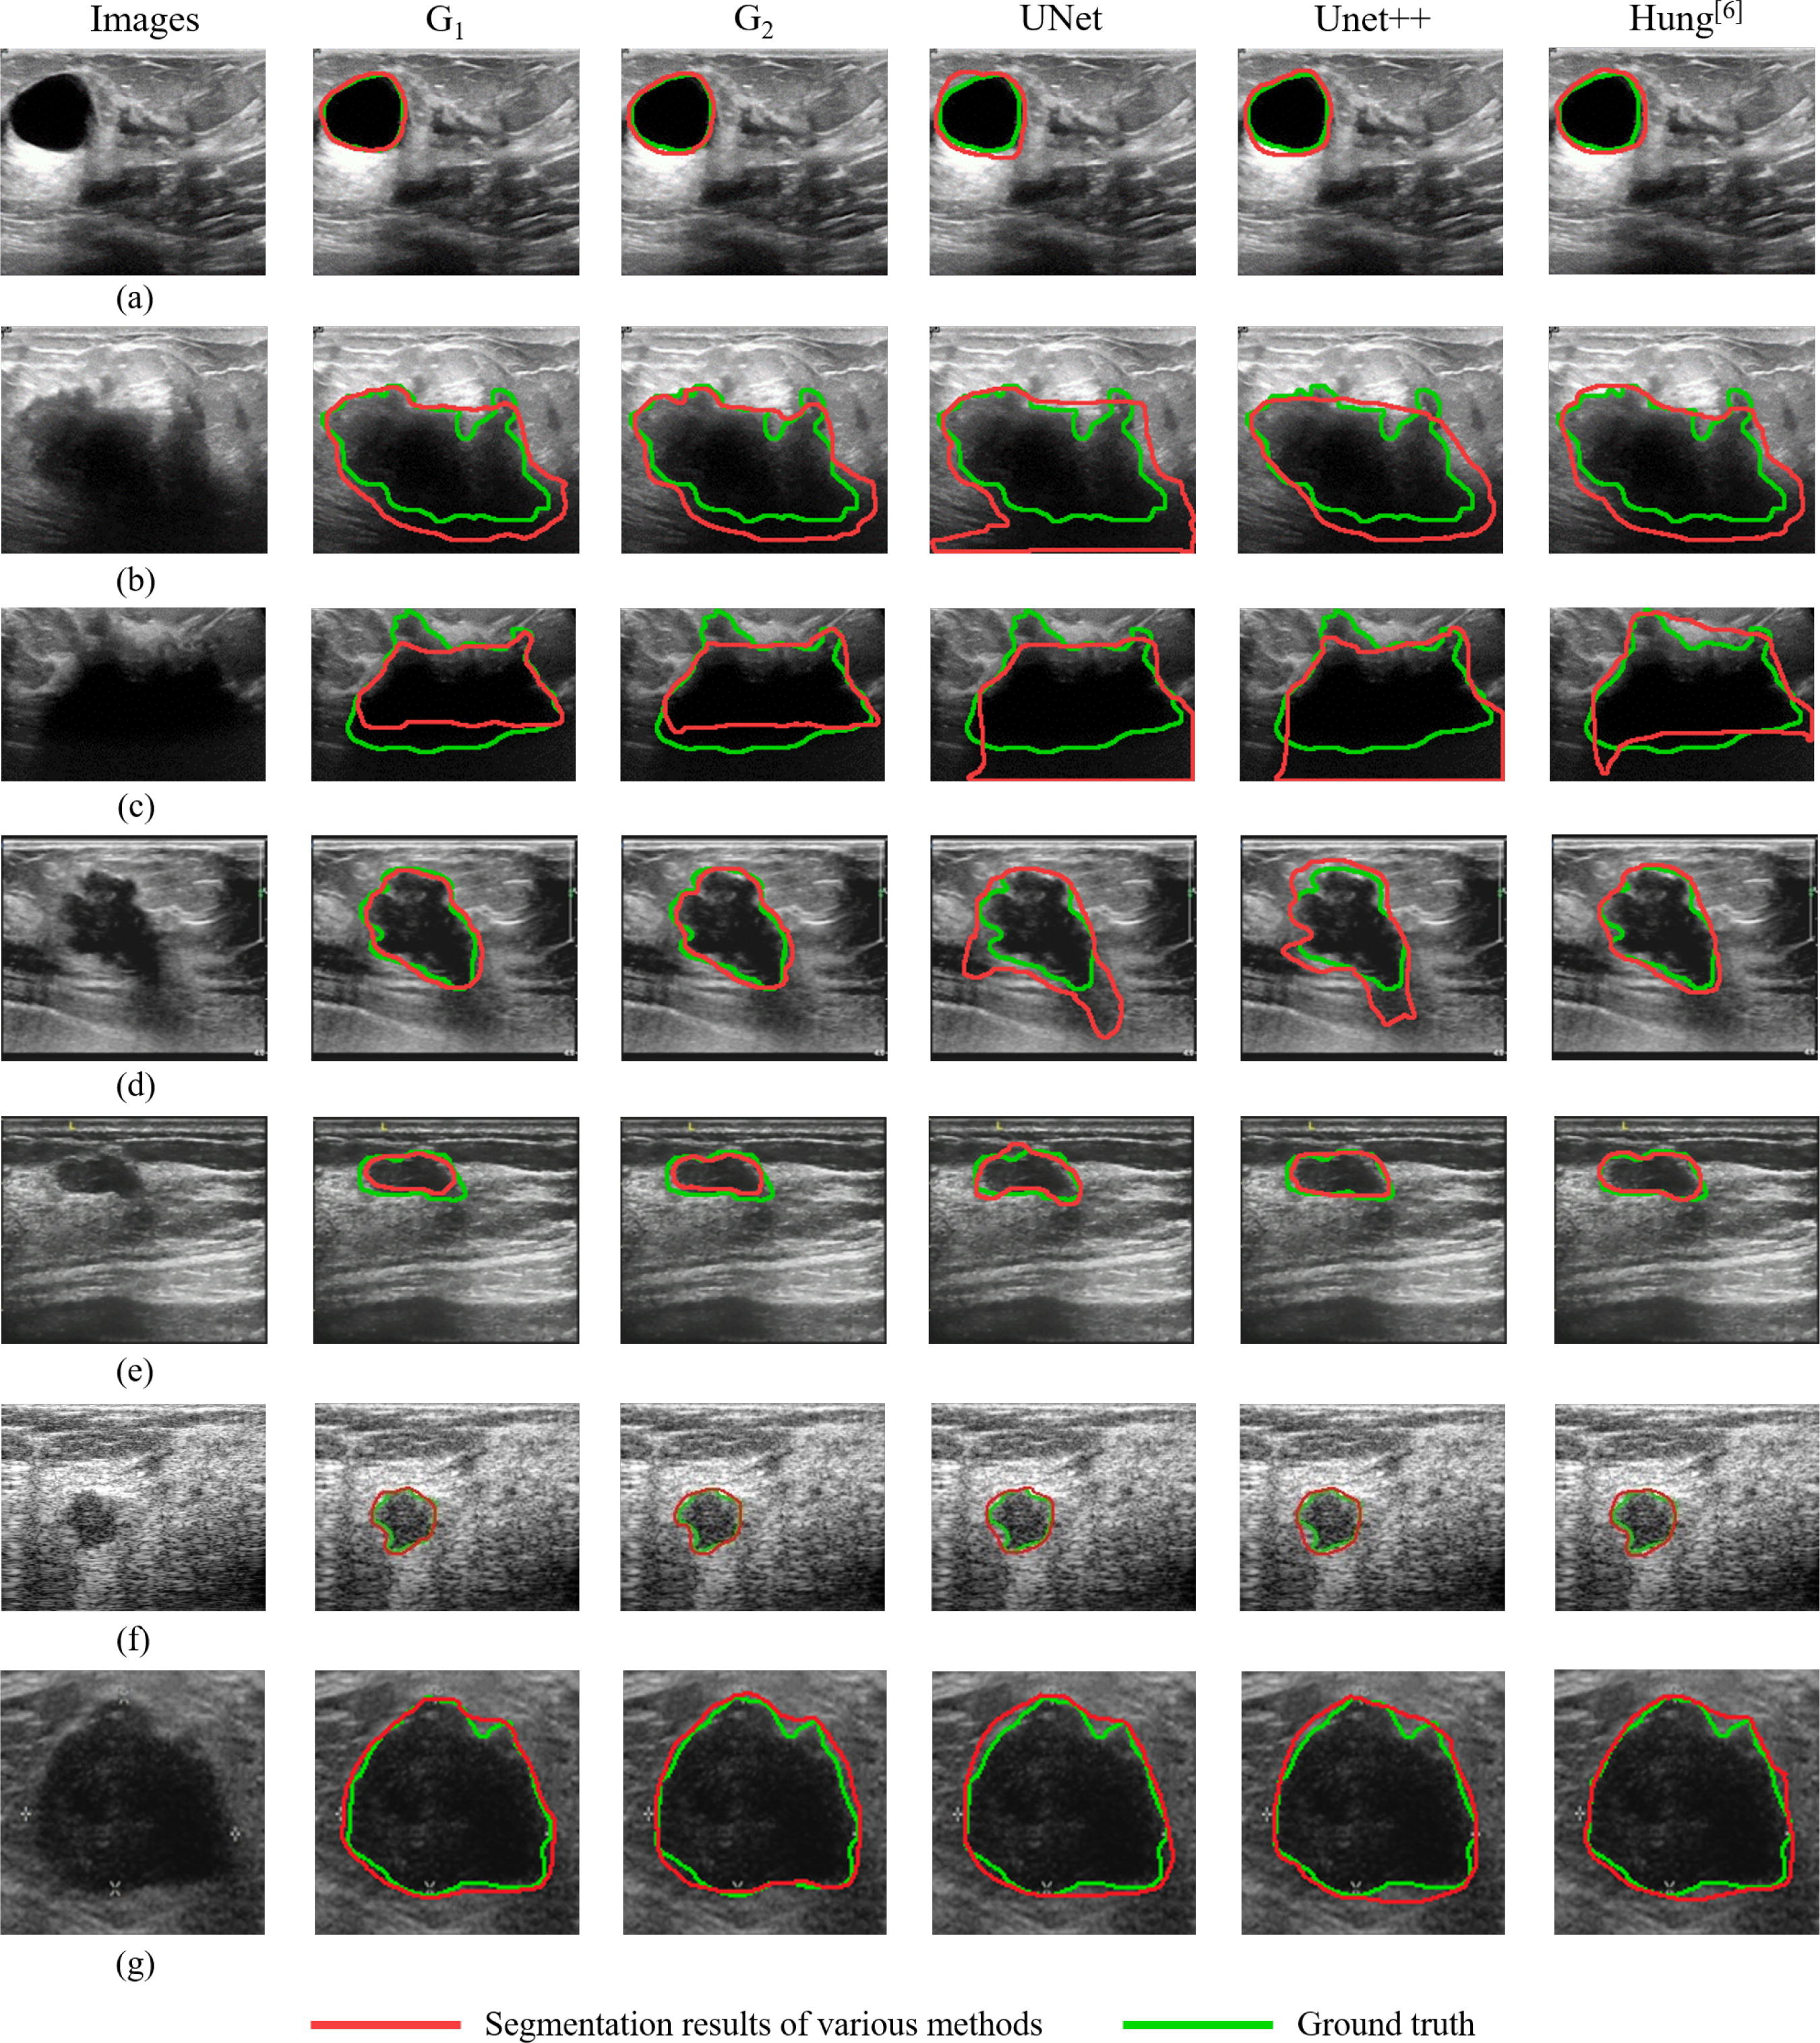





Images
G₁
G₂
UNet
Unet++
From paper
With Unlabeled
100% labeled
Not possible
Not possible
Segmentation results of various methods
Ground truth

Slide 2





Images
G₁
G₂
UNet
Unet++
From paper
With Unlabeled
100% labeled
Not possible
Not possible
Segmentation results of various methods
Ground truth

Slide 3





Images
G₁
G₂
UNet
Unet++
From paper
With Unlabeled
100% labeled
Not possible
Not possible
Segmentation results of various methods
Ground truth

Slide 4
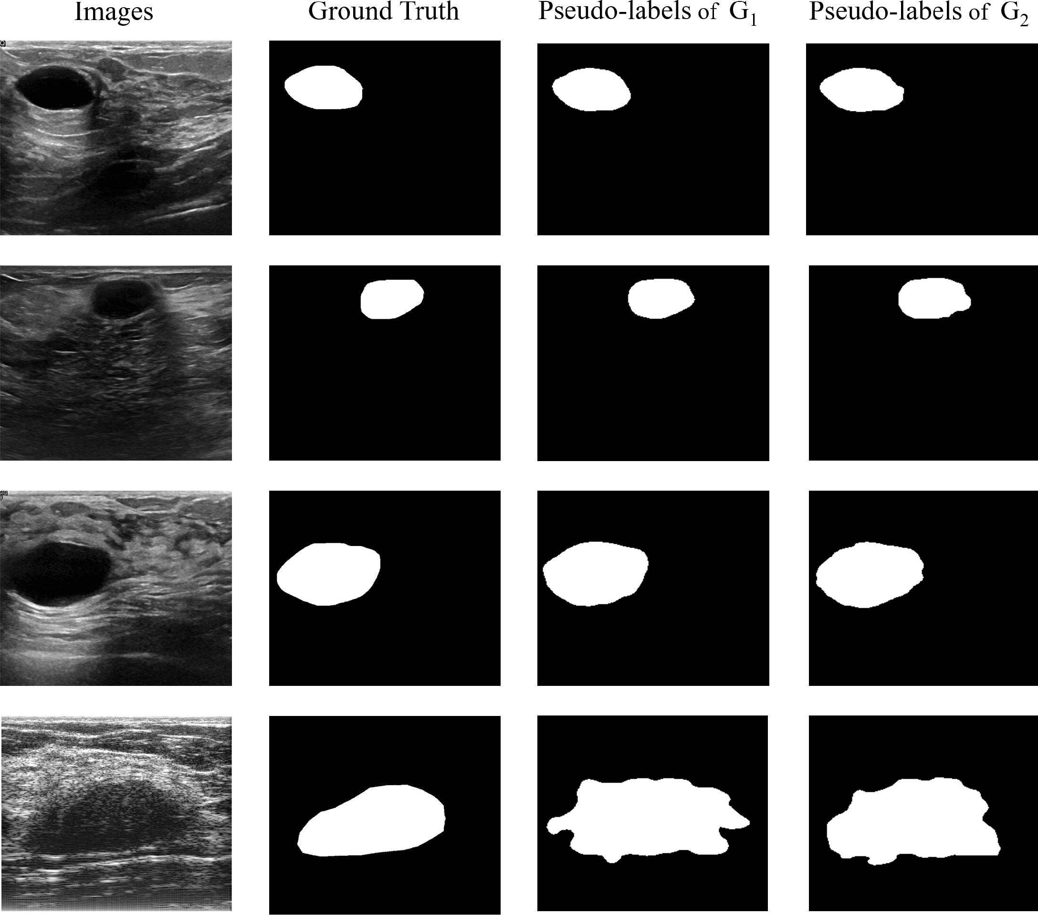

Images
Ground Truth
Pseudo-labels of G₁
Pseudo-labels of G₂
From paper
Results

