Slide 1
Deep Learning for Prediction of Business Outcomes
— Image Diagnosis of Pneumonia
Team 5: Shijie Liu, Xingchen Li , Fengqiao Yang

Slide 2
Agenda
1.Introduction
2.Problem Description
3.Data Description
4.Data Preprocessing
5.Binay Model
6.Categorical Model
7.Conclusion, Discussion, and Recommendation

Slide 3
Introduction
shortage of medical resources
cost-saving
operational efficiency

Slide 4
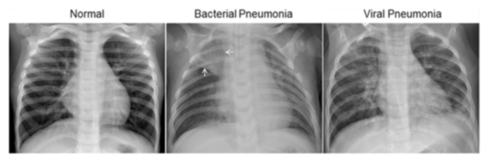
Problem Description
Diagnose Pneumonia based on the chest X-Ray

Slide 5
Binary target model
Normal
Pneumonia
Categorical target model
Normal
Bacterial
Viral

Slide 6
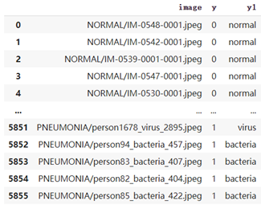
Data Description
1583 2780 1493

Slide 7
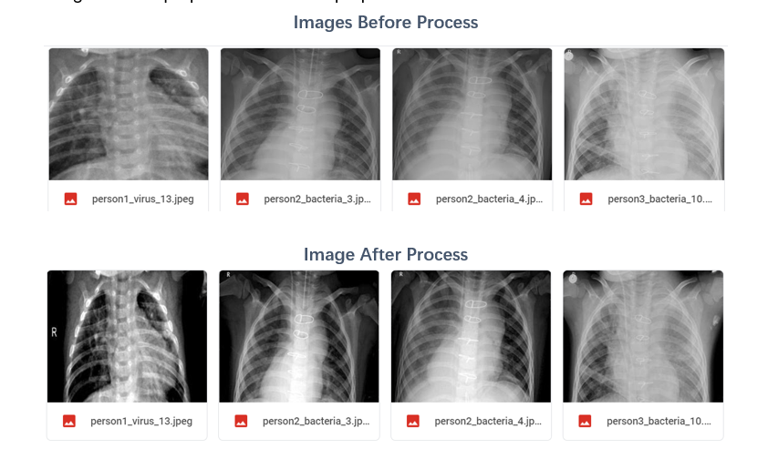
Data Preprocessing
· Resize the images into 256 x 256
· Adjust contrast with autocontrast function
· Increase the sharpness by 20%
· Set black points of the graph to 50
· Adjust the brightness of non-black parts
of images to 150.
Gray Scale -> RGB

Slide 8
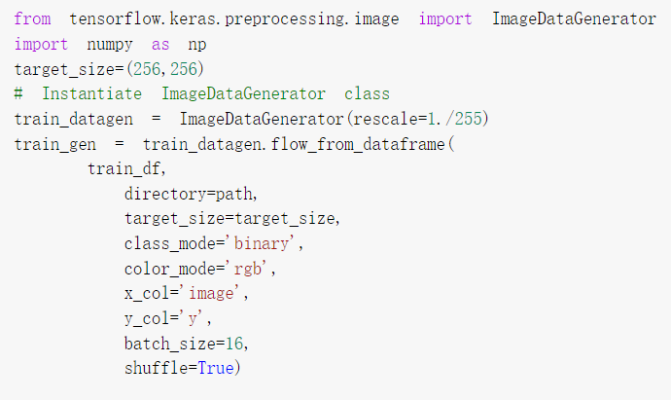
Binary Model

Slide 9
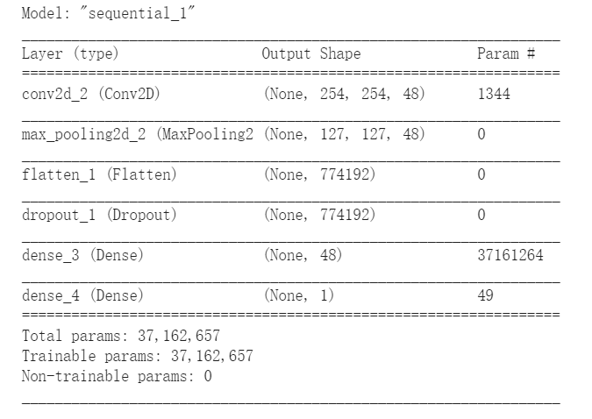
Binary Model

Slide 10
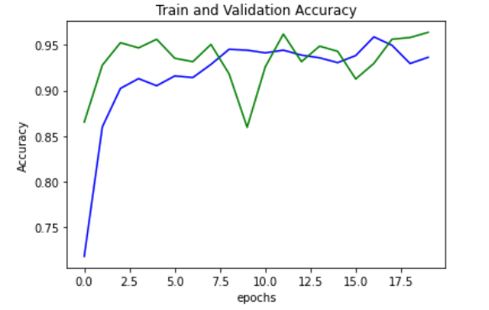
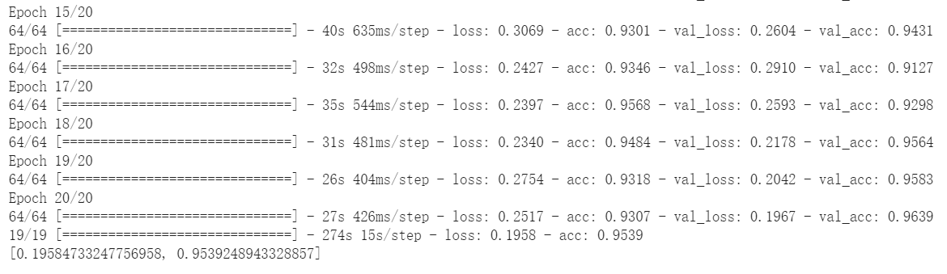
Binary Model

Slide 11
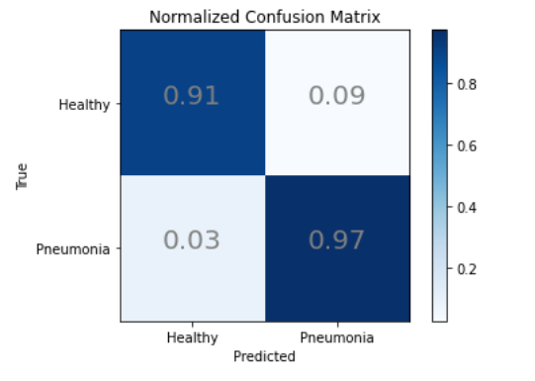
Binary Model

Slide 12
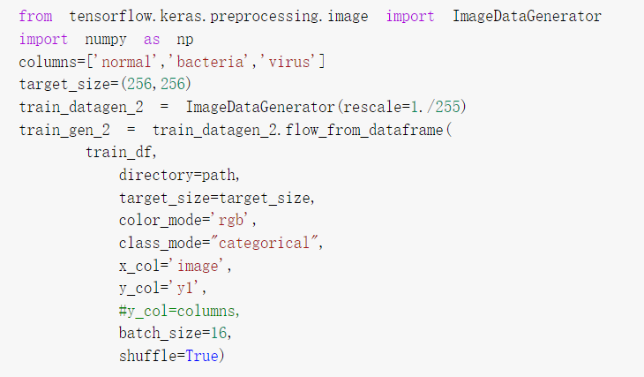
Categorical Model

Slide 13
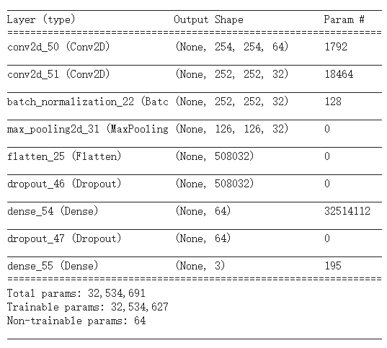
Categorical Model

Slide 14
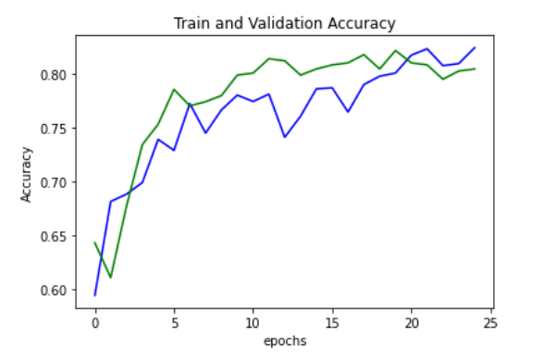
Categorical Model

Slide 15
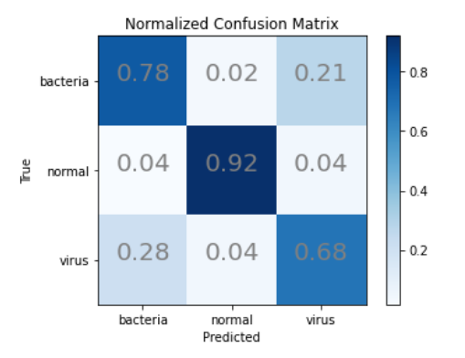
Categorical Model

Slide 16
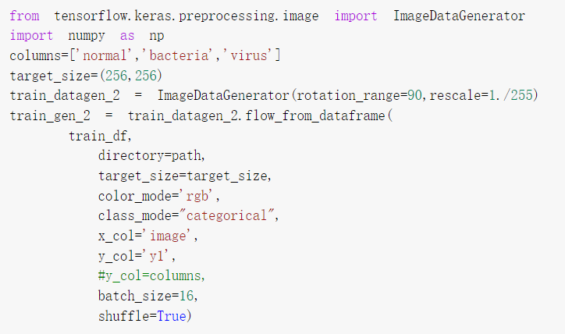
Categorical Model (Data Augmentation)

Slide 17
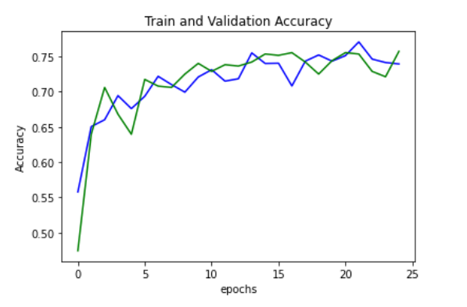
Categorical Model (Data Augmentation)

Slide 18
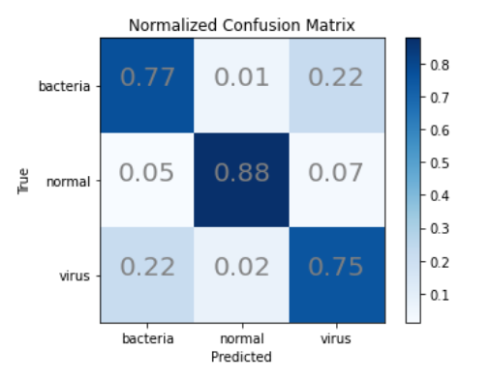
Categorical Model (Data Augmentation)

Slide 19
Conclusion
Convolutional Neural Network
Binary Model
Categorical Model
Normal
Pneunomia
Normal
Virus
Bacteria

Slide 20
Thank You!

