Slide 1
First Sub-Goal:
Employees Performance & Productivity Analysis
Goal:
Understand Relationship between Customer Satisfaction Rates and Job Record of Employees

Slide 2
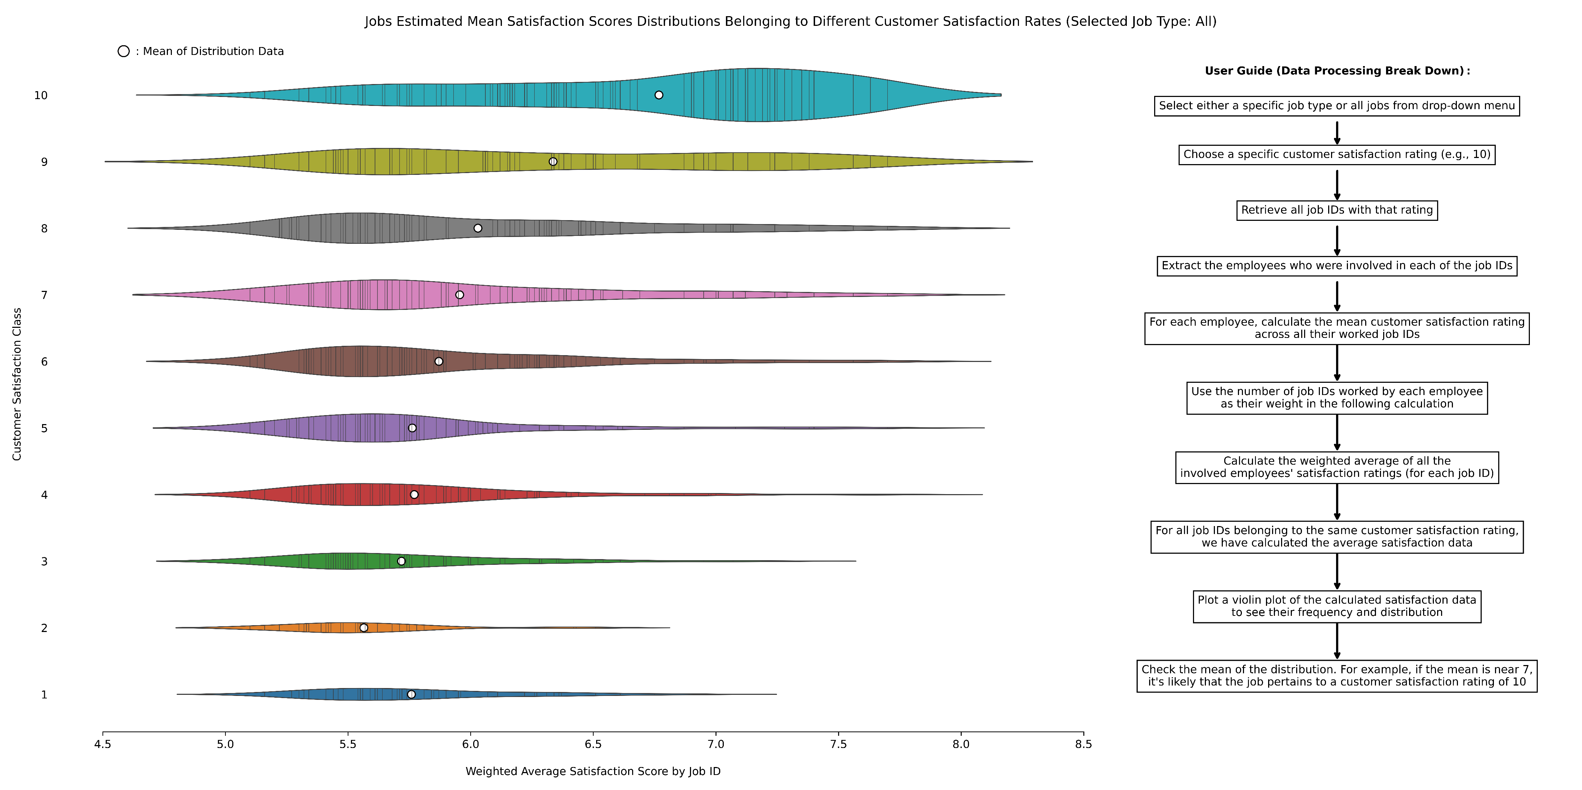
Visualization1: Interactive, Explanatory, Somewhat Exploratory, Derived Data

Slide 3
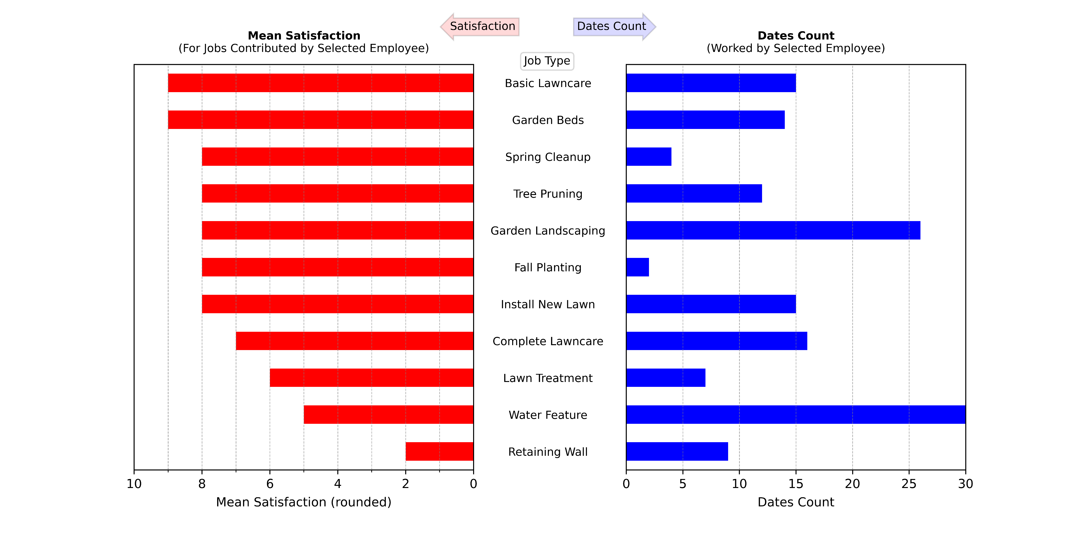
Visualization2: Interactive, Exploratory, Derived Data

Slide 4
Second Sub-Goal:
Job Scheduling & Resource Allocation Optimization

Slide 5
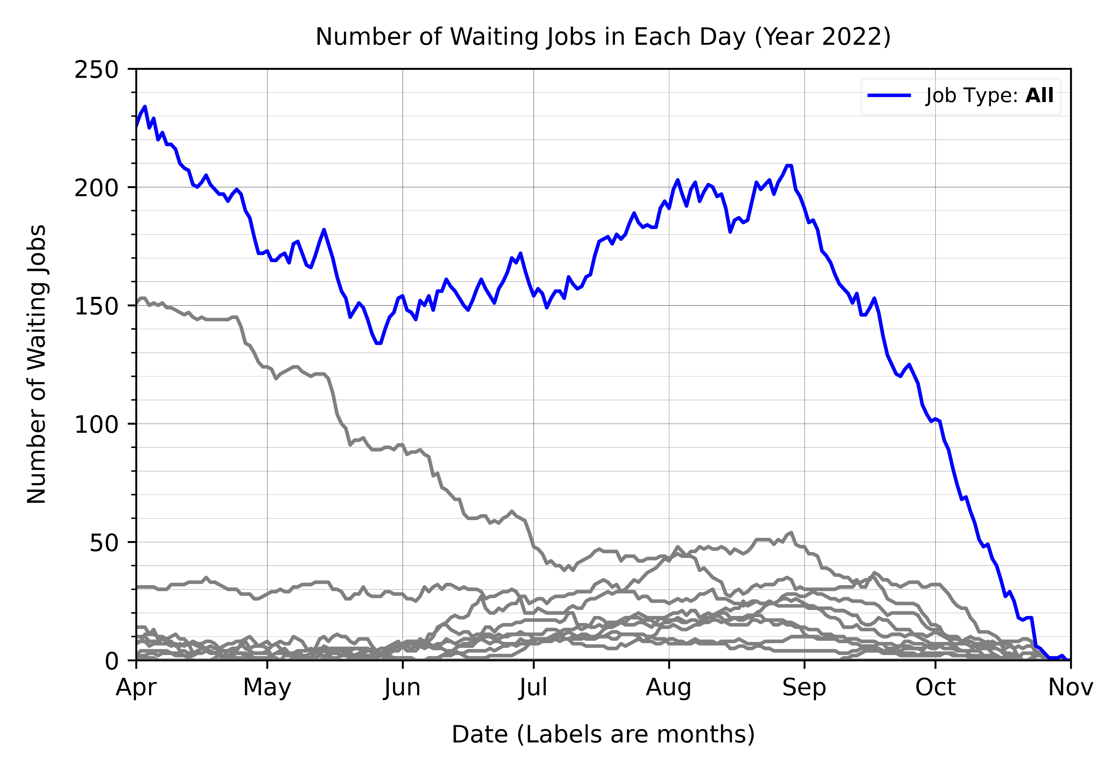
Visualization 3: Interactive, Explanatory, Somewhat Exploratory

Slide 6
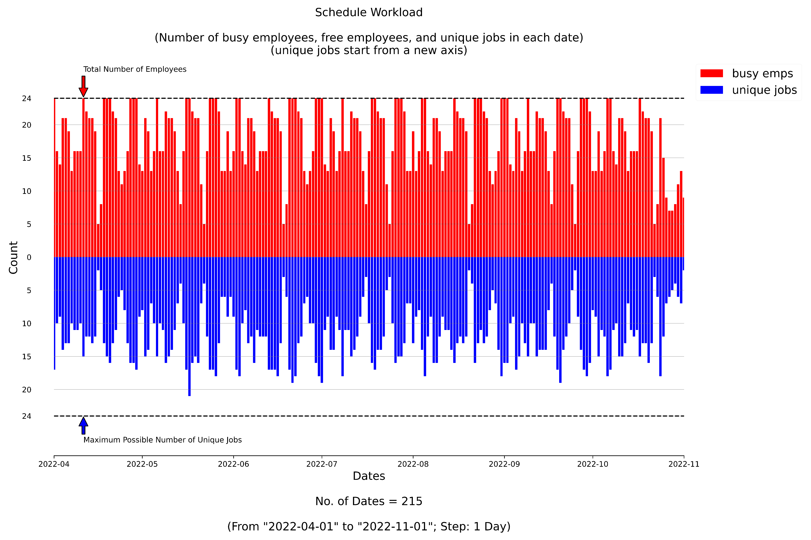
Visualization 4: Explanatory, Somewhat Exploratory, Derived Data

