Slide 1
BONDO2
RAG-Based University Chat-bot
Mohammad Tarakh
Ali Assi
Layal Saadeddine

Slide 2

Outline
Introduction
Why Bondo2?
Technologies used
Architecture
Pipeline
Challenges and Future work
Conclusion
Demo

Slide 3
Introduction

Slide 4
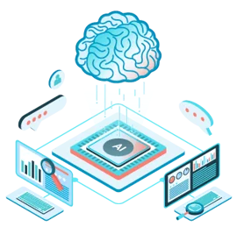
Revolution of conversational AI

Slide 5
Enhancing
Administrative and Academic Support through
Intelligent Information Retrieval

Slide 6
Why Bondo2?

Slide 7
RAG enhances text generation with retrieved documents.
RAG has reduced the generation of incorrect information.
RAG excels at handling domain-specific knowledge.
Giving back to community.

Slide 8
Technologies used

Slide 9
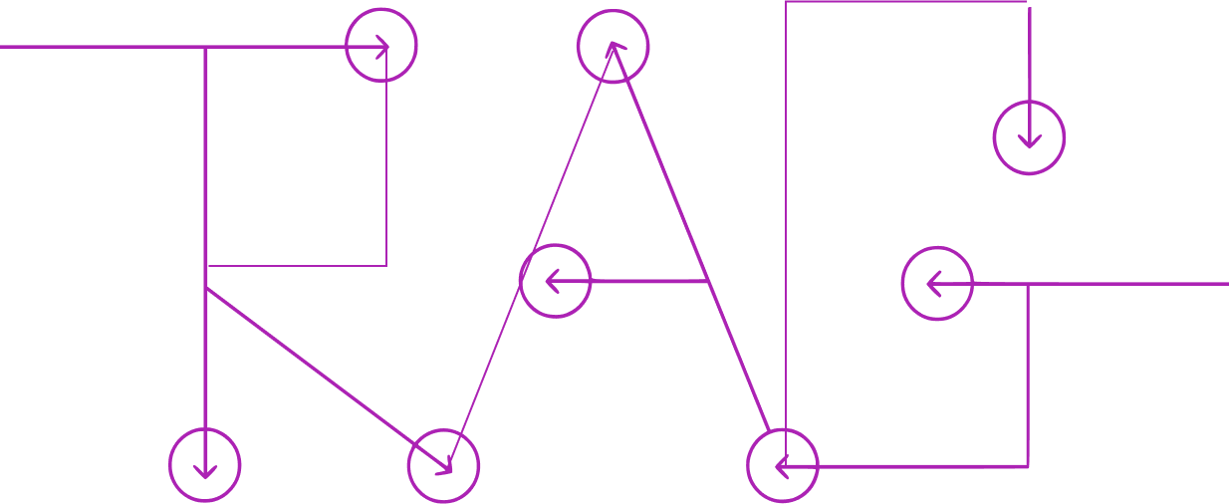





Embeddings
FAISS
🤗
🐑 Model

Slide 10
Architecture

Slide 11
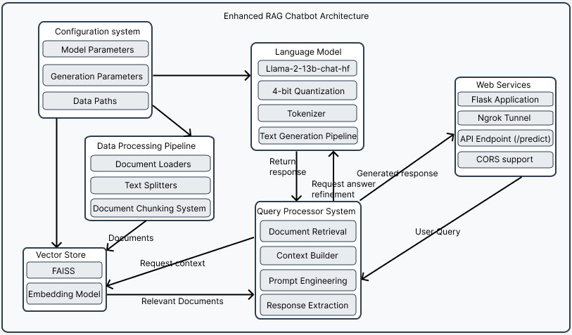

Slide 12
Pipeline

Slide 13
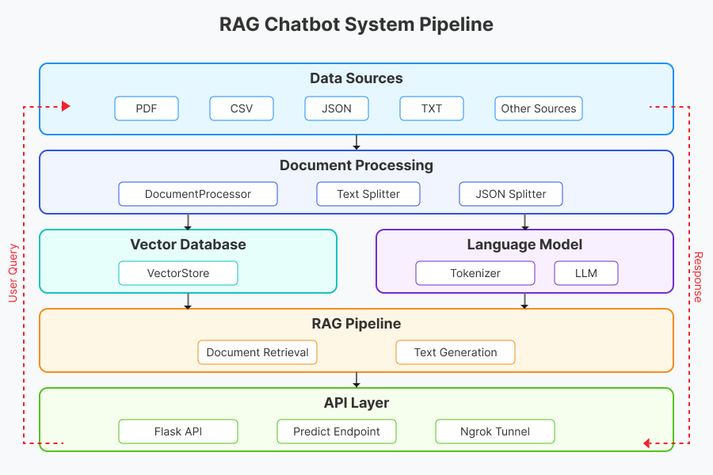

Slide 14
Why RAG not Fine Tuning?

Slide 16
Challenges and Future Work

Slide 17

Challenges
No Real-World Dataset
Time Constraints
Limited Resources

Slide 18
Achievements
Future Work
State-of-the-Art RAG approach
Speech-To-Text Integration
Document Extraction
Chat Message Extraction to PDF
Bookmarking and History Tracking
University Integration
Administrative Reference System
Integrating a Re-ranker Model
Supporting File Uploads
Optimizing for Critical Questions
Caching Mechanisms
Analytical Capabilities
Expanding language support
And many more…

Slide 19
Conclusion

Slide 20
Demo

Slide 21
Thank you!!

