Slide 1
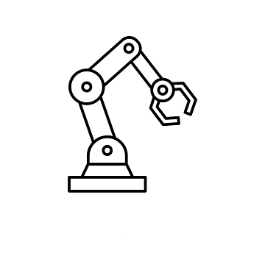
Inverse dynamics problem for the three degrees of freedom (DOF) robot arm and control using the sliding mode control.
Presenter : Ali Rezaei
Spring 2023

Slide 2
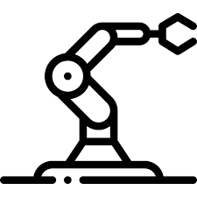
Lecture Outline
Forward Kinematics
Jacobian
Forward Dynamics
Euler-Lagrange method
Kinetic energy
Potential energy
Inertia tensor
Inertia Matrix
Christoffel symbols and equation of motion
Forward Dynamics and Control
Why robust control?
Sliding Mode Control
Introduction to SMC
Classic reach rules
Chattering
Inverse Dynamics and Control
Simulation
Chaotic behavior
Point Tracking
Desired Trajectory Tracking

Slide 3
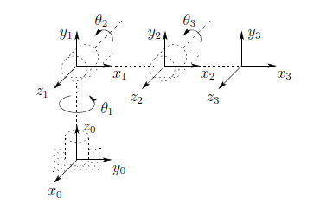
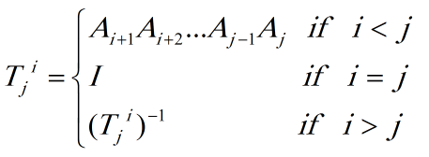

Forward Kinematics
The problem of kinematics is to describe the motion of the manipulator without consideration of the forces and torques causing the motion. The kinematic description is therefore a geometric one.
forward kinematics, which is to determine the position and orientation of the end-effector given the values for the joint variables of the robot.
The inverse kinematics problem is to determine the values of the joint variables given the end-effector position and orientation.

Slide 4

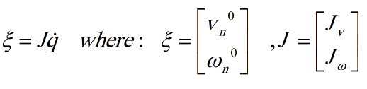


Jacobian
In this part we derive the velocity relationships, relating the linear and angular velocities of the end-effector to the joint velocities.
Mathematically, the forward kinematic equations define a function between the space of cartesian positions and orientations and the space of joint positions. The velocity relationships are then determined by the Jacobian of this
function. The Jacobian is a matrix that can be thought of as the vector version of the ordinary derivative of a scalar function. The Jacobian is one of the most important quantities in the analysis and control of robot motion. It arises in
virtually every aspect of robotic manipulation: in the planning and execution of smooth trajectories, in the determination of singular configurations, in the execution of coordinated anthropomorphic motion, in the derivation of the dynamic equations of motion, and in the transformation of forces and torques from the end-effector to the manipulator joints.

Slide 5


Forward Dynamics
The dynamic equations explicitly describe the relationship between force and motion. The equations of motion are important to consider in the design of robots, in simulation and animation of robot motion, and in the design of control algorithms.
Euler-Lagrange method
In the calculus of variations and classical mechanics, the Euler–Lagrange equations are a system of second-order ordinary differential equations whose solutions are stationary points of the given action functional. The equations were discovered in the 1750s by Swiss mathematician Leonhard Euler and Italian mathematician Joseph-Louis Lagrange.
Because a differentiable functional is stationary at its local extrema, the Euler–Lagrange equation is useful for solving optimization problems in which, given some functional, one seeks the function minimizing or maximizing it. This is analogous to Fermat's theorem in calculus, stating that at any point where a differentiable function attains a local extremum its derivative is zero. In Lagrangian mechanics, according to Hamilton's principle of stationary action, the evolution of a physical system is described by the solutions to the Euler equation for the action of the system. In this context Euler equations are usually called Lagrange equations. In classical mechanics, it is equivalent to Newton's laws of motion; indeed, the Euler-Lagrange equations will produce the same equations as Newton's Laws. This is particularly useful when analyzing systems whose force vectors are particularly complicated. It has the advantage that it takes the same form in any system of generalized coordinates, and it is better suited to generalizations. In classical field theory there is an analogous equation to calculate the dynamics of a field.

Slide 6
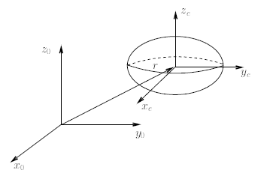


Kinetic energy
In the previous section, we showed that the Euler-Lagrange equations can be used to derive the dynamical equations in a straightforward manner, providedone is able to express the kinetic and potential energy of the system in terms of a set of generalized coordinates. In order for this result to be useful in a practical context, it is therefore important that one be able to compute these terms readily for an n-link robotic manipulator. In this section we derive formulas for the kinetic energy and potential energy of a rigid robot using the Denavit-Hartenberg joint variables as generalized coordinates.
To begin we note that the kinetic energy of a rigid object is the sum of two terms: the translational energy obtained by concentrating the entire mass of the object at the center of mass, and the rotational kinetic energy of the body
about the center of mass. Referring to Figure we attach a coordinate frame at the center of mass (called the body attached frame) as shown.
The kinetic energy of the rigid body is then given as:
$$ω$$
where m is the total mass of the object, v and are the linear and angular
velocity vectors, respectively, and I is a symmetric 3 × 3 matrix called the
Inertia Tensor.

Slide 7



Potential energy
Now consider the potential energy term. In the case of rigid dynamics, the only source of potential energy is gravity. The potential energy of the i-th link can be computed by assuming that the mass of the entire object is concentrated at its center of mass and is given by:
$$r_{ci}$$
where g is vector giving the direction of gravity in the inertial frame and the vector gives the coordinates of the center of mass of link i. The total potential energy of the n-link robot is therefore:
In the case that the robot contains elasticity, for example, flexible joints, then the potential energy will include terms containing the energy stored in the elastic elements.
Note that the potential energy is a function only of the generalized coordinates
and not their derivatives, i.e. the potential energy depends on the configuration of the robot but not on its velocity.

Slide 8

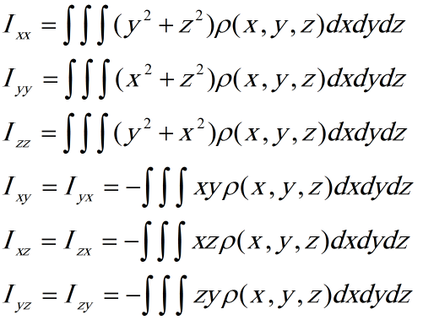
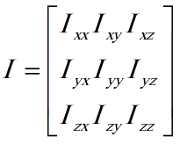
Inertia Tensor
The moment of inertia, otherwise known as the mass moment of inertia, angular mass, second moment of mass, or most accurately, rotational inertia, of a rigid body is a quantity that determines the torque needed for a desired angular acceleration about a rotational axis, akin to how mass determines the force needed for a desired acceleration.
It depends on the body's mass distribution and the axis chosen, with larger moments requiring more torque to change the body's rate of rotation.
Let the mass density of the object be represented as a function of position, . Then the inertia tensor in the body attached frame is computed as:
The diagonal elements of the inertia tensor, are called the Principal Moments of Inertia about the x,y,z axes,
respectively. The off diagonal terms, are called the Cross Products of Inertia. If the mass distribution of the body is symmetric with respect
to the body attached frame then the cross products of inertia are identically zero.
Where:

Slide 9

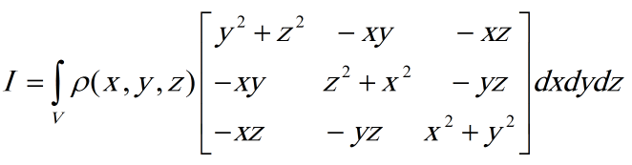
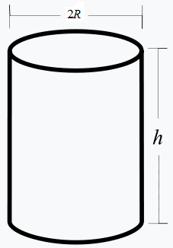
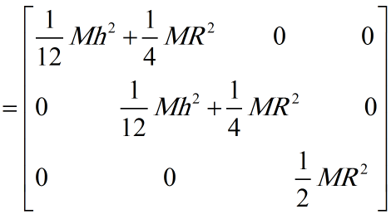
Inertia Tensor of cylinder
Consider a uniform solid cylinder of mass M, radius R, height h. The density is then
And the moment of inertia tensor is:

Slide 10










Inertia Matrix
Now consider a manipulator consisting of n links. We have seen in previous parts that the linear and angular velocities of any point on any link can be expressed in terms of the Jacobian matrix and the derivative of the joint variables. Since in our case the joint variables are indeed the generalized coordinates, it follows that, for appropriate Jacobian matrices and , we have that:
$$J_{v_{i}}$$
$$J_{ω_{i}}$$
$$i$$
$$m_{i}$$
$$i$$
Now suppose the mass of link is and that the inertia matrix of link , evaluated around a coordinate frame parallel to frame but whose origin is at the center of mass, equals . Then the overall kinetic energy of the manipulator equals:
$$i$$
$$I_{i}$$
In other words, the kinetic energy of the manipulator is of the form:
where D is a symmetric positive definite matrix that is in general configuration dependent. The matrix D is called the inertia matrix.

Slide 11





Christoffel symbols and equation of motion
Now that we have obtained the potential and kinetic energy in general for a robot, we can form the Lagrangian of the robotic system.
where the n × n “inertia matrix” D is symmetric and positive definite for each
The Euler-Lagrange equations for such a system can be derived as follows. Since
We have that:
And:

Slide 12




Also:
Thus the Euler-Lagrange equations can be written:
By interchanging the order of summation and taking advantage of symmetry, we can show that:
Hence:

Slide 13





Christoffel Symbols of the First Kind
The terms in Equation (6.58) are known as Christoffel symbols (of the first kind). Note that, for a fixed k, we have
cijk = cjik, which reduces the effort involved in computing these symbols by a factor of about one half. Finally, if we define:
then we can write the Euler-Lagrange equations as:
In matrix form:

Slide 14
Forward Dynamics Control
Why Robust Control?
In control theory, robust control is an approach to controller design that explicitly deals with uncertainty. Robust control methods are designed to function properly provided that uncertain parameters or disturbances are found within some (typically compact) set. Robust methods aim to achieve robust performance and/or stability in the presence of bounded modelling errors.
From a control point of view, modeling inaccuracies can be classified into two major kinds:
• structured (or parametric) uncertainties
• unstructured uncertainties (or unmodeled dynamics)
Important Control parts :
• Sliding Surface Design
• Choosing the Control law

Slide 15


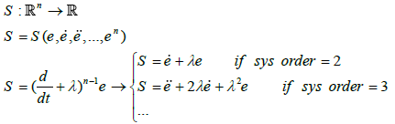
Sliding Mode Control
Consider the following n-order nonlinear system
The goal is that the state vector X follows the desired vector Xd. Tracking error is defined as follows
The sliding surface is defined as follows :

Slide 16

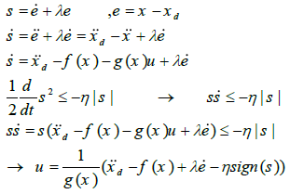
Now we want to provide a suitable control law to always stay on the sliding surface.
As an example consider the nonlinear equation :
Hence:

Slide 17


Classic reach rules
Constant rate reach law :
Exponential reach law :
Power rate reach law :
General reach law :

Slide 18
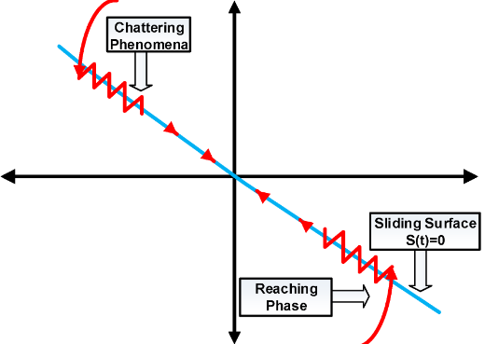
Chattering
Since the implementation of the corresponding control switchings is necessarily incomplete (for example, in the case of momentary switching). are not exactly known, this leads to chattering, which is an undesirable phenomenon Because it includes high control activity and in addition, it is possible that the high frequency dynamics in the stage
Modeling has been neglected (such as unmodeled structural modes and time delay, etc.). Fig The following shows this phenomenon.

Slide 19
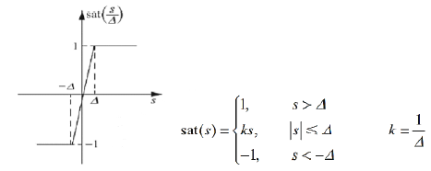

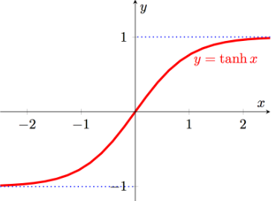
How to reduce chattering ?
For this purpose, it is suggested to use the following functions instead of the sign function.
Saturation function :
Relay function :
Hyperbolic tangent function :

Slide 20
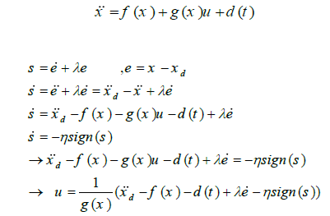

Add disturbance :
Remember d(t) is unknown! Let change the control law as follows :

Slide 21


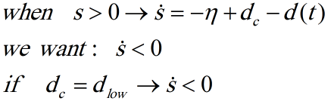
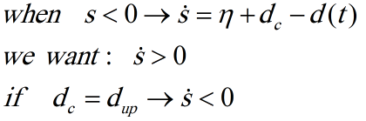


Rewriting equations :
Remember that the disturbance to the system is bounded, in other words :
Now we want to obtain dc in such a way that we reach the sliding surface in the presence of disturbance.
Let define :
So :

Slide 22

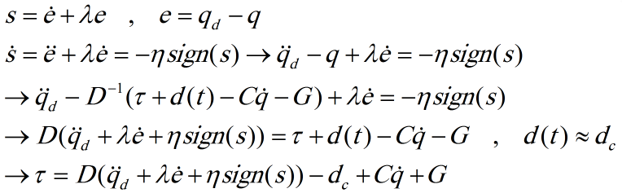
Implement sliding mode Control for 3 DOF manipulator :
Suppose we have analyzed the robot dynamically, and we have the dynamic equations in the following matrix form.
Design sliding surface and choosing control law :

Slide 23
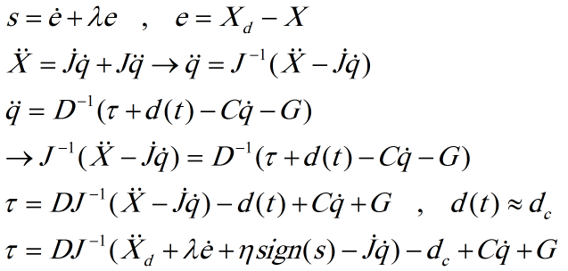
Now we are ready to write the inverse dynamics problem.
Rewriting control law :

Slide 24
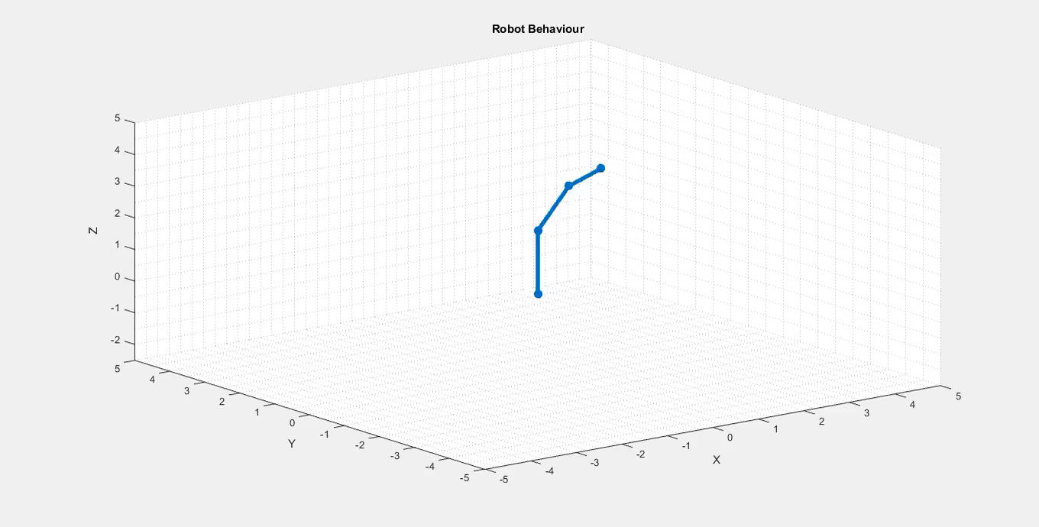

Slide 25
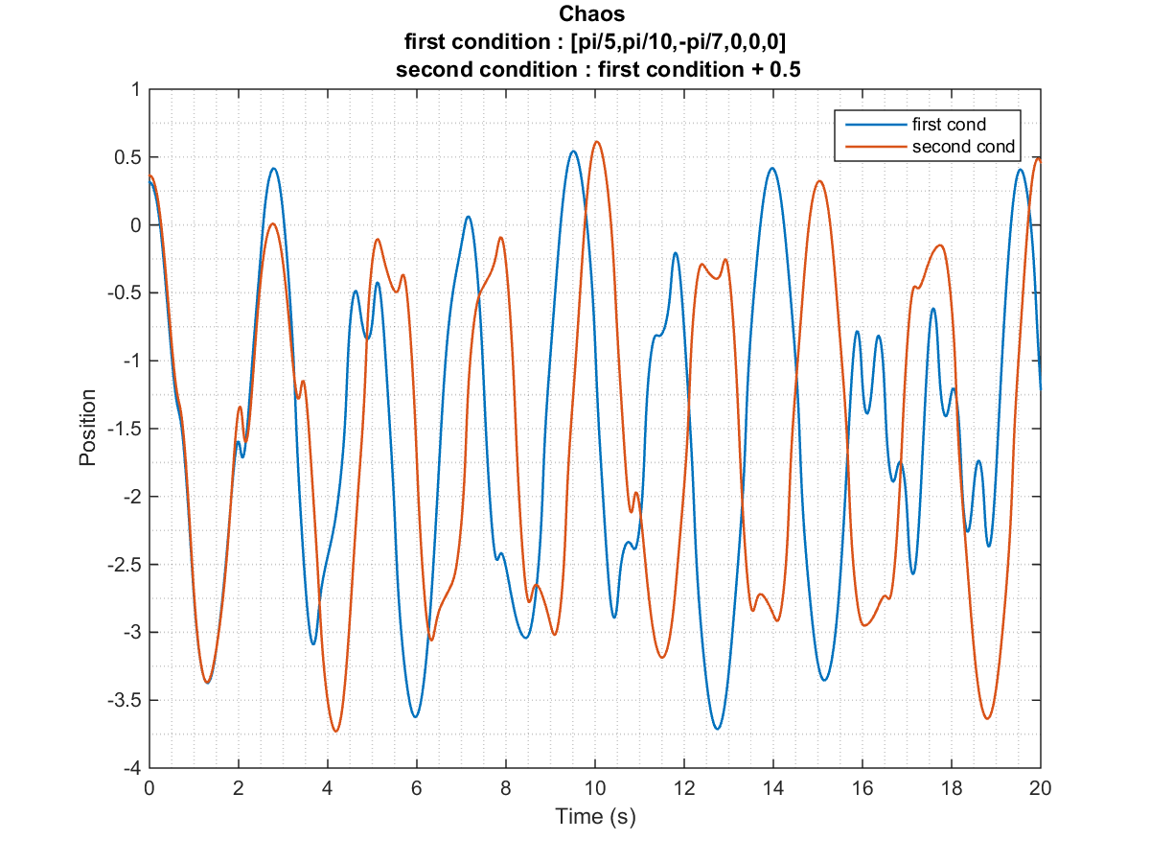
Comparing two different solutions for close initial conditions

Slide 26


Slide 27
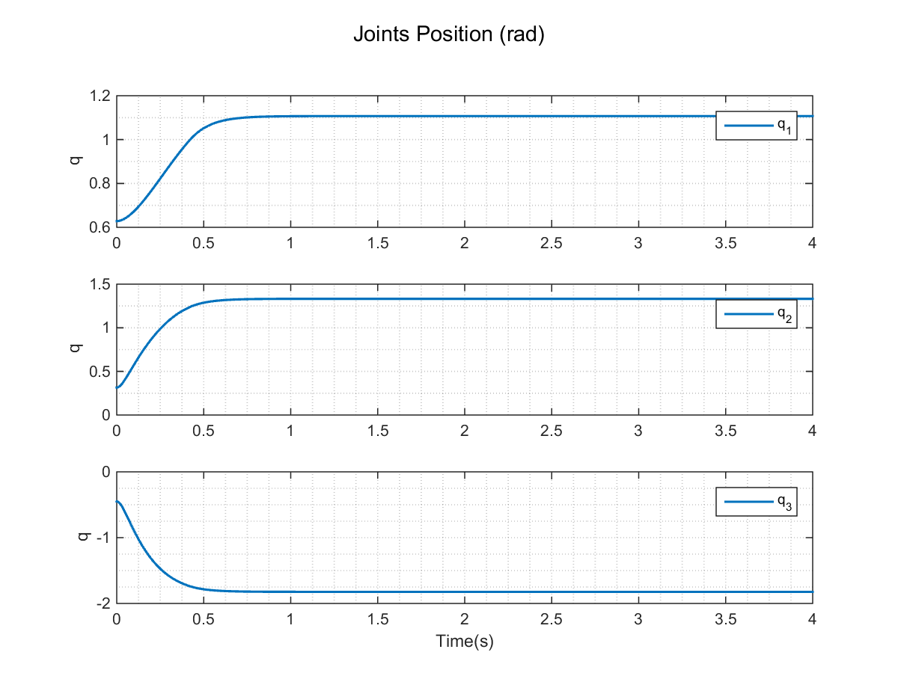

Slide 28
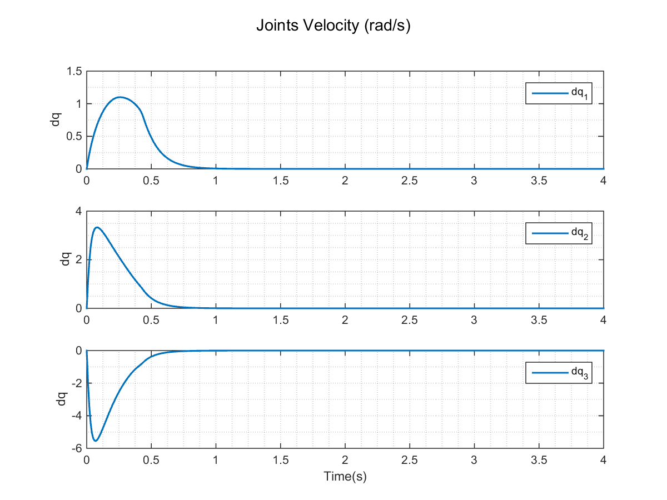

Slide 29
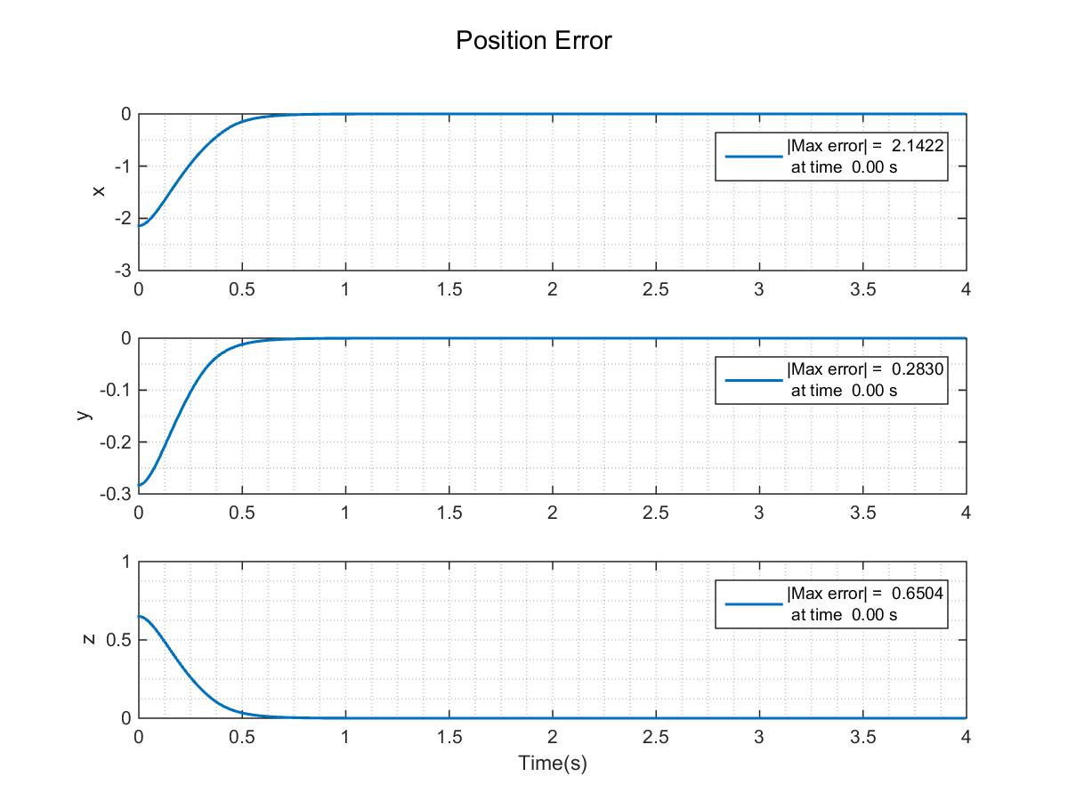

Slide 30
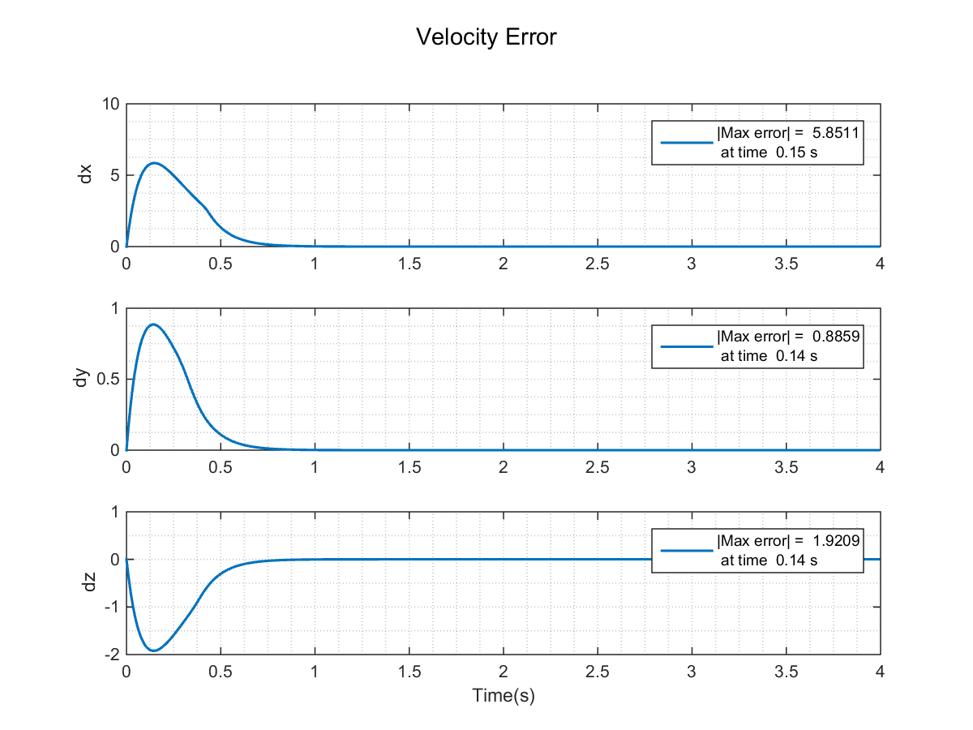

Slide 31
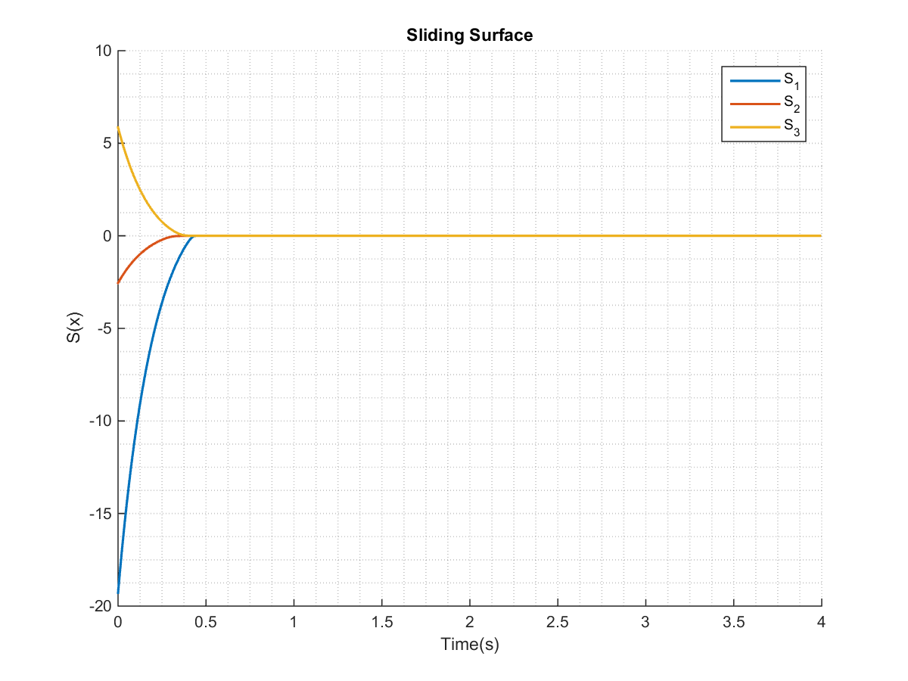

Slide 32
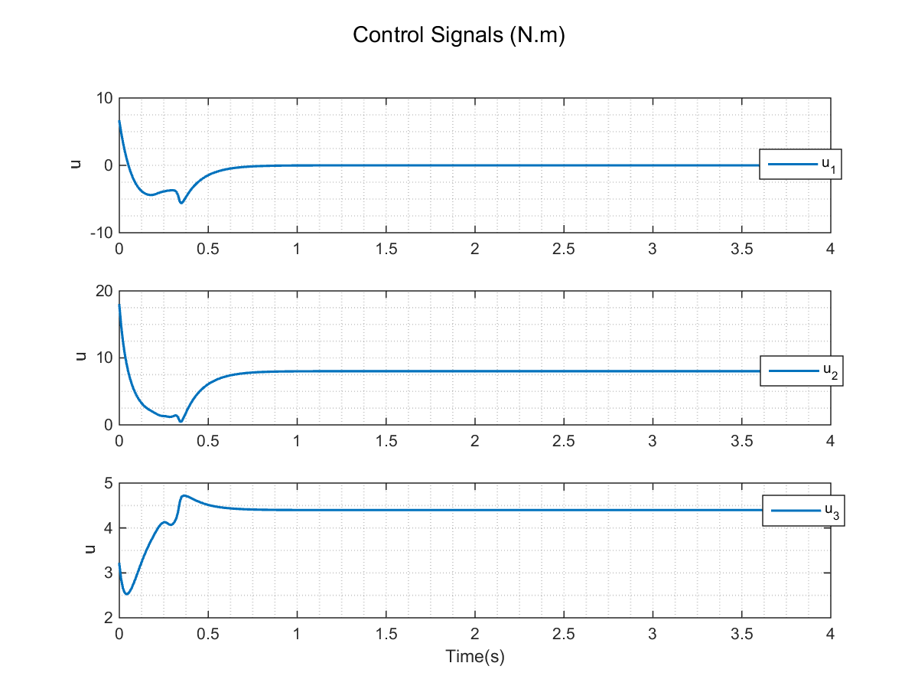

Slide 33

3D View

Slide 34
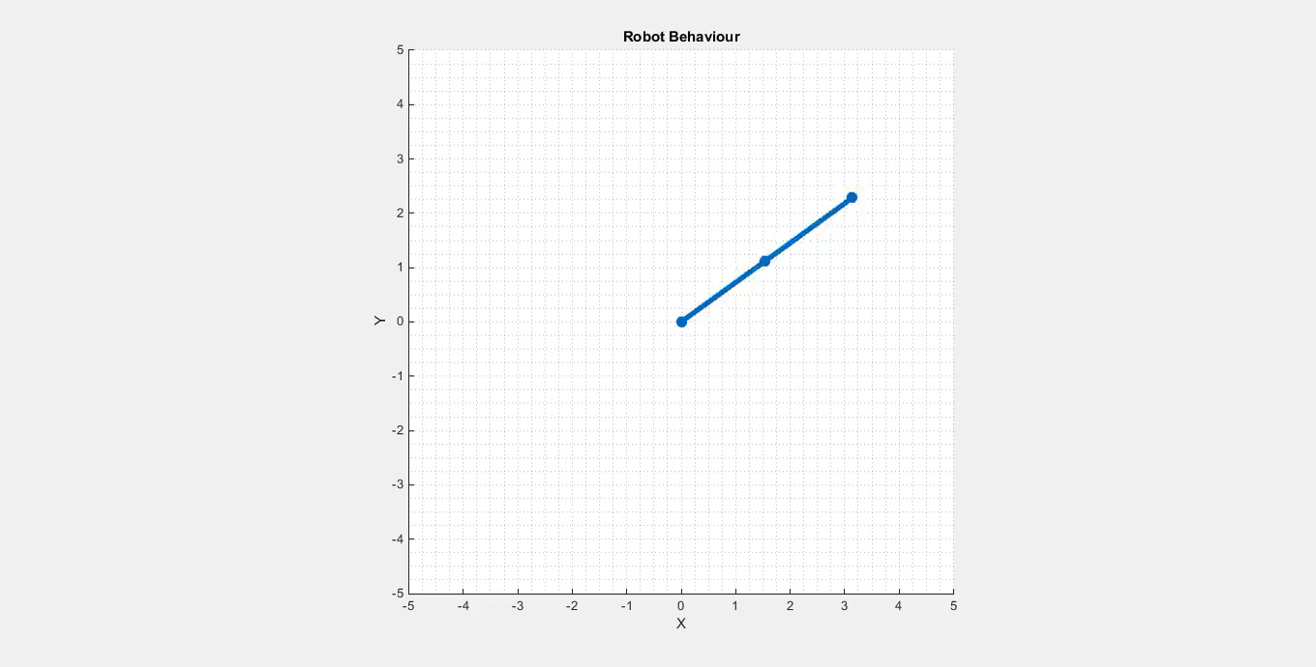
Top view (YX)

Slide 35
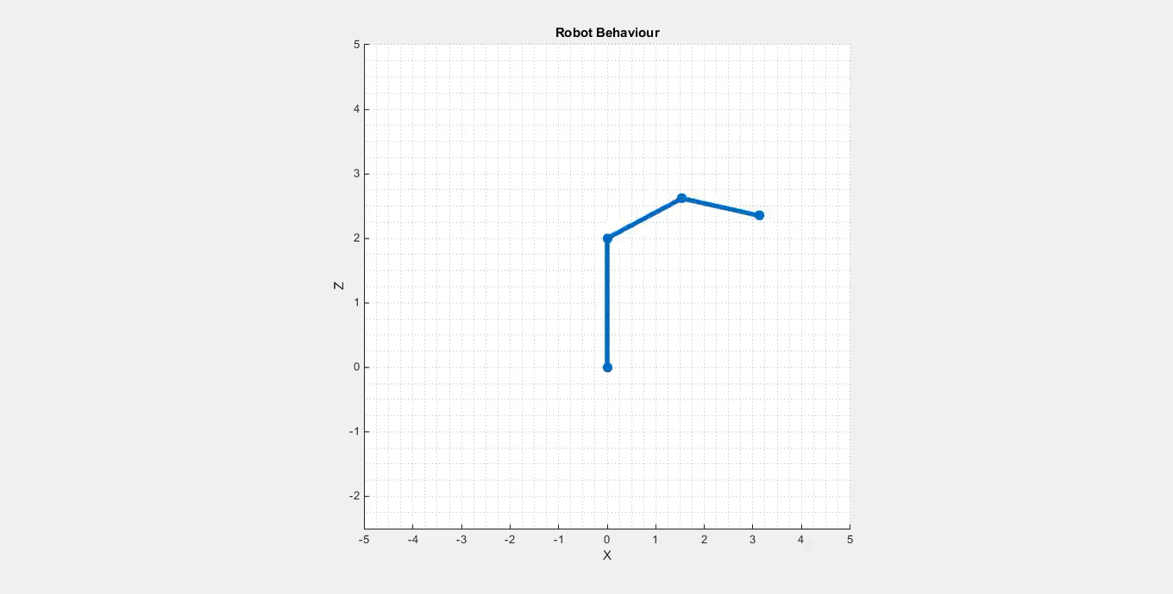
Right view (ZX)

Slide 36
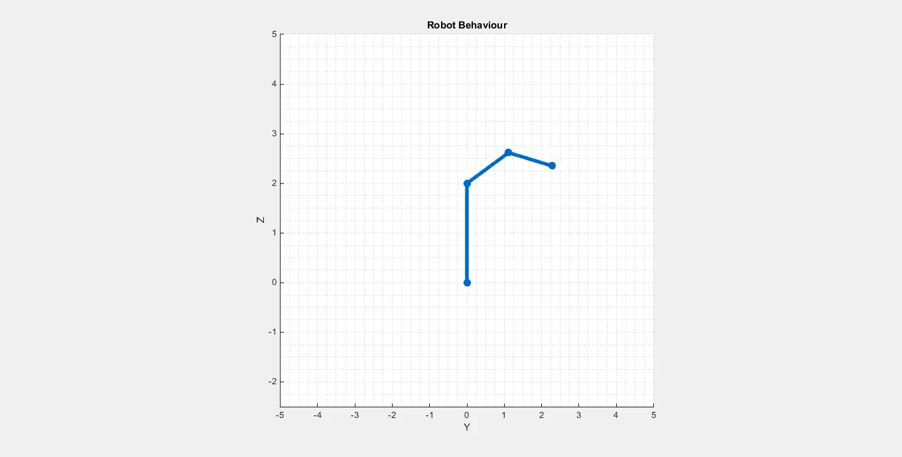
Left view (ZY)

Slide 37
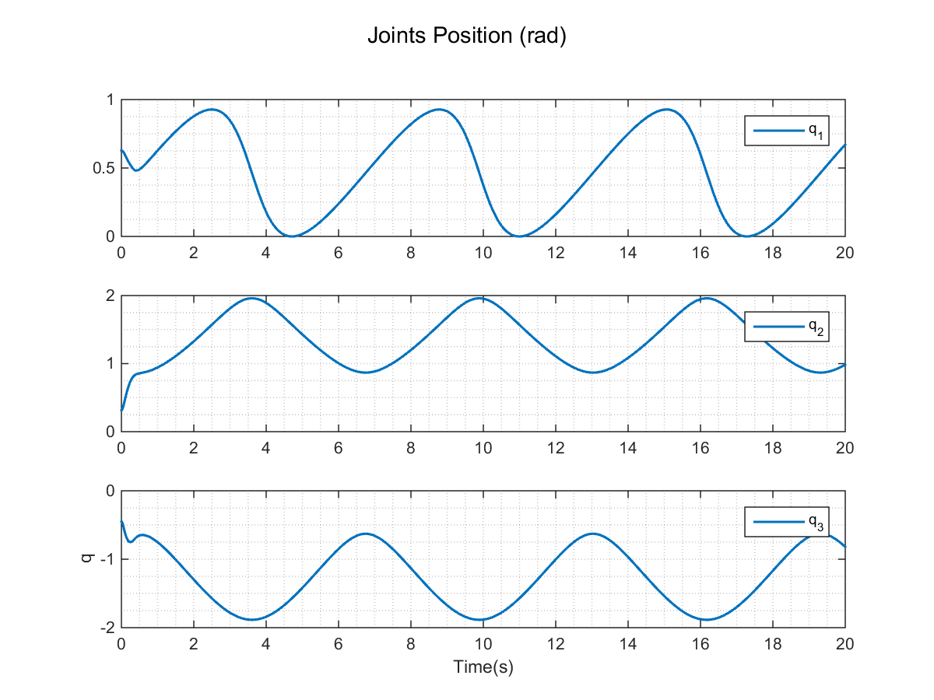

Slide 38
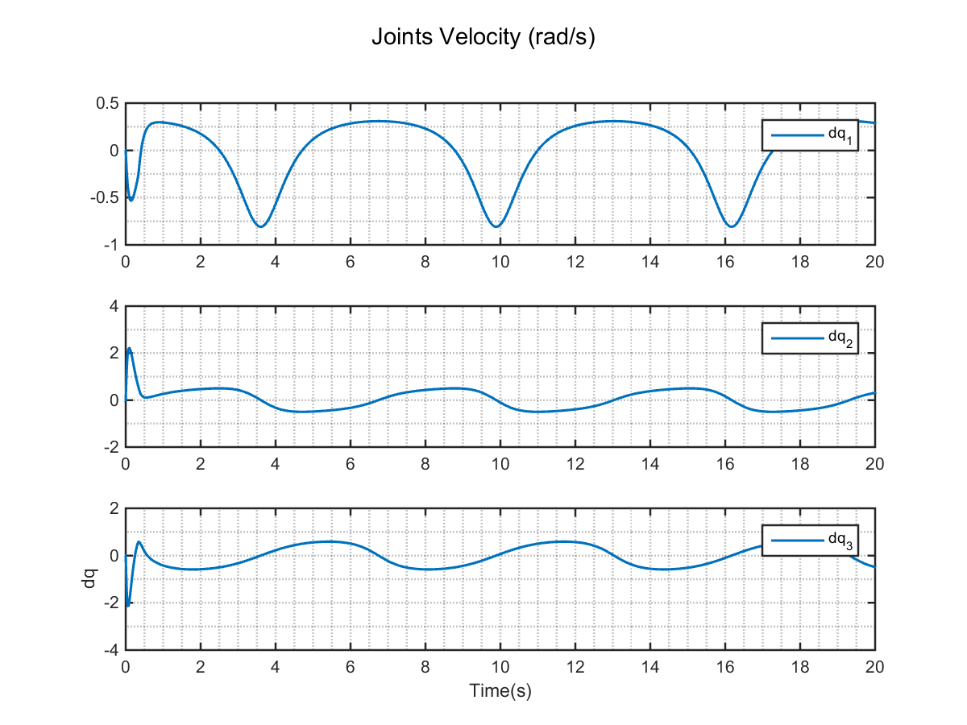

Slide 39
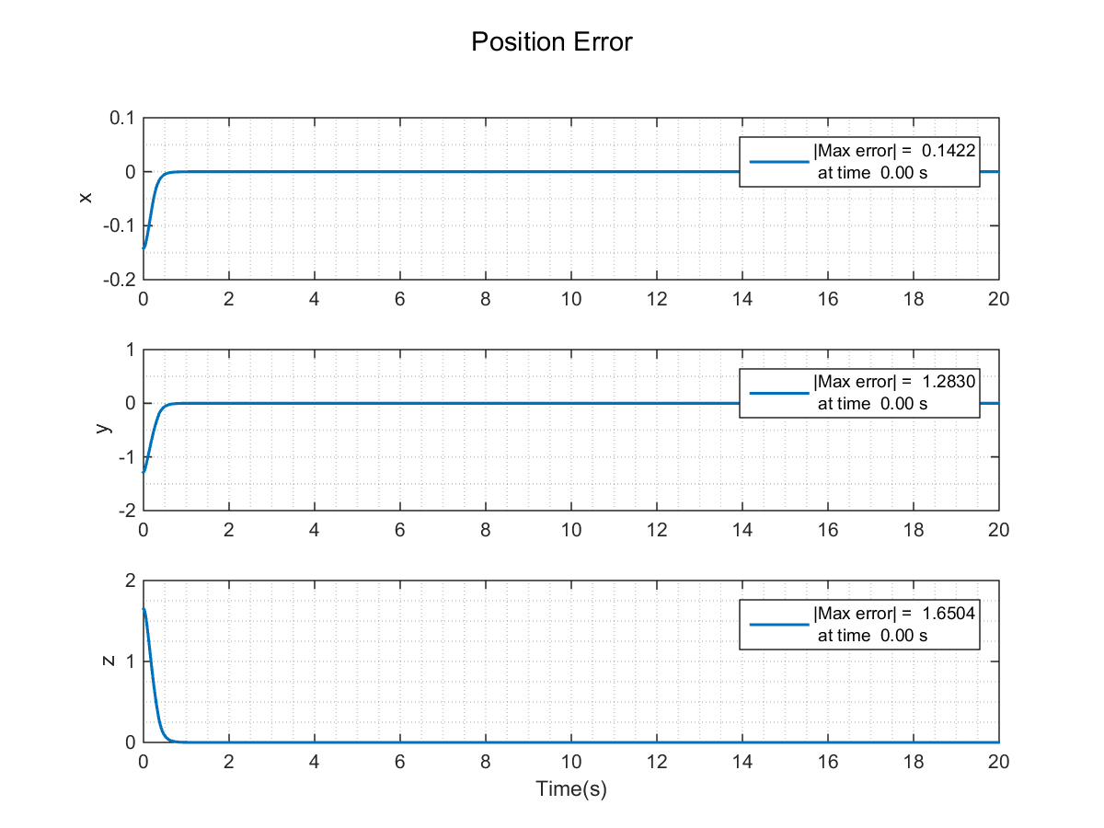

Slide 40
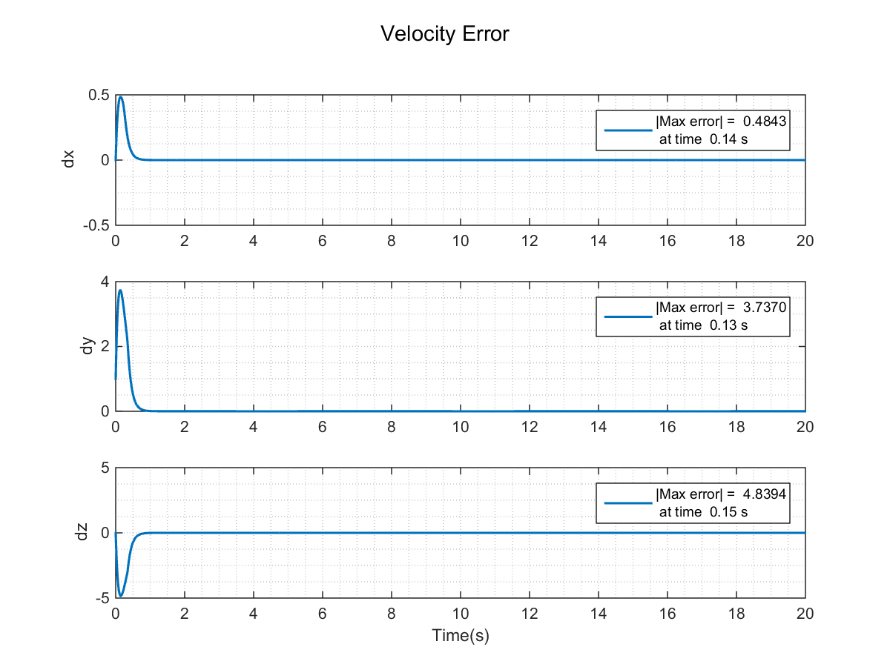

Slide 41
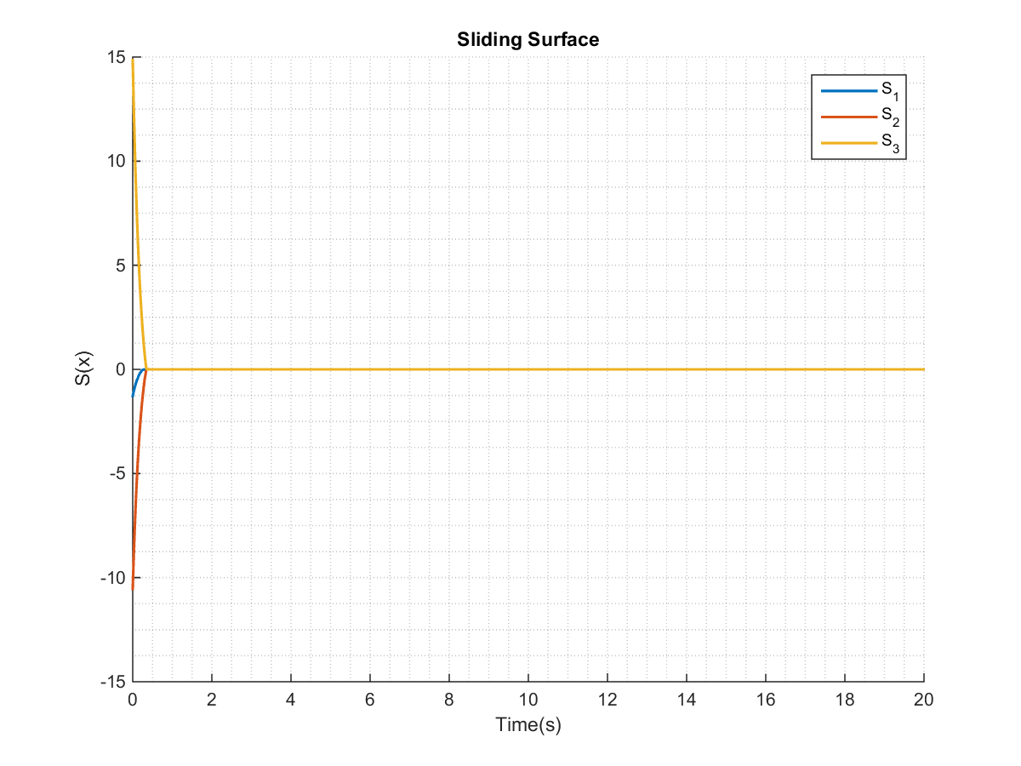

Slide 42
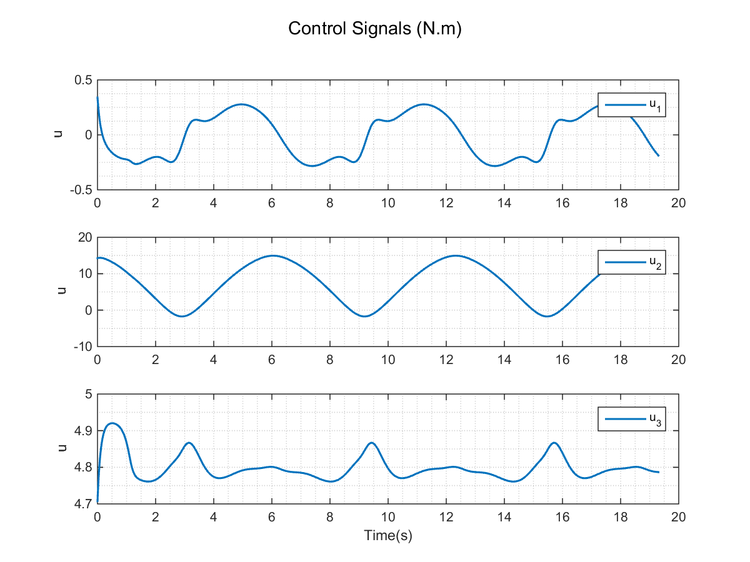

Slide 43
References :
Robot Modeling and. Control. Mark W. Spong, Seth Hutchinson, and M. Vidyasagar. JOHN WILEY & SONS.
Applied nonlinear control. Jean-Jacques E. Slotine, Weiping Li p. cm.
Nonlinear systems. H. Khalil.
All codes are available on my GitHub page :
https://github.com/AliiRezaei/3DOF-inverse-dynamics-control-using-sliding-mode
Thank you for your attention!

